Slide 1
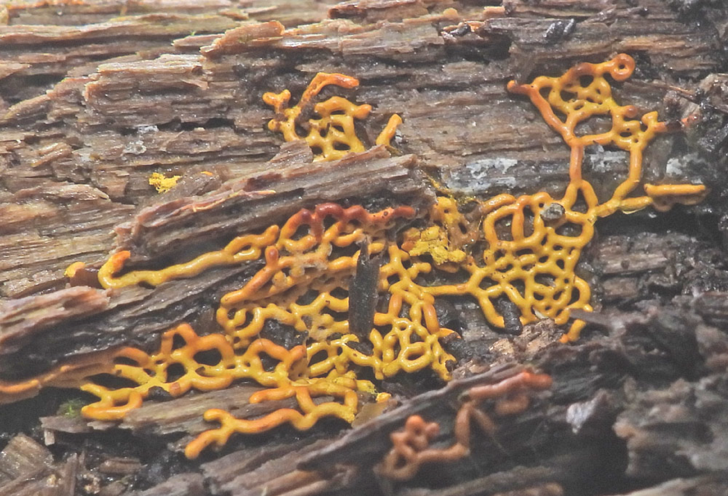

Partners meeting
27-28.03.2025. Baltezers, Latvia
Anna Saļņikova

Slide 2
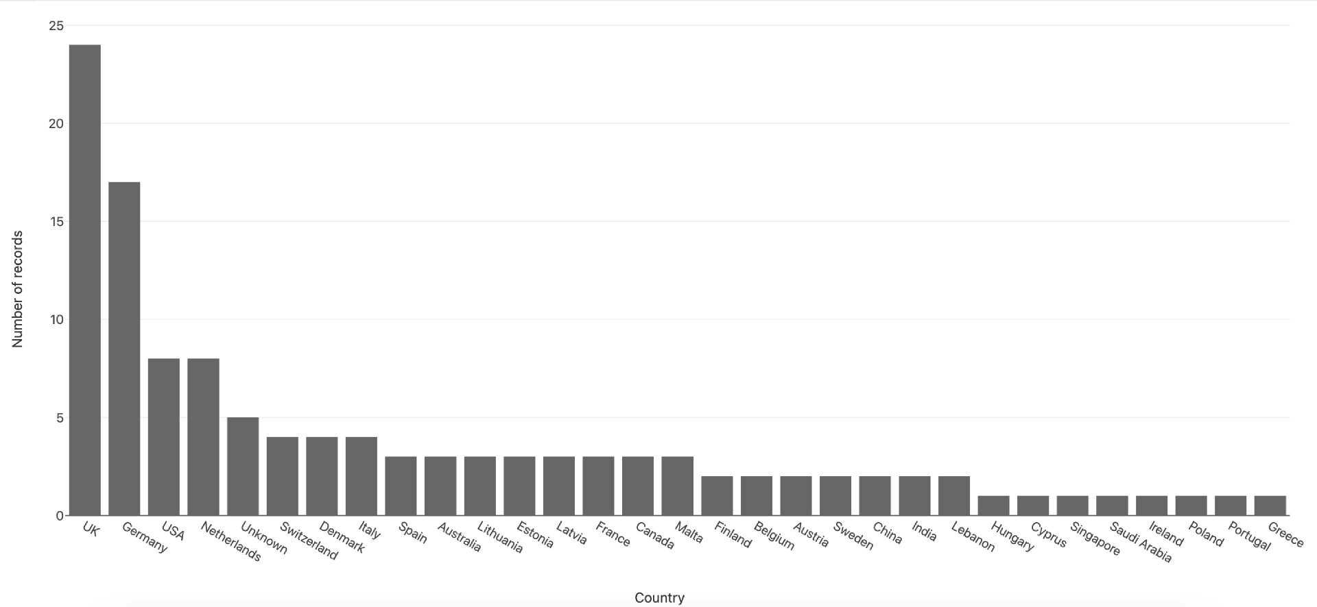
Country

Slide 3
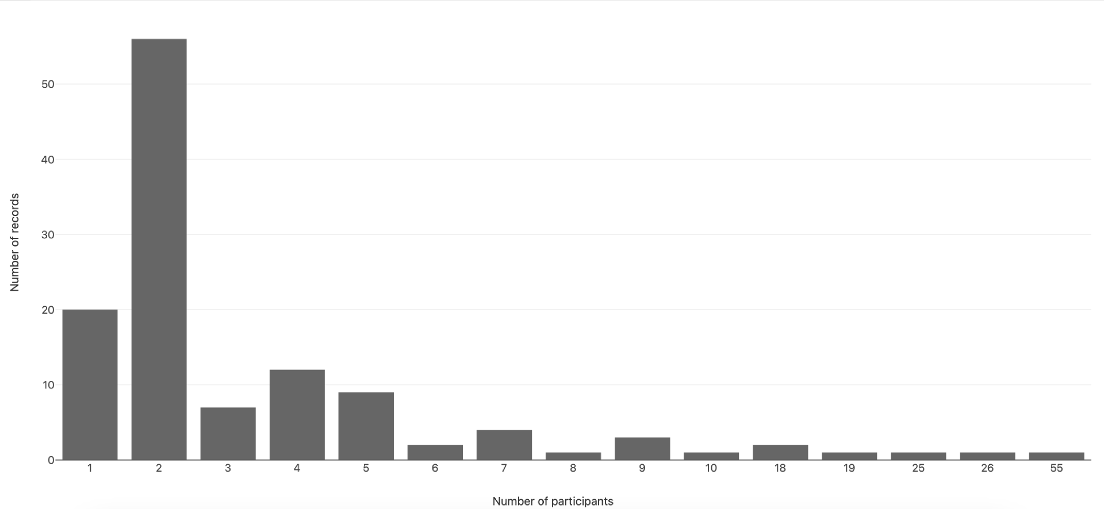
Number of Participants

Slide 4
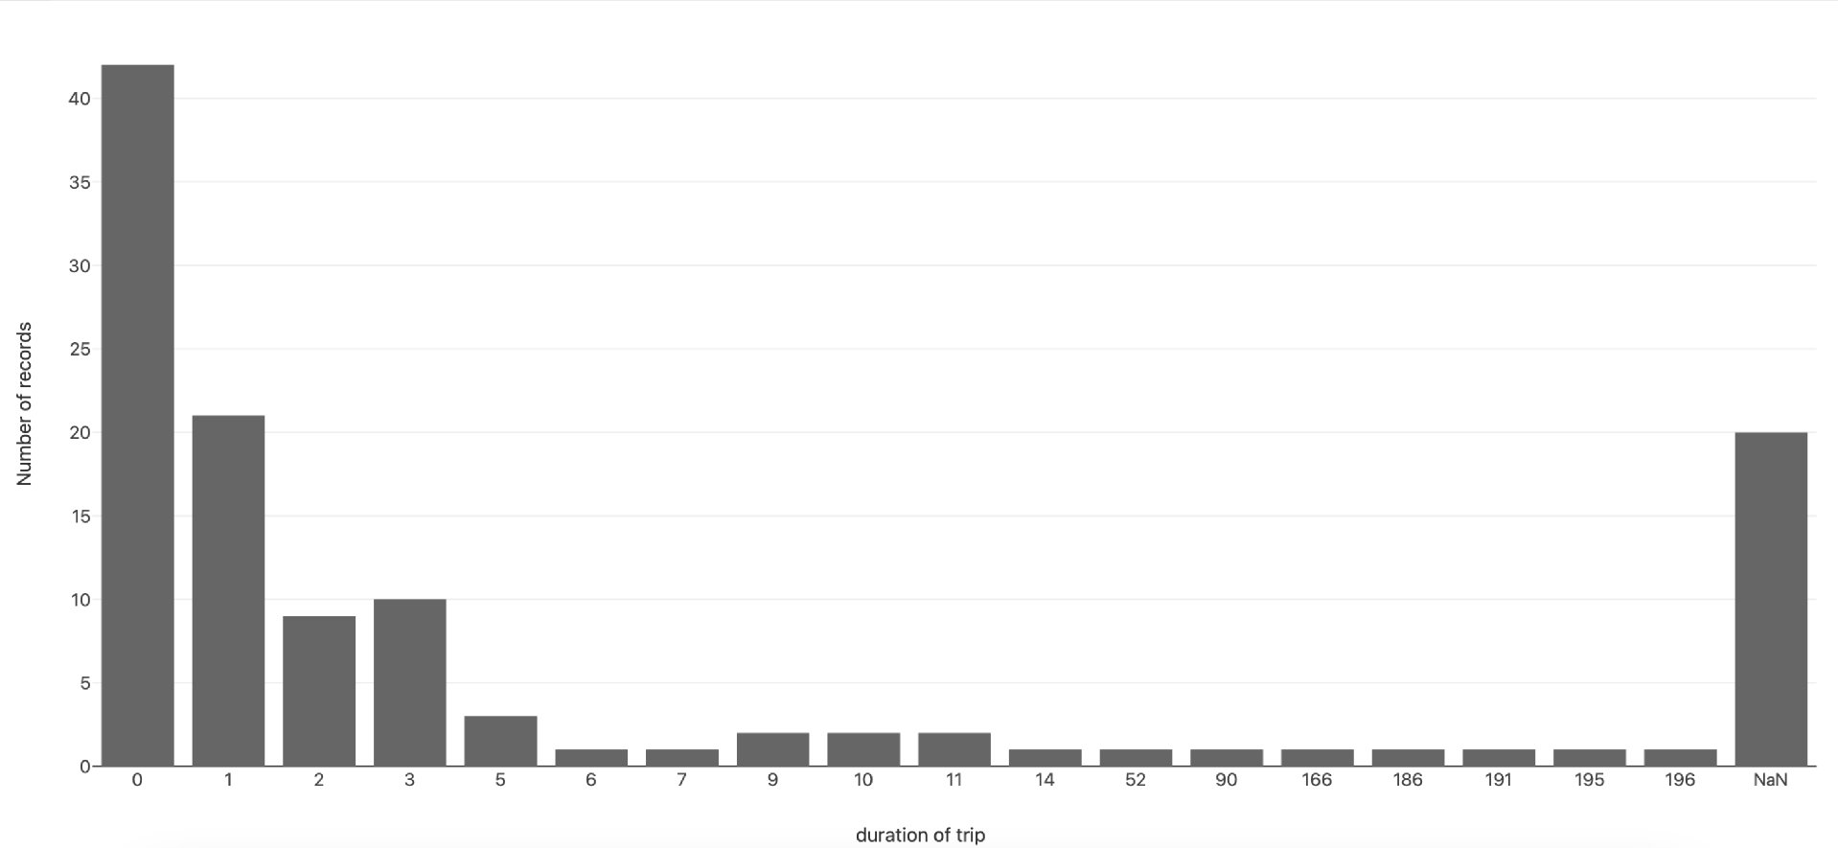
Duration of Trip

Slide 5
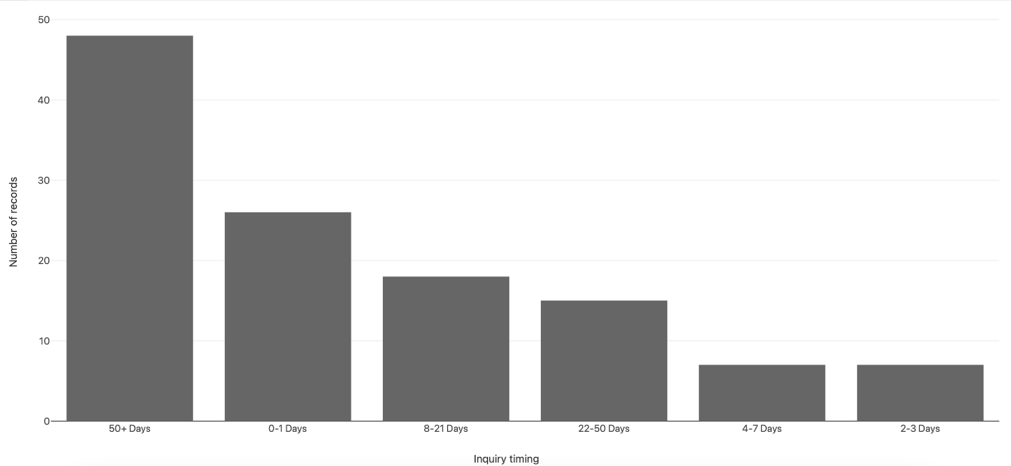
Timing

Slide 6
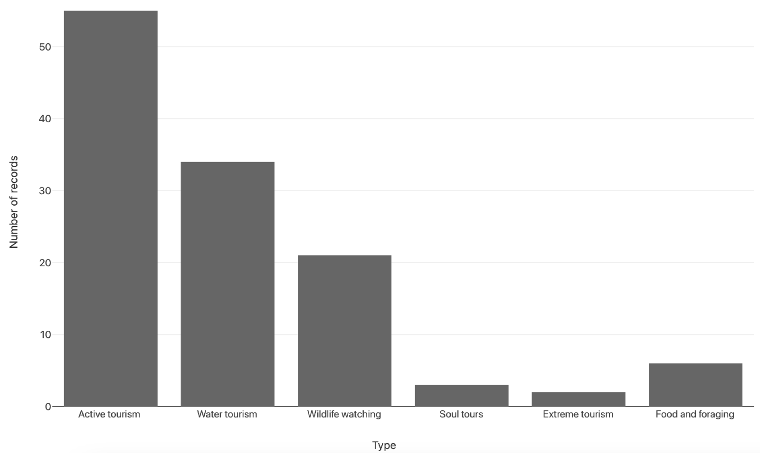
Category

