Slide 1


Opening Pärnu Beach for People with Special Needs
Summer period feedback
Pärnu Lahe Rotary club

Slide 2
.
The goal of the Pärnu Lahe Rotary Club is to promote and implement charitable activities in the community.
The club is committed to fulfilling the dreams of people who, due to their special needs (disabilities) have never been able to enjoy the beaches of Pärnu Bay and swim in the sea.
The initiative was boosted by people with special needs who inspired us and let us know what people with disabilities expect, need and dream about.

Slide 3
Project TARGET GROUP
People with wheelchair or visually impaired.
People with disabilities, including children who have been in a wheelchair since birth or have some other disability.
A veteran who has served our country.
People with temporary mobility difficulties, including our lovely grandmothers and grandfathers who experience difficulties moving on the beach sand, and beach visitors with small children's strollers.

Slide 4
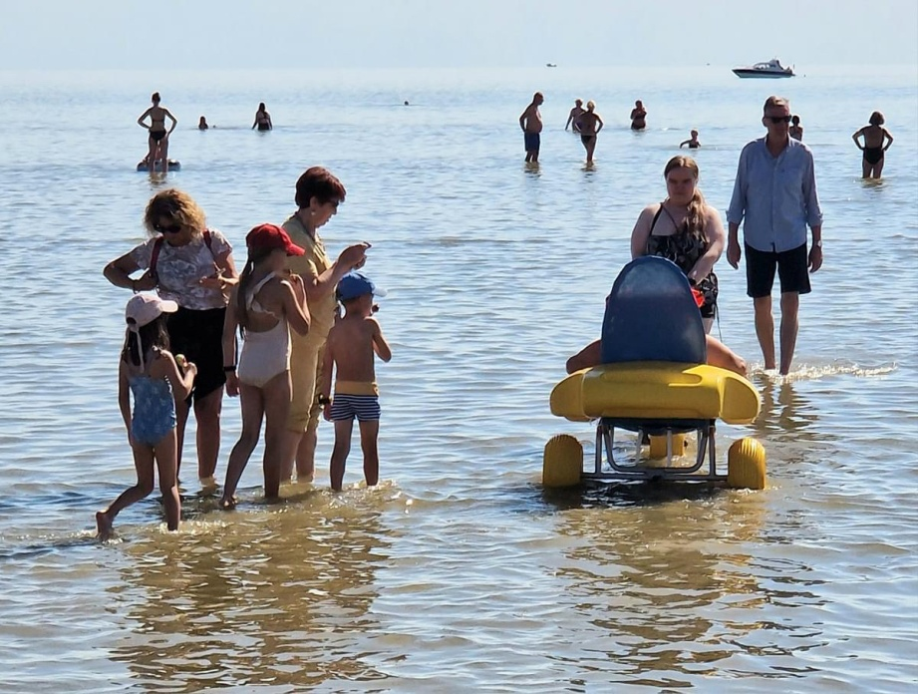
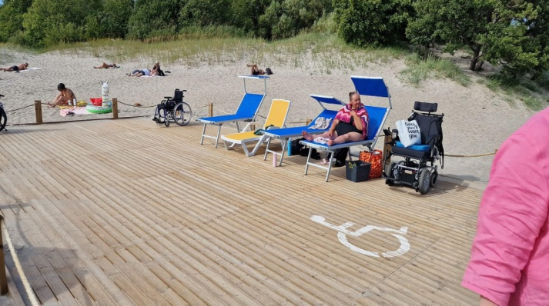
Summer in Pärnu Invaranna
Invarand became popular both among people with special needs and other summer vacationers.
Pavilion was open every day from 01.07 to 31.08 at12-18.
In beautiful weather, when the green flag flew in the coast guard pavilion, the customers had the opportunity to rent floating chairs and, if necessary, use the wheelchair lift.
Before using the service, the customer had to fill out and sign the usage agreement. It was important to indicate whether the customer wanted to use a life jacket or not.
The time of using one floating chair per person was 1 hour.
Only customers with a support person could use the service.

Slide 5
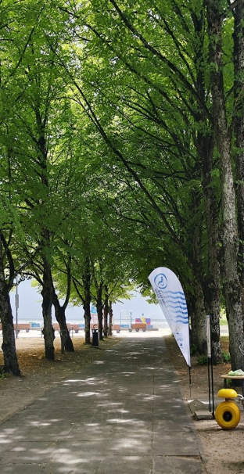
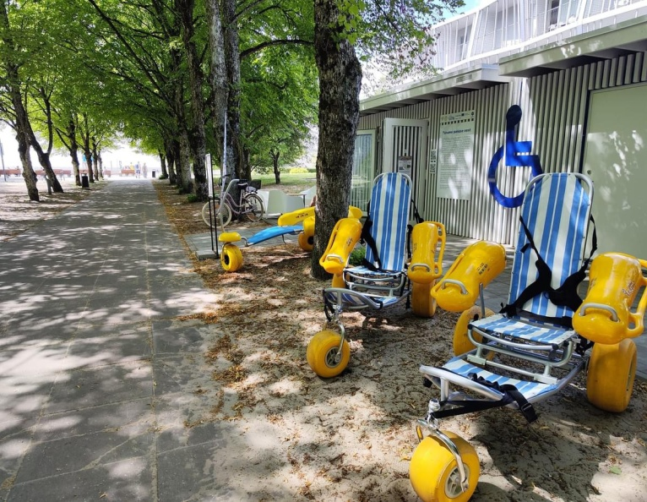
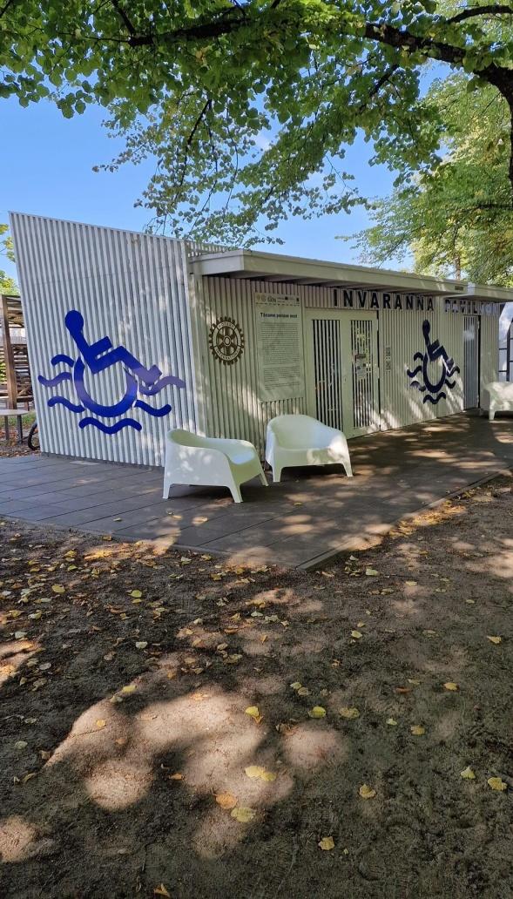
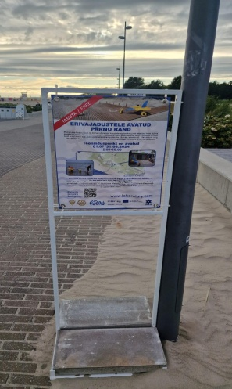
Summer´s activities
The members of our club worked as volunteers in the invaranna from 12 to 18 sharing information, being helpful to users, and guiding the youth of the work center with special needs, who help in the work of the center on a daily basis. The wages of young men are paid by Pärnu City.
The tasks of the young men were: installing the rolling road in the morning and bringing it back in the evening, cleaning the boardwalk, rolling road at the beginning of the day, during the day and other activities that require assistance.
In the process of offering the service, we added in red to the information material that the service is free, because many people thought it was a paid service.
We also changed the visuals of the inva logo to better match the architect's vision.

Slide 6
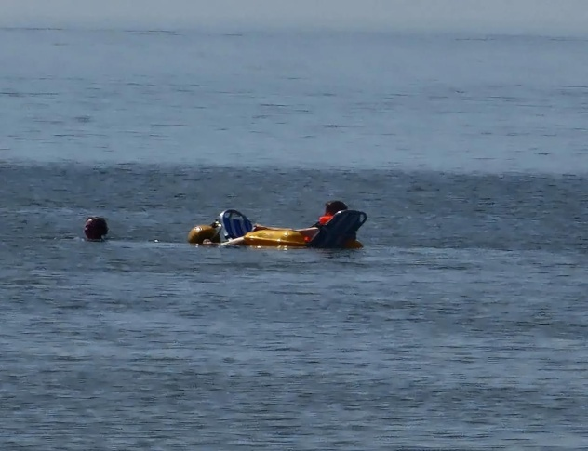
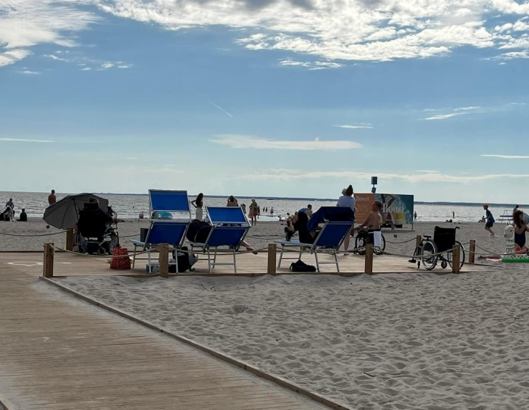
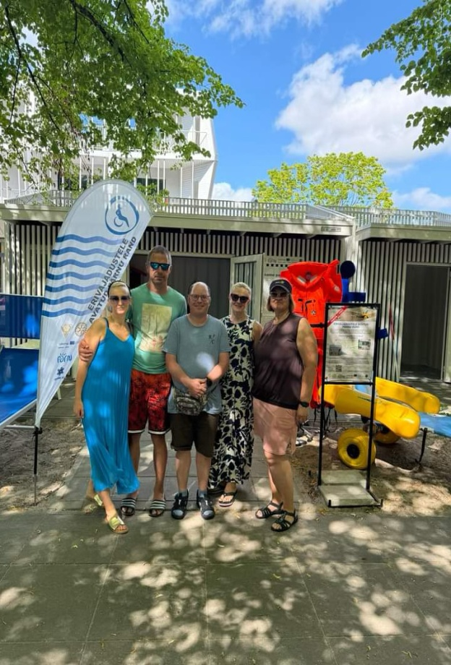
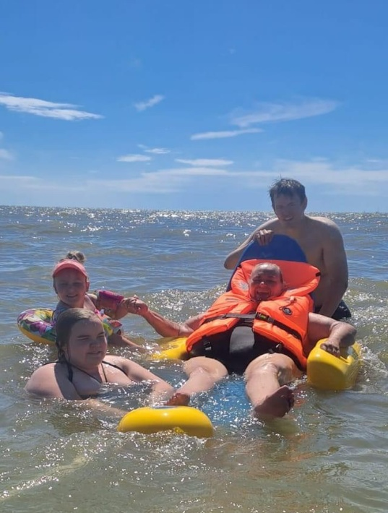
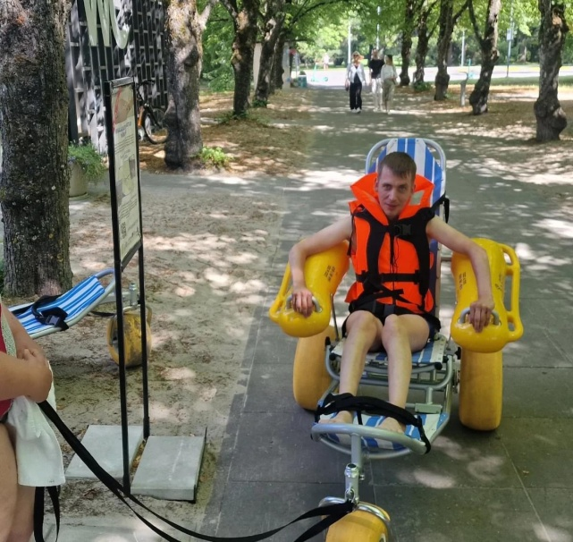
Summer mosaic

Slide 7
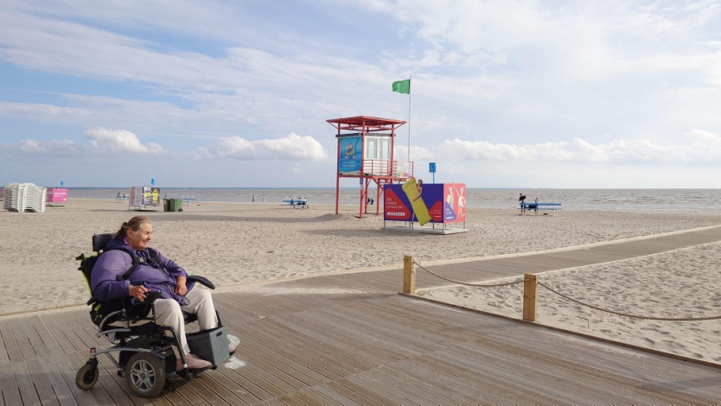
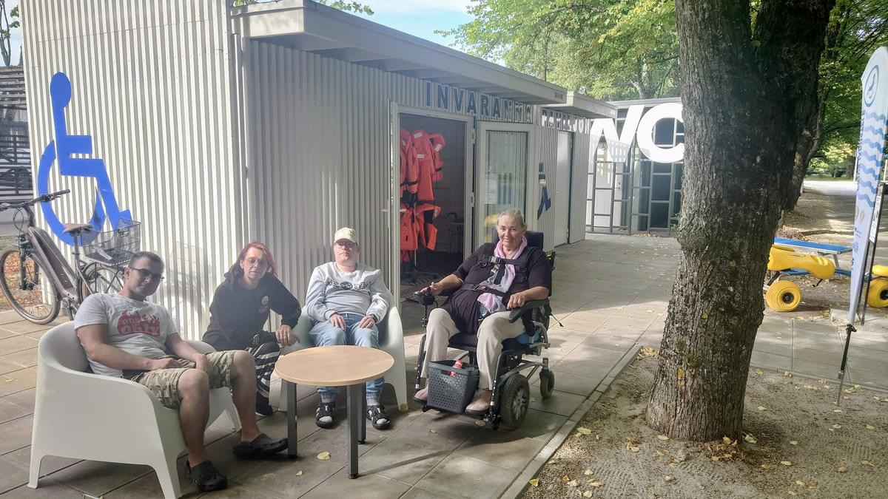
We find friends
During the summer the Inva pavilion became also a meeting place or a place for socializing. If the weather didn't allow to go swimming or if the wheelchair user didn't have a support person, it was also nice to talk talk.

Slide 8
statistics
NVARAND was open for a total of 63 days, 30 of them with a green flagA
Total of 32 chair uses.
    - 2 users 1X
    - 6 users 2X
    - 3 users 3X
    - 1 user 4X
    - 1 user 5X
A total of 11 regular users.
A total of 31 wheelchairs on the terrace on different days.

Slide 9
Feedback from users of the service
Customers received information from TV/media.
The boardwalk could be longer.
The containers are in the right place, there is no need to move them to the sand.
Should do more advertising so people know.
There could be advertising posters with shorter text and more eye-catching.
Customers must follow the rules - use of the chair for 1 hour.
Repeat users of the service should not have to re-fill the application each time.
There could be a chair pick-up and drop-off service (for a modest fee)
It was nice to be around people and have fun.
Advertise is too small - put a big slogan between the trees.
There is no water tap for washing feet.
Please share more information about the service.

Slide 10
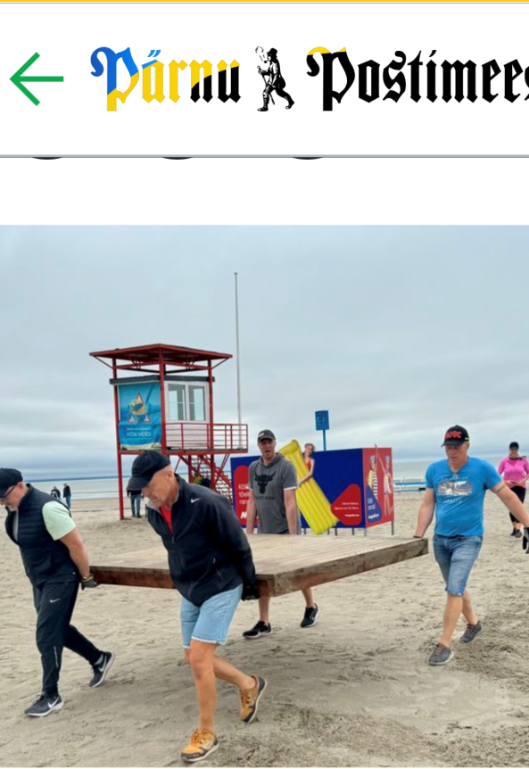
Media coverage
Invaranna information was added to the visitparnu.com page. Unfortunately only in the Estonian version. https://visitparnu.com/parnu-rand/
On September 15, we organized a labor day, during which the pavilion was conserved for the winter, the boardwalk was taken up and taken to the Pärnu Sadama territory for storage. The club's women and their husbands, members of the Pärnu Rotary Men's Club, helped. The proceedings were covered by Pärnu Postimees.
GALERII ⟩ Invarand osutus menukaks nii erivajadustega kui ülejäänud suvitajate seas, link https://parnu.postimees.ee/8096343/galerii-invarand-osutus-menukaks-nii-erivajadustega-kui-ulejaanud-suvitajate-seas

Slide 11
PLRK Project webpage
https://www.laherotary.com/projektid/
Kontakt persons:
sigridjamnes@gmail.com
esta.rotary@gmail.com

Slide 12
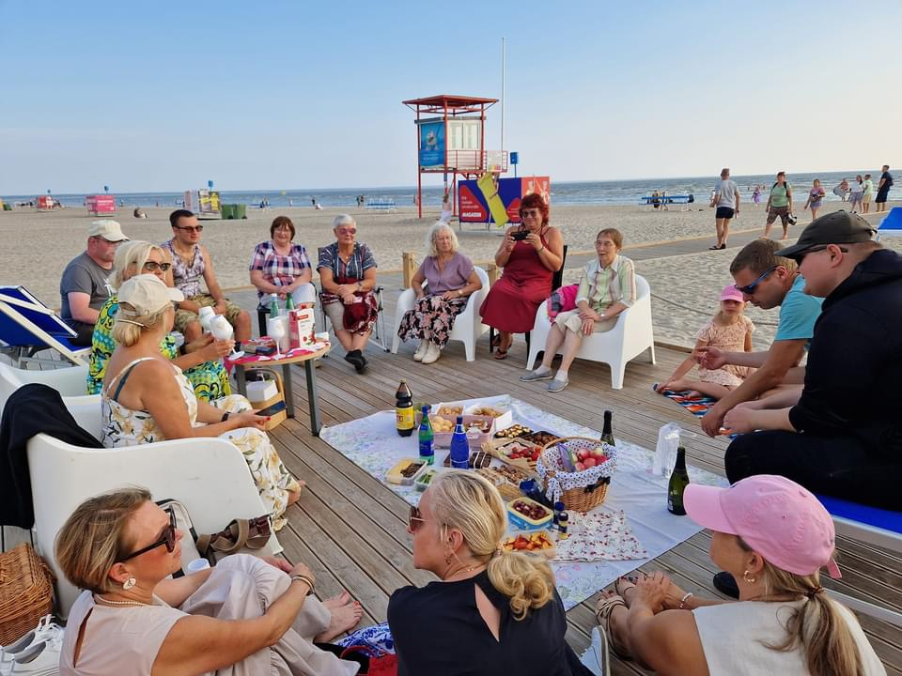
The development of our service continues

