Slide 1


Forest and Coastal Hiking Trails' accessibility improvement for different social groups
(EE-LV00013 – Accessible Hiking Trails)
4th project partner meeting, September 24-25th, 2024
Asnāte Ziemele, LCTA

Slide 2
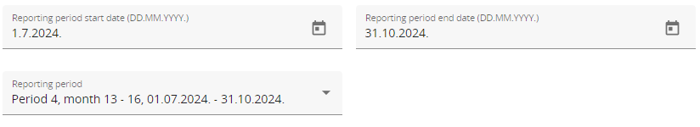
Project reporting
The 3rd period project report has been submitted in the JEMS. Waiting confirmation by the JS.
The forth project period ends at the end of October.
The forth period partner reports are due until 14th of November.
The partner reports of the third period were of better quality.
Emphasis should be placed on Work Package 3. On activities, investments, site improvements, pilot testing. All activities of the period should be described, what is the progress, what is planned, any obstacles encountered, etc. It should not be all empty.

Slide 3
Project work plan
WP1 Joint development of accessibility solutions
WP1 develops 7 accessibility solutions to be implemented on the Coastal Hiking Trail and Forest Trail for the target groups: disabled people (wheelchair, impaired vision, disabled hiking groups), seniors, families with young children, school-aged youth, and people facing language and cross-cultural barrier. Partners will jointly implement the solutions and methodology for their piloting to be carried out under WP3. The WP1 aim is also to ensure training support for tourist service providers.
WP2 Marketing and promotion
The activities are aimed at cross-border cooperation of partner organisations to promote and market improved accessibility of the Coastal Hiking Trail and the Forest Trail as two cross-border hiking products.
WP3 Pilot actions of the accessibility solutions in the improved sites
The aim is to improve 16 sites for accessibility and to pilot the 7 accessibility solutions developed under WP1. A piloting action implies a piloting hike with the target group, collection of feedback, conclusions for finalisation of the solution, input for training materials, and recommendations for replication.
Sites to be improved on the map: Google Maps
7 accessibility solutions (1. Wheelchair accessibility solutions. 2. Accessibility solutions for impaired vision. 3. Web cam accessibility solutions (seniors, families). 4. Accessibility solutions adapting hiking for families with young children. 5. Self-guided hiking skills for school-aged youth. 6. Adaptation for foreign language and cross-cultural social groups. 7. Guided hikes for groups of disabled people).

Slide 4
Project activities
Activity 1.1
Involvement of the targeted social groups
Project partners have consulted with some organisations representing the targeted groups already during the project preparation. Representatives of the targeted social groups will be involved in development, piloting and promotion of the accessibility solutions, and in development of training materials.
Cooperation will take place throughout the project duration. The social group experts will ensure an active link between their represented organisations and the project team so that the developed solutions are relevant, usable and beneficial for the potential users. Through social group organisations the project information will be channelled to their members.
Project communication with the social group organisations will take place via information exchange in meetings, project events, online communication, etc. The activity will include promotion of the project and Interreg programme for wider public.
Partner input! Which social group organizations you work with and how do you involve them into your activities?
Please note all coopetation in your project partners reports and the project cooperation between partners google excel table.

Slide 5
Activity 1.2
Involvement of local communities
Local involvement is needed to ensure sustainability of the accessibility solutions developed by the project through local awareness and acceptance.
The project will address local NGOs, SMEs, local representatives of the targeted social groups, local guides, local municipalities and other members of local communities.
Local meetings will introduce the pilot solutions for different social groups. Site inspections will be done together with representatives of local communities. They will participate in piloting activities. Ca 12 regional workshops, seminars and similar events in Latvia and Estonia altogether (ca 15 participants in each event) will draw public attention to accessibility issues for different social groups and will initiate social involvement - setting up a hiking trail volunteer movement. This movement will be based on the already existing network of hiking trail enthusiasts. The activity will include promotion of the project and Interreg programme for wider public.
Partner input! How many of the workshops / seminars have been organized?

Slide 6
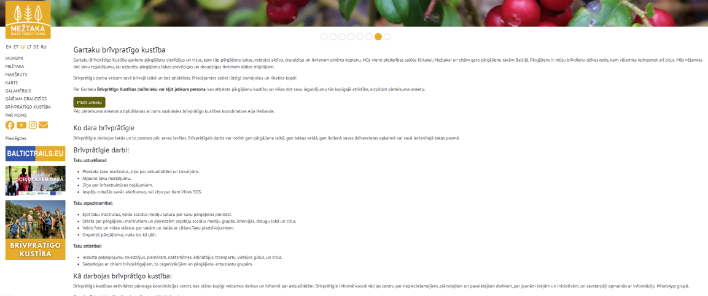
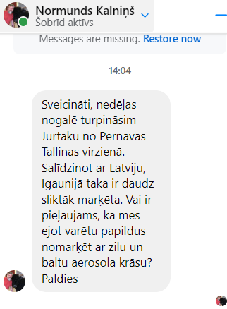
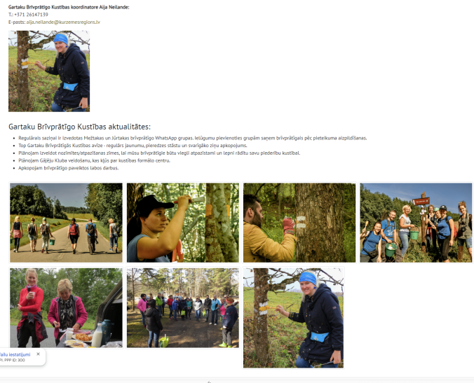
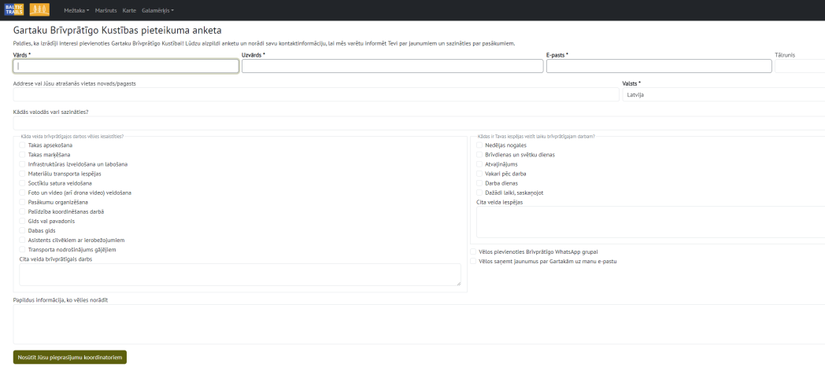
Hiking trail volunteer movement https://baltictrails.eu/en/forest/volunteer
First event was held on 11.05.2024. in Jaunķemeri/Kurzeme (40 participants).
Whatsapp group created.
Volunteer web section created.
Includes all info.
Includes an application form to become a voulunteer.

Slide 7
Activity 1.3
Development of the accessibility solutions and assessment of their potential uptake
Project partners with the social group experts will specify accessibility solutions for site improvements on the Coastal Hiking Trail and the Forest Trail.
The potential site improvements have been conceptually formulated by partners during the project preparation phase based on the observed needs.
Discussions and input from the targeted social groups will lead to the precise specification so that site improvements guarantee such accessibility solutions that are relevant and replicable on a cross-border scale. The solutions will be piloted under WP3 and then finalised according to the piloting findings. Each solution will include indications of the actions needed for it to be taken up or to be upscaled.
Based on previous experience and local consultations, the project team will revise both trails by sections to assess the potential for up-take of the proposed solutions after they are piloted. Selected trail sections will be inspected on-site for assessment of their relevance.
Partner input! Please update the table.
https://docs.google.com/spreadsheets/d/1xpiLt2JBmPtq3xyS6yrBtJ98JXFCL1h2CqfpzGaRYQA/edit?gid=1435449887#gid=1435449887

Slide 8
Activity 1.3, Development of the accessibility solutions – common presentation by groups (and assessment of their potential uptake)
Wheelchair accessibility solutions to facilitate wheelchair hiking on different surfaces. (KPR, RPR, PLRK)
Impaired vision. Accessibility solutions for impaired vision (audio guides, special signposting, brail, etc.). (RPR, HM, SMG, Peipsimaa, LC, KPR)
Web cam accessibility solutions for trail current condition visualization before the hiking trip (safe hiking planning for seniors, families with young children). (VPR, Peipsimaa, LC, MS)
Young children. Accessibility solutions adapting hiking for families with young children (short distance hiking loops on trails, attractive and nature educational games and 3D objects while on a hike). (VPR, SMG)
School youth. Self-guided hiking skills for school youth. (MS, VPR, SMG)
Cross-cultural social groups. Adaptation for foreign language and cross-cultural social groups. (MS, LC)
Disabled people. Guided hikes for people with disabilities. (ERTO, LC, MS)
Cooperation between partners google table –
https://docs.google.com/spreadsheets/d/1xpiLt2JBmPtq3xyS6yrBtJ98JXFCL1h2CqfpzGaRYQA/edit?usp=sharing

Slide 9
Activity 1.4
Training materials and training
Guidelines (LV/EE/EN) with set of criteria (addressing the targeted social groups) for development of accessible hiking services. The final version will include best practice piloting experiences of the accessibility solutions.
So far 2 have been made. 1) Pärnu accessability solution, 2) Kuldīga audioguide.
Practical hints for hikers on how to use the online solutions (weather stations, web cameras, and platforms etc.) for planning a safe hike. (MS PP4)
Training video and a methodology on how to guide groups with special needs. (ERTO)
Short 8 training videos (to include in the guidelines) recorded with experts from the targeted social groups. (KPR, RPR, VPR, MS + Setu, Peipsi, ERTO = 5LV + 3EE)
Practical training seminars for service providers and guides, with participation of social group experts (3 in EE, 3 in LV, ca 20 persons in each). KPR, RPR, VPR + ERTO, Setu, Peipsi, Hademeste). How many have been organized?
Accessibility service icons will be designed for the targeted social groups and added on the web to the Coastal Hiking Trail and the Forest Trail. (LC) COMPLETED

Slide 10
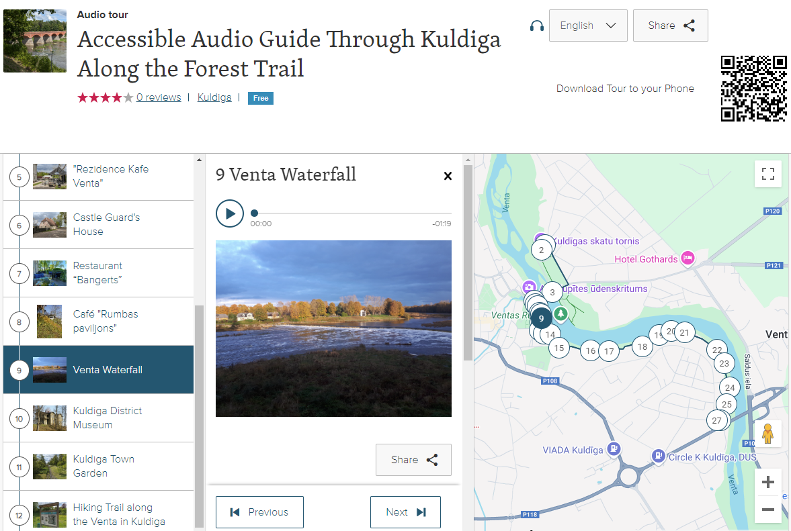
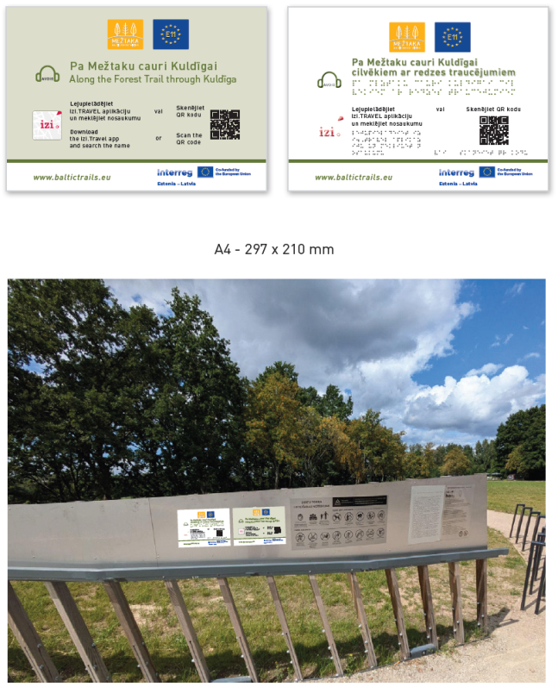
Activity 3.9
Audioguide for the Forest Trail section Snēpele - Kuldīga
Audioguide activity for the Forest Trail section Snēpe - Kuldīga is almost finished. The last tasks remain, such as the installation of information boards in nature. We plan to report the activity in the 4th period of the project.
Two versions of the audioguide have been created, one more general and one specially made for people with visual impairments. Both versions are available in both English and Latvian languages.
https://izi.travel/en/3ffc-accessible-audio-guide-through-kuldiga-along-the-forest-trail/en - visuL imperment
https://izi.travel/en/30c2-through-kuldiga-along-the-forest-trail-pa-meztaku-cauri-kuldigai/en

Slide 11
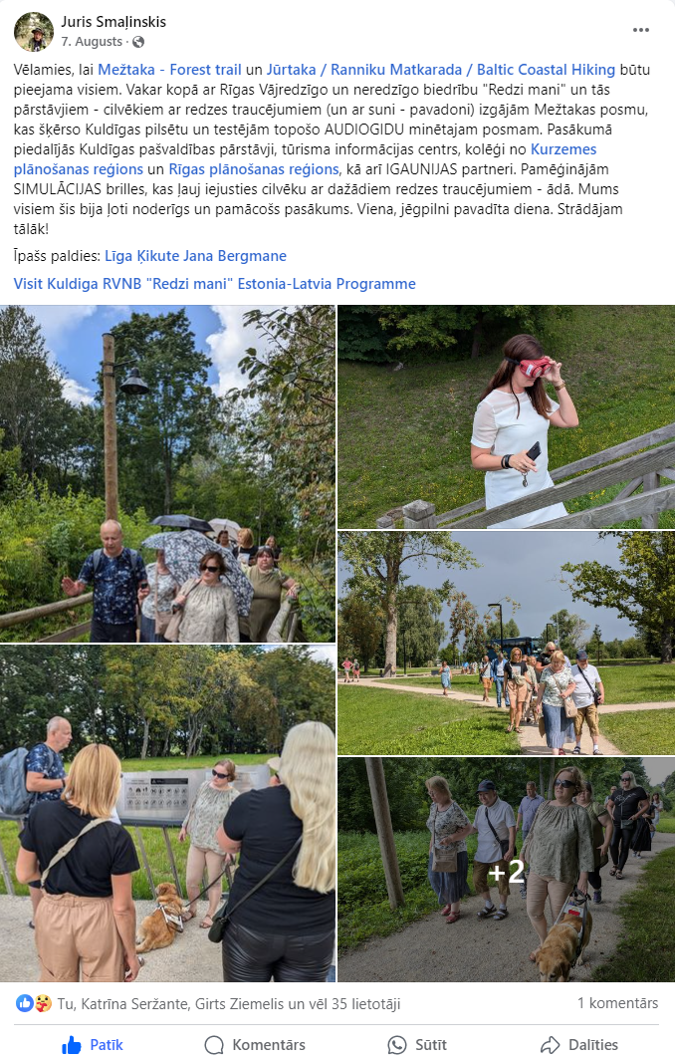
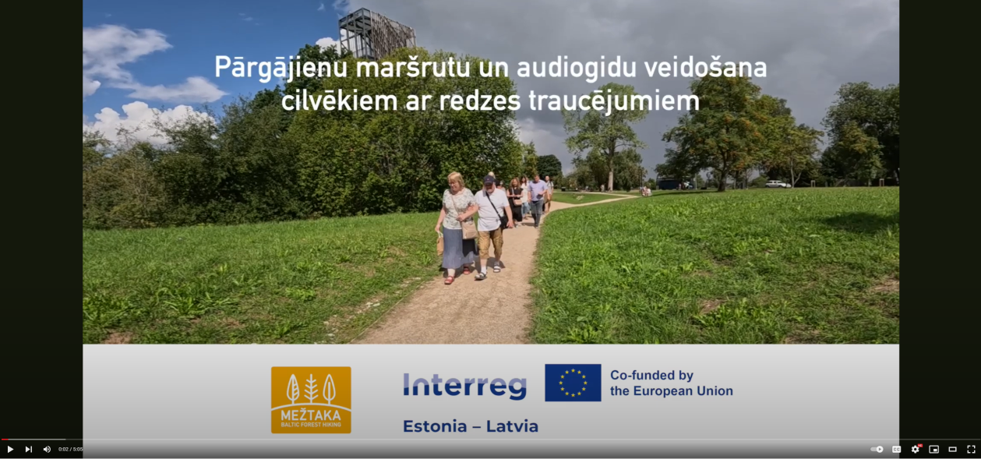
Activity 3.9
Audioguide for the Forest Trail section Snēpele - Kuldīga
On August 6th, the audioguide was pilot tested.
The project partners, targeted social groups, and local government representatives participated.
A special video was made about the pilot testing.
https://www.youtube.com/watch?v=Vd8F0CfzVZQ

Slide 12
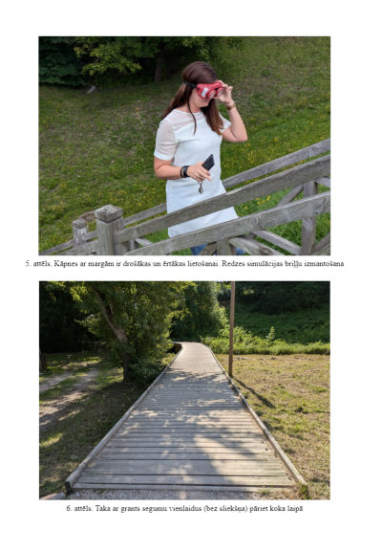
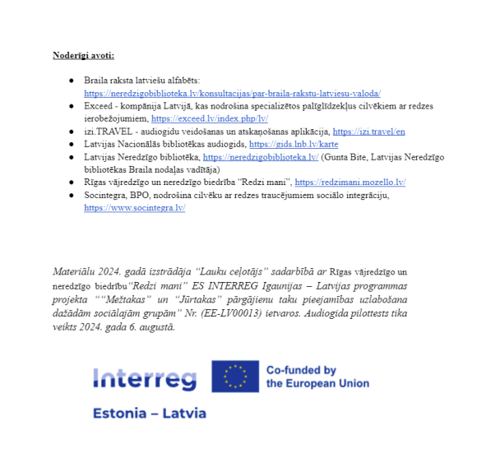
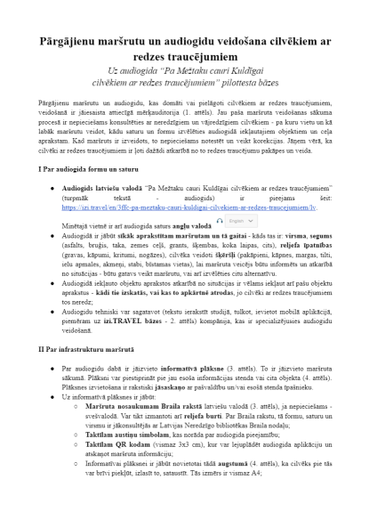
Activity 3.9
Audioguide for the Forest Trail section Snēpele - Kuldīga
After the creation of the audioguides and the pilot testing, guidelines for creation of hiking routes and audio guides for people with visual impairments were developed.
As part of the project activity 1.4, Training materials and training.
1) Guidelines with set of criteria (addressing the targeted social groups) for development of accessible hiking services. The final version will include best practice piloting experiences of the accessibility solutions.
Developed guidelines –
https://docs.google.com/document/d/1TiBFzJaUHElVf4iVR_o0-4LxXSFB-wFWnvC2IsH2W10/edit

Slide 13


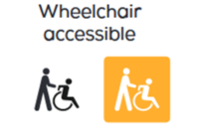
Activity 2.1
Special interest hikes for social inclusion of the targeted social groups
The partners will design special interest hikes on both trails for general public as well as for social inclusion of the targeted social groups. The hikes will highlight added value experiences to hiking and will be titled accordingly for marketing purposes: Culinary experience, Nature delight, Children pleasure, Winter bliss – skiing/winter hiking, Cycling, Cultural experience, Easy hike, Urban walks
The hikes accessible to the targeted social groups will be marked with special symbols in the baltictrails.eu web site and on the map. For example, a combined hiking and bird watching experience will be marked if the respective trail stretch is accessible on wheelchairs or is suitable for seniors or other targeted social groups. This designation will be based on the target group needs and the existing trail development experience. The state-of-art of the trail sections with the best potential will be checked by on-site inspections.
Agreed with ERA: https://www.era-ewv-ferp.org/quality-day-walk/
How to get info social group symbols to be added accordingly? Ask info centers? Experts?

Slide 14
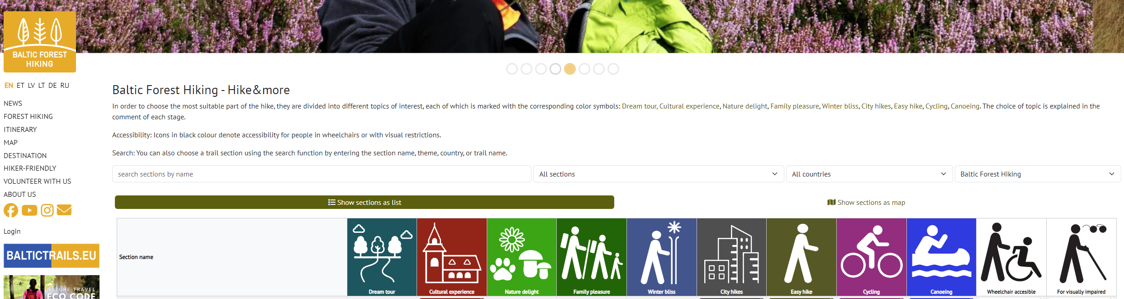
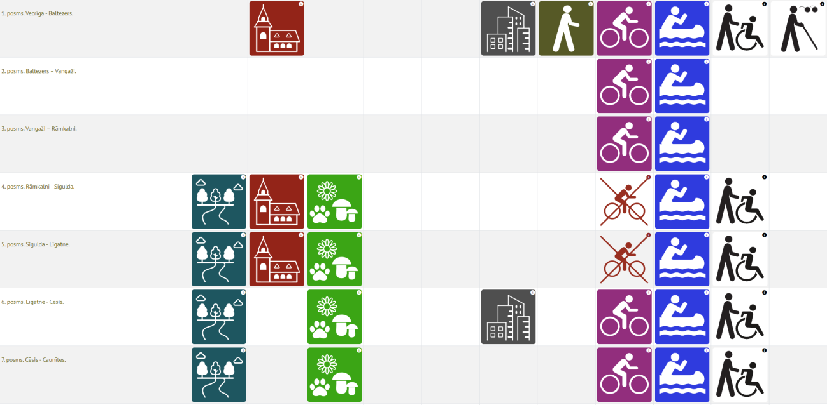
https://baltictrails.eu/en/forest/specialization
Special interest hikes activity finished and added to the website.
A full list of trail sections and what specializations are available at each section can be seen.

Slide 15
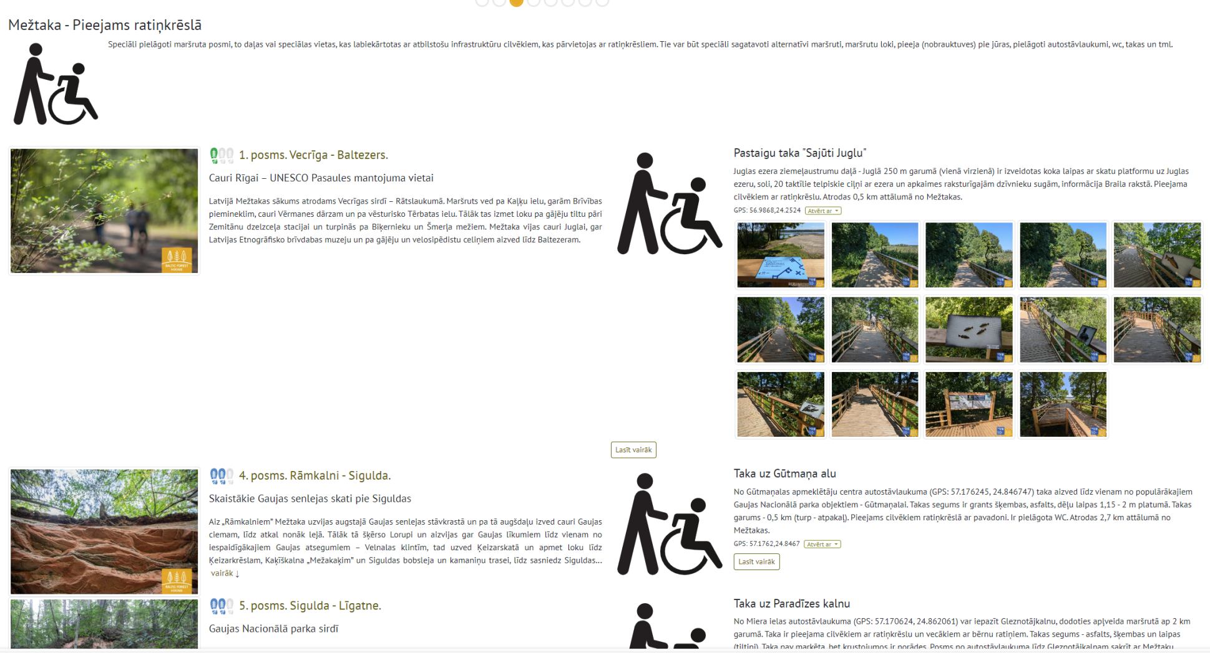
https://baltictrails.eu/lv/forest/specialization/wheelchair-accessible/sections
Each specialization has its own web subpage, where the description of the specialization and all the sections of the trails where it is available can be seen. As well as available activities, for example, short trails with social inclusion.

Slide 16
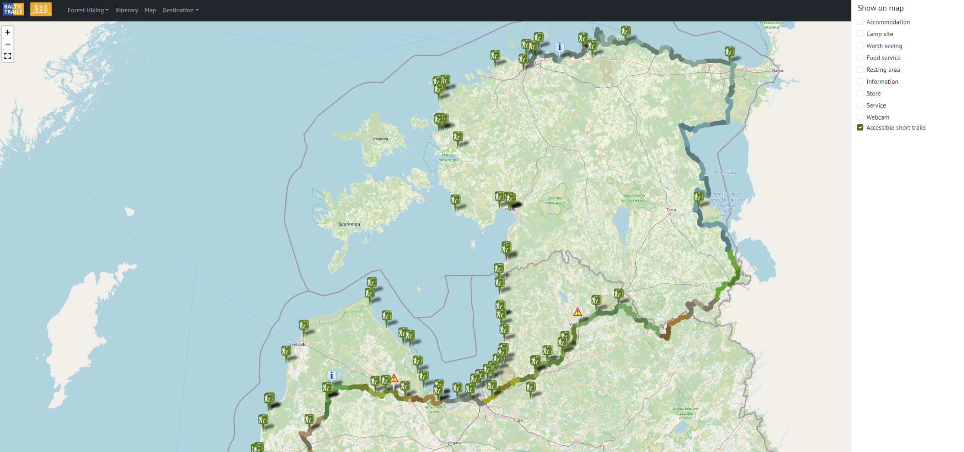
Accessible short trails / Pieejamās īstakas
The accessible short trails filter / search option added to the web page interactive map (https://baltictrails.eu/en/coastal/map)

Slide 17
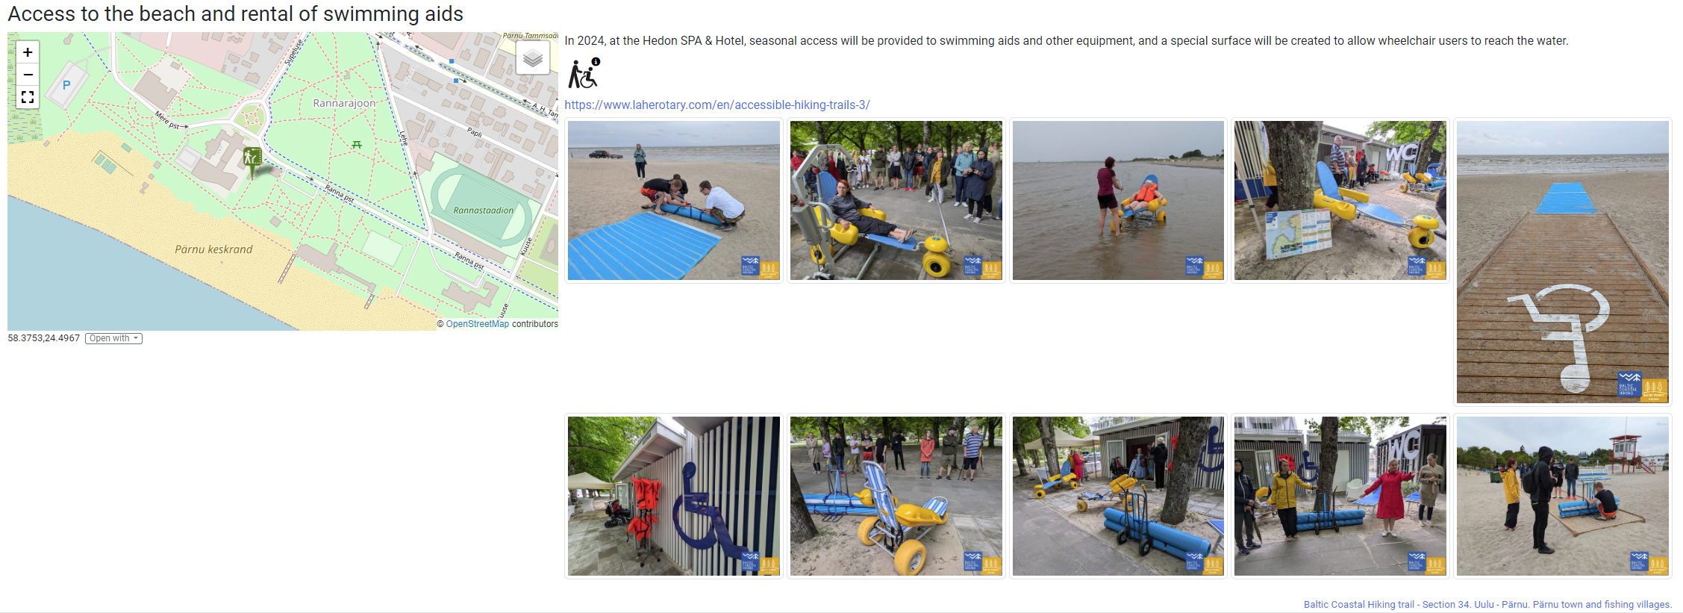
https://baltictrails.eu/en/coastal/shorttrail/95
Each short trail / specializaton object has its own suppage, which is customizable.
Photos, general info, descriptions, link etc. should be added.

Slide 18

Activity 2.2
Hikers friendly sign for accessibility
The Hiker's Friendly (HF) sign that currently marks businesses specialised in services for hiking tourists will be extended with new accessibility criteria to cater for the targeted social groups.
The criteria will be set together by the project team and experts representing the social groups to ensure relevance. The criteria will be discussed with partners and finalised, based on feedback. The new criteria will be included and explained in the training materials and training events.
The HF accessibility concept will be promoted to SMEs and they will be encouraged to apply for the sign. It is expected to involve both, the present HF sign holders and also attract new ones. Well-known and internationally recognized accessibility symbols will be integrated with the Hikers' Friendly sign and incorporated into the visual identification of the special interest hiking products for the targeted social groups. The visual identification of the hiking products, including the accessibility signs, will be incorporated/adapted for use on our websites, apps, social networks, printed and online maps, and other marketing materials.
HF awarding meetings will take place twice a year in EE and LV online. Ca 350 services in Latvia and Estonia will be labelled as Hikers' Friendly - accessible.
LV = 284 and EE = 38?

Slide 19
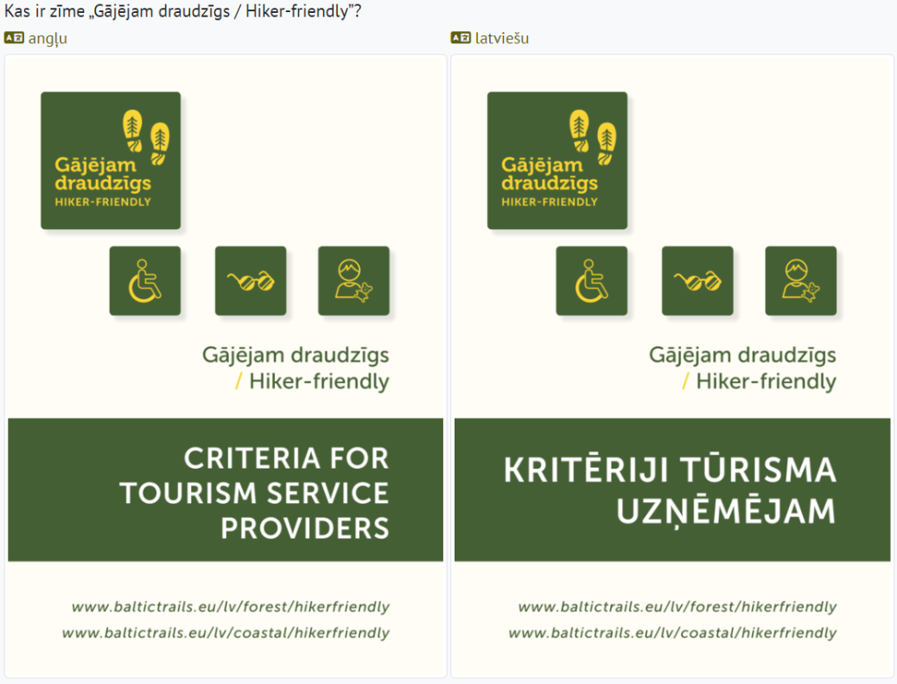
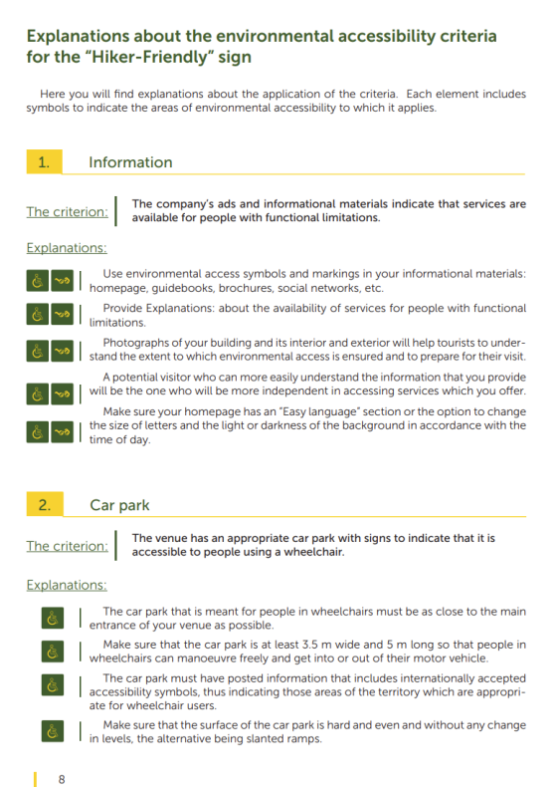
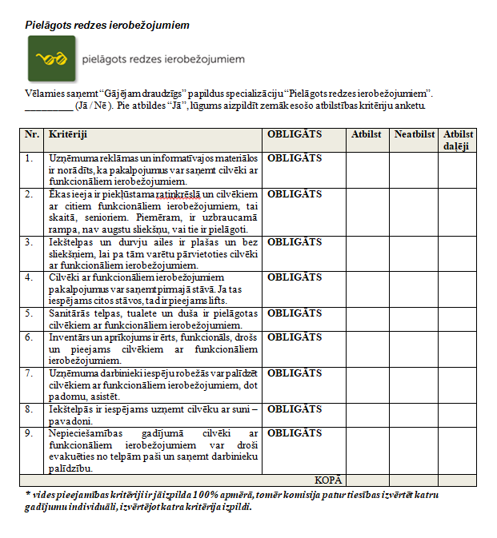
Hikers friendly sign for accessibility
Criteria for tourism service providers had been extended with new accessibility criteria.
Wheelchair accessible
Visually accessible
Children-Friendly
Detailed explanations for all accessibility criteria.
Criteria have been finished in Latvian and English languages. (Available in baltictrails.eu and elsewhere). Sent for Estonian translations.
The Latvian application forms for the sign have been updated.
The next meeting of the LV HF commission is scheduled for early November.
The application form indicates that Ca 350 services in Latvia and Estonia will be labeled as Hikers' Friendly - accessible.

Slide 20

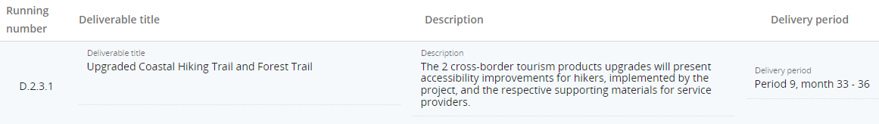
Activity 2.3
Web site and digital improvements
The baltictrails.eu web site will be adapted to show the accessibility of hiking for different social groups. Accessibility solutions and conditions will be explained, general practical information will be added for each of the targeted social groups. Symbols will be designed to mark the trail sections and services that are suitable for the targeted social groups. Selected Baltictrails website segments will be extended to support accessibility (ARIA) enhancements and high contrast css color scheme for visually impaired visitors.
Special interest hikes with denoting symbols will be put on the web site. To improve planning accessibility, external online resources such as web cameras and weather stations will be connected to the website for trail current condition visualization. Audio guides will be linked to the respective trail sections, training materials, videos, the map will be made available from the web site. The website will be linked from project partner websites.

Slide 21
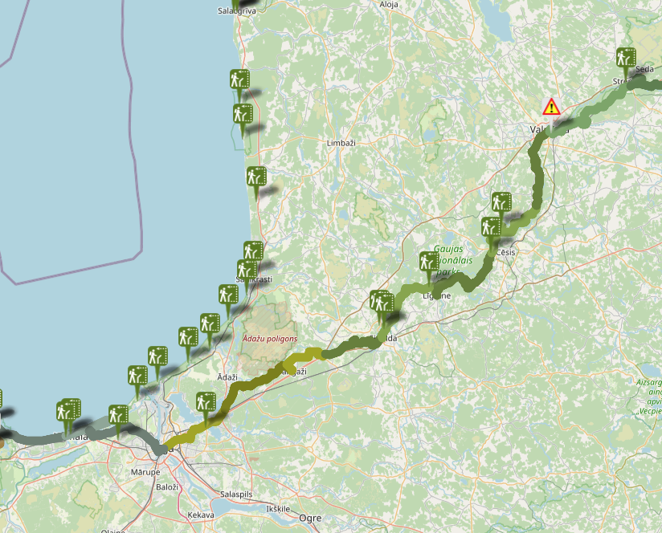
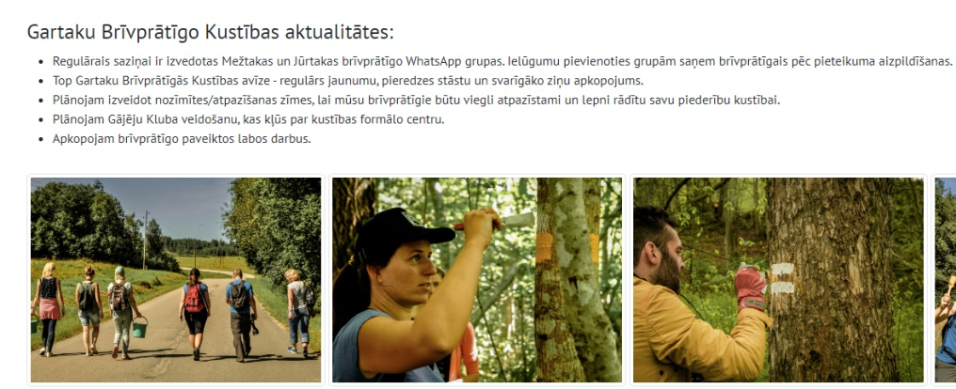
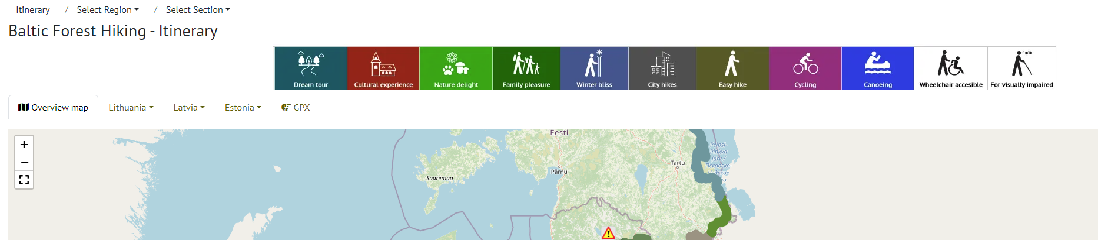
Web site improvements since last meeting
Specializations - https://baltictrails.eu/en/forest/specialization
Volunteer movement web section - https://baltictrails.eu/en/forest/volunteer
Accessible short trails in web and on interactive map
Continuous updates to the project webpage - https://baltictrails.eu. Both technical and content improvements. Information updates were done, for example, added new accommodations, updated information of service information, inserted some new information about the actual situation in particular stretches.
Various smaller technical updates.

Slide 22
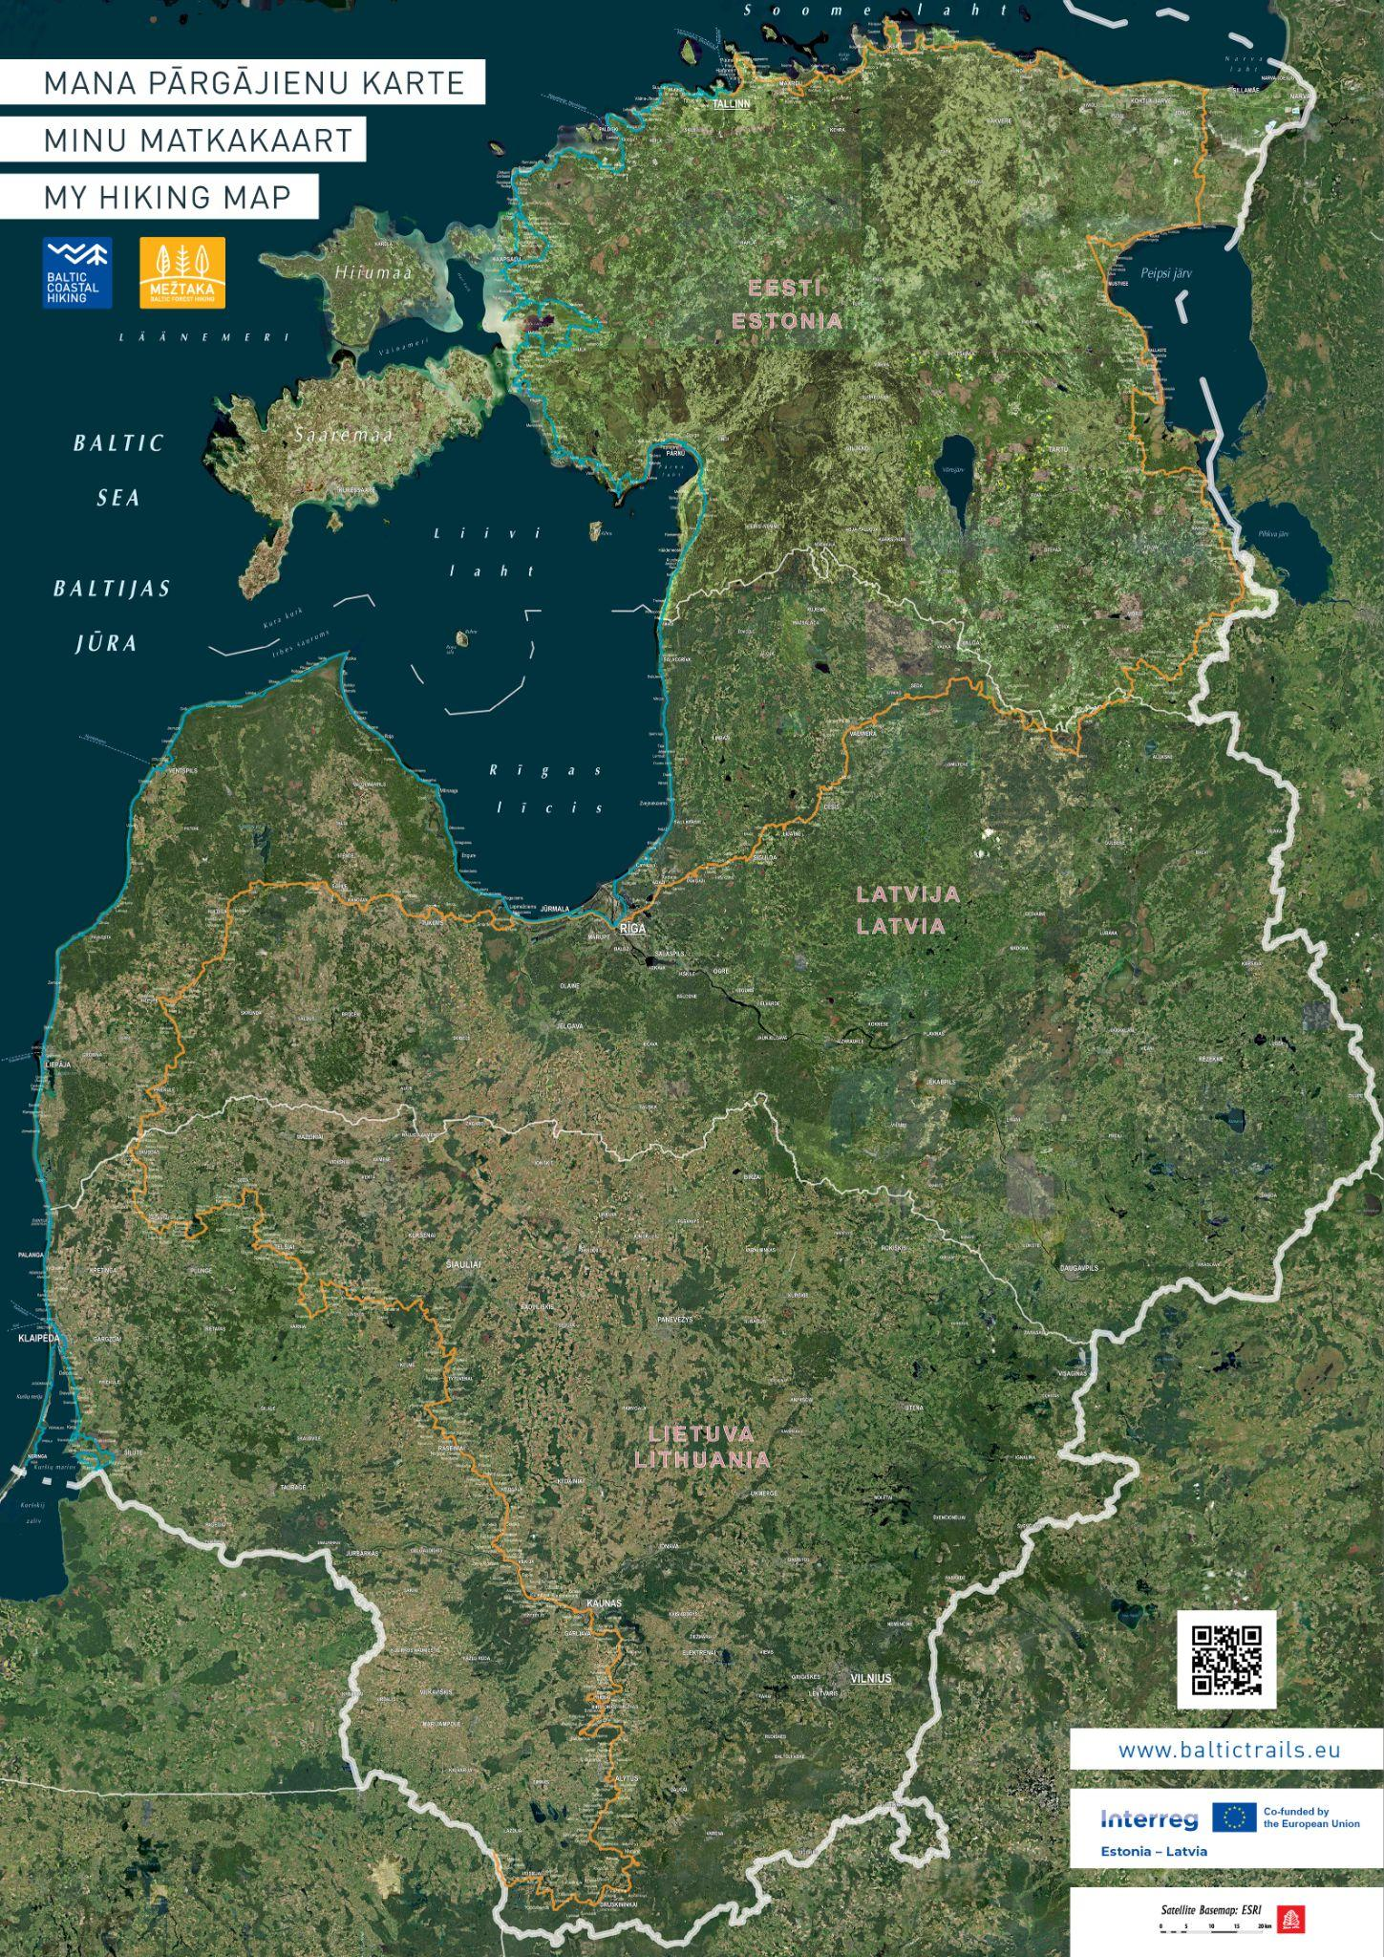
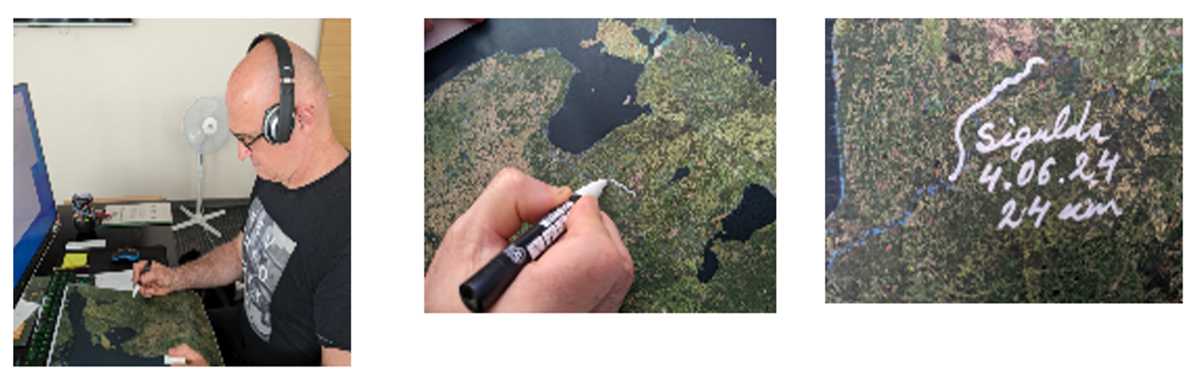

Activity 2.4, Printed map
Specialised Coastal Hiking Trail and Forest Trail folding poster map.
Last design works. Will be in A0 size and include all 3 Baltic countries.
~October 2024
Will be printed in ca 20,000 copies.

Slide 23
Activity 2.5,
Video reels
Short (ca 30 sec.) video reels, 5 in Estonia and 5 in Latvia, will be made for use by partners in social networks and other online resources.
They will feature representatives of the targeted social groups actually experiencing hiking on the Coastal Hiking and Forest Trail. The aim is to encourage and demonstrate the accessibility solutions enabling and supporting the hiking experience.
The video reels will be made in the improved sites on the Coastal Hiking Trail and the Forest Trail.
The video reels will be put on the baltictrails.eu web site, posted on Coastal Hiking Trail and Forest Trail Fb profiles, disseminated to the organisations representing the targeted social groups.

Slide 24

Activity 2.6
Communication
The activity will promote the project progress and its results to public at large, stakeholders, targeted social groups:
press releases and social media feeds about the project progress and achievements,
media/fam trips, 1 in EE, and 1 in LV, ca 10 pers. in each trip, to demonstrate accessibility solutions and produce media coverage to draw society attention to hiking accessibility in general.
two national scale tourism events, one in EE, and one in LV, 70 participants in each. The audience - tourism service providers, hiking guides, municipalities, tourist info centres, and other stakeholders involved with maintenance of the hiking trails, providing tourist services and tourist information. The aim is to induce uptake of the accessibility solutions developed and piloted by the project.
media interviews, participation in media programs and other relevant PR activities by opportunity.
The activity will include promotion of the project and Interreg for wider public.

Slide 25



The Baltic Trails social media
Overview of Instagram Pages
https://www.instagram.com/meztaka
https://www.instagram.com/jurtaka
Followers: 3400
(+23 in 3 months)
8 posts + stories
1500 views per month
Followers: 3228
(+75 in 3 months)
35 posts + stories
1500 views per week

Slide 26
Overview of Facebook Pages https://www.facebook.com/meztaka https://www.facebook.com/jurtaka
 | March - June | June - September | Rise / fall | March - June | June - September | Rise / fall
Followers | 9033 | 9145 | + 108 | 6673 | 6852 | +179
Reached audience | 52 894 | 31 362 | -21 532 | 33 961 | 128 793 | +94 832
Posts published | 35 | 29 | -6 | 38 | 52 | +14
Link clicks | 54 | 133 | +79 | 128 | 2560 | +2432

Slide 27
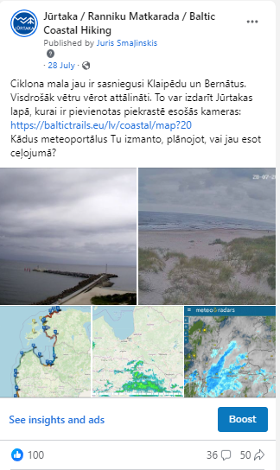
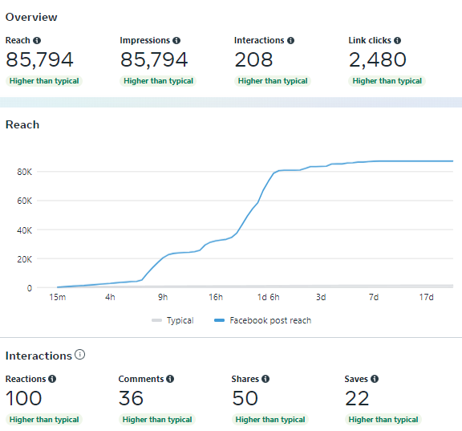
Most popular posts on FB: Top 3
No. 1

Slide 28
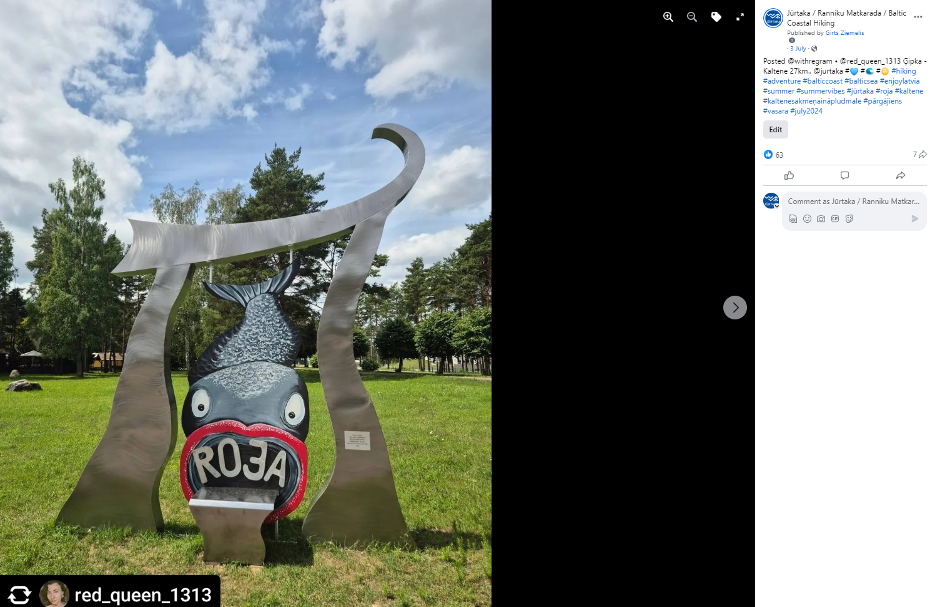
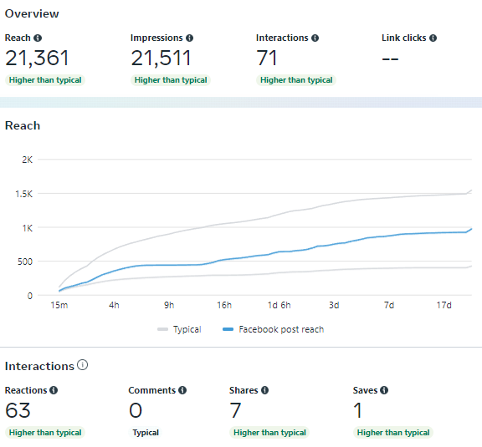
Most popular posts on FB: Top 3
No. 2

Slide 29
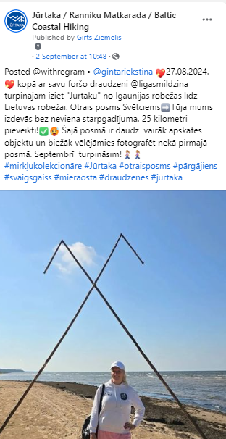
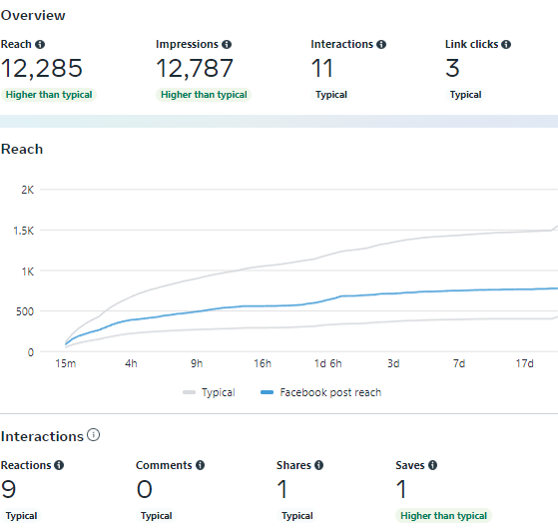
Most popular posts on FB: Top 3
No. 3

Slide 30
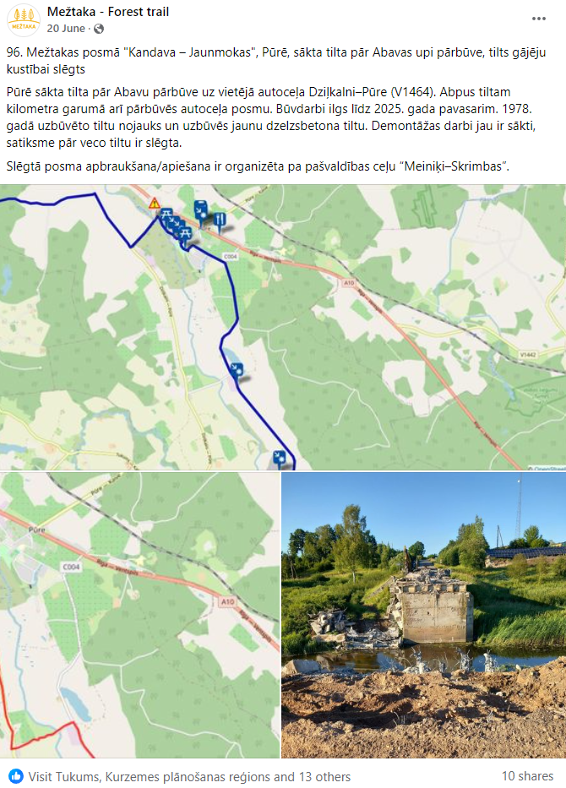
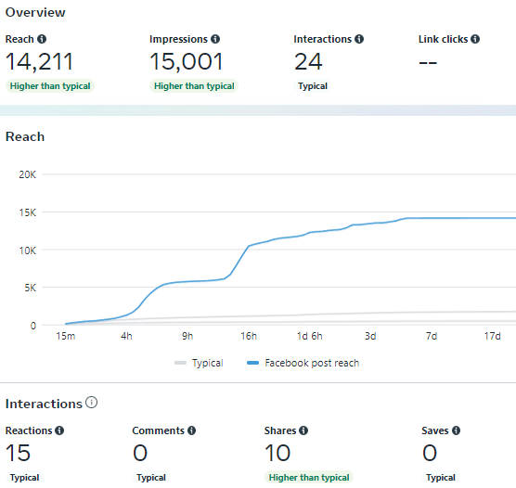
Most popular posts on FB: Top 3
No. 1

Slide 31
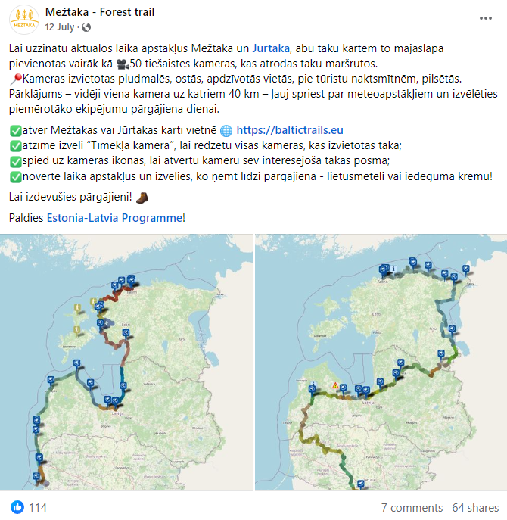
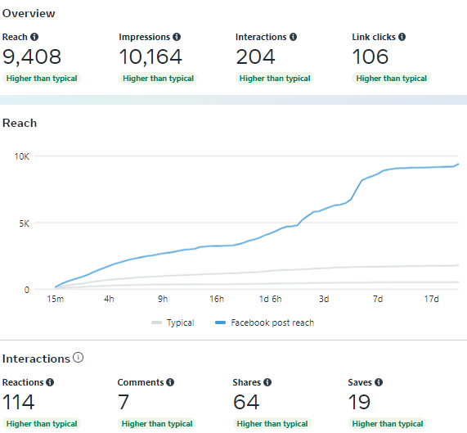
Most popular posts on FB: Top 3
No. 2

Slide 32
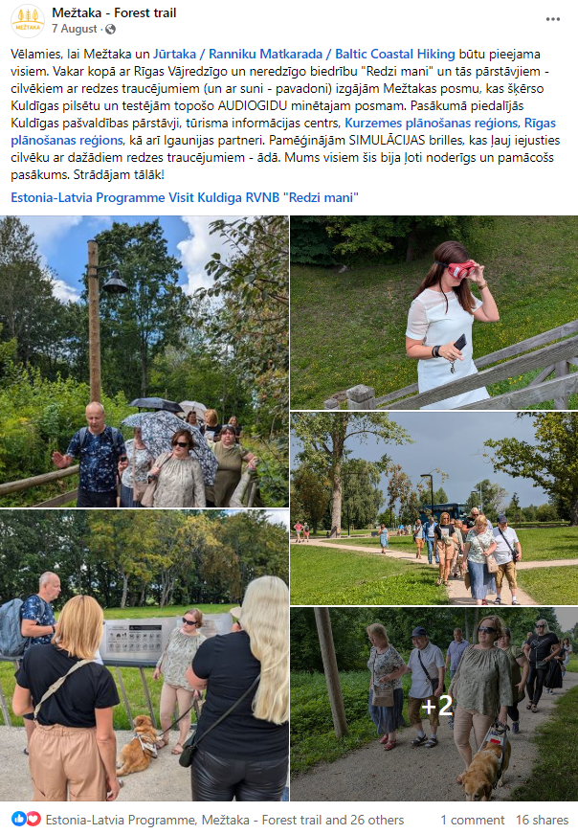
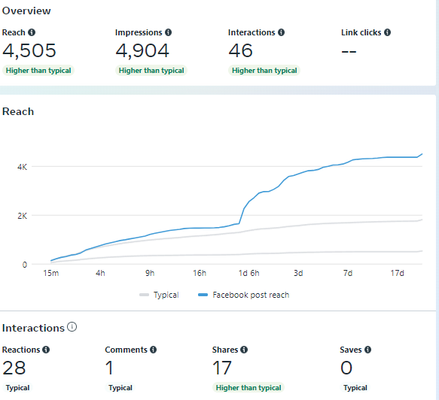
Most popular posts on FB: Top 3
No. 3

Slide 33
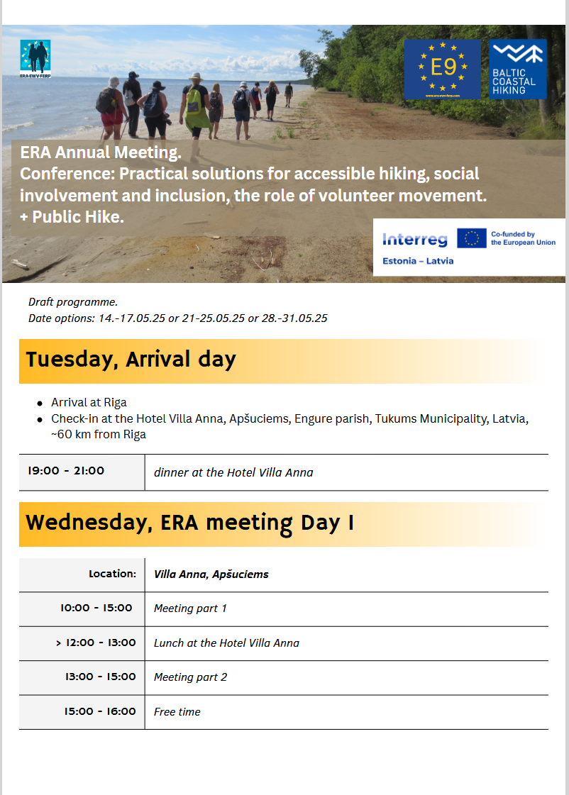
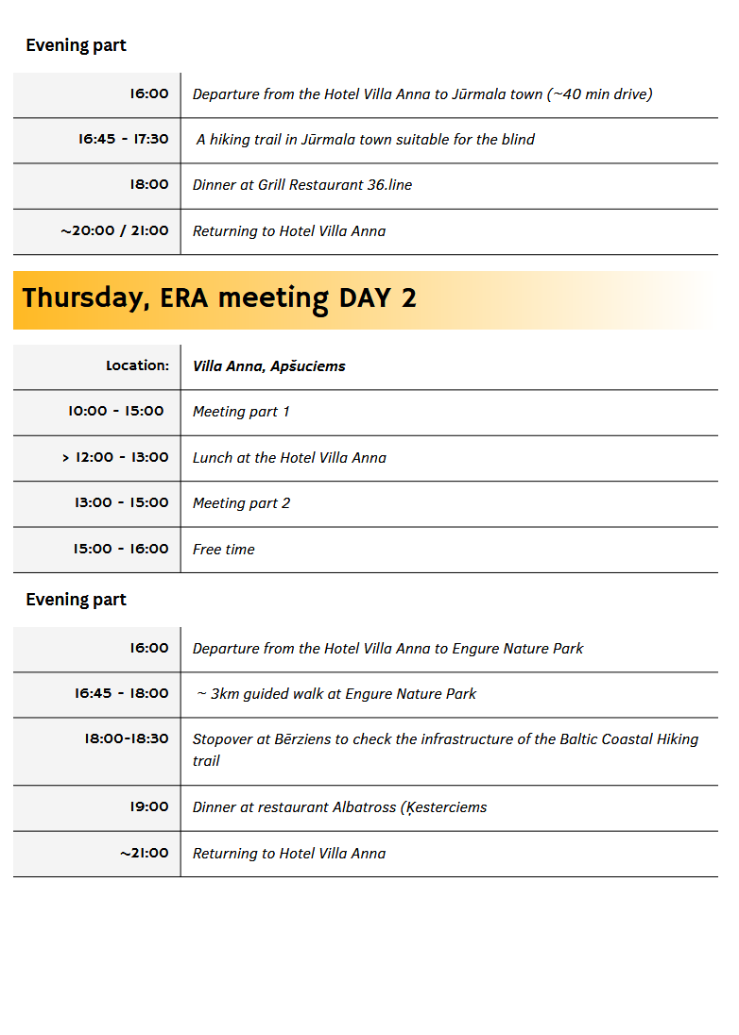
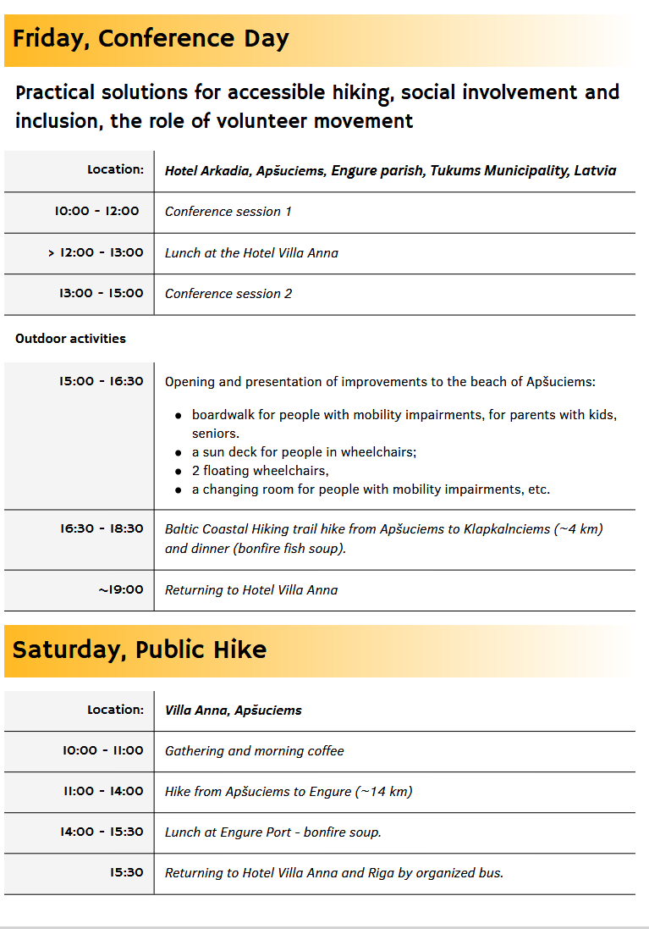
Activity 2.7
Cooperation with international hiking community
The project final international conference (ca 100-150 participants, incl. ca 50 LV and 20 EE) with participation of ERA will be a 2-day event with a practical discussion session. A pre-study tour will be organised for international participants and/or Estonian stakeholders to demonstrate the solutions and encourage their uptake. The event location is planned in Kurzeme region, Latvia.
Conference topic: practical solutions for accessible hiking, social involvement and inclusion, the role of volunteer movement.
May 2025 – ERA board meeting in Latvia – combined with project final conference and a public hike

Slide 34
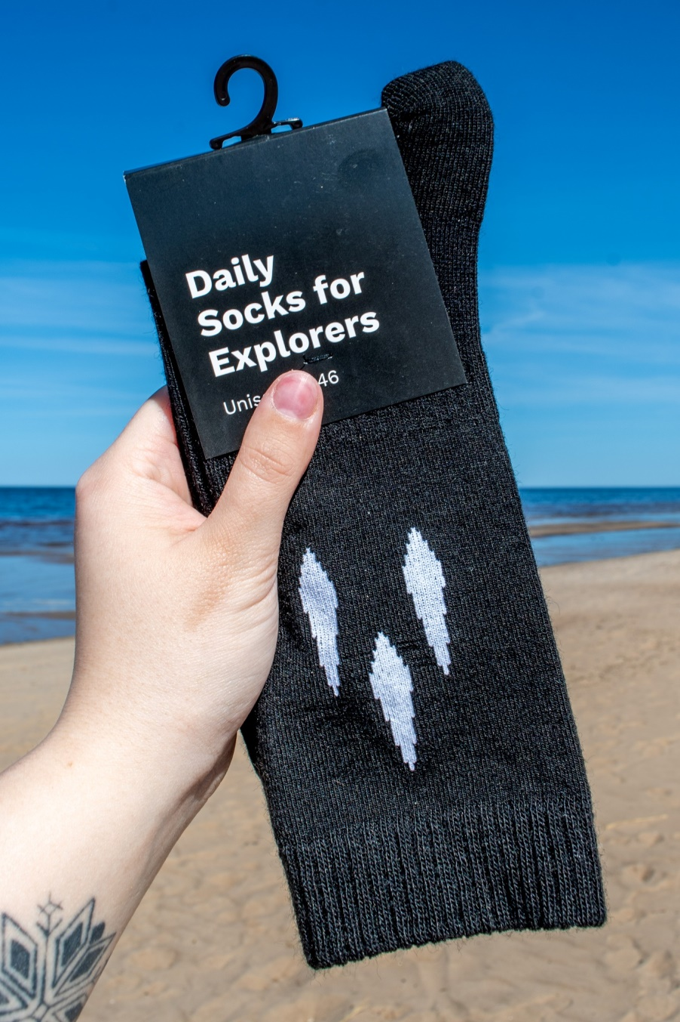
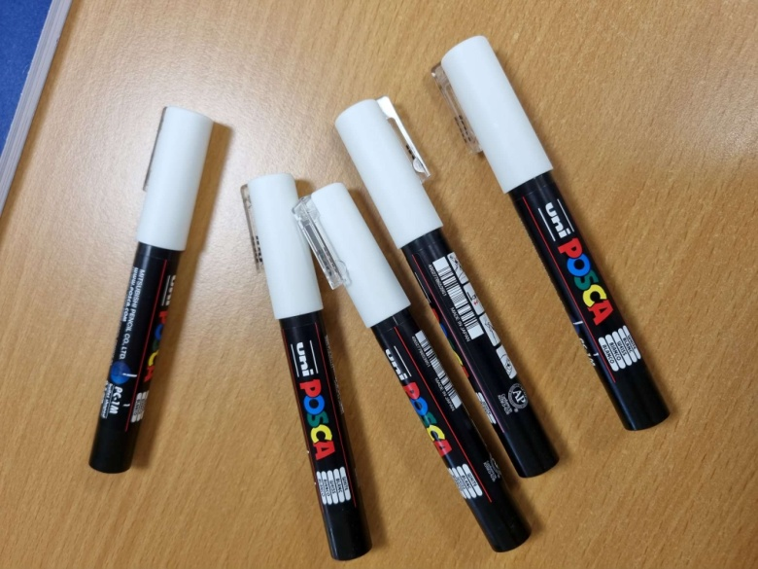

Activity 2.8
Promotion items
Any new ideas?
Promotional items (e.g.: T-shirts, cups, flags, banners, flyers, leaflets, etc.) will be produced to support social inclusion - for distribution in project events such as hiking piloting, the cross-border hikes and other with participation of hiking volunteers and the targeted social groups.

Slide 35
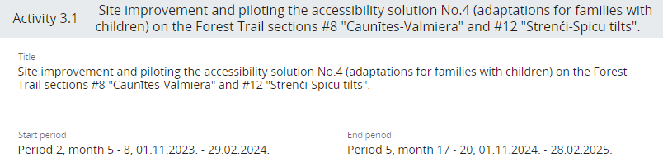
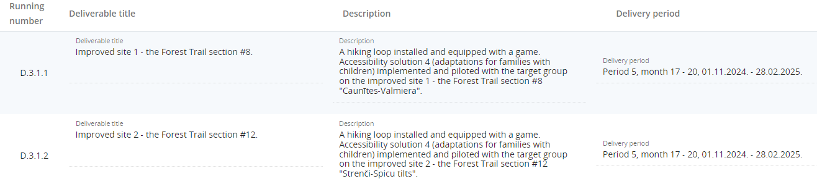
3-7km hiking loops will be installed improving two sites on the Forest Trail to make hiking more accessible for families with young children, seniors and other groups not fit for long distance hiking but still willing to hike the Forest Trail. To make the hike more attractive for families with children, a digital game for each loop will be developed and installed on the site using informative tablets with QR codes at the start/end points of both loops. The game can be activated only on site and the children will play the game while moving along the loop. Through the digital game children will learn some facts about the forest, hiking, flora and fauna, etc. The trail loops will be marked. The accessibility solution will be piloted with the target group (ca 10 pers. from EE, ca 20 pers. from LV) on the improved site. Investment description is provided in the Investment section of this WP.
Developed by PP3 VPR.

Slide 36
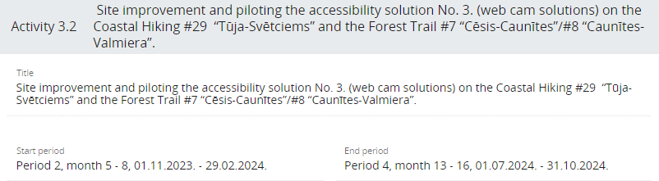
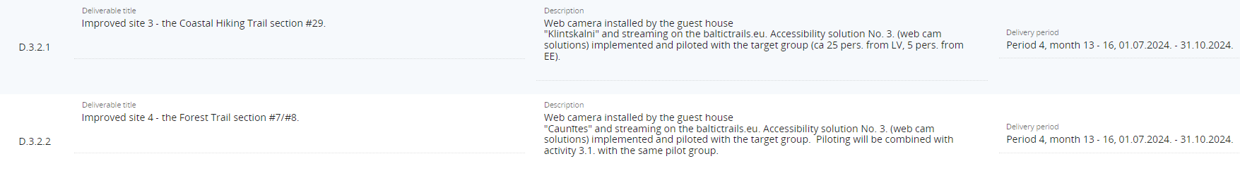
Web cams will be installed to stream the real time weather conditions on the trail: 1) by the guest house “Klintskalni” on the Coastal Hiking section #29 “Tūja-Svētciems”, 2) on the Forest Trail, between sections #7 and “Cēsis-Caunītes” and #8 “Caunītes-Valmiera”, near the guest house “Caunītes”, a Hikers' Friendly tourist service provider. The cameras will be streamed on baltictrails.eu web site. Seniors, families with children and other groups for whom weather might be an obstacle, will be able to check the weather and trail condition and to make sure before the planned hike if the trail is accessible to them, e.g., no ice or mud, no heavy rain or wind. Installation of web cams will improve accessibility and safety of hiking.
Investment description is provided in the Investment section of this WP.
Piloting the accessibility solution No. 3 with a group hike is justified as follows:
- Quality of feedback for improvements.
The hiking trail is very popular, therefore the piloting hike will be open to public to attract different target audience profiles: domestic LV and Estonian participants for cross-border spectrum, families with children in different age groups, seniors in different age groups and with different hiking abilities. The participants will be asked to evaluate, by means of a questionnaire, their experience using the webcam info for planning and preparation (e.g., what to wear, what to bring along), and whether the webcam info has been reliable enough and helped to estimate the real conditions on the trail. This type of data can be obtained only by on-site hike. The feedback data will be used to improve the accessibility solution, and to disseminate the info for uptake.
- Dissemination
Invited participants will be those potentially interested in the uptake of the solution. They will have an opportunity to see how the solution works and ask questions to the project team about webcam technical solutions and exchange experiences. The piloting hike will be featured in our social networks as an innovative social activity.
- Cost efficiency
The number of participants in the group does not significantly impact the costs. The costs of announcing the hike, inviting the participants, guide services, preparation and distribution of the questionnaire and data processing, etc. does not significantly grow if there are more participants. We believe it is cost-efficient in terms of the range and quality of feedback data it will bring, as well as for the dissemination of the project and accessibility solution.
Developed by PP3 VPR.

Slide 37
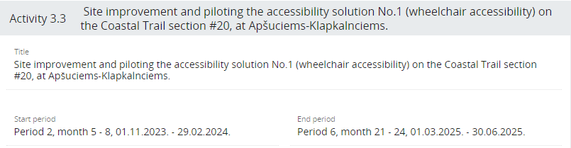
Two specially designed beach wheelchairs with two life jackets will be made available at Apšuciems village for people with mobility issues who would like to experience coastal hiking on the beach. 5km of the beach between Apšuciems and Klapkalnciems villages offer surface that is suitable for hiking experience in beach wheelchairs specially designed to make travelling across sand possible. The accessibility solution will contain the beach wheelchairs, life jackets, one wooden pathway at Apšuciems beach to adapt the trail surface, changing cabin in Apšuciems, sun decks in Apšuciems and Klapkalnciems to make sun bathing possible. The accessibility solution will be piloted with the target group (ca 15 pers. from LV, ca 3 pers. from EE). Investment description is provided in the Investment section of this WP.
Developed by PP2 KPR.

Slide 38
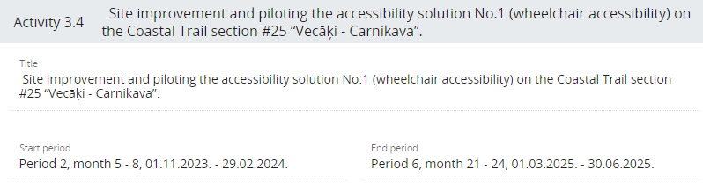
Two specially designed outdoor wheelchairs will be made available at Carnikava local history centre for people with mobility issues to enable coastal hiking experiences on varied surfaces - forest paths, gravel, snow, mud. The solution will allow adaptive hiking on different surfaces on the Coastal Hiking Trail Section #25 “Vecāķi - Carnikava” allowing to use different local alternatives included in this section - the promenade, the beach, the forest paths in the Piejūra nature park. The accessibility solution will contain the wheelchairs that are specially designed for outdoor experiences, and universal design elements for necessary adaptations. The accessibility solution will be piloted with the target group (ca 15 pers. from LV, ca 3 pers. from EE). Investment description is provided in the Investment section of this WP.
Developed by PP5 RPR.

Slide 39

Impaired vision accessibility solutions (examples: info in braille, guided ropes, audio-guide with spoken text and navigation instructions) will be installed on a 2km hiking trail (on beach in Jurmala), a local route alternative on the Coastal Trail section #21 "Ragaciems-Dubulti" and the Forest Trail section #100 "Bigauņciems-Dubulti". Accessibility signs pointing to the nearest WC, noting that it is accessible for disabled persons and has a baby changing table will be installed on the beach.
The accessibility solution will be piloted with the target group (ca 15 pers. from LV, ca 3 pers. from EE). Investment description is provided in the Investment section of this WP.
Developed by PP5 RPR.

Slide 40

Accessibility solution for people with impaired vision will be implemented and piloted on the Coastal HikingTrail (#31 "Ikla-Kabli") in Häädemeeste municipality. The solution will include an audio guide for listening on site, information signs and boards for sightseeing and service places adjusted for visually impaired persons, short wooden trails over spots of soft sand, and some resting facilities. The audio guide will highlight the Livonian (Liivi) topic as part of the local cultural heritage as this cross-border area, together with Northern Latvia, is the historical Northern-Livonia.
The accessibility solution will be piloted with the target group (ca 20 pers. from EE, ca 5 pers. from LV). Investment description is provided in the Investment section of this WP.
Developed by PP8 HM.

Slide 41

The former Petseri Northern Camp of the Estonian Defence Forces (established in 1926), is one of the worth seeing sites on the Forest Trail section #20 Kolodavitsa‒Värska in Setomaa region. To attract families with children on a hike, attractive objects of the former camp (e.g., a shooting range, artillery camp) will be visualised in 3D format, based on historical photos and showing the objects as they were at the time when the site was functioning as a military training camp. To split the distance and have a rest on a hike with children, a resting place for hikers on the shore of Õrsava lake, and 5 resting benches along the trail from Õrsava lake to Värska will be installed and equipped with audio guides introducing the Forest Trail section and the sites worth seeing on a hike.
The accessibility solution will be piloted with the target group (ca 30 pers. from EE, ca 10 pers. from LV). Investment description is provided in the Investment section of this WP.
Developed by PP9 SMG.

Slide 42

GPS supported audio guide hosted on available platforms will be produced for part of the Forest Trail section #92 "Snēpele-Kuldīga". The audio guide will introduce the trail section, and will help the users with impaired vision to navigate through part of Kuldīga on the Forest Trail. Audio guides will also be produced for the hiking trail sections in Kurzeme: 21 records on the Coastal Hiking Trail and 13 records on the Forest Trail. For these sections, the GPS feature will not be used as the signal is not always reliable in nature areas. The audio guides will provide information in English and Latvian about the respective trail section.
The accessibility solution will be piloted with the target group (ca 30 pers. from LV, ca 10 pers. from EE). Investment description is provided in the Investment section of this WP.
Developed by LP1 LC and PP2 KPR.

Slide 43


The activity will cover Forest Trail sections in Peipsimaa region. 5 web cameras will be installed on municipal lands to stream the real time weather conditions on baltictrails.eu web site. 15-17 audio guides will be installed on the existing Forest Trail signposts in Peipsimaa region. The web cam solutions will be piloted with the target group by using all cameras to access trail conditions and choosing for a pilot hike (ca 30 pers. from EE, ca 10 pers. from LV). The audio guides installed at the same sites as webcams will undergo testing in a joint pilot action. The testing reports will be used for improvements, if necessary.
Investment description is provided in the Investment section of this WP.
Justification of the cameras in the improved sites is as follows:
1. Improved site 16 - Forest Trail section #21/22 in Räpina municipality.
The web cam will stream the real time meteorological information from the Mehikoorma village, Räpina municipality in southern Peipsimaa. The weather conditions here are in general similar to the southeast of Estonia.
2. Improved site 15 - Forest Trail section #24 in Luunja municipality.
The web cam will show the water levels in the River Emajõgi and the operation of the local ferry which is the only way to cross the river on this section of the Forest Trail route.
3. Improved site 14 - Forest Trail section #25 in Peipsiääre municipality.
The webcam will show meteorological conditions in the central part of the Peipsi region - on the eastern coast of Lake Peipus. Strong winds are common here, and during the winter, there may be a snow cover. During the summer, the sun shines brightly. The camera will provide visibility of road conditions depending on the weather. This will help seniors and families with children make better decisions about going out in specific weather conditions, as well as choose appropriate equipment - clothing, footwear, etc.
4. Improved site 13 - Forest Trail section #28/29 in Mustvee municipality.
The web cam will show the trail surface on the former narrow-gauge trail line in the surroundings of Avinurme and the weather conditions in the northern part of the Forest Trail in Estonia.
5. Improved site 12 - Forest Trail section #28 at Tiheda, Mustvee municipality.
The web cam will show the situation on the Lake Peipsi – the height and intensity of waves, the trail conditions on the lakeside – its width, relief, surface condition, vegetation. In winter – the presence or abscence of show or ice, the weather – clowds or sunshine, etc. The lake landscape is unique and very beautiful therefore it is important to improve its accessibility for the targeted social groups.
Developed be PP10 Peipsimaa.

Slide 44

The implementation of a "learn by doing" approach for planning and executing hikes has the potential to increase accessibility and interest in hiking activities among school-aged youth. This methodology involves the development of a self-guided program for school groups, in which participants aged 18 and over, or accompanied by a parent or supervisor, are able to plan and execute their own hikes. This approach emphasizes on self-reliance as an important quality that can be taught through self-guided events. The methodology includes trail analysis, map reading, navigation, meal planning and catering, will be produced in LV/EE/EN languages, digital format. The piloting site will be selected by the target group (ca 25 pers.) as part of the planning process.
Developed by PP4 MS.

Slide 45

The proposed solution aims to make hiking more accessible for social groups of foreigners temporarily residing in Latvia and Estonia for reasons such as studies, work, or refugee status as well as foreign tourists general. A methodology will be developed to address the practical considerations for reaching these groups and preparing them for hiking, including information on the necessary equipment and gear, the use of public transportation to reach hiking sites, the specifics of rural and nature areas, and the availability of services such as food. The methodology will provide practical hints for hiking tourism organizers and service providers to use when working with this specific social group and will be produced in LV, EE languages in digital format. Pilot testing with a group of ca 25 persons.
Developed by PP4 MS.

Slide 46

In cooperation with trained guides, the piloting hike will test the methodology and the result of training events for guides under WP1 on how to guide group hikes for people with disabilities. Pilot testing with a group of ca 20 persons (15 from EE, 5 from LV).
Developed by PP6 ERTO.

Slide 47
Next meeting?
Next project partner meeting - in Estonia
From LV's partners, KPR has one partner meeting in the budget. The budget is not divided into periods on when what is planned.
From EE’s partners, both Setomaa and Peipsimaa have a partner meeting in their budgets.

Slide 48


