Slide 1
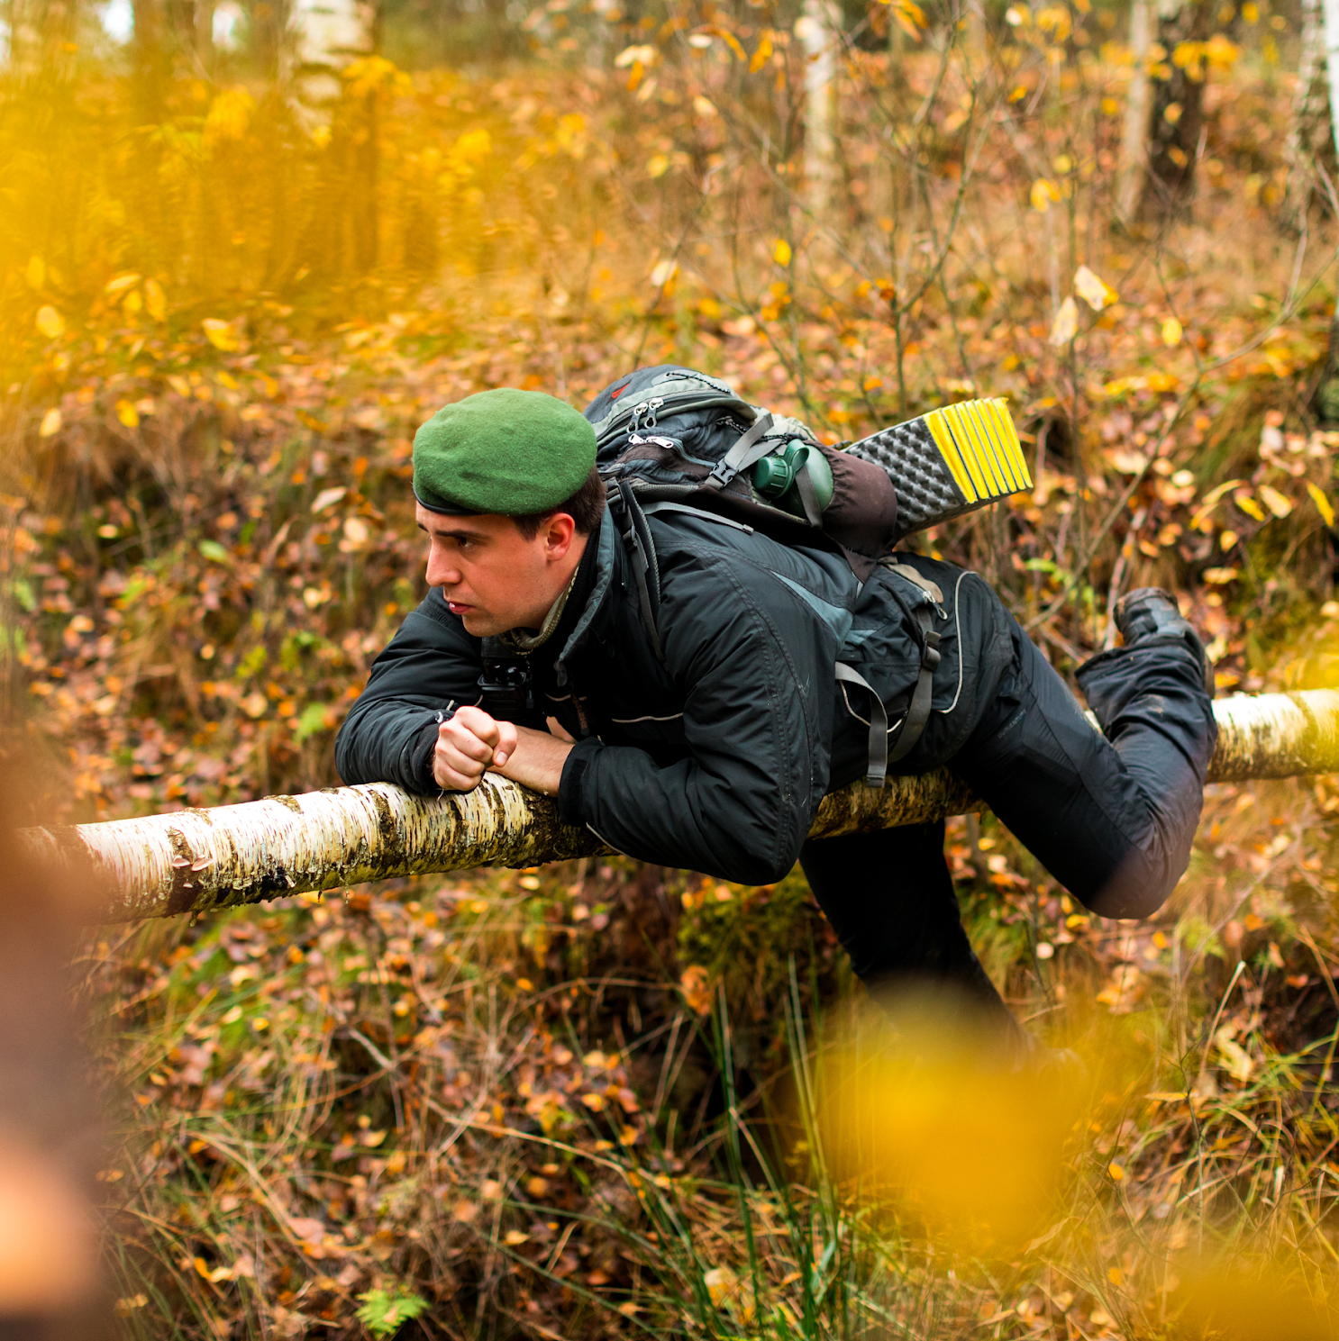

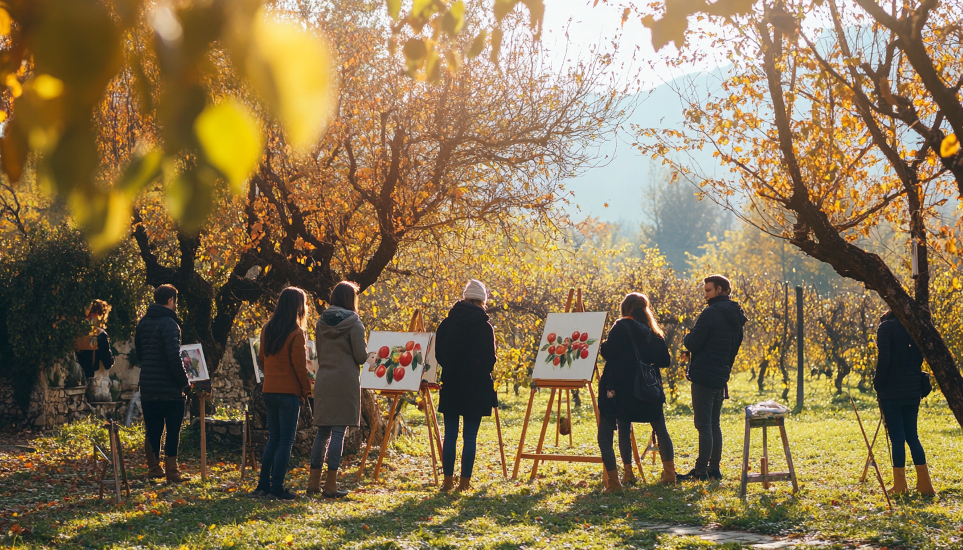
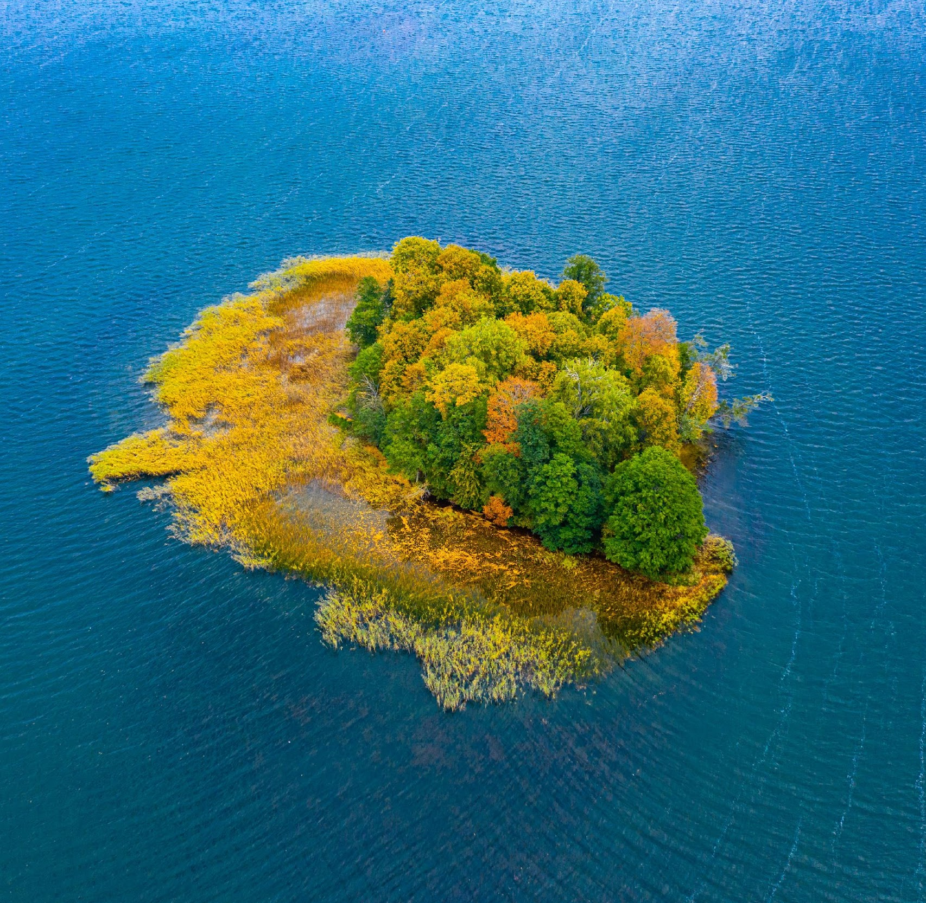

Partners’ Meeting
Autumn 2024
04.09.2024. Riga, Latvia

Slide 2
Content for today
1. In Person activities
2. Updates on Baltic Nature tourism
3. SME & Product statistics
4. Client requests
5. Feedback from SMEs
6. Social media statistics
- Facebook
- Instagram
Website
7. Planned activities

Slide 3
In Person Activities and Meetings
Notes:
What have we done?
Where have we been?

Slide 4
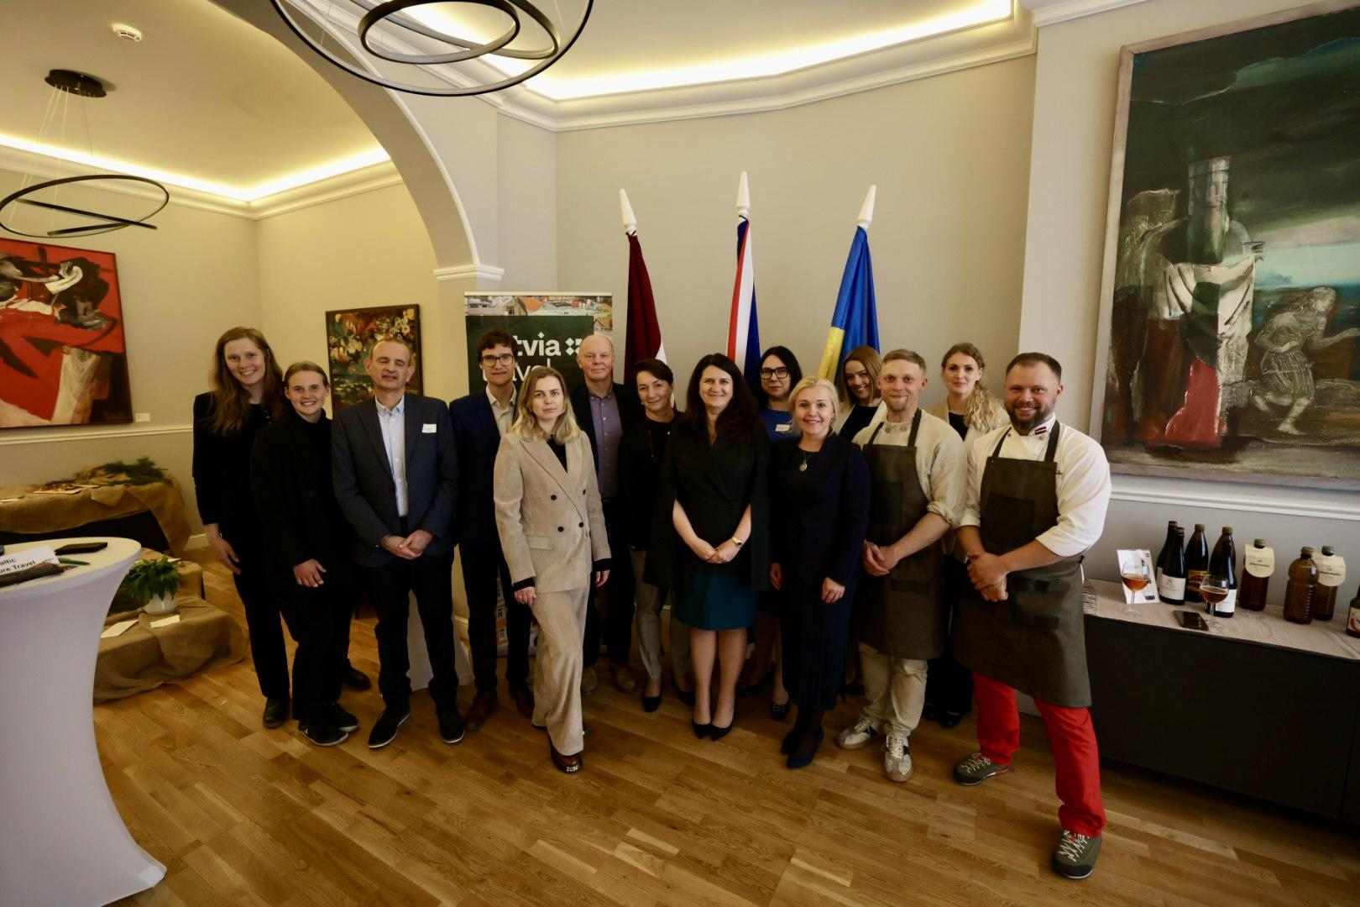

Visit at the Embassy of Republic Latvia to the United Kingdom

Slide 5
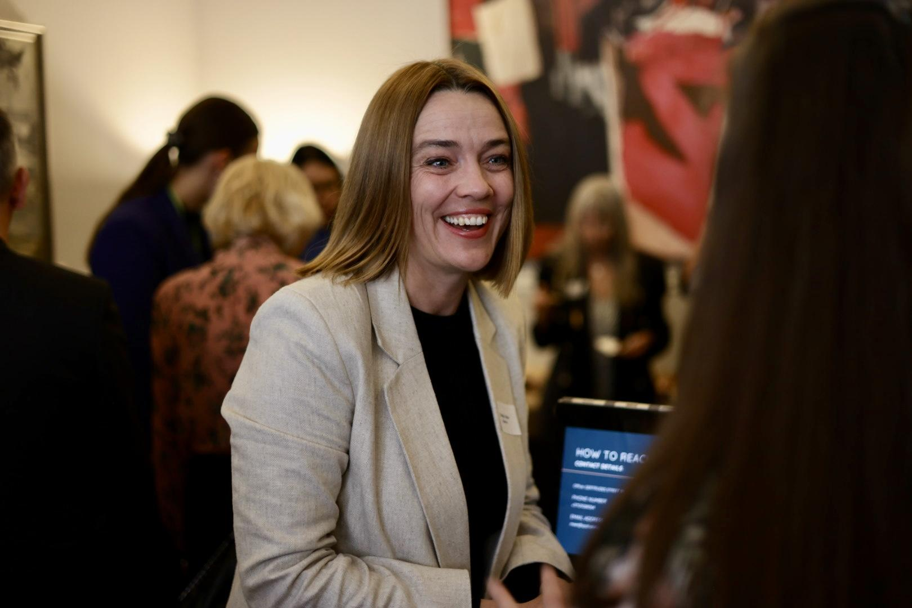
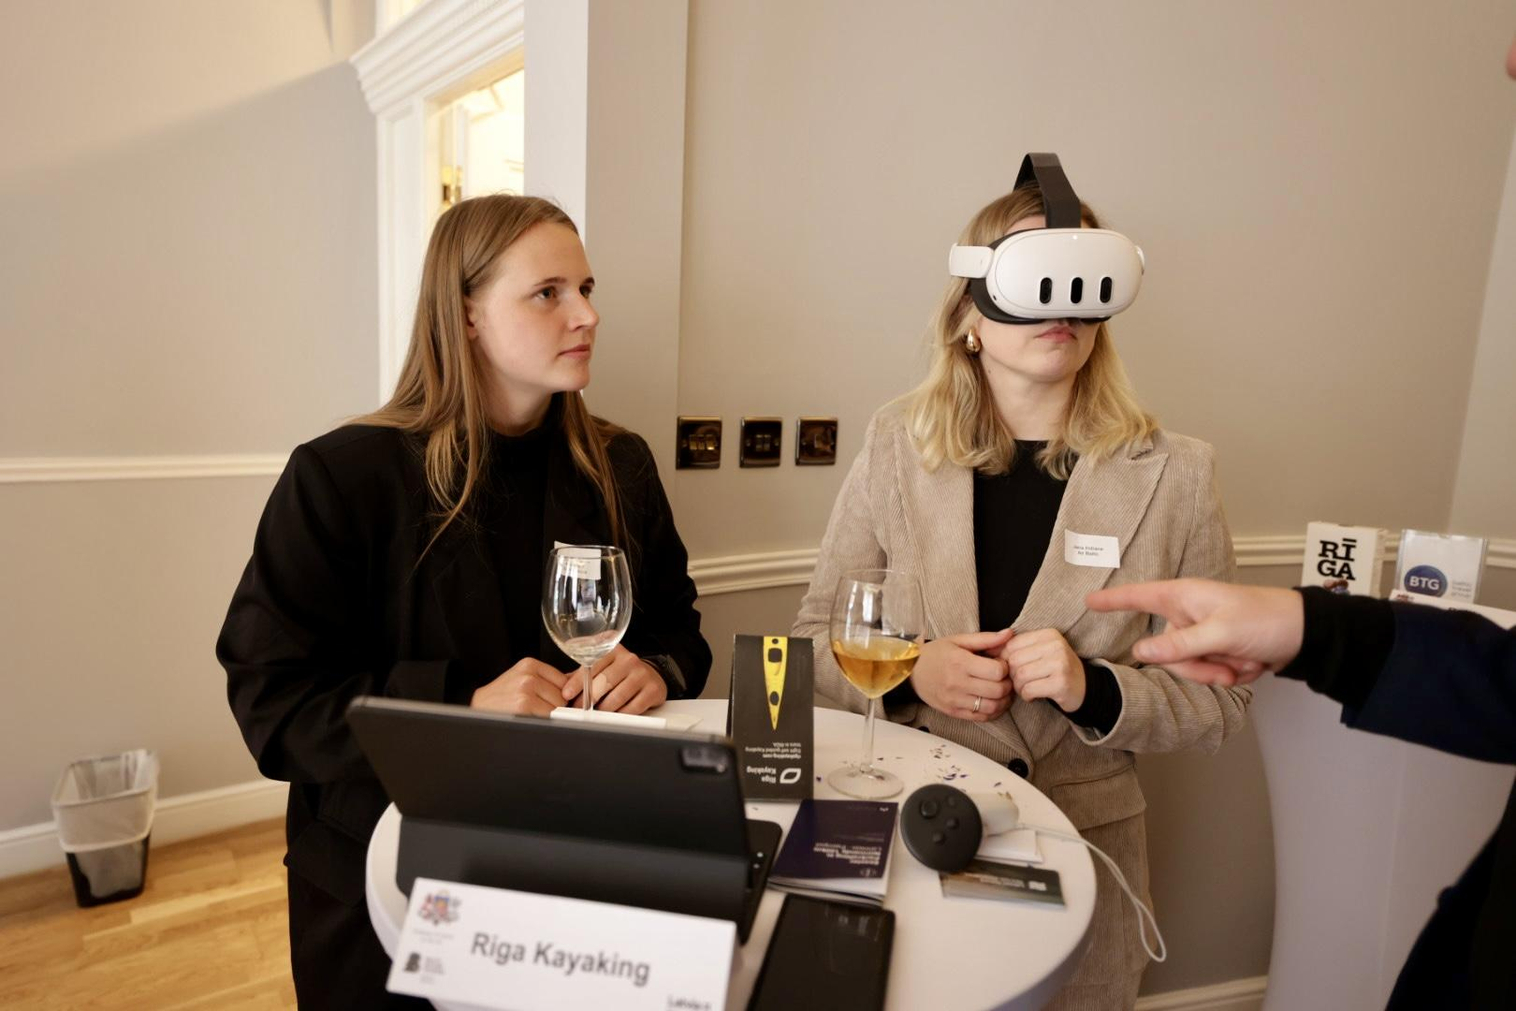
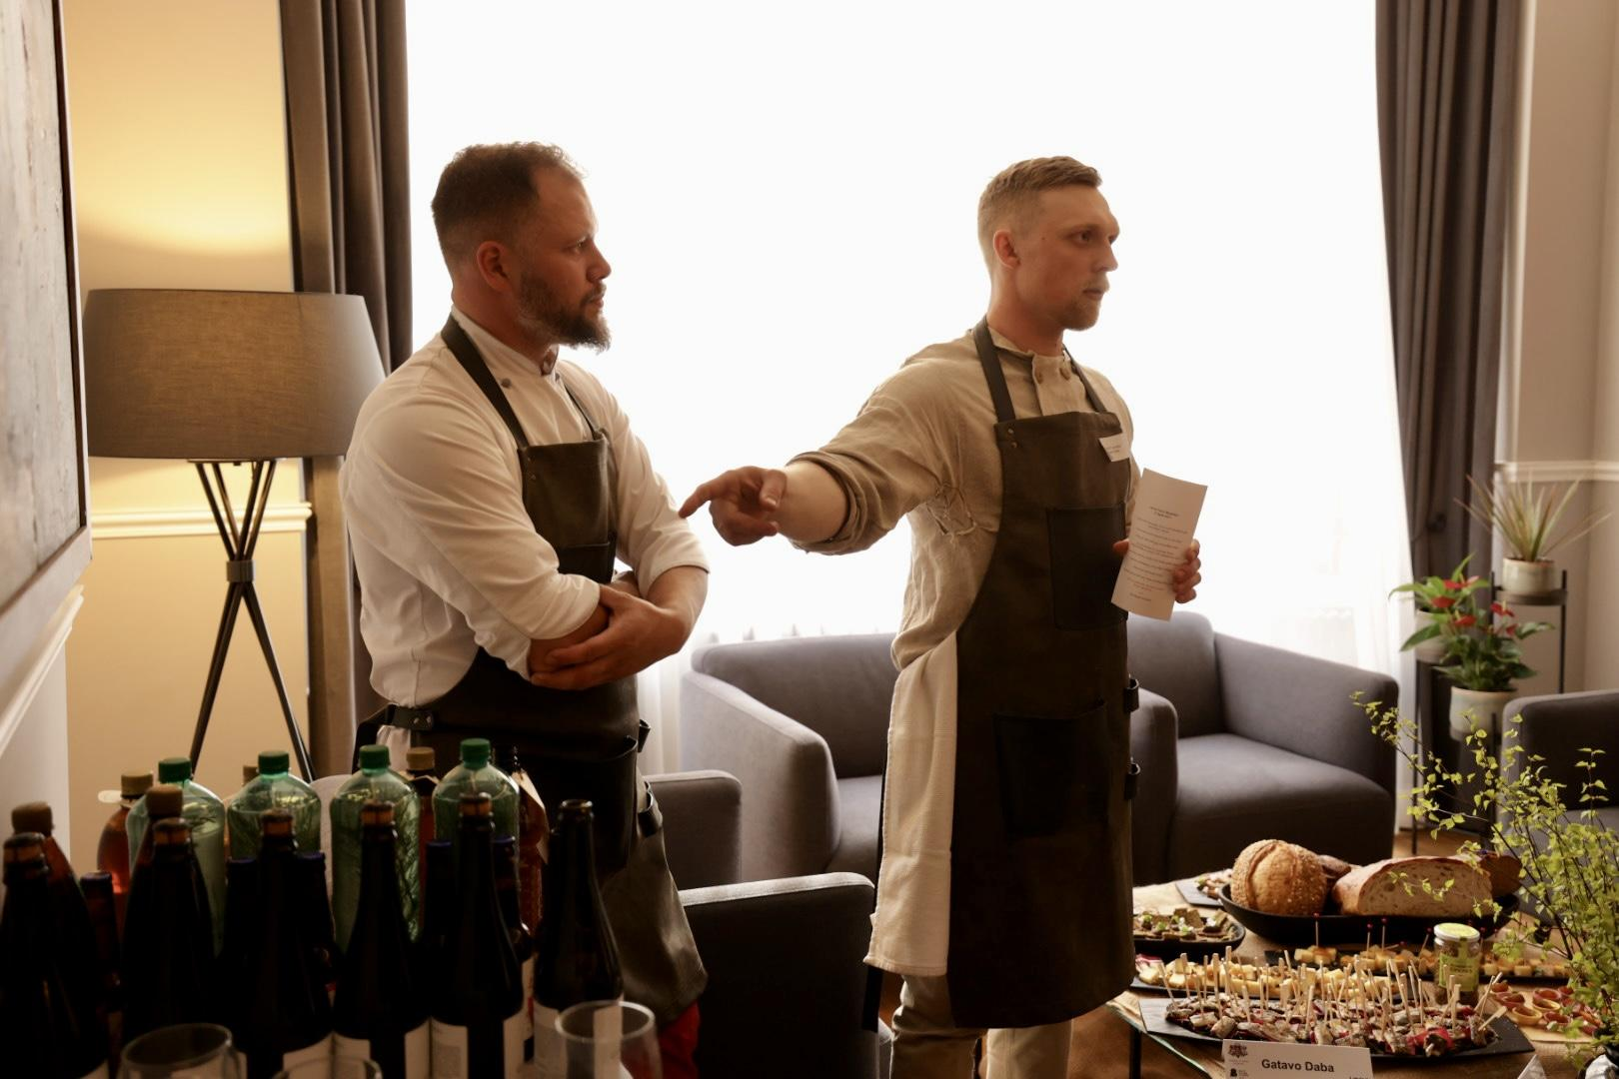
Visit at the Embassy
5 SMEs presented their products and connected with numerous UK travel companies.
Participating SMEs:
Baltic Nature Travel
SPALVA
Movement Spontaneous
Gatavo Dabā
Baltic Travel Group

Slide 6
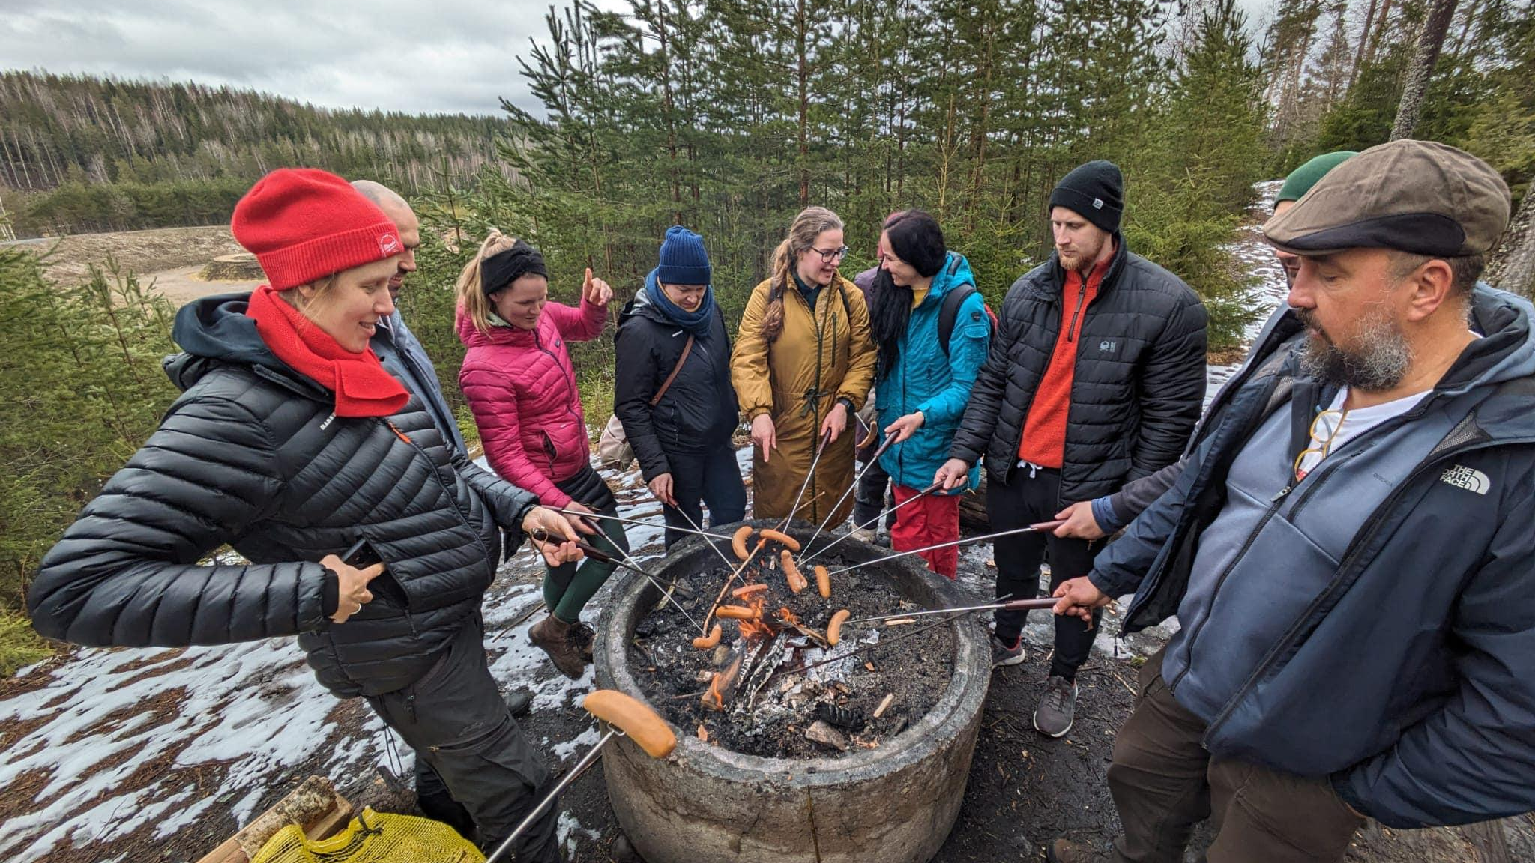

Study trip to Finland
(25 to 28th of April)

Slide 7
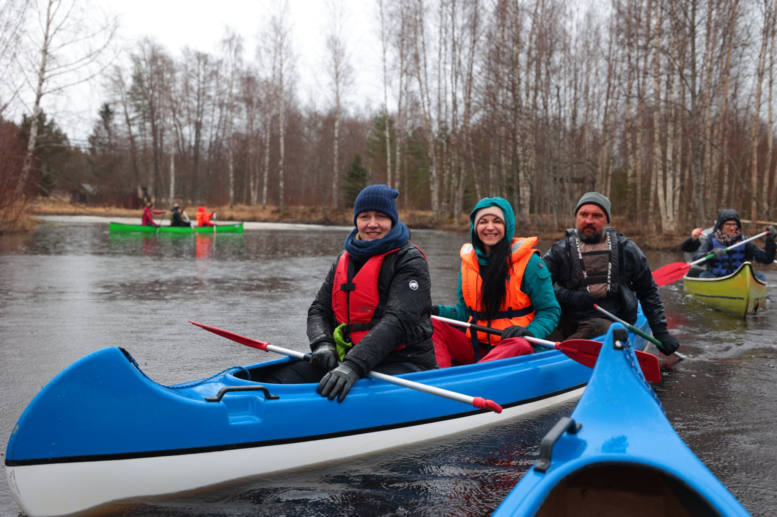
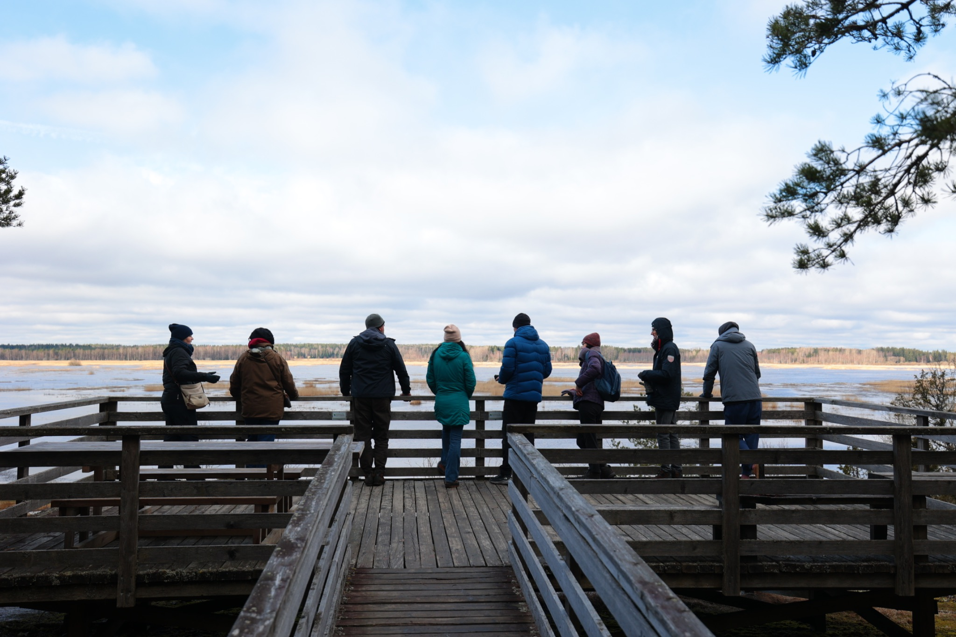
Study trip to Finland
A 4-day trip with Latvian and Estonian SMEs and project partners
Visits to local Finnish SMEs to explore diverse nature tourism activities
Participation:
10 SMEs from Latvia
10 SMEs from Estonia

Slide 8
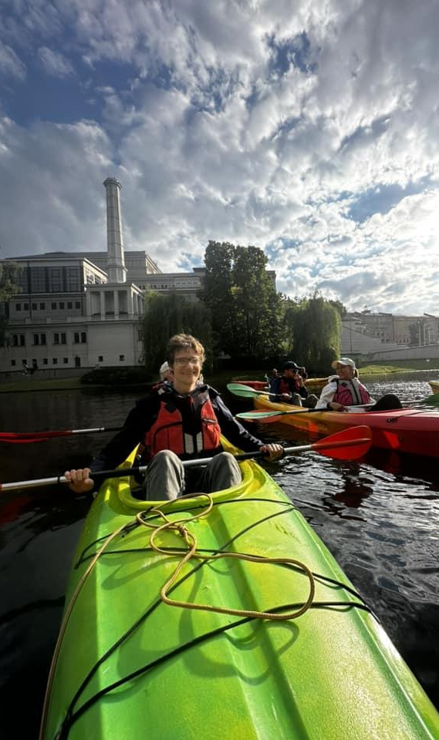
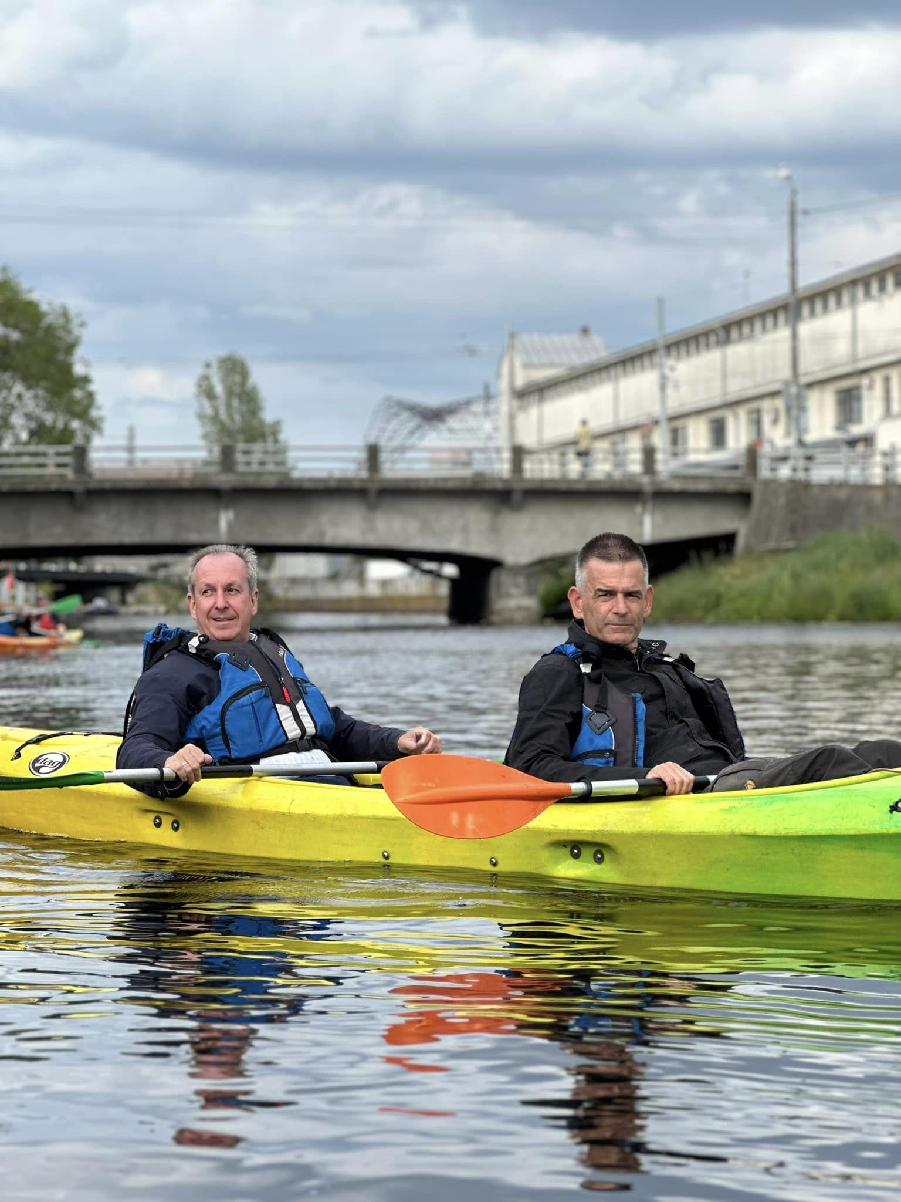
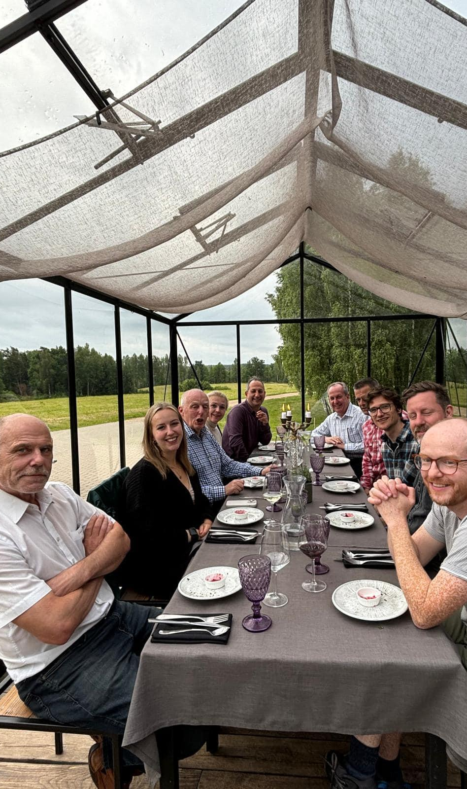
FAM trip (10-13th June)

Slide 9
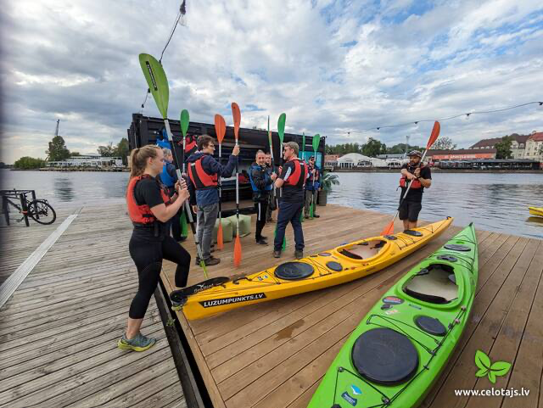
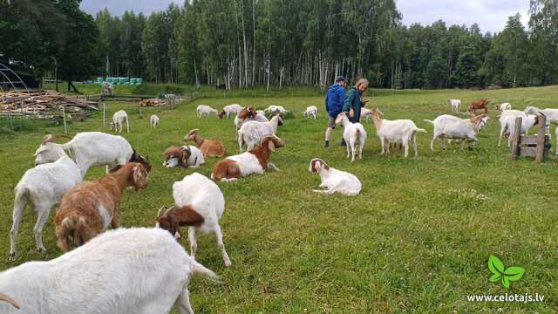
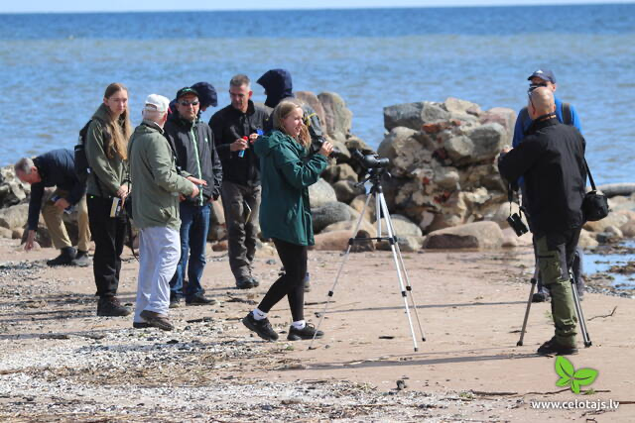
FAM Trip in Latvia
7 tour operators invited
3-day package tour showcasing local attractions
Some of the feedback:
Yes, the trip met my expectations in full. The tour helped my understand why a person should visit Latvia, not just a city break to Riga, but to stay additional days and experience the countryside. The tour showed me how easy it is to travel around the country. It is a pleasant, easy accessible county, which I am happy to promote to my clients.

Slide 10
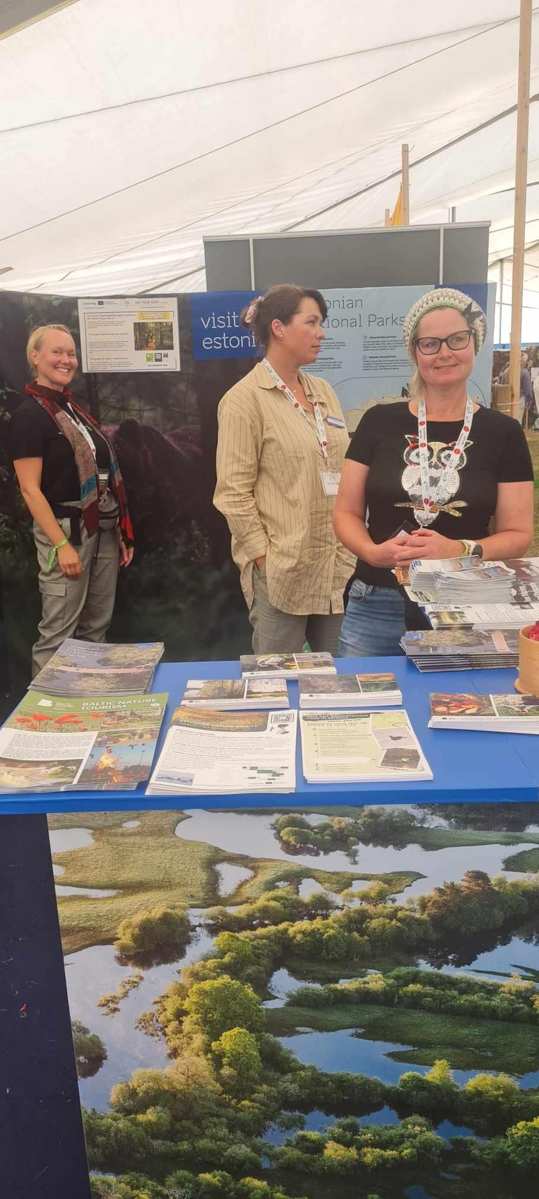
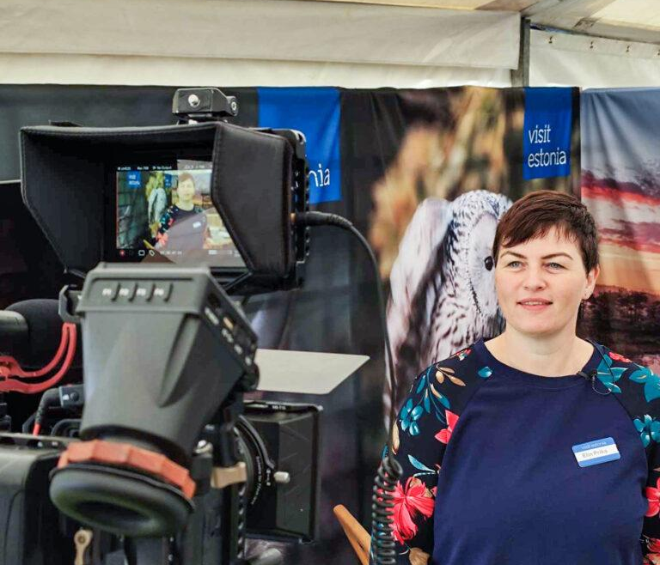
Global Birdfair

Slide 11
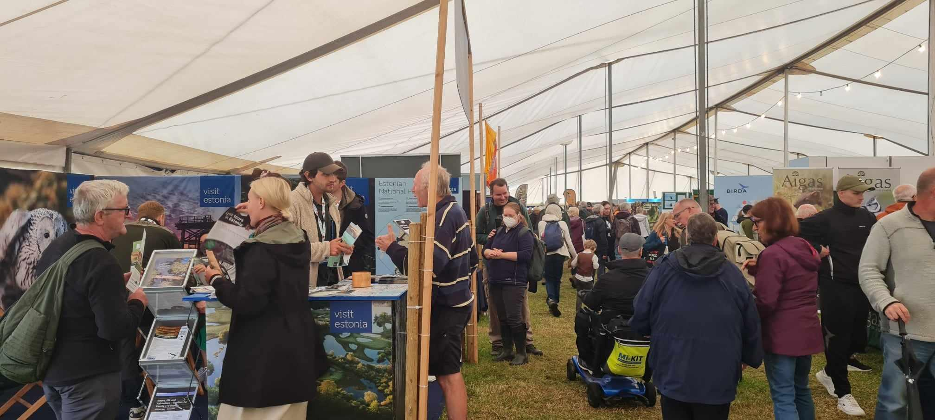
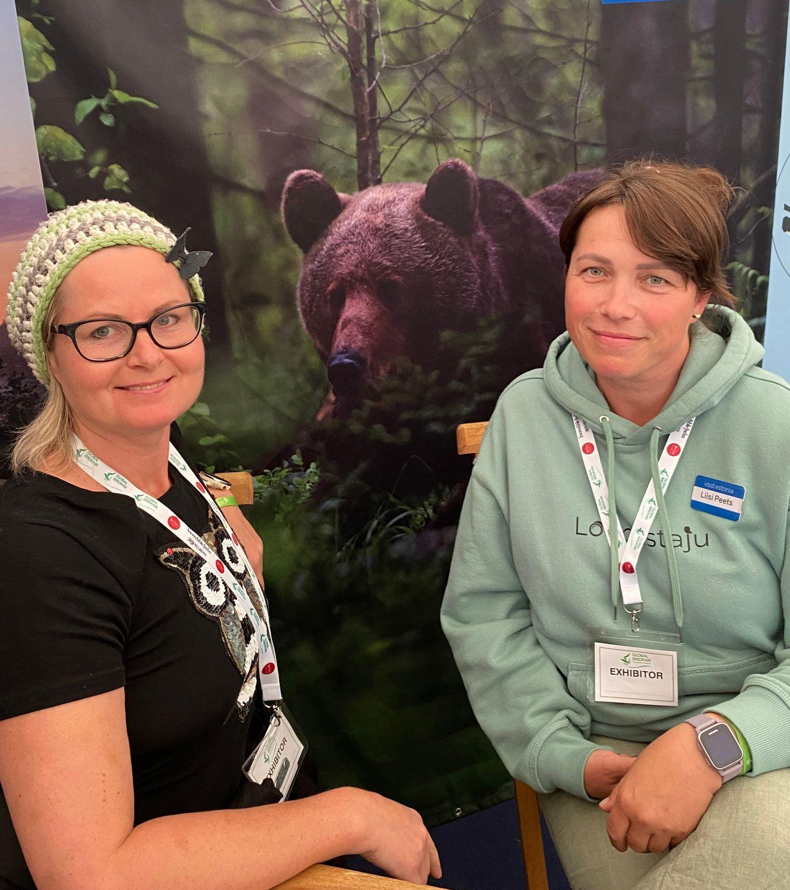
Birdfair “Conserving Nature Worldwide”
~3 days
~15000 visitors
Estonian entrepreneurs/stand for ~15 years
Loodustaju for bird and nature watching trips in South-Estonia
NaTourEst with bird and mammal watching, bear and photography hides, self-guided apps and nature guides
Birding Haapsalu with exceptional bird and mammal watching trips
Wild Nature Estonia with photography hides, wildlife tours, trailer hide rental, animal watching
Metsarestoran with local Estonian nature food
Main questions:
Is it possible to come by train?
all about Steller Eider’s
What is the best time to visit for max possibilities in nature
lynx
many have visited, very satisfied

Slide 12
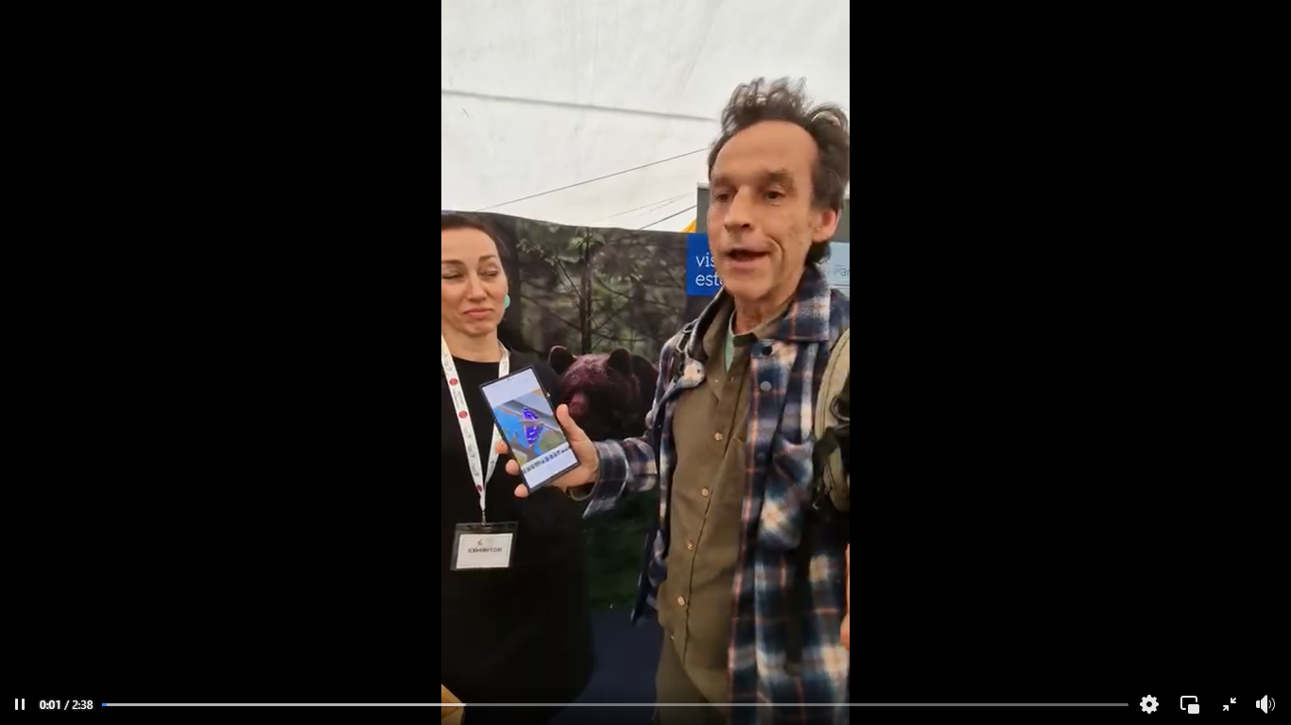

Slide 13
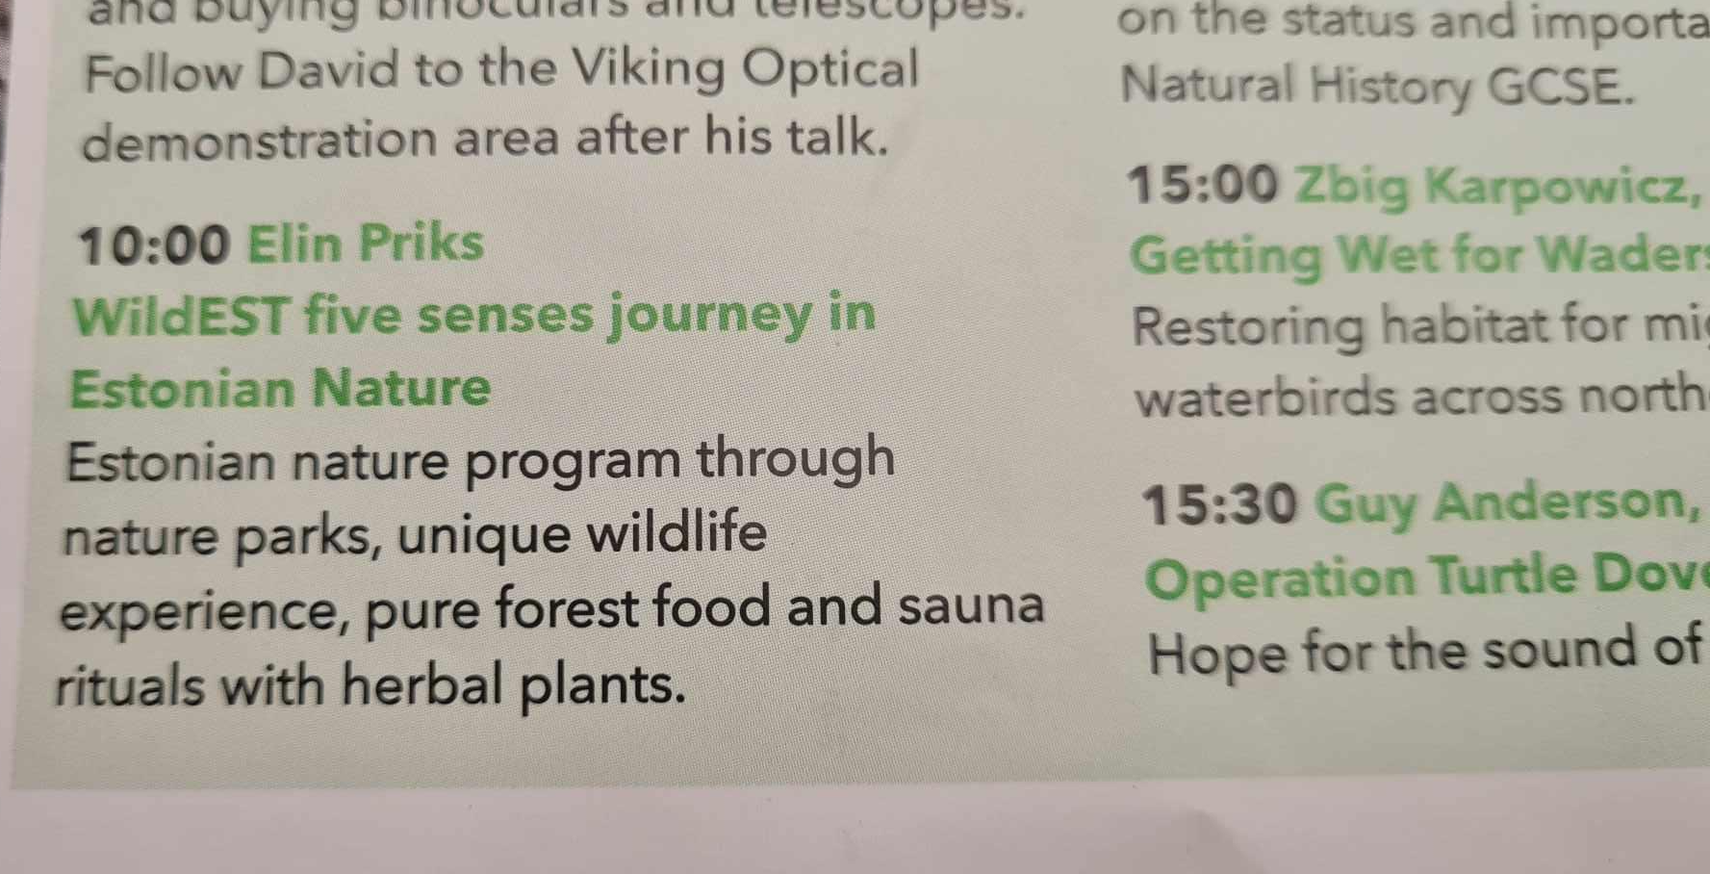
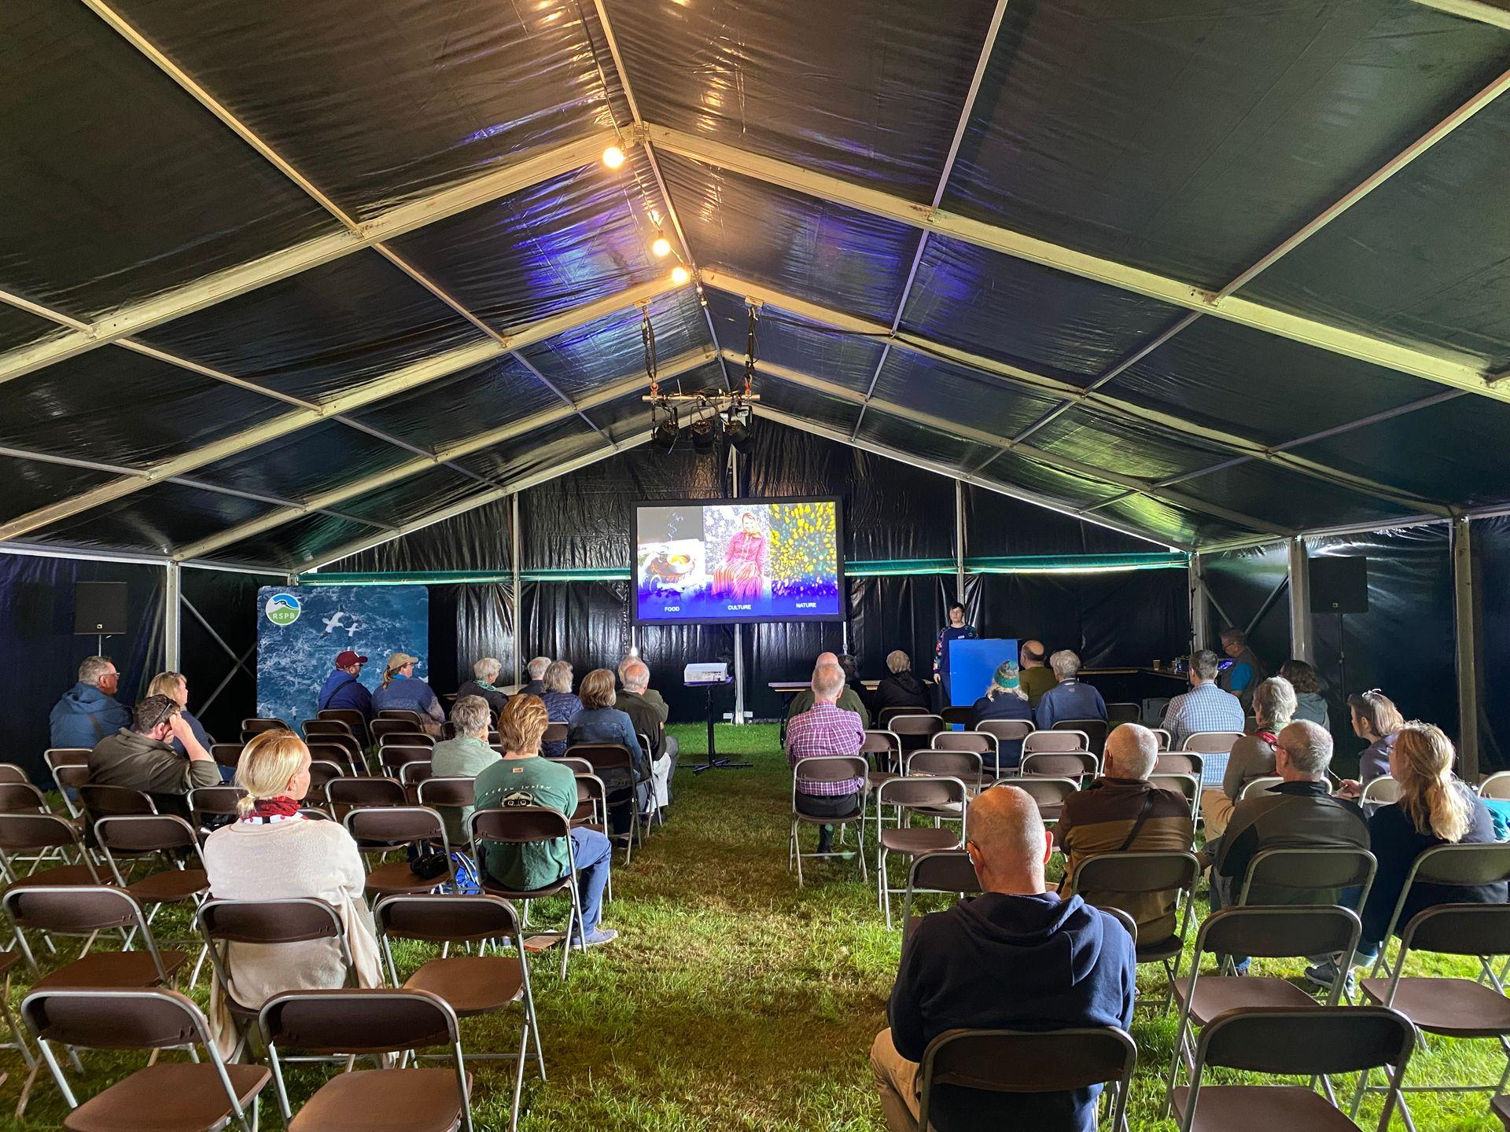
Reception and presentation
12.07 Estonian reception with presentations and introduction of Estonian nature entrepreneurs. Estonian forest food catering.
~15 participants
13.07 presentation in big hall
~60 participants

Slide 14
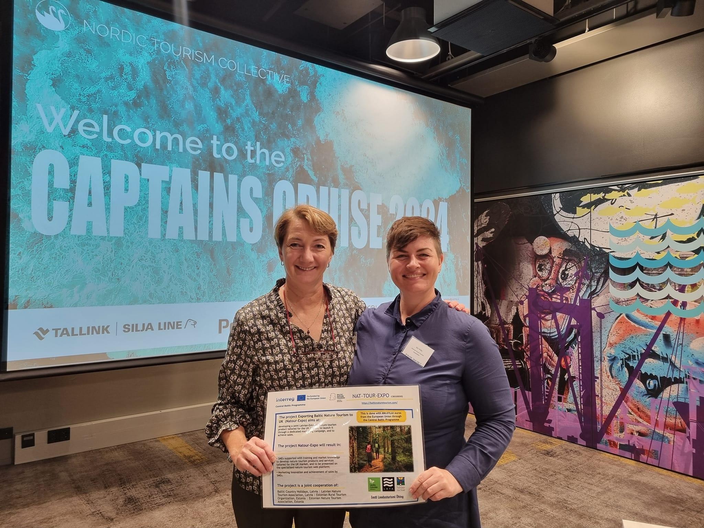
Nordic Captain’s Cruise
(28 to 29th of Aug)
Notes:
What have we done?
Where have we been?

Slide 15
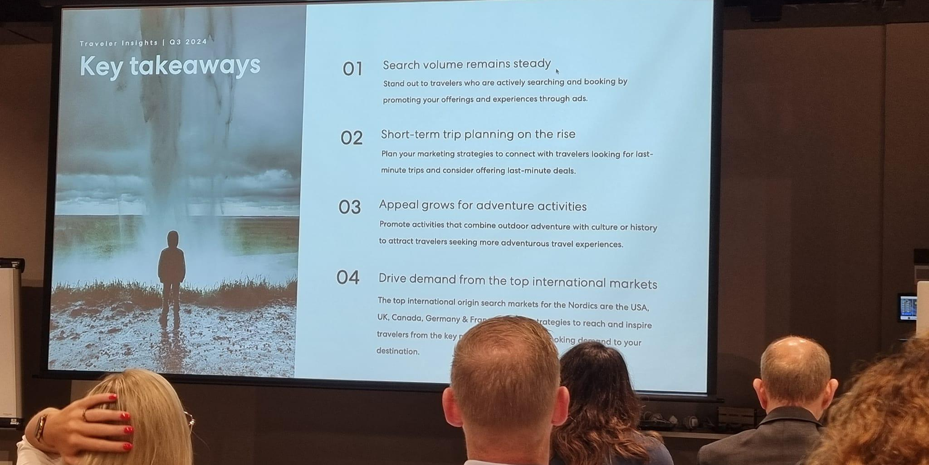
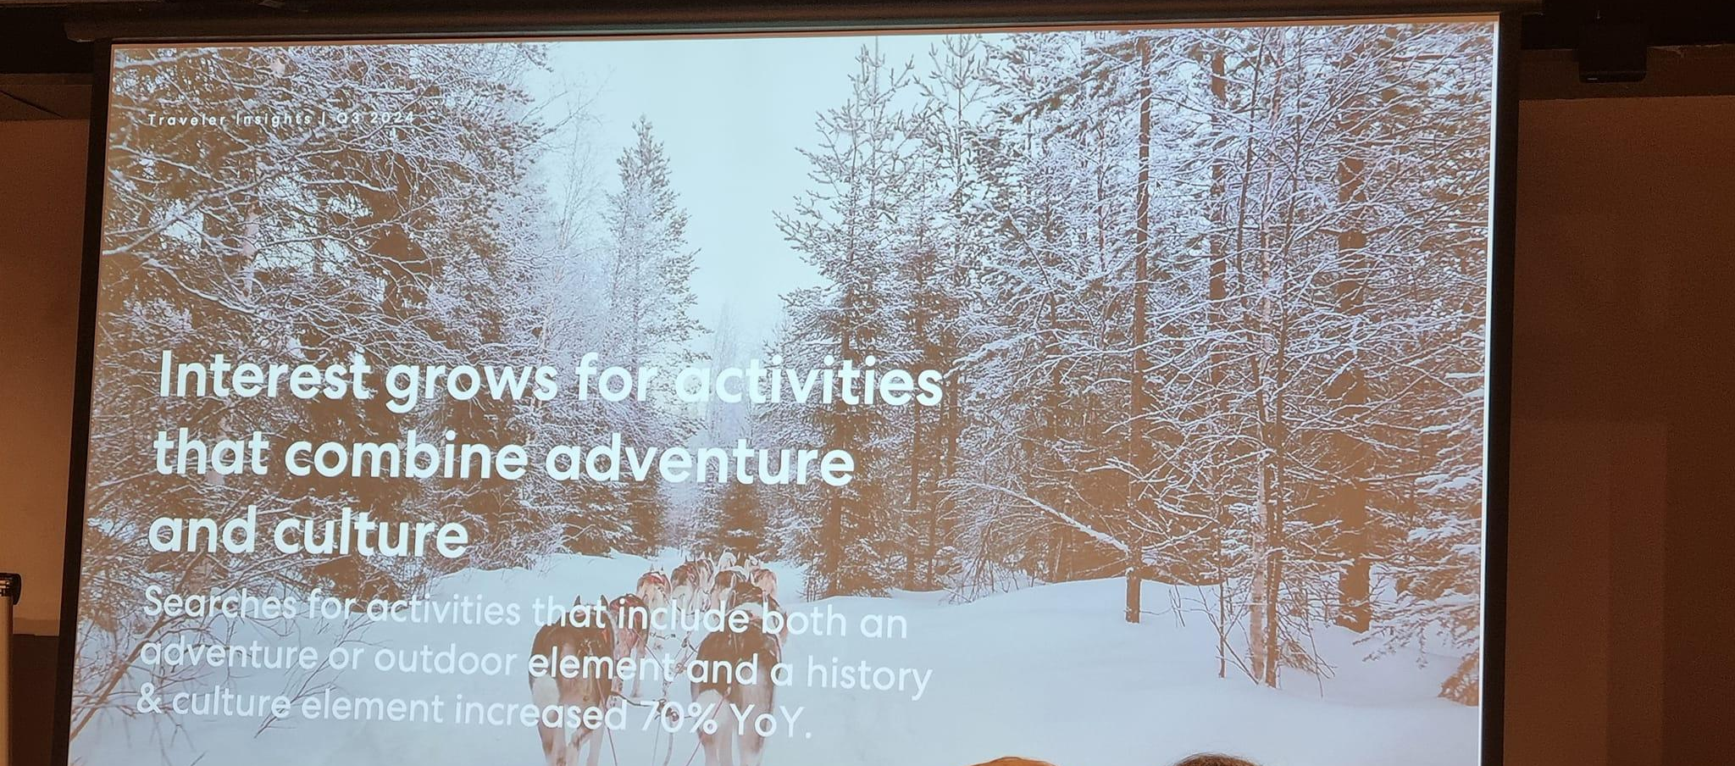
99 participants
B2B meetings
market prognosis and updates
(USA, Asia, UK, Spain, Italy, China, India, Japan)
Search and market trends based on Expedia
Discussions on AI, travel sustainability, long-haul markets
Baltics on rise
Nature and culture interest on rise

Slide 16
Updates on balticnaturetourism.com

Slide 17
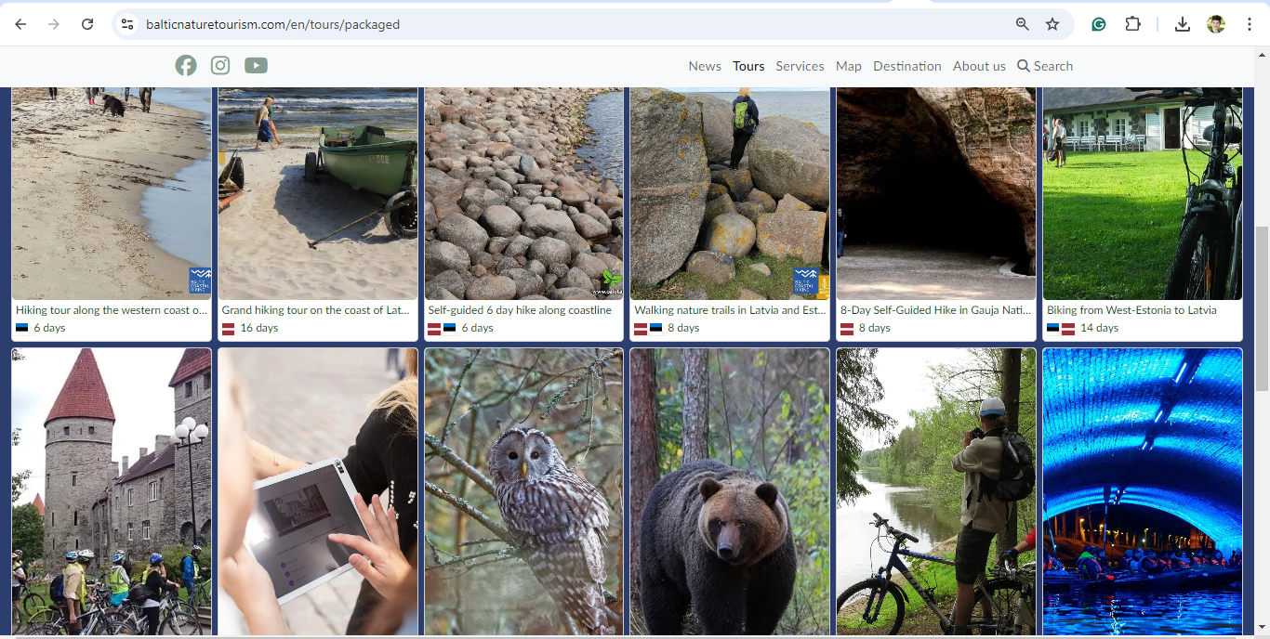
New category
Package tours
Created for Latvian embassy event
Easier for travel trade and professionals
Inspiration for creating packages, combinations

Slide 18
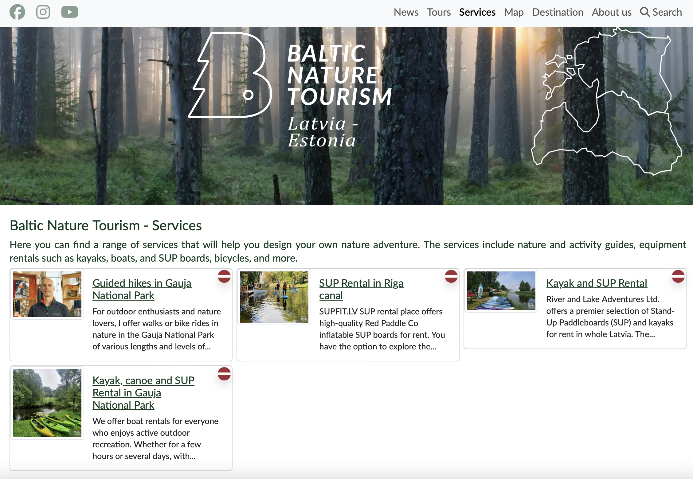
Services
Fixed services section
More SMEs joining after summer due to busy summer season

Slide 19
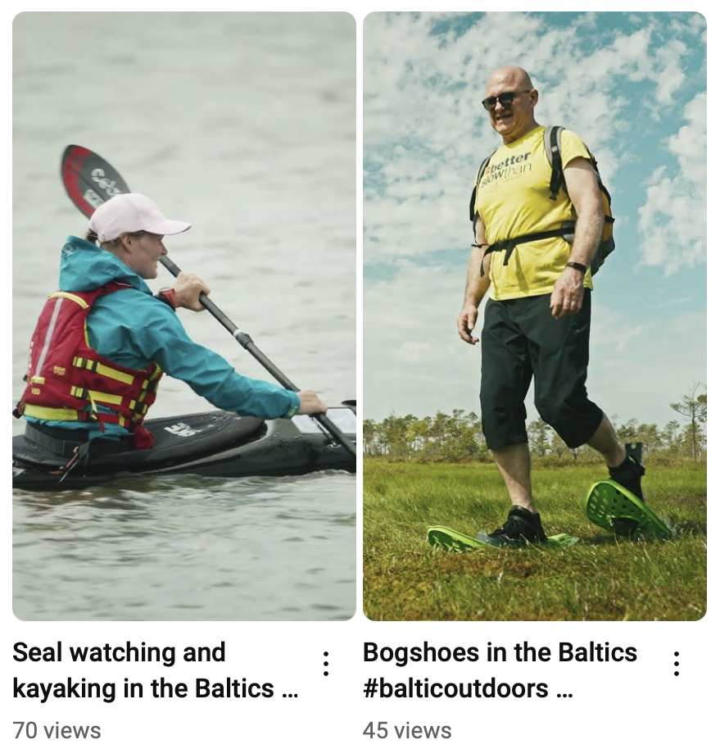
Video filming Summer - done
Seal watching + sea kayaking
Bogshoe hiking
Notes:
What have we done?
Where have we been?

Slide 20
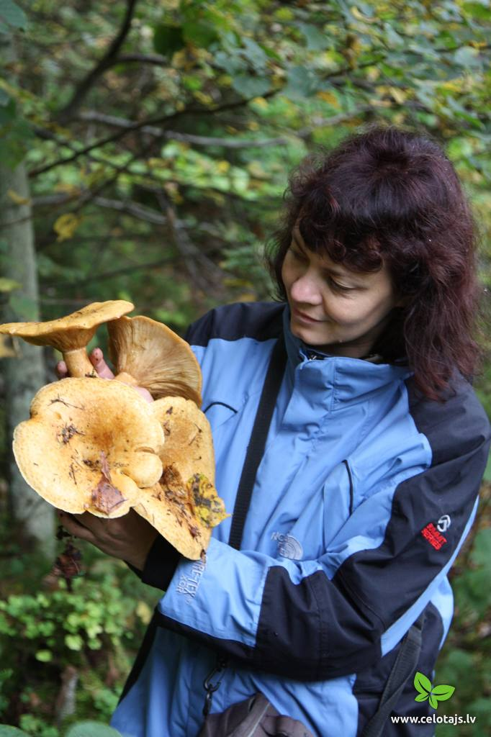
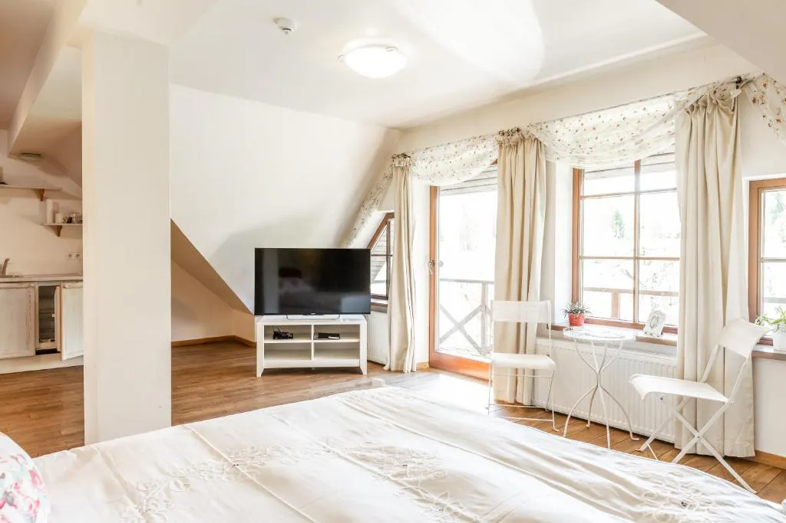
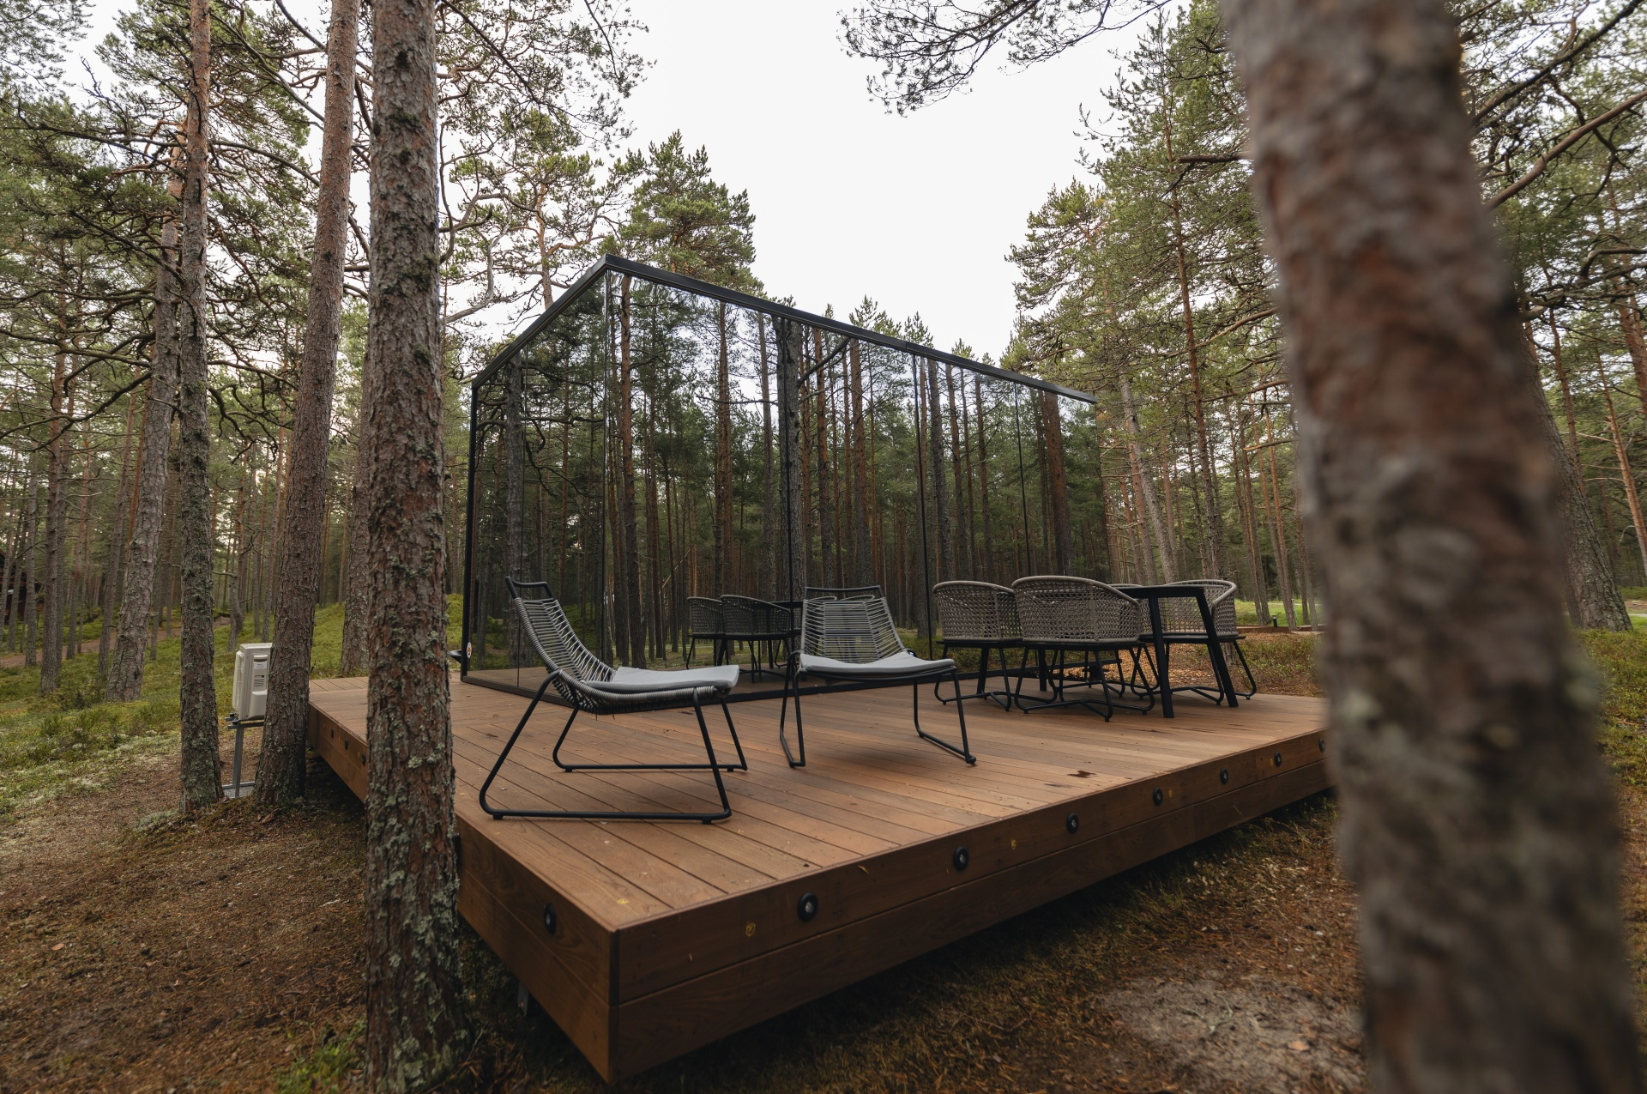
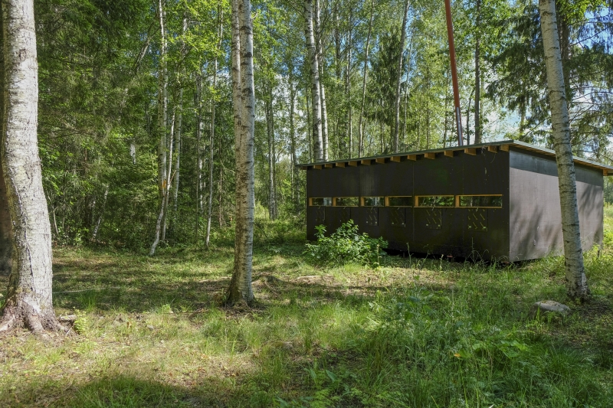
Video filming Autumn
- Accomodation and mushroom picking at Karlamuiza + accomodation at Ööd Hotels (18.07. + 04.09.) Ööd hotels have houses also in England and Latvia
- Bearwatching from a hide (05/06.09.)
Notes:
What have we done?
Where have we been?

Slide 21
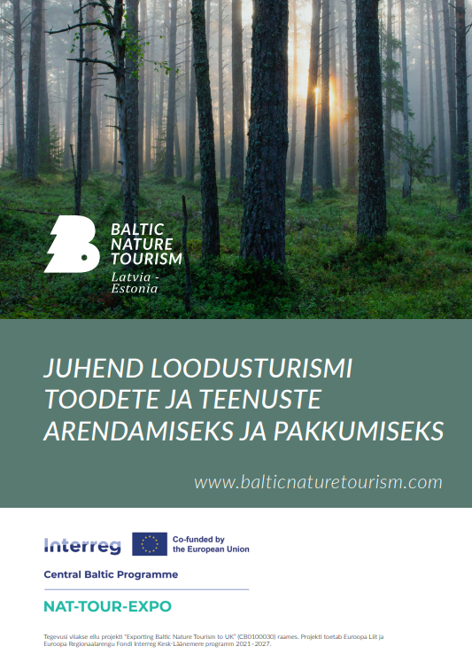
Product and service manual (EST)
free to download

Slide 22
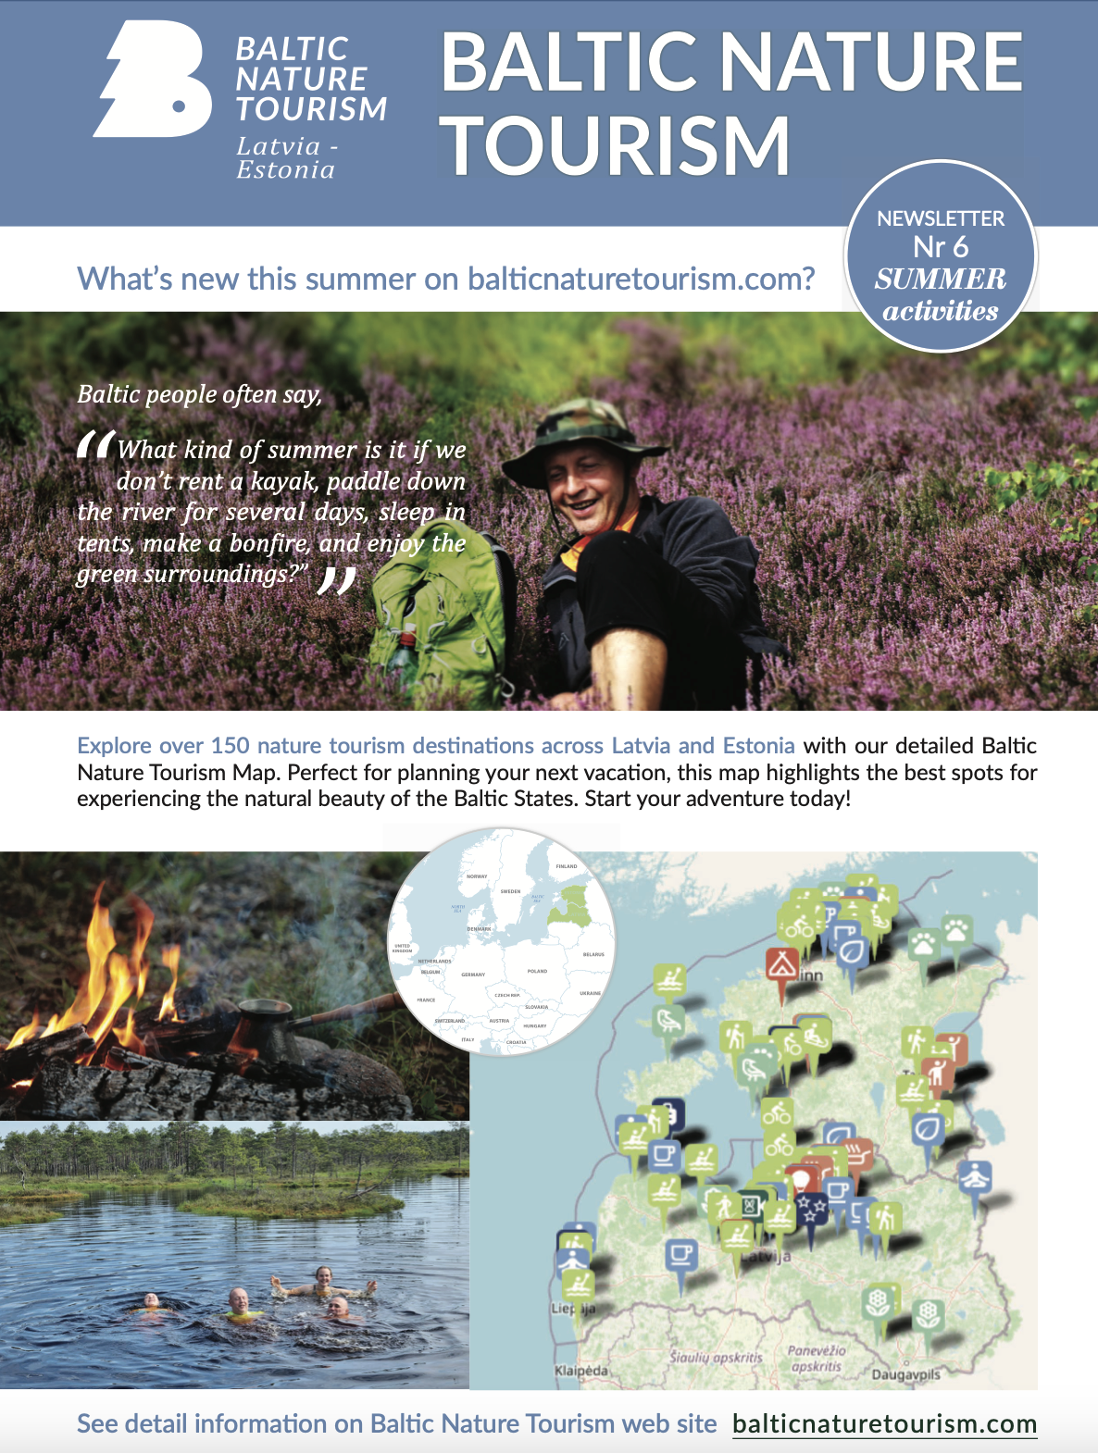
Seasonal newsletters
Autumn 2024 in process
Notes:
What have we done?
Where have we been?

Slide 23
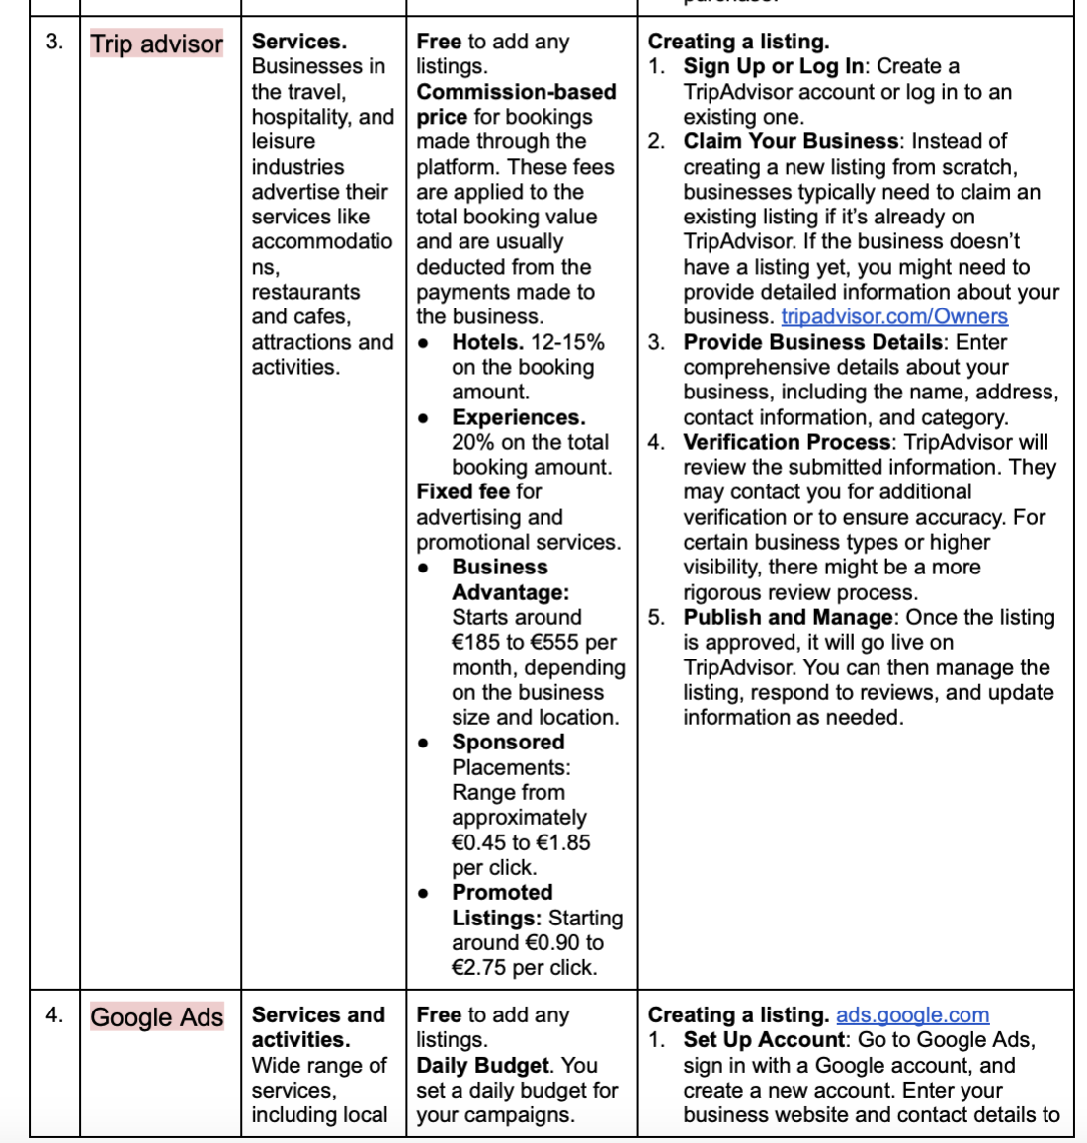
Effective Online Sales Platforms for Advertising
- Airbnb
- Dāvanu serviss
- Trip Advisor
- Google ads
- Facebook ads
- Instagram ads
- Kingitus.ee
- Google my business
- Latvia travel
- Visit Estonia

Slide 24
New SMEs & Products

Slide 25
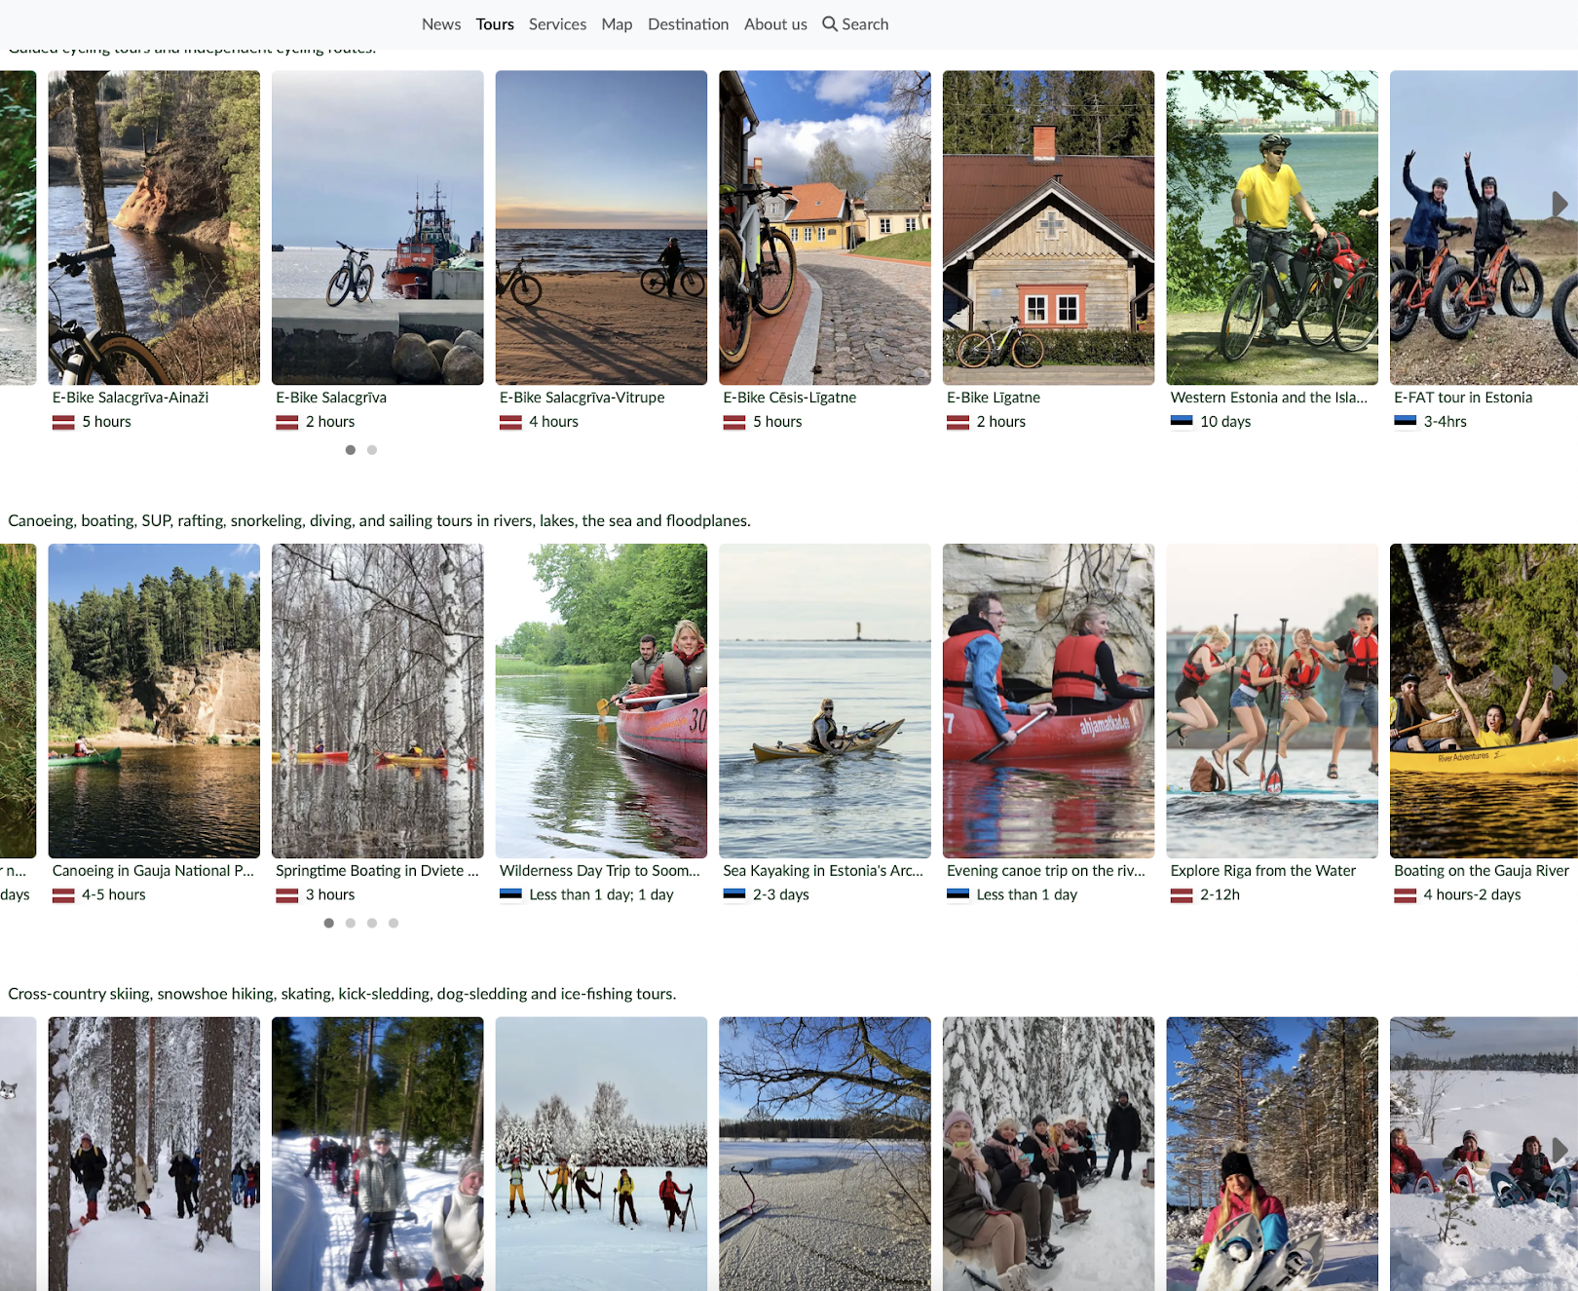
Statistics
- 53 SMEs from Latvia (+7)
29 SMEs from Estonia
194 products in total online, 91 in Estonia (+7), 103 in Latvian (+19)
*only products and SMEs that are published online

Slide 26
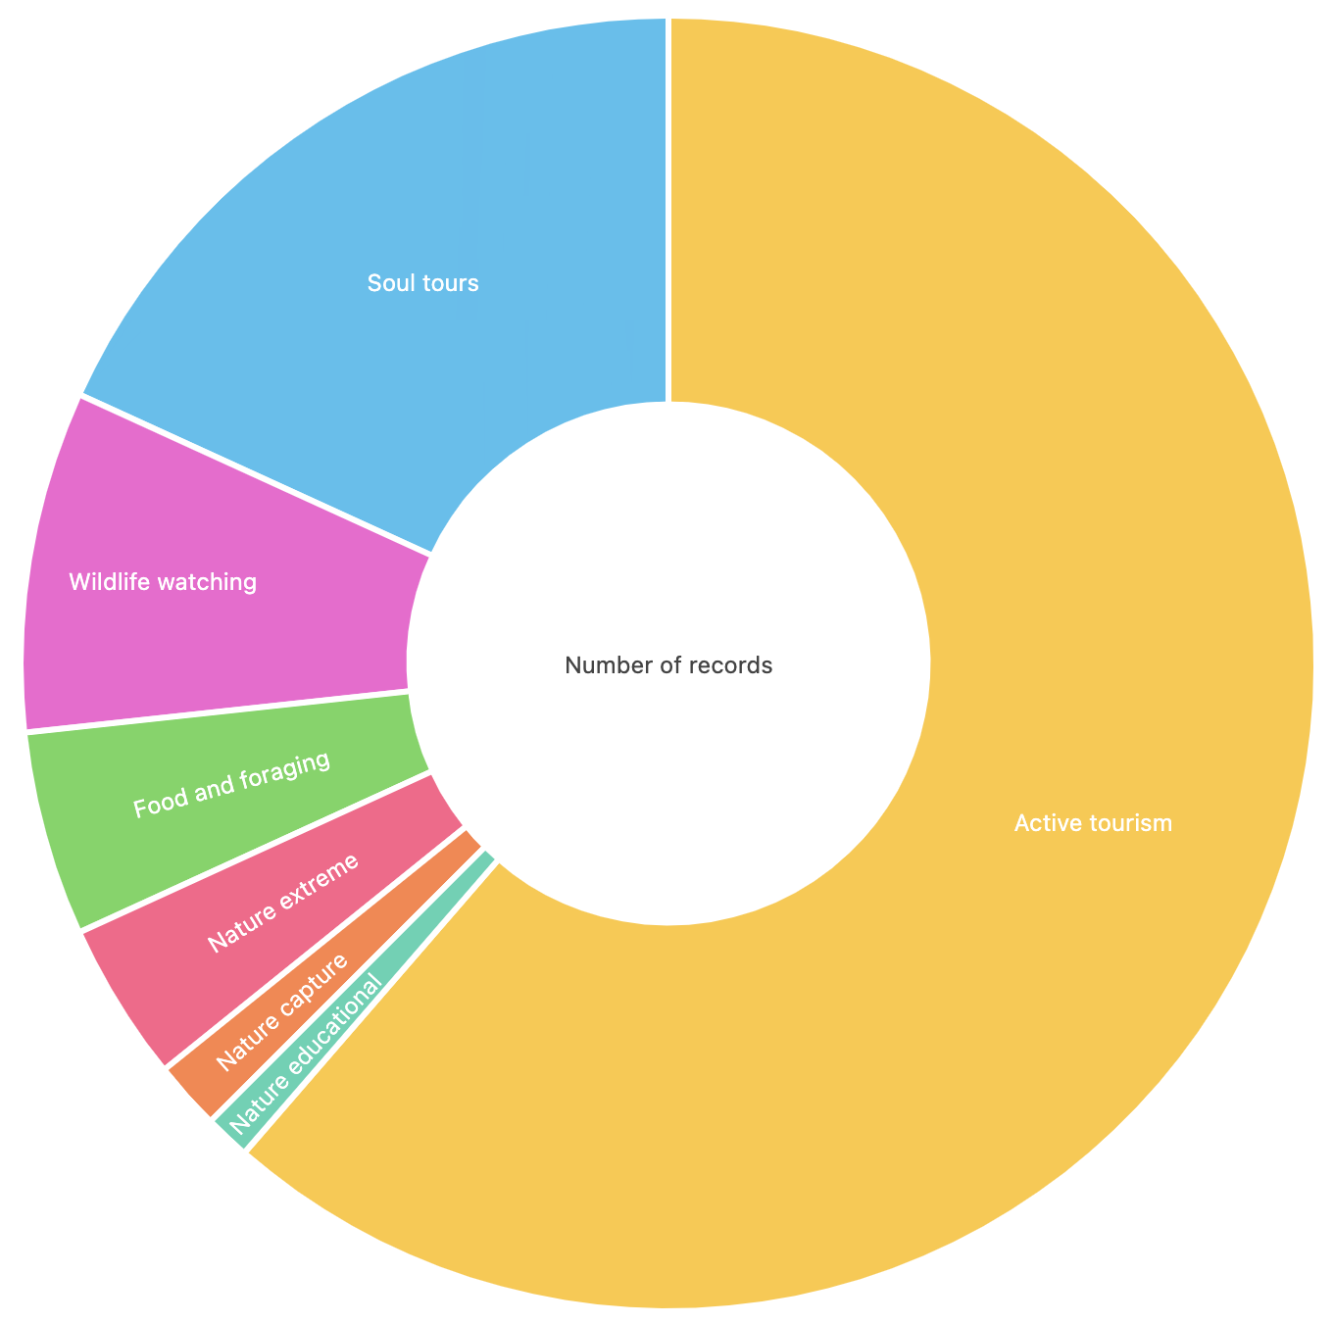
Products per category
Soul tours
41 (+9)
Wildlife watching
18 (+3)
Food and foraging
10 (+2_
Active toursim
116 (+8)
Nature extreme
8 (+1)
Nature capture
4 (+1)
Nature educational
2

Slide 27
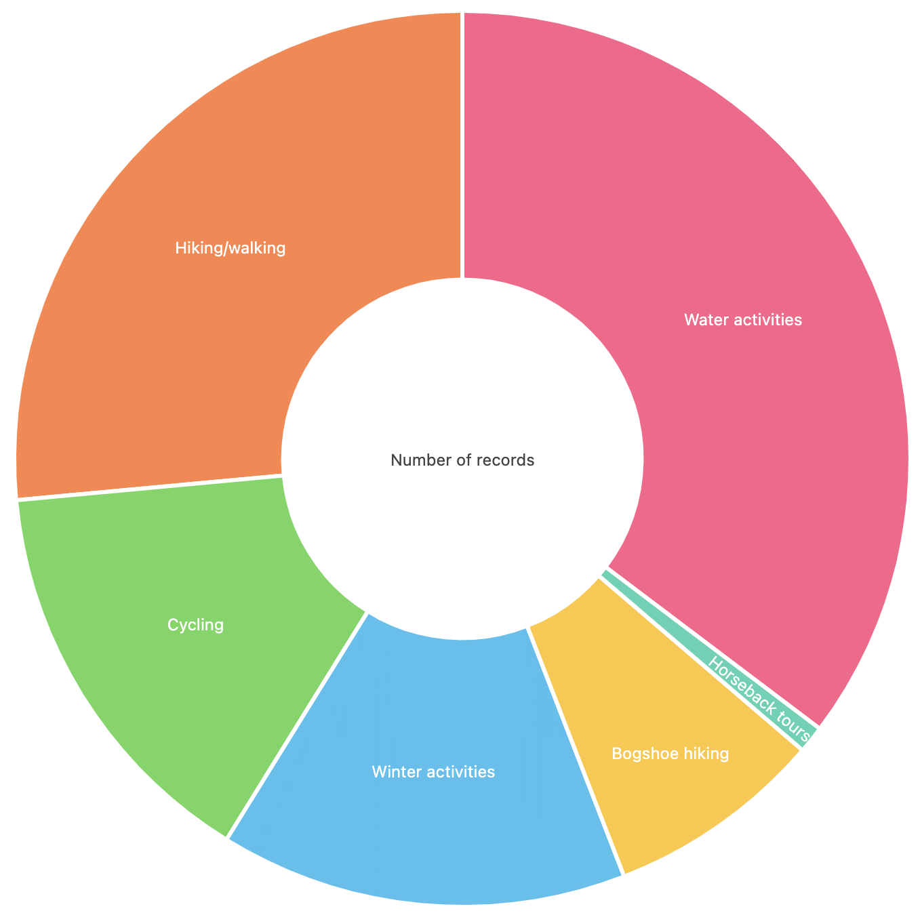
Active tourism
Hiking/
walking
30 (+3)
Suggestion
Water has the most offers compared to other categories.
A dedicated "Water" category will improve customer navigation and make it easier for customers to find these products.
Water activities
39 (+3)
Cycling
17 (+2)
Horseback tours
1
Winter activities
15
Bogshoe
9 (+1)
Notes:
Suggestion to take out the water activites, because for people it is hard to find.
Nature capture has only 2 and it’s a separate group, and join with another larger group.

Slide 28
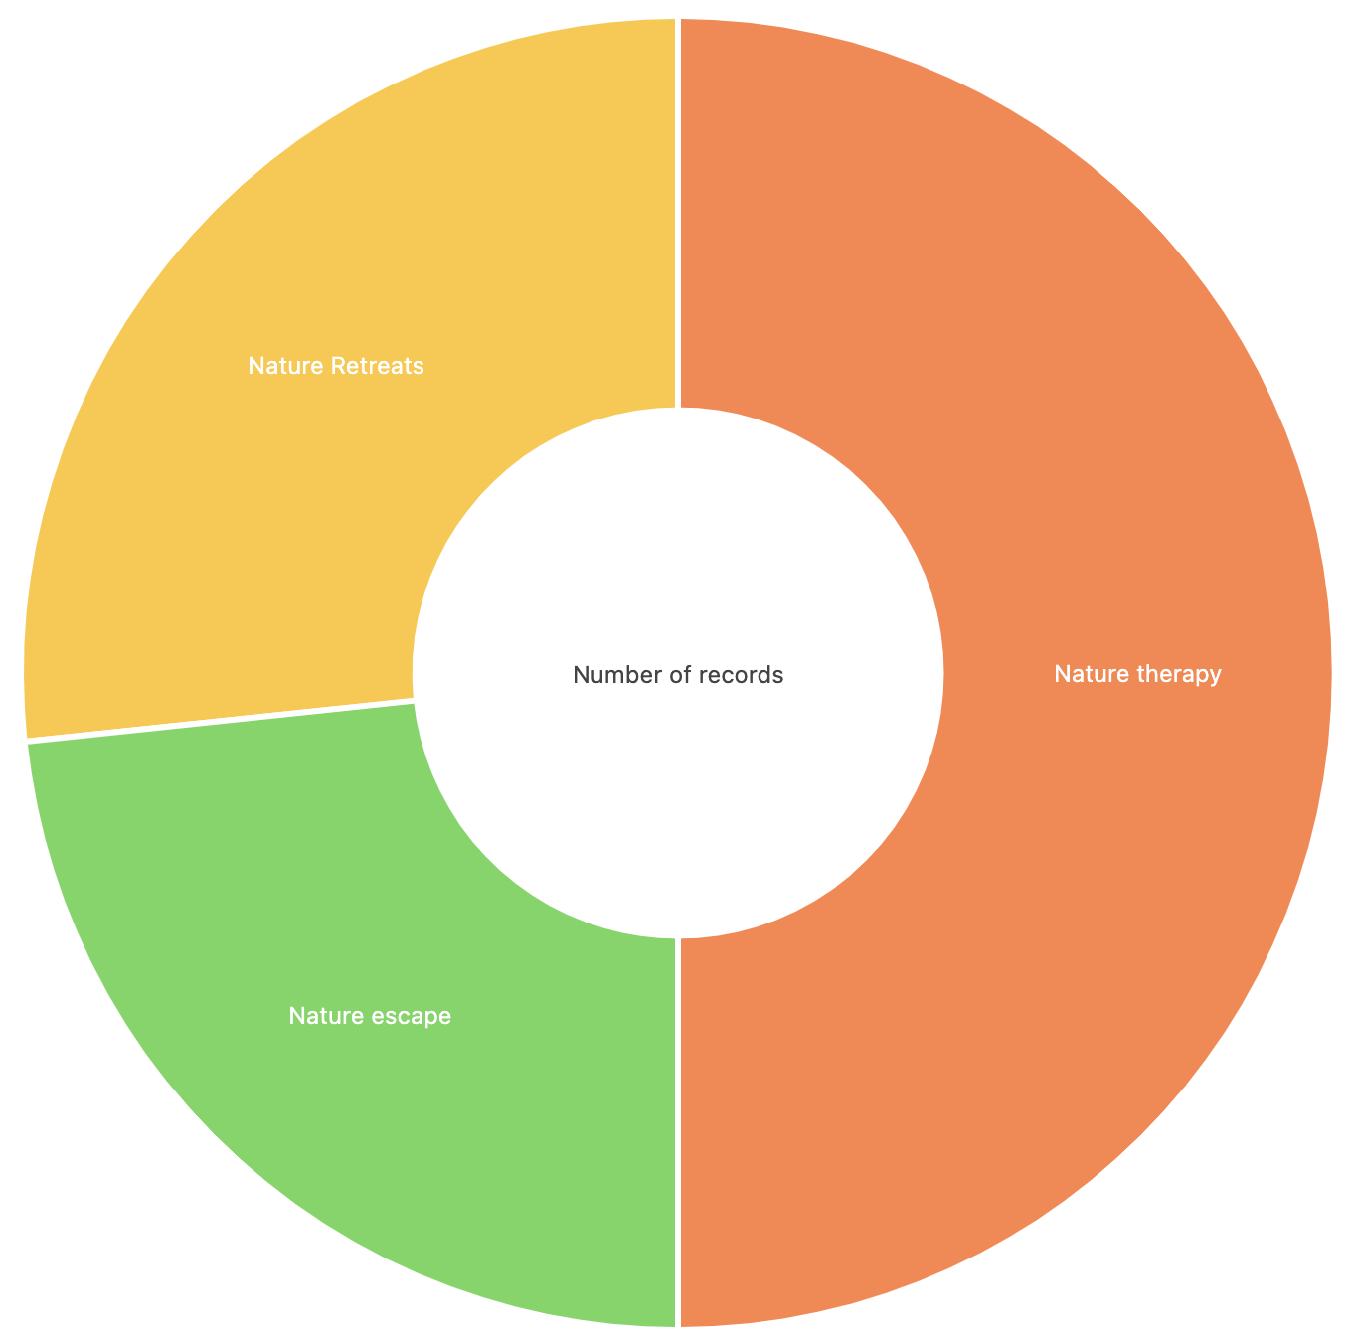
Soul tours
Nature retreats
11 (+3)
Nature therapy
18 (+3)
Nature escape
11 (+4)

Slide 29
What do we know from the email requests?

Slide 30
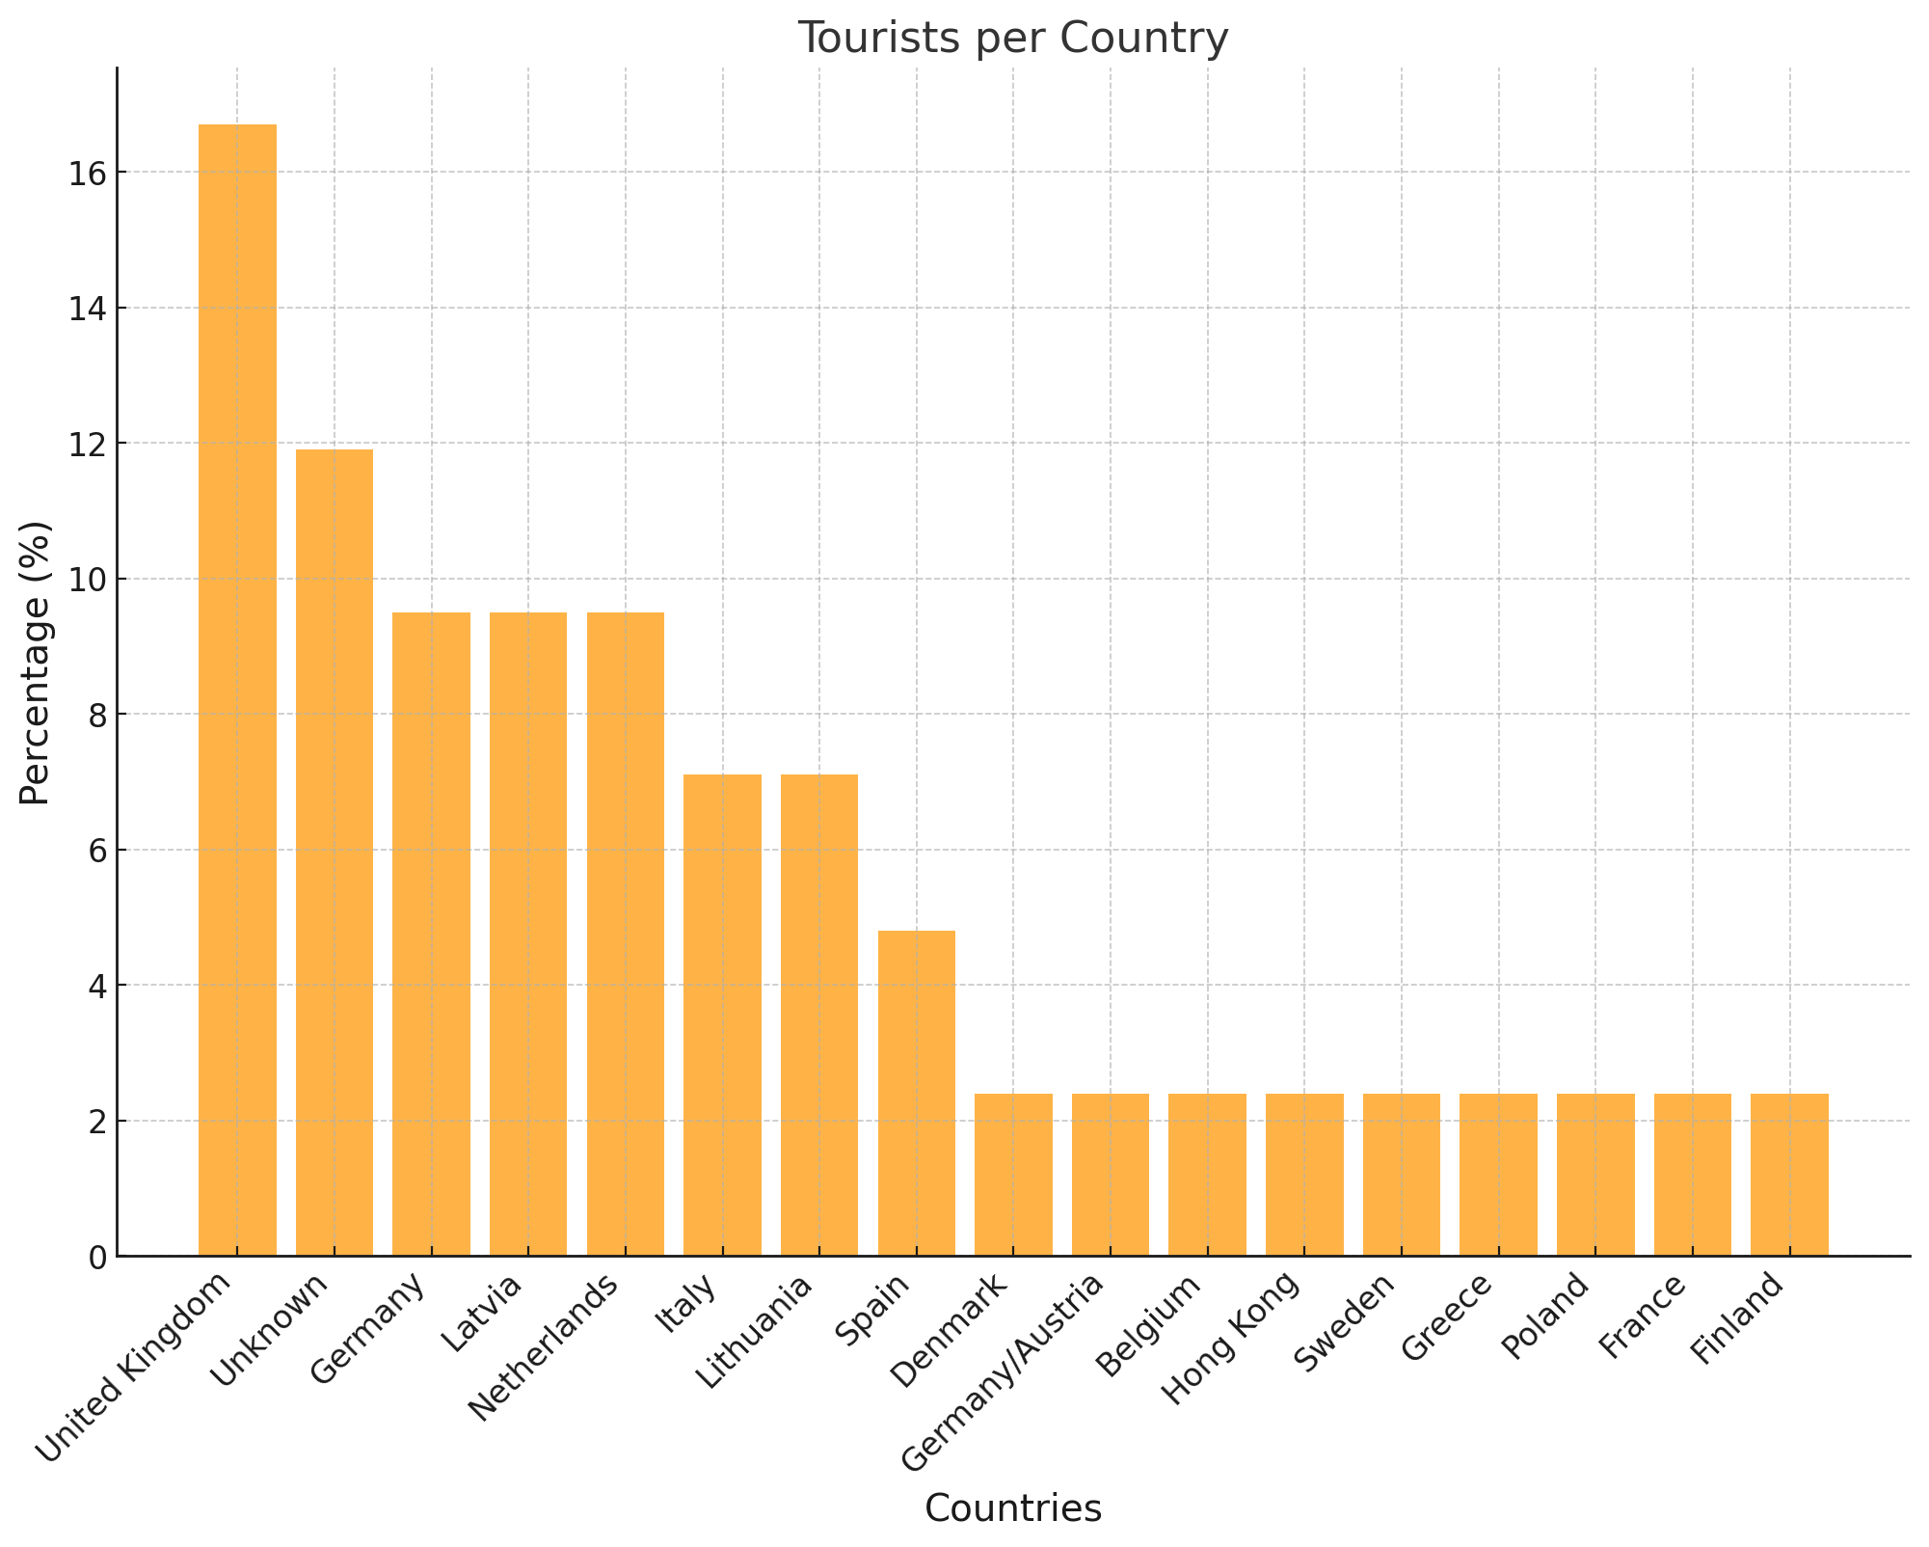

Slide 31
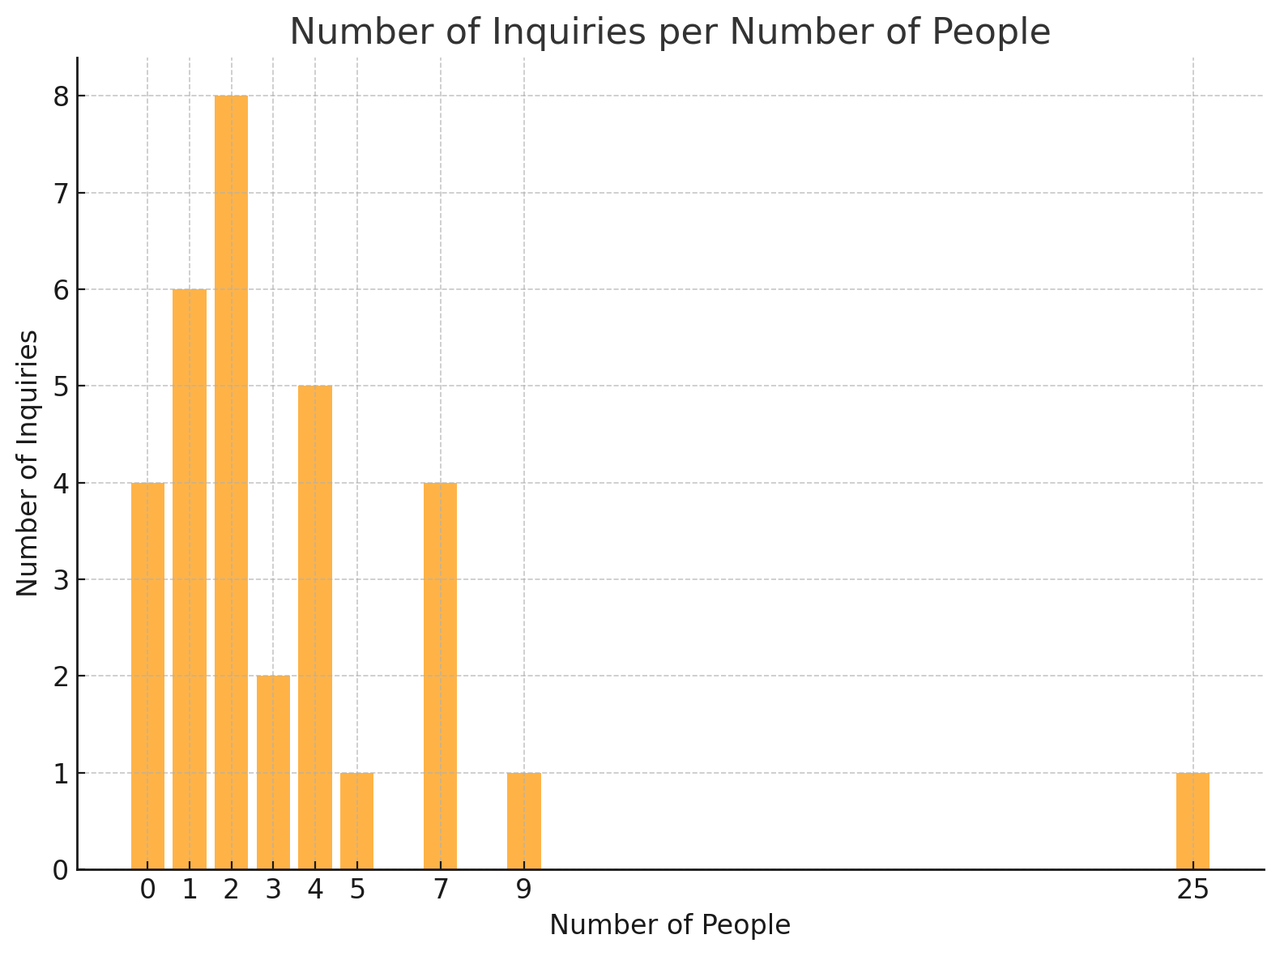
Not mentioned

Slide 32
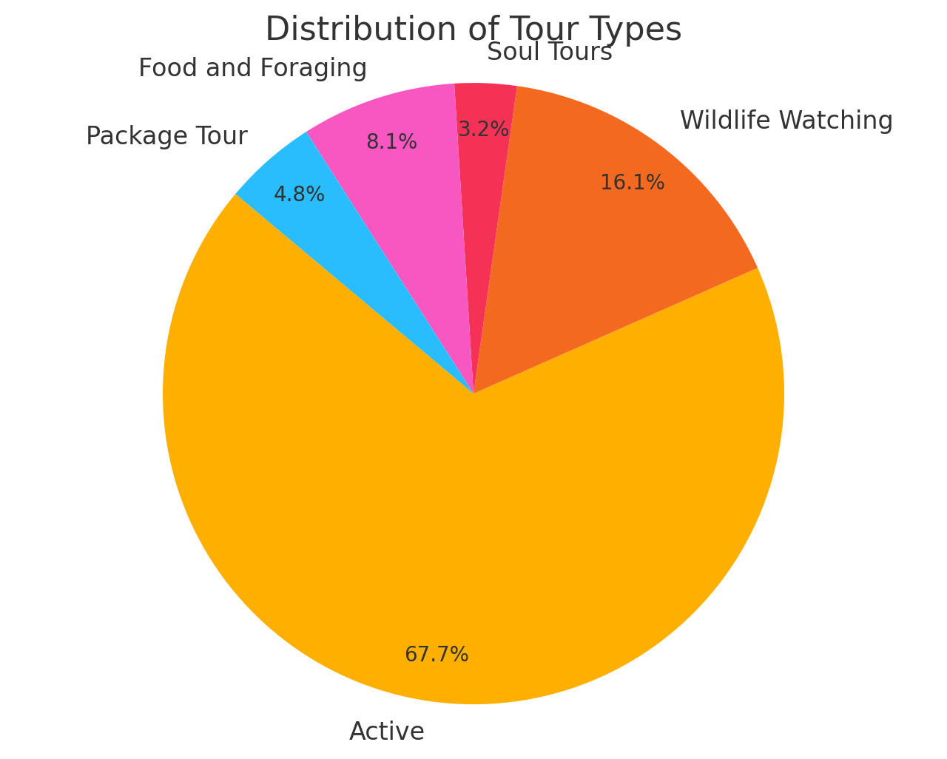

Slide 33
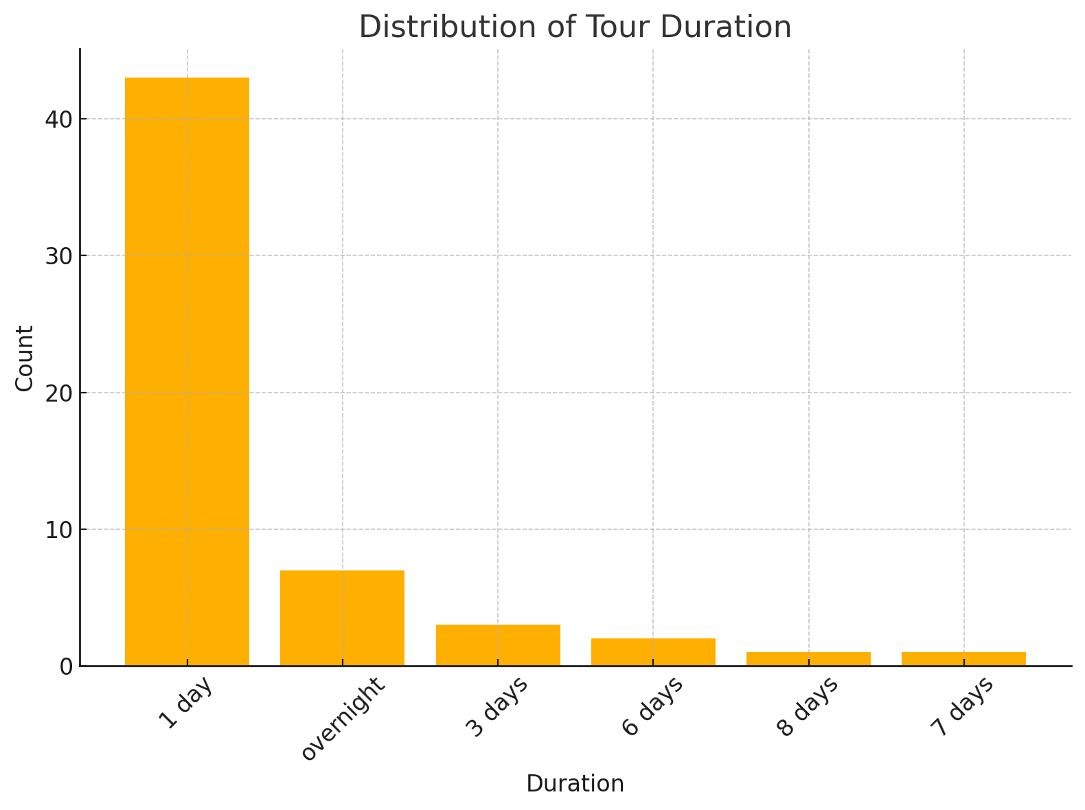

Slide 34
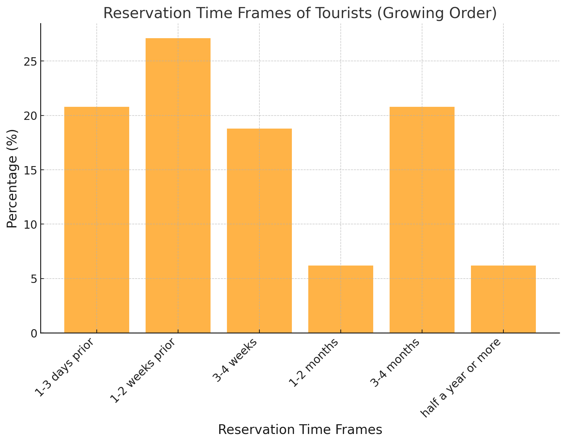

Slide 35
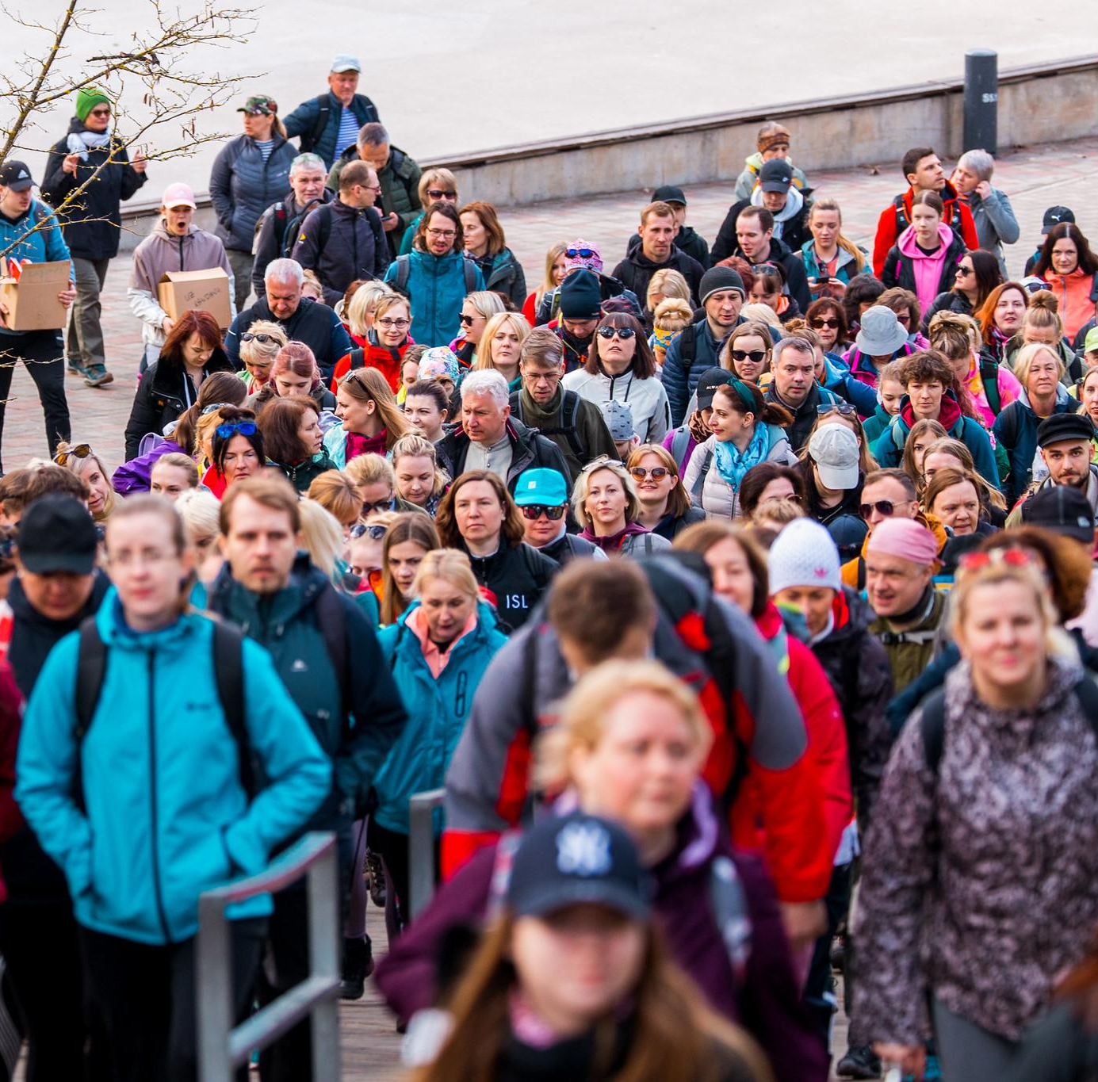
Feedback from SME
Hi, Anna
I received it, but it’s quite unrealistic among other tasks. You could try asking X again by email, but the time for consideration is too short.
Is there a way to set a restriction in the application system that requires applying 1 week in advance? That would make it a bit more manageable, although I have to say that from now until mid-October, there are practically no free days...
P.S. I checked with X, and they also can’t.
Best,
…

Slide 36
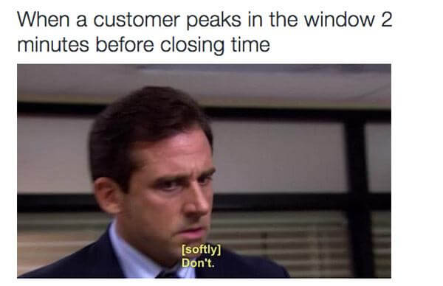
Feedback from SME
Hi Anna,
We have observed that last-minute bookings are becoming increasingly common. However, these bookings are also the most likely to be cancelled at the very last moment.

Slide 37
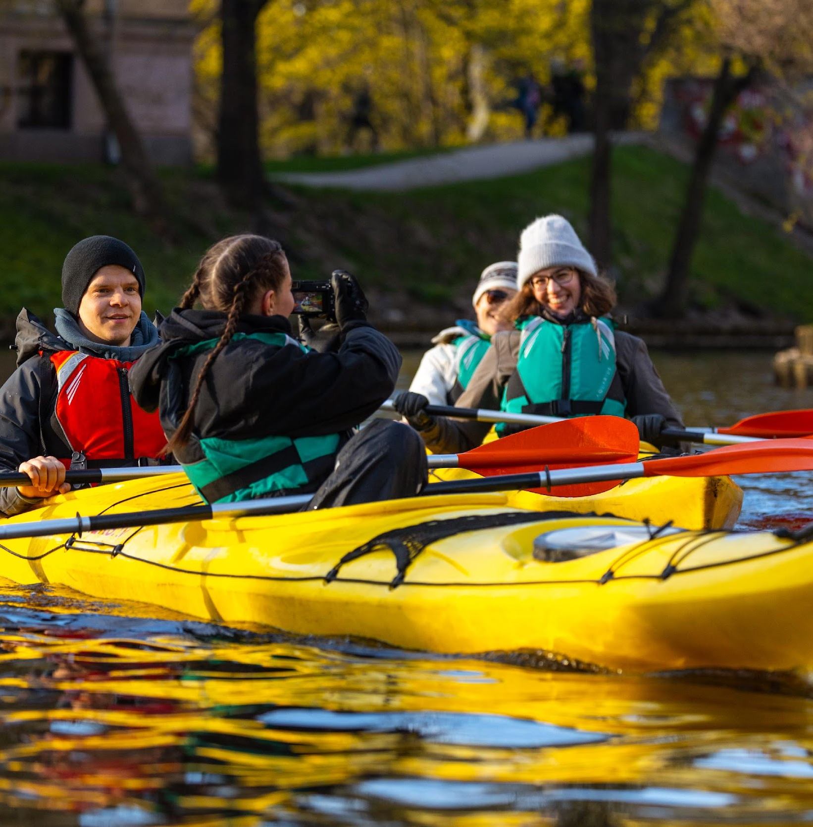
Feedback from SME
Hi,
We received a request from a group of Dutch ladies who want to go paddle boarding in Riga tomorrow. Unfortunately, I have a large group scheduled for the same day, so I can only refer them to another rental place. I will call the other company to check if they have availability.
Who should be responsible to reschedule or refer to another company?
Notes:
Who is responsibe

Slide 38

Feedback from SME
We have noticed that some inquiries are being sent multiple times (such as the original, through a forwarder, and a reminder from you).
We usually receive and respond to the initial inquiry, so multiple emails can be a bit overwhelming and may cause some confusion. We appreciate your understanding in this matter.

Slide 39
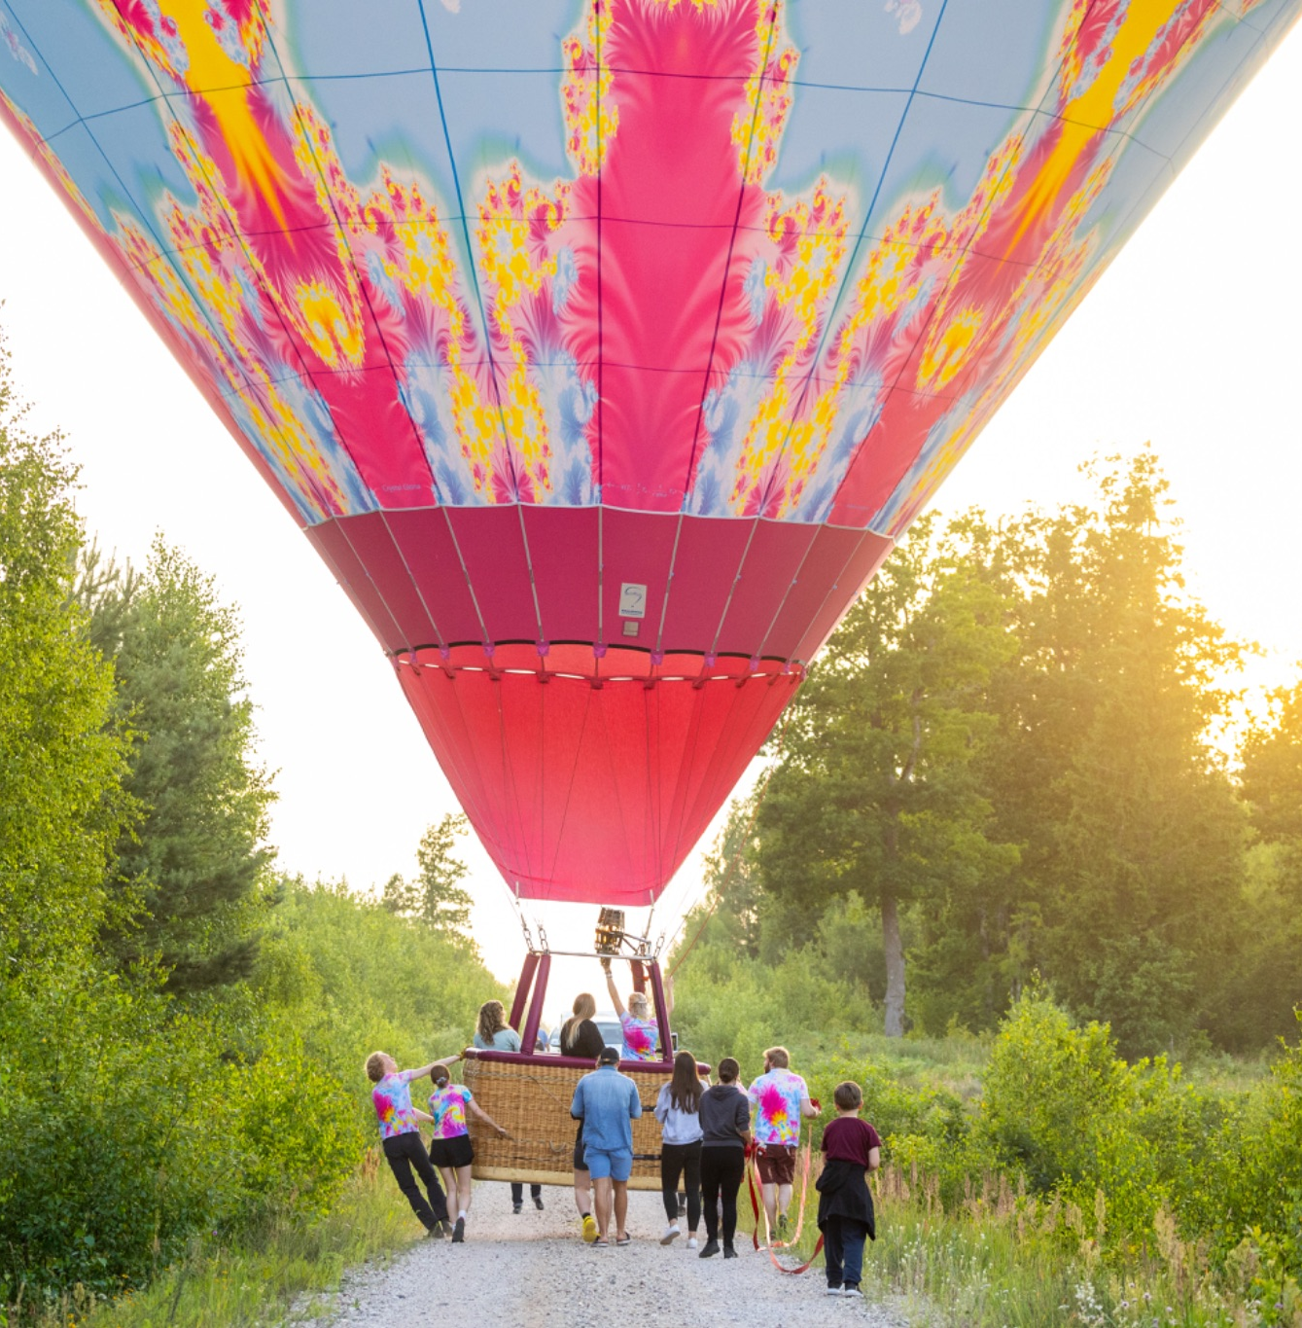
Feedback from SME
Latvian and Estonian SMEs have indicated that they have made a close collaboration between countries. The collaboration have been in forest restaurant packages and bicycle tours.
These SMEs were in touch with ERTO/ENTA.

Slide 40
Social media statistics
(March – August)

Slide 41
Facebook

Slide 42
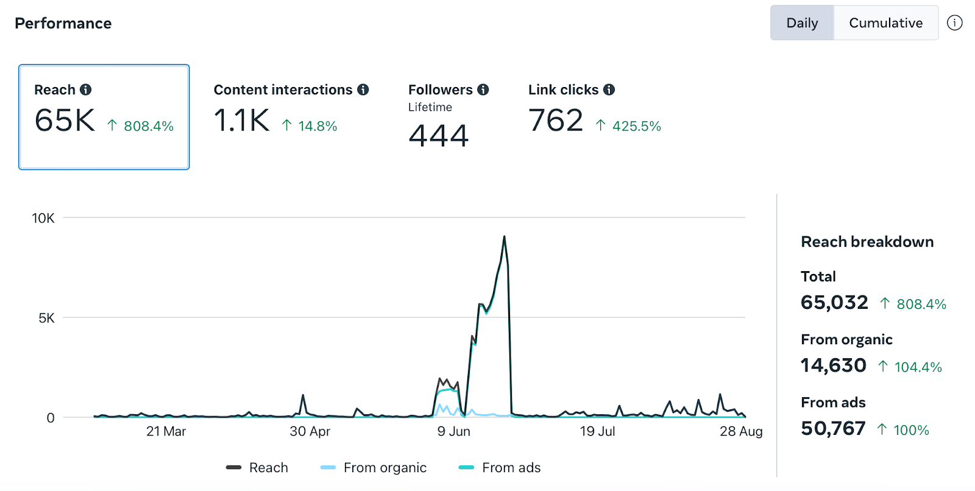

Daily & Cumulative Reach
Study trip to Finland
FAM trip
Started posting galleries

Slide 43


Daily & Cumulative Followers
FAM trip
Captains Cruise

Slide 44
Paid Ads

Slide 45


Slide 46


Slide 47


Slide 48


Slide 49


Slide 50


Slide 51
Top 3 posts

Slide 52


Slide 53


Slide 54


Slide 55
Top 3 reels

Slide 56

Notes:
paid ad

Slide 57

Notes:
paid ad

Slide 58


Slide 59
Website

Slide 60


Slide 61

August, 2024
Paid adverts start

Slide 62

2nd of June - 2nd of Sep
Paid ads
Posts in interest groups
Inquiries received

Slide 63

Instagram

Slide 64


Daily & Cumulative Reach
Study trip to Finland
Study trip to Finland
FAM trip

Slide 65


Daily & Cumulative Followers

Slide 66
Top 3 posts

Slide 67


Slide 68


Slide 69


Slide 70
Top 3 reels

Slide 71


Slide 72


Slide 73


Slide 74
Planned activities in 2024
Travel Bulletin Activity and Adventure Showcase, Manchester, 17th Sep 2024
Adventure Europe, Online, 25th Sep 2024
WTM London, Latvia and Estonia stands, 5-7th Nov 2024
Arrival Activate, Edinburgh, 23-25th Nov 2024
Fam trip to Estonia in November for Christmas (to be confirmed)
Estonian Embassy event with VisitEstonia (to be confirmed)
cooperation with university of life sciences-nature conference and studies
19.11 ELTÜ nature tourism seminar
Content article in National Geographic
Adding SMEs and services on airtable/website

Slide 75
Baltic’s nature coverage in media
Baltic coast Express.co.uk
Lonely planet TOP 15 for Estonia
The Guardian Estonian northern coast
The guardian about cycling
Forbes The most walkable cities
Outdoor swimwear Glorious swims in cola-color bogs
Wanderlust Travel Green
BBC Estonian naked wellness tradition

Slide 76
Thank you!
Elin Priks, Anna Palelione, Anna Salnikova

