Slide 1

Project „Forest and Coastal Hiking Trails' accessibility improvement for different social groups” partners meeting
24.09.2024, Vidzeme
Project ID and acronym: EE-LV00013 – Accessible Hiking Trails

Slide 2
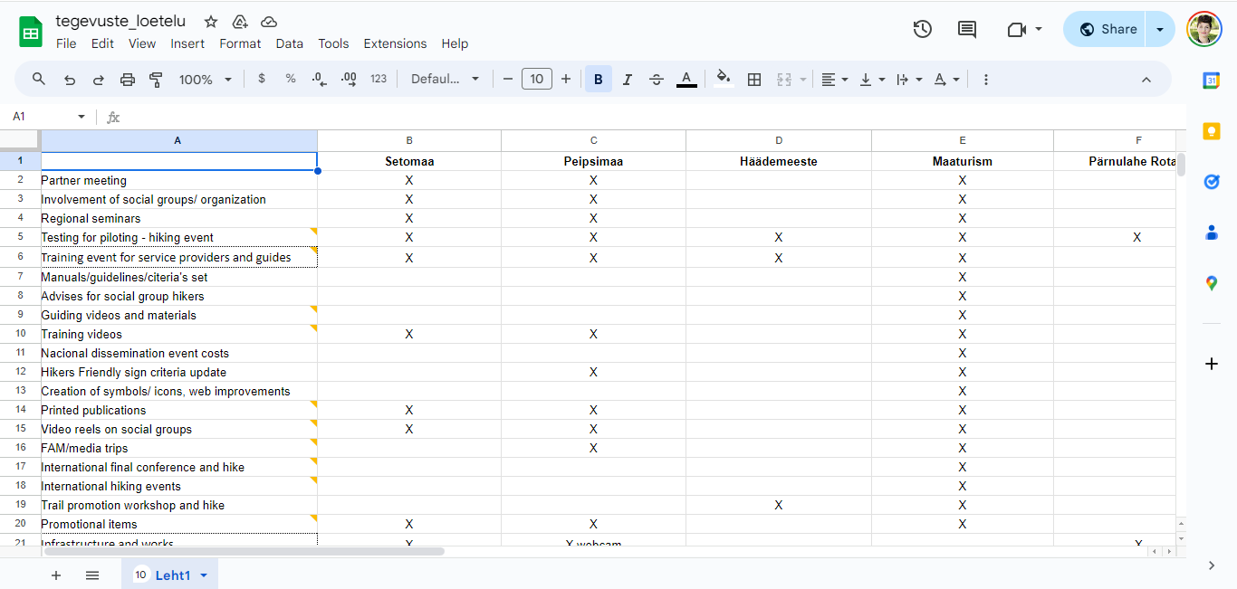
Monthly meetings

Slide 3
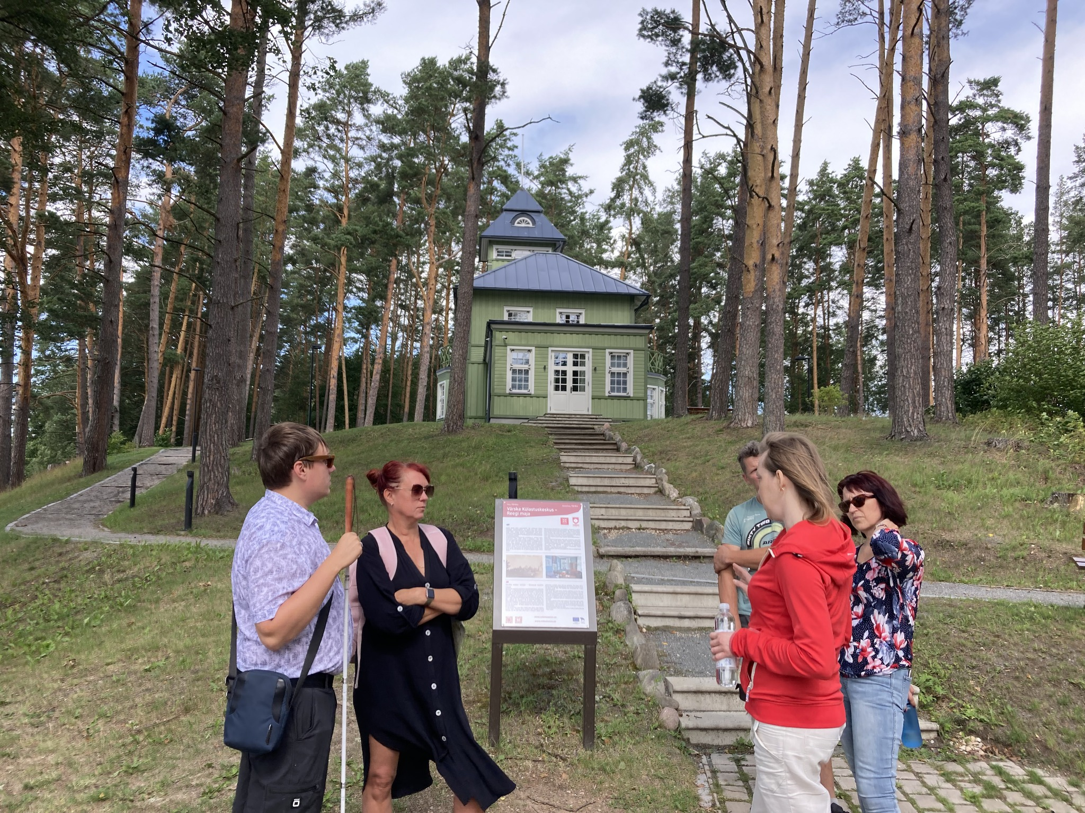
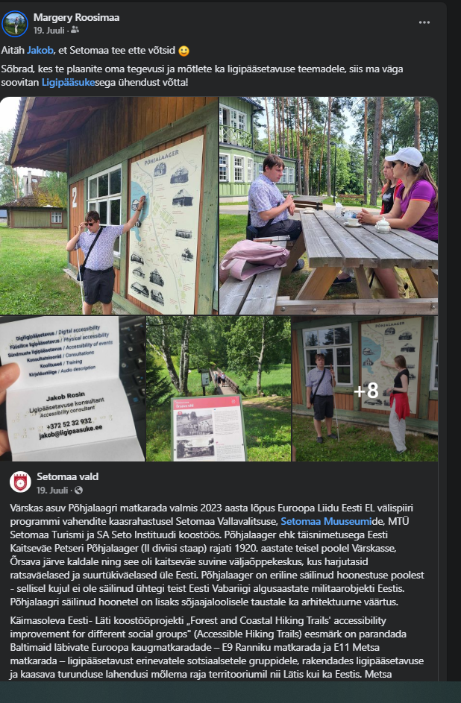
Setomaa activities
Impaired vision hike and suggestions from Jakob Rosin, Ligipääsuke (July 18, 2024)
Written recommendations regarding the hiking trail from Jakob (shared) added to JEMS
Facebook post
Liisa from ERTO joined

Slide 4
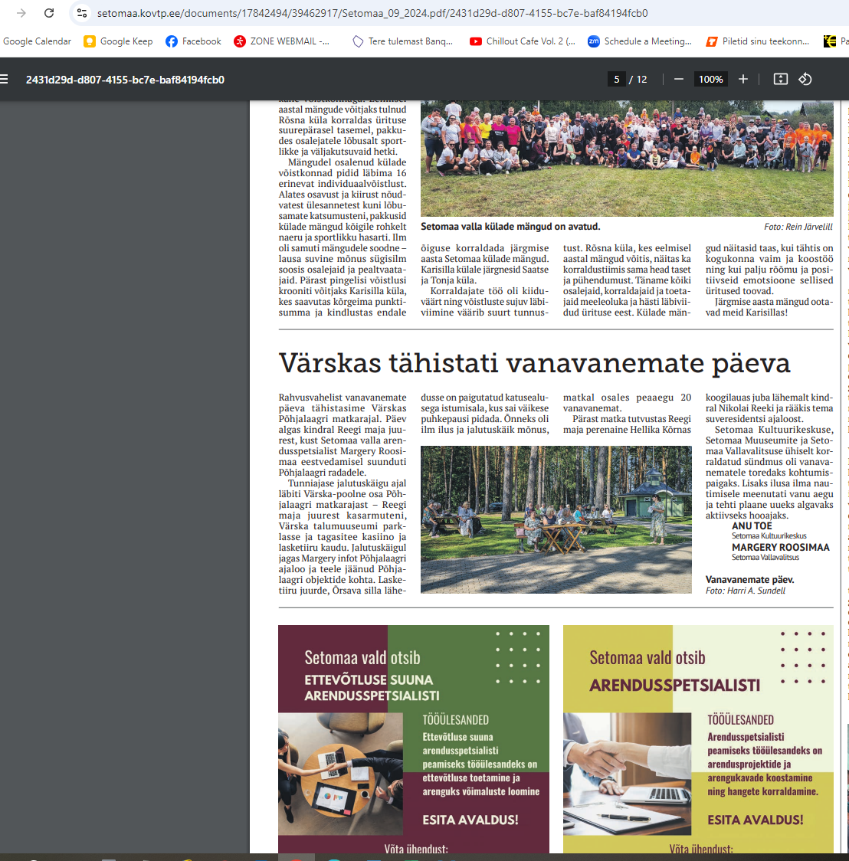
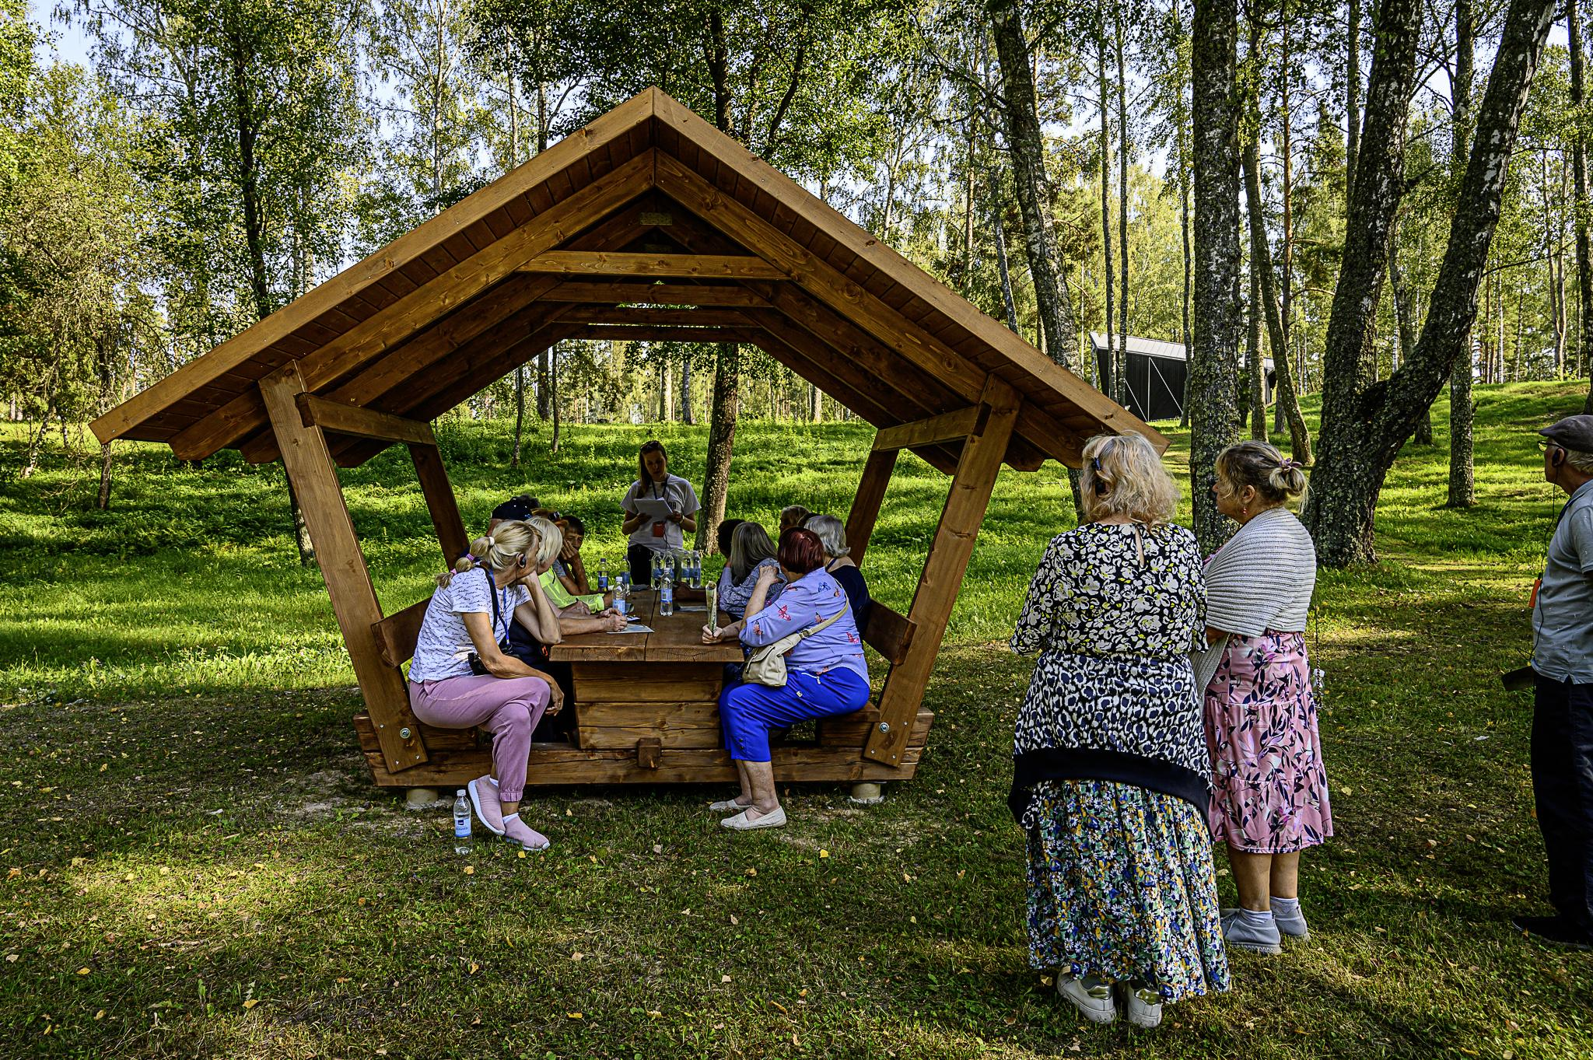
Setomaa
A resting picnic table/bench with a roof has been ordered and installed by Lake Õrsava (added to JEMS)
On Grandparents' Day (September 8, 2024), I conducted a hike for our grandparents (18 participants) - not a direct target group - registration list and photos in JEMS
Facebook post, article
The Hiker-Friendly label was applied for by Setomaa Museums (5 houses). Setomaa Museums received the labels
Meetings with Estonian partners

Slide 5
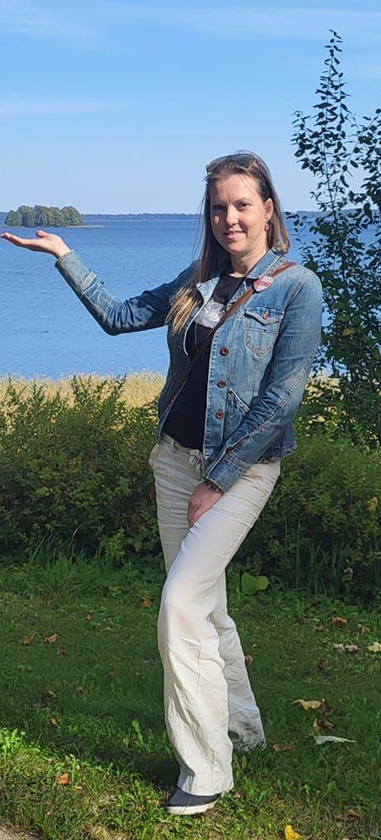
Margery left Setomaa Municipality 16.09
no jet new contact
but Margery has a company for service providers in adhering to the necessary regulations and requirements for service delivery and in implementing best practices. Also long practise with people with disabilities and organizations.
Some next project activities will be agreed with Setomaa municipality

Slide 6
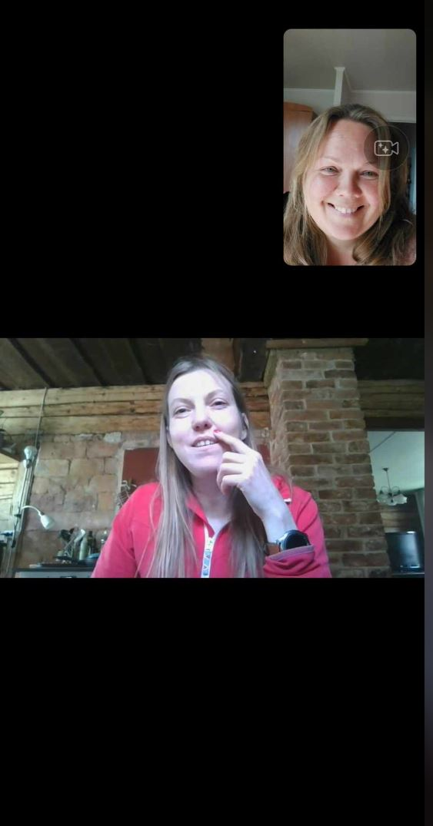
Peipsimaa activities
Meeting with a German journalist with the aim of inviting them to Peipsimaa.
In June, a trip for Germans with a guide to Peipsimaa and Setomaa, which included a German journalist.
Participation in the pilot project in Kuldiga.
Discussions with municipalities regarding webcams.
Participation in the work of the Hiker-Friendly Label committee.
Meeting with a representative from Setomaa.
Investments are planned to be implemented in 2025.
Eveli will conduct communication with target groups, local municipalities, project partners, and other stakeholders prior to the investment in the fall of 2024.
Hike in October.
Peipsimaa Development Forum in December.

Slide 7
Häädemeeste activities
Participation in the pilot project in Kuldiga
A list of points of interest and services requiring audio guide information is being compiled in collaboration with museum and tourism professionals (October 2024) In cooperation with the municipal government and the Fenno-Ugric Society, materials are being prepared for the audio guide to reflect the theme of Livonia.
Finding a contractor for the technical preparation of the audio guide (November - December 2024)
According to the budget and the anticipated costs of activities, we will find experts for the preparation of informational texts, translations, and recording (November 2024 - March 2025)
Ikla Border Point - more detailed development of the investment in cooperation with the municipal government and the designer - November 2024 - January 2025, construction of facilities - March - May 2025.

Slide 8
Häädemeeste activitites
Regarding beach access, problematic areas have been reviewed with local residents for accessibility to the hiking trail for wheelchairs, strollers, and people with mobility impairments (sand dunes, wetlands, etc.).
Beach Access - development of solutions in collaboration with an expert, according to the existing budget - November 2024 - January 2025.
Construction of beach access points, finding contractor for this - March 2025 - June 2025.

Slide 9
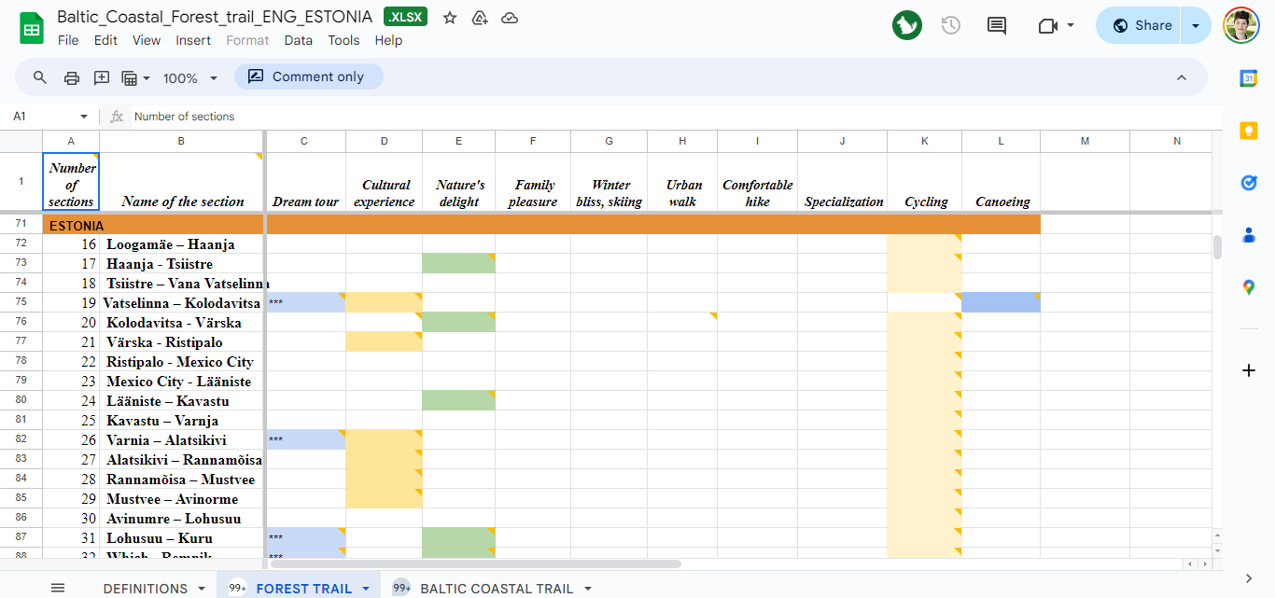
Foresttrail hiking stretches category

Slide 10
ERTO
Participation in a meeting organized by Setomaa municipality with Jakob Rosin, a representative of visually impaired individuals from the NGO Ligipääsuke, with the aim of obtaining recommendations on how to make the hiking trail more accessible for visually impaired people.
Maintaining contact with Polina Rožkova, a representative of the Latvian association for people with mobility impairments, with feedback expected at the end of September 2024.
Issuing the Hiker-Friendly label (5 new recipients of the label).
Updating of the label "Hiker Friendly" + sign sub-specializations (Children-friendly, Wheelchair accessible, Visually accessible) translations into Estonian language
Cameras update

Slide 11
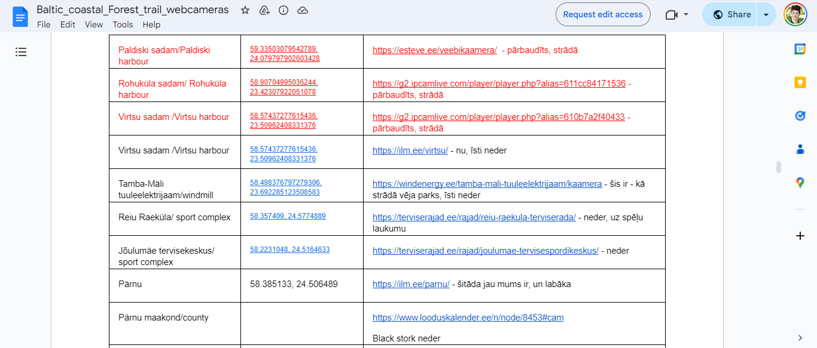
Cameras

Slide 12
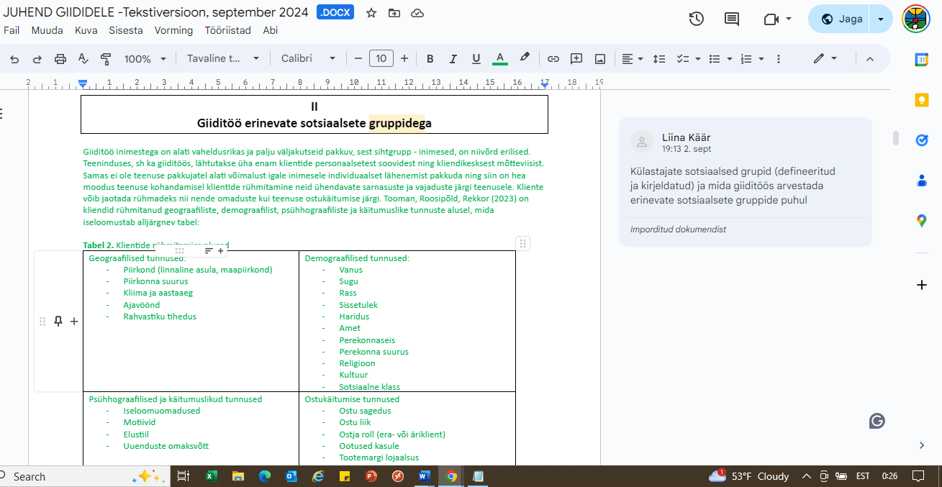
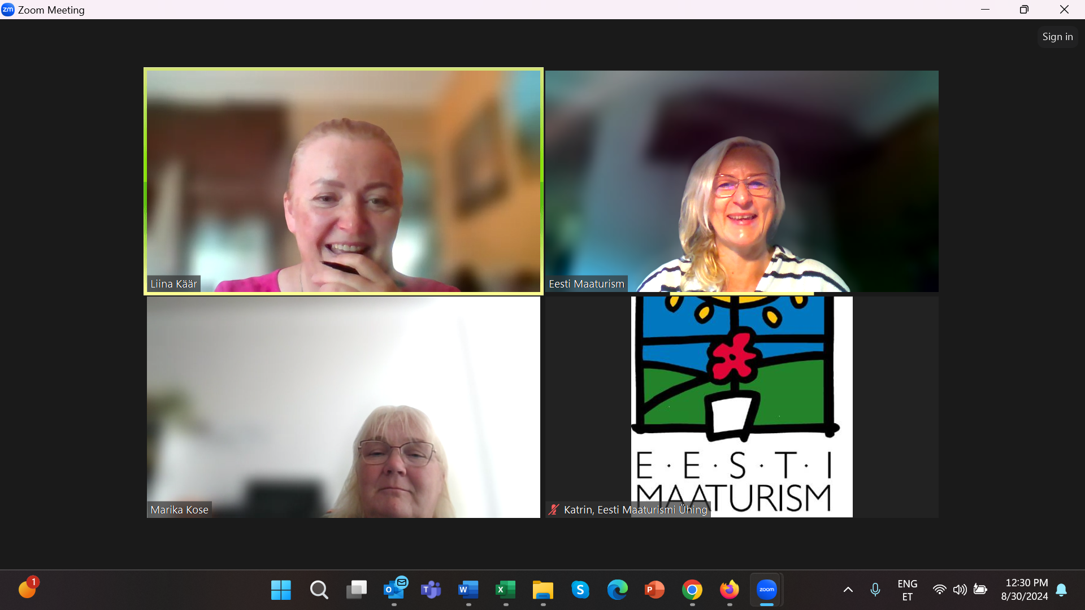
ERTO
Gathering input and agreeing on content with the Guides' Association regarding the compilation of a handbook for guides, which includes chapters on organizing hikes for various social target groups.
How the guide's should work with various social groups is described in the manual: with children, elderly people, VIP clients (e.g. representatives of power, people of very high prestige etc.), people of different genders, people with special interests (e.g. with a deep interest in nature, cultural interest, military interest, etc), people with special needs (vision disability, hearing disability, intellectual disability, mobility impaired). In addition, in the manual are touched how the guide has to deal with other health disorders if they appear (allergies, mental disorders, food intolerance, etc.).
The concept of rural life guide (maaelugiid) has been introduced as a new topic - who is he, how to introduce rural lifestyle, where to get information, etc.
Coordination of the handbook content with representatives of social target groups (ongoing at the moment)
Presentation and coordination of the handbook content with Latvian partners

Slide 13
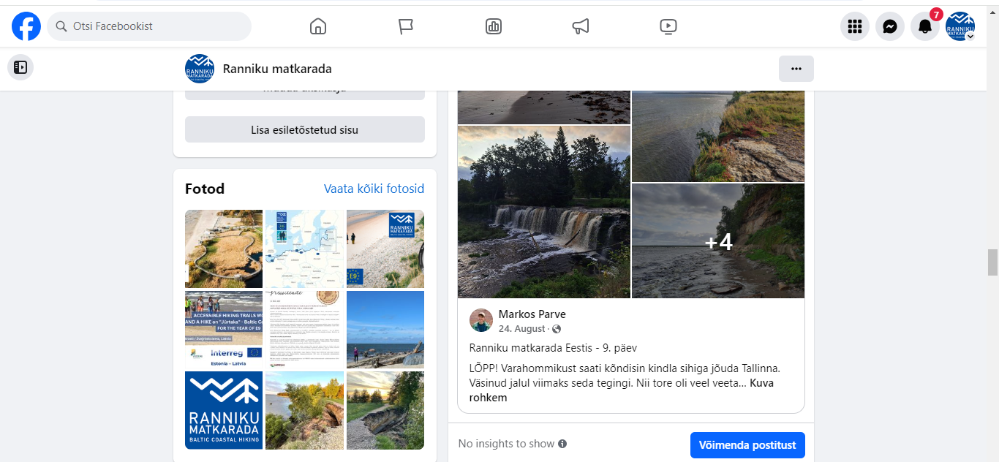
Collaboration with Markos Parve, who completed the Coastal Hiking Trail from the Kaliningrad-Lithuania border to Tallinn (posts about day hikes shared on social media, feedback received from hikers).

Slide 14
Feedback Markos Parve
overall very good
suggestion more by the sea shore and forest (not asphalt and roads)
confusing the Lithuanian part is not mentioned
On some stretches there are changes/detours
Markings needs refreshing
Information boards are not always on the strech/road
The guidebook should distinguish between free camping areas and paid campsites

Slide 15
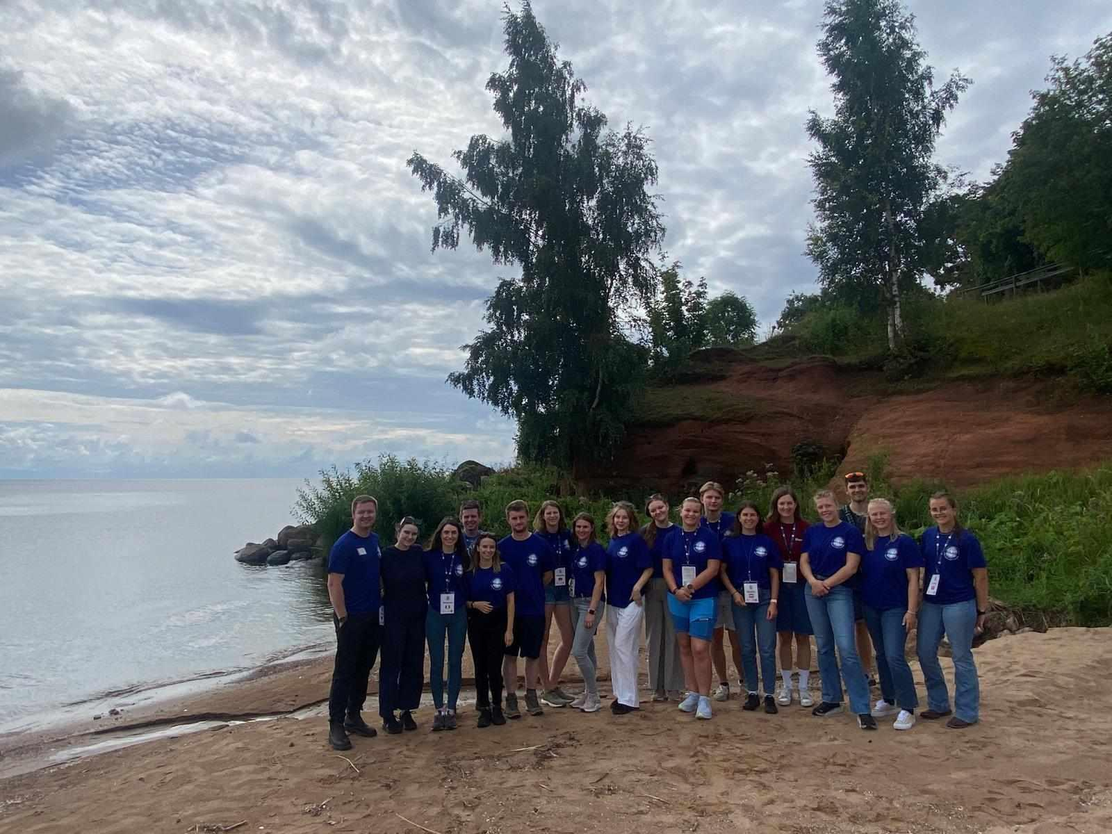
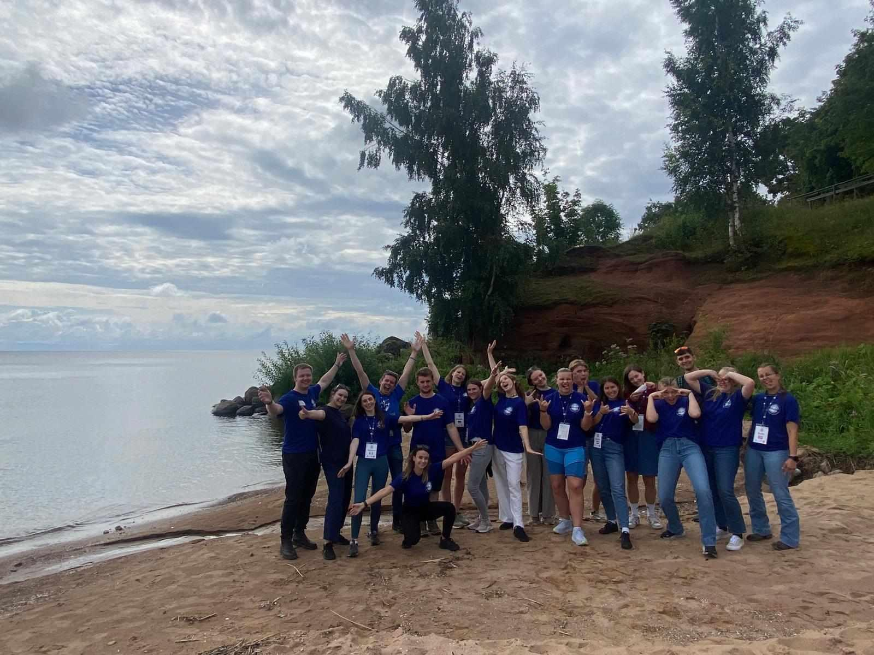

Slide 16
ERTO near future
Training for entrepreneurs (regional seminar in Western Estonia) on possibilities for improving accessibility
Training event for service providers and guides (22.10.2024)
National dissemination event on 27.11.2024 focusing on hiking and accessibility topics
Processing feedback from hiker Markos Parve and implementing potential improvements
Processing feedback from Polina Rožkova, representative of the Latvian mobility impairment association (we may propose inviting her to speak at the regional seminar)

Slide 17
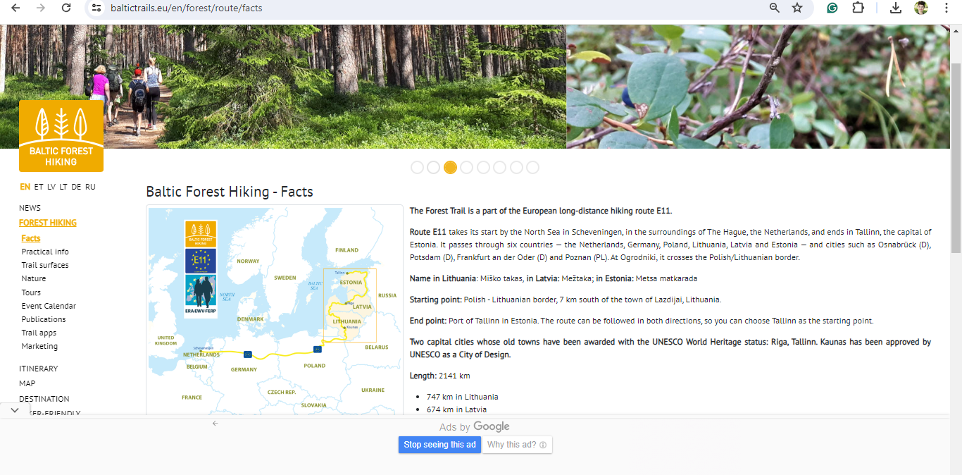
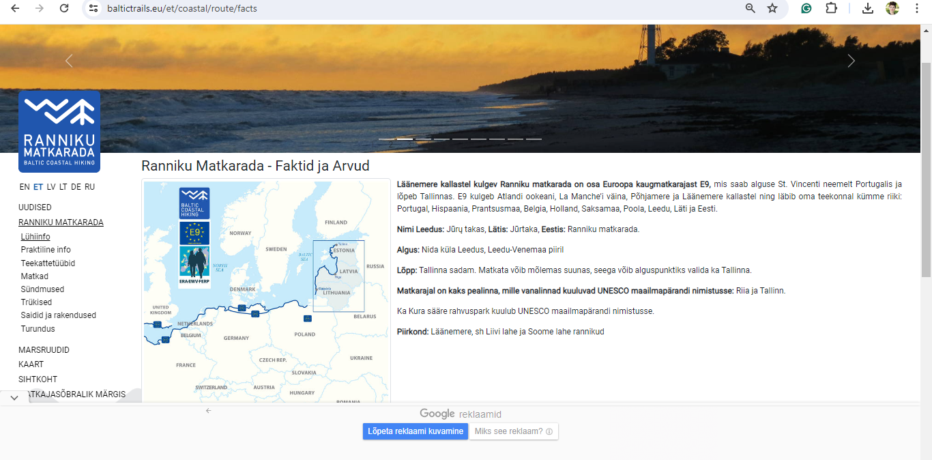
Website updates
website information updates
website analyze, changes
URL
broken links
needs updated technical search info
contacted tourist information for accommodation, food, sites

Slide 18
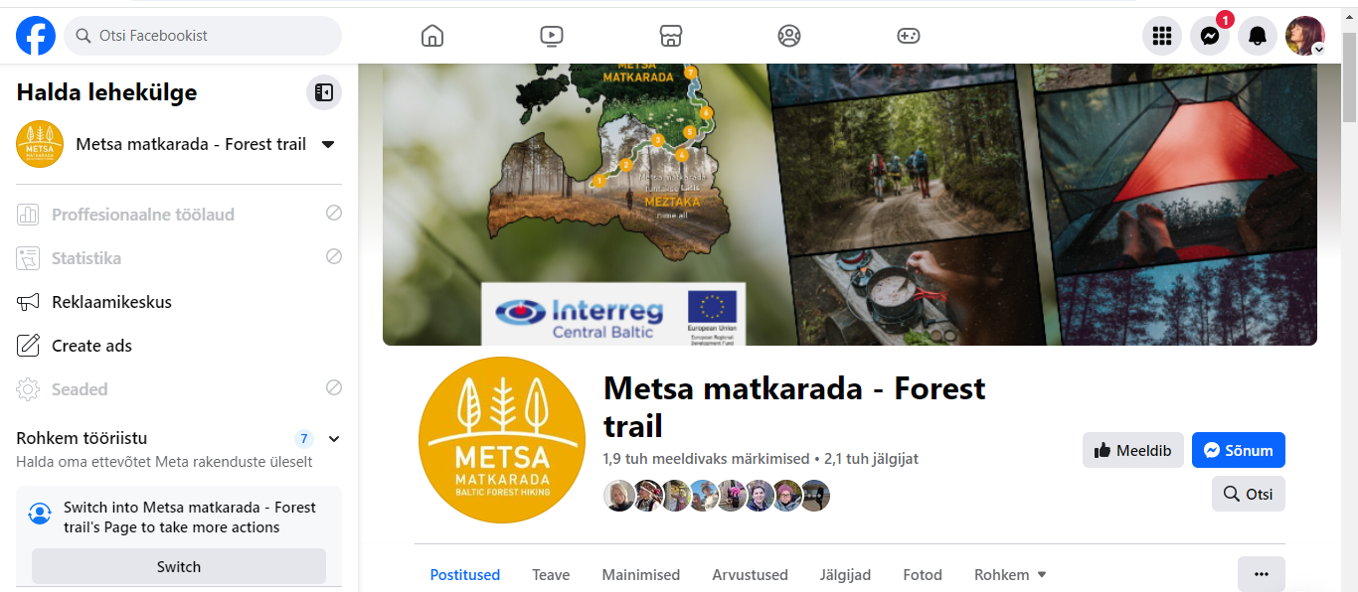
Facebook
Meta updates
Content
deleted/added admins
Ranniku/coastal hiking will be updated asap

Slide 19
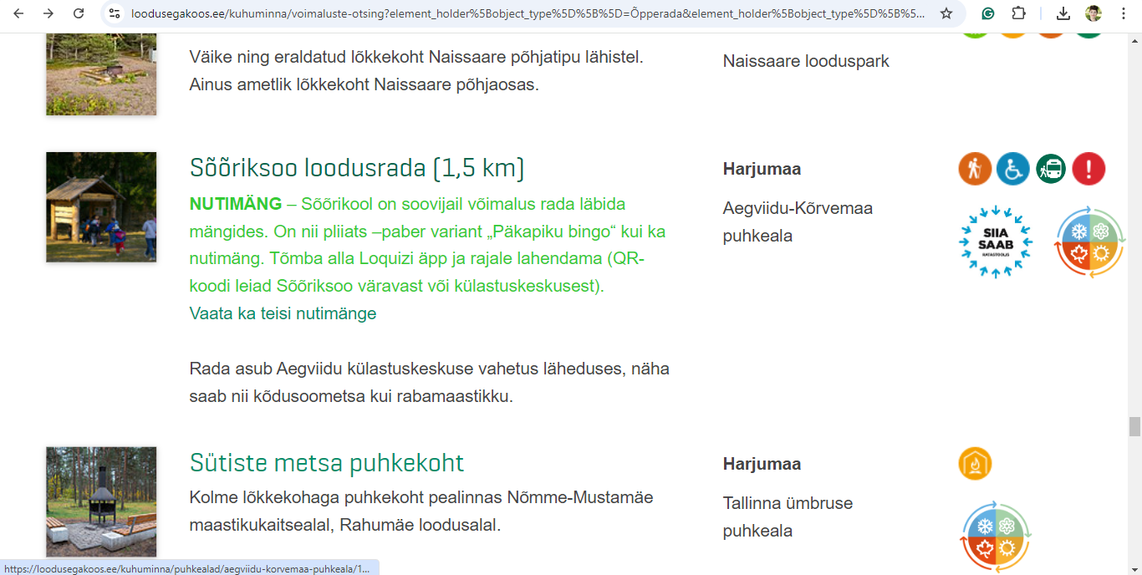

Slide 20
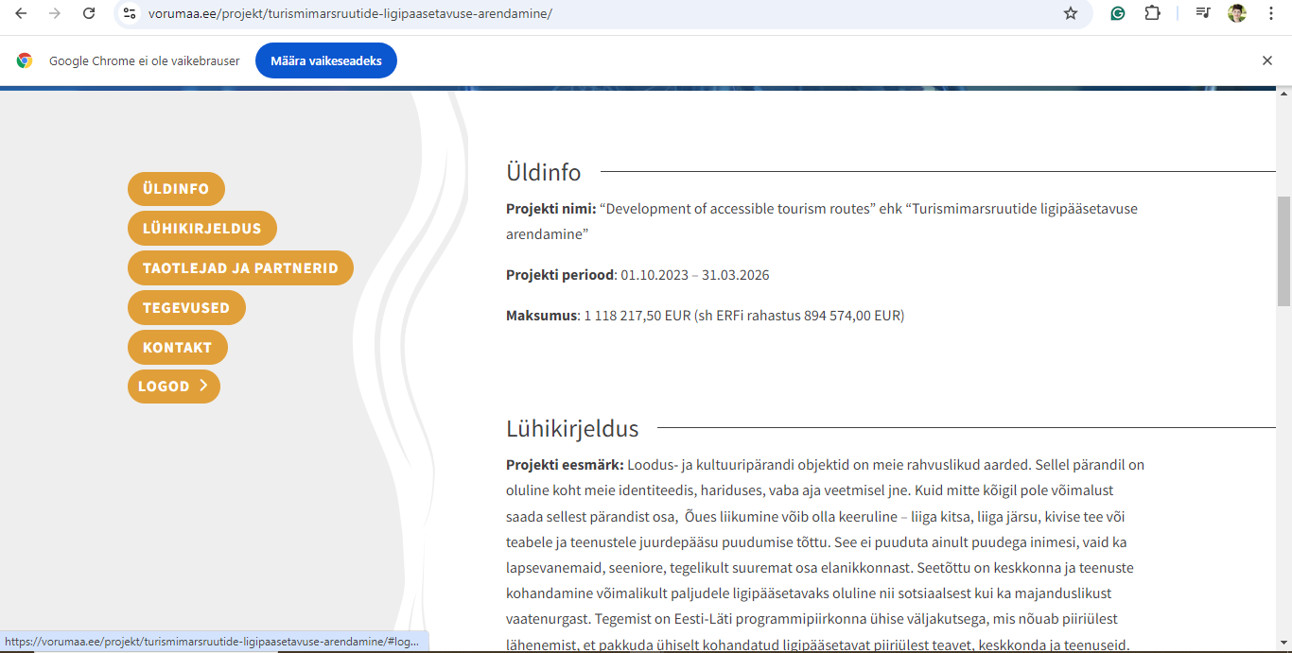
Vidzeme planeerimispiirkond, www.vidzeme.lv
Eesti Puuetega Inimeste Koda , www.epikoda.ee
Võrumaa Arenduskeskus , www.vorumaa.ee
SA Tartumaa Turism – Lõuna-Eesti DMO , www.visitsouthestonia.com

Slide 21
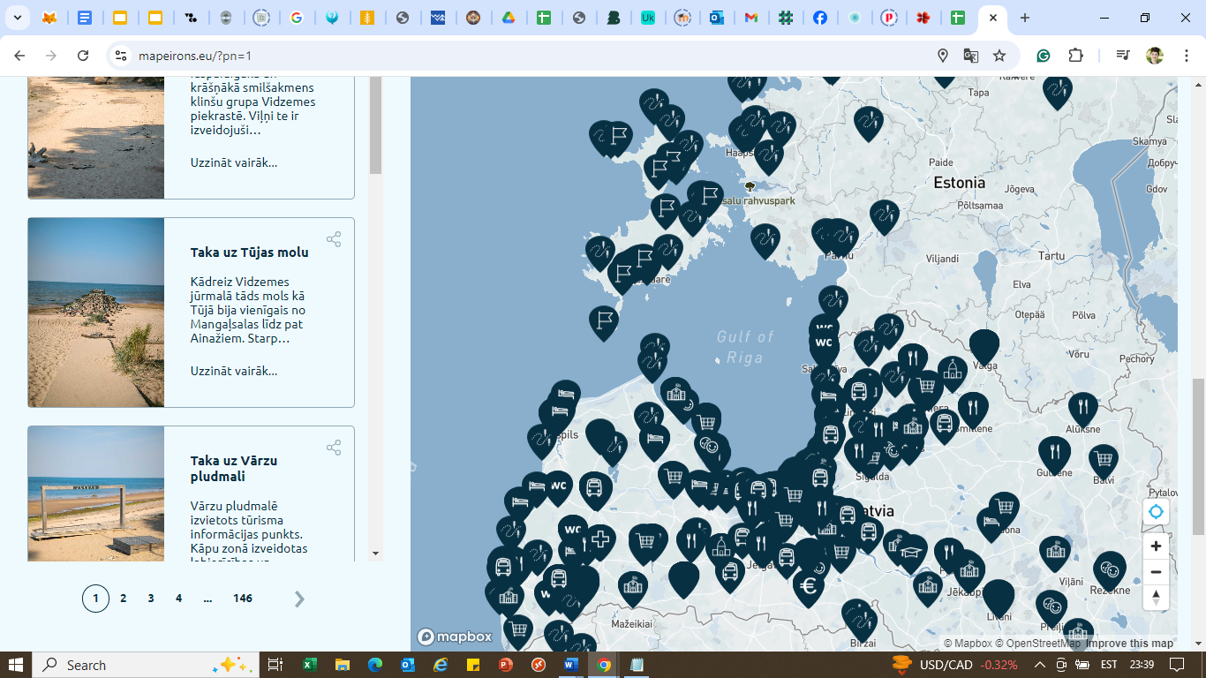

Slide 22
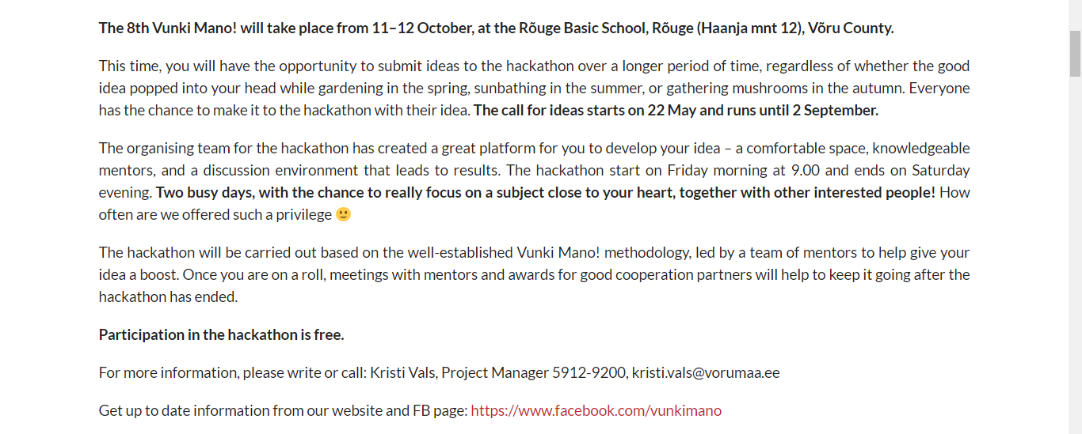
Vunki mano häkaton, 11-12.10

Slide 23
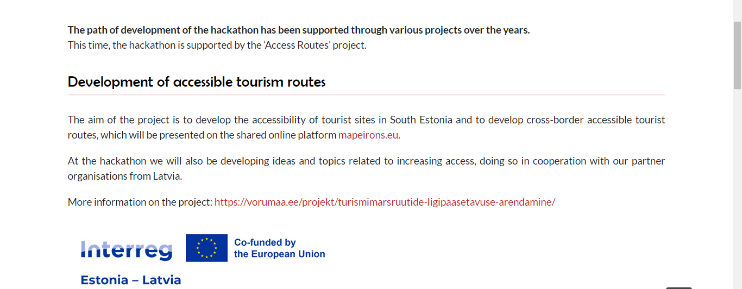
Sets of senses for interpreting museum content
A production proposal sketch that would help to better and more diversely present museum content to different visitor groups, including people with disabilities, children, etc.
Whose problem it is? Museum workers, people with disabilities, children
Kurzeme planning region, Alise Lūse

Slide 24
Sets of senses for interpreting nature
For the creation of a set/sets of senses for interpreting nature, which would help to better and more diversely present natural values to different visitor groups, including people with disabilities, children, etc.
Whose problem this is: Nature guides, tourism specialists, specialists from the Nature Conservation Agency, people with disabilities, children
Vidzeme planning region, Ilze Liepa

Slide 25
Estonian projects
Making the Tamula beach promenade and swimming area accessible to people with disabilities
Sensory trail for Pokumaa- We aim to create enhancements to the trail so that everyone can perceive and experience the essence of Pokumaa more deeply

