Slide 1

Exporting Baltic Nature Tourism to UK
(NAT-TOUR-EXPO)
Project partner meeting, 4th September 2024, Riga, Latvia

Slide 2


Programme reporting periods and logos
3rd period project report is ready to be sumbitted, we are waiting for partner reports to be certified.
4th project reporting period, 01.07.2024.-31.12.2024.
List of participants template –
https://centralbaltic.eu/wp-content/uploads/2023/05/List-of-participants.xlsx
Logos + Interreg Brand Design Manual 2021 - 2027
https://centralbaltic.eu/programme-logos/

Slide 3
Planned project activities
WP1
A 1.1, Matching the nature and tourist service potential with the UK market needs
A 1.2, Training support to SMES for product development and improvement
A 1.3, Best practice study trip for SMES - nature tourism product providers
A 1.4, Nature tourism product development
A 1.5, Visual identity and web design for presentation of the nature tourism product
A 1.6, Estonian-Latvian nature tourism product promo materials
A 1.7, National dissemination events
A 1.8, Nature tourism web platform
A 1.9, Project communication to SME target audience
WP2
A 2.1, Estonian-Latvian nature tourism product presentation at specialised travel trade events
A 2.2, FAM trips for UK tour operators, travel companies and media
A 2.3, Estonian-Latvian nature tourism product presentation at travel markets
A 2.4, Estonian-Latvian nature tourism product presentation to nature organisations in the UK
A 2.5, Sales calls to specialised companies in UK
A 2.6, Digital marketing
A 2.7, E-newsletters and press releases
A 2.8, Review of other sales and marketing platforms
A 2.9, Project communication to general public
Activities completed

Slide 4
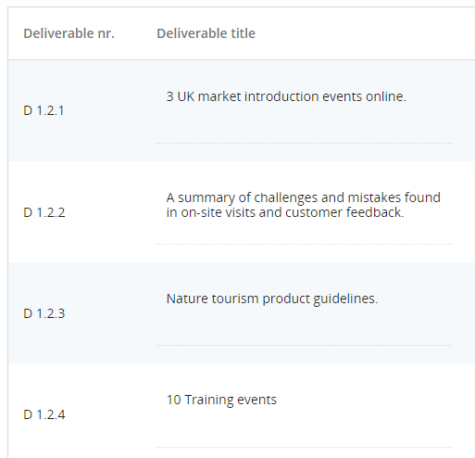
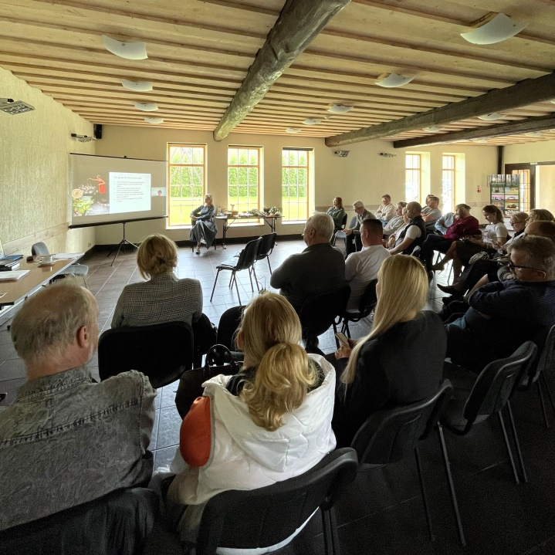
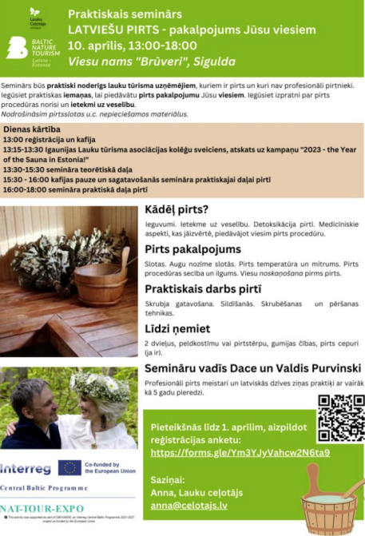
Activity 1.2
Training support to SMES for product development and improvement
Training event by LC.
On 10th of April, LC organized a training event for SMEs. 30 persons participated. The seminar was practically useful for rural tourism entrepreneurs who have a sauna and who are not professional bathers. The seminar was led by Dace and Valdis Purvinski - professional sauna masters and practitioners with more than 5 years of experience. The seminar was held in two parts. In the theoretical part, it was possible to gain an understanding of the course of the sauna procedure and its effects on health. In the practical part, you could gain knowledge about warming up, scrubbing and beating techniques in the sauna.

Slide 5
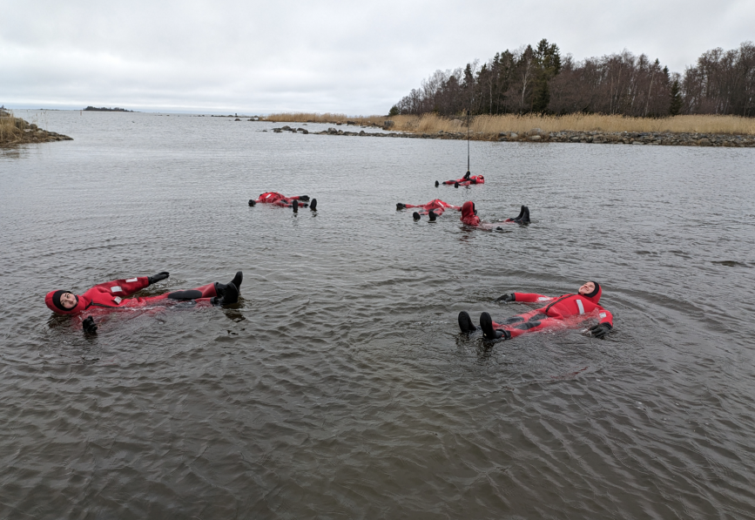
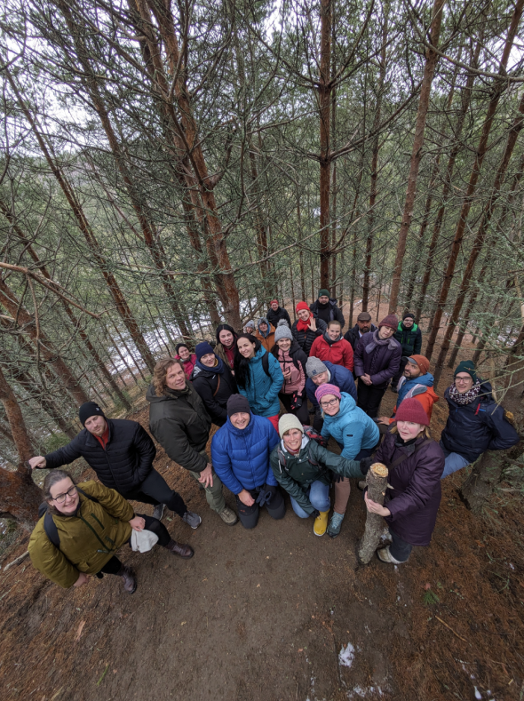
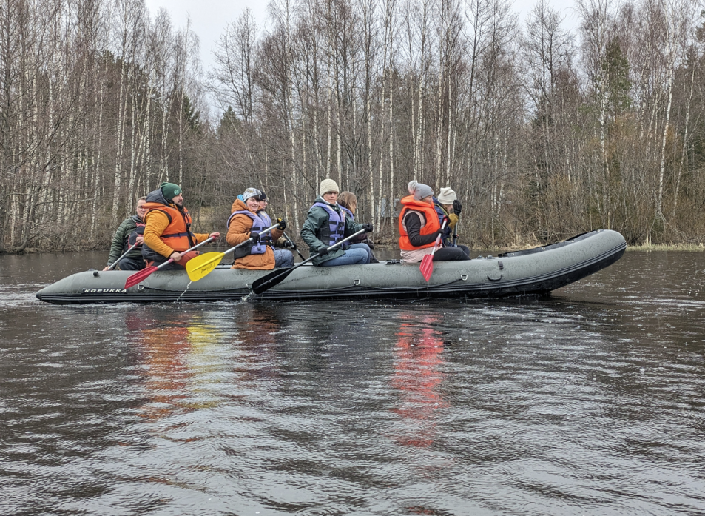
Activity 1.3
Best practice study trip for SMES - nature tourism product providers
Latvian and Estonian nature and active tourism entrepreneurs went on a study trip to Finland from April 25-28, 2024. 28 persons participated (9 SMES from LV and 10 SMEs from EE). The programme included visits to successful nature tourism product providers.
Photo gallery - https://galerija.celotajs.lv/lv/f/Events/2024/240425_Somija_study_ture_UK_projekts.

Slide 6
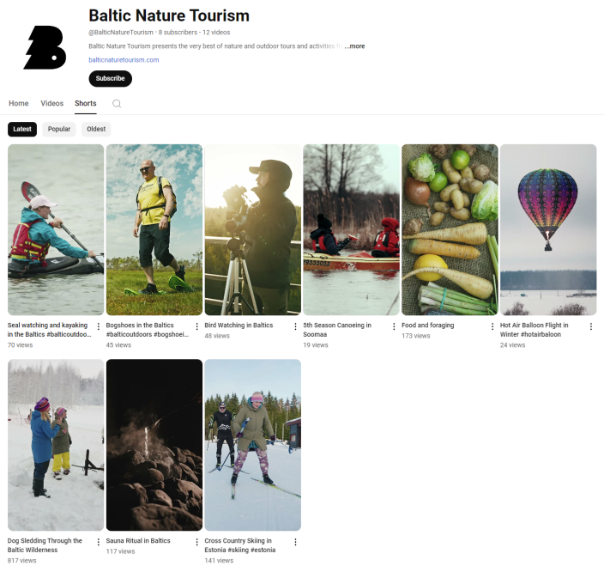
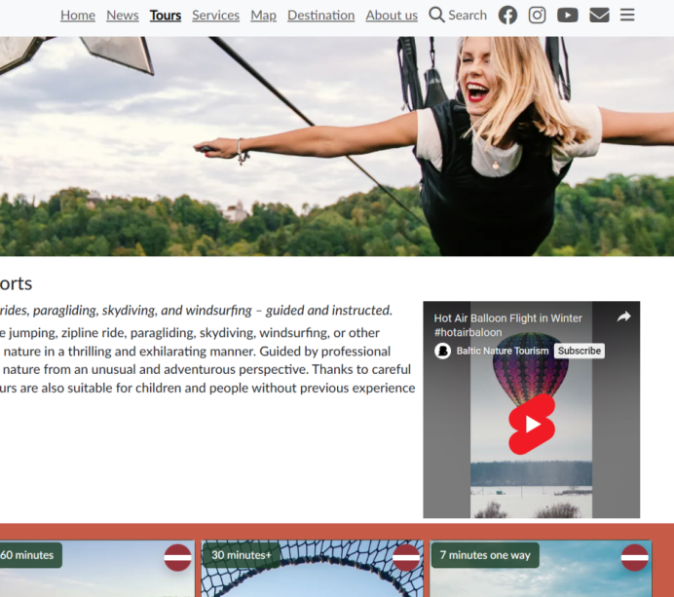
Activity 1.4
Nature tourism product development
At the end of this reporting period, there are 182 products in total published online (88 EST, 94 LV) provided by 47 EST SMEs and 73 LV SMEs (total 120 SMEs).
Filming of the short promotional video reels continues. 9 in total have been finished. Bogshoe walking and seal watching / kayaking are the 2 latest finished reels. They can be viewed in the https://balticnaturetourism.com website and the projects youtube channel.
https://www.youtube.com/@BalticNatureTourism
All reels can be downloaded from here - https://files.fm/u/3s9u5awenk
The BNT filming schedule -
https://docs.google.com/spreadsheets/d/18wXqaS_EPHK7w6n5Lk4XIFbb-kpdJxQ8CO4YCF_2pcA/edit?usp=sharing

Slide 7
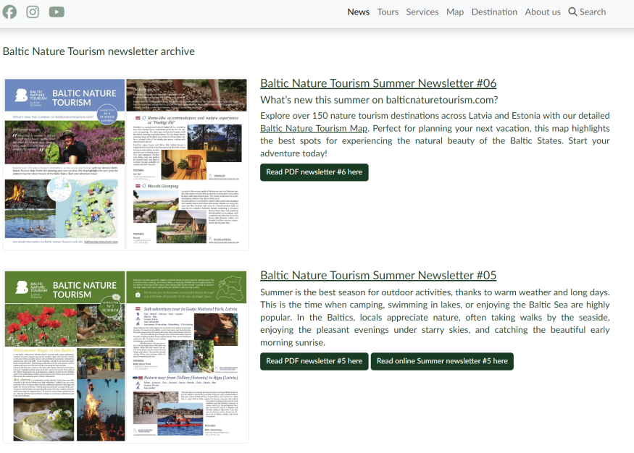
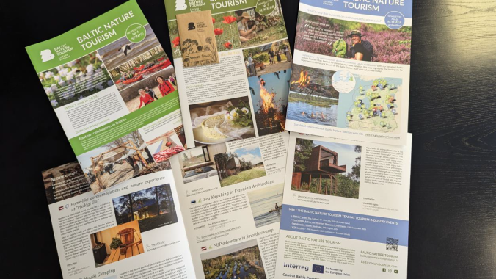
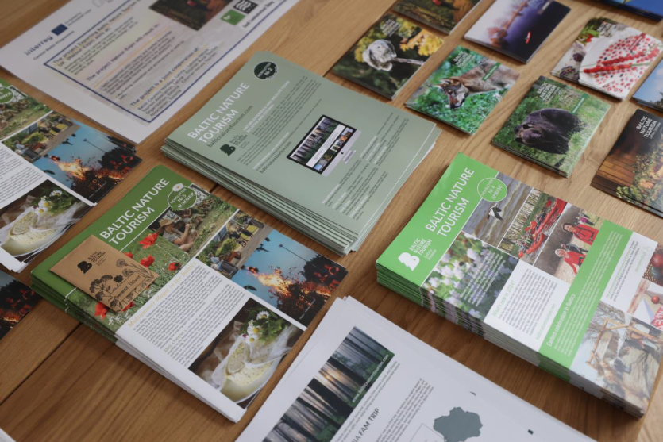
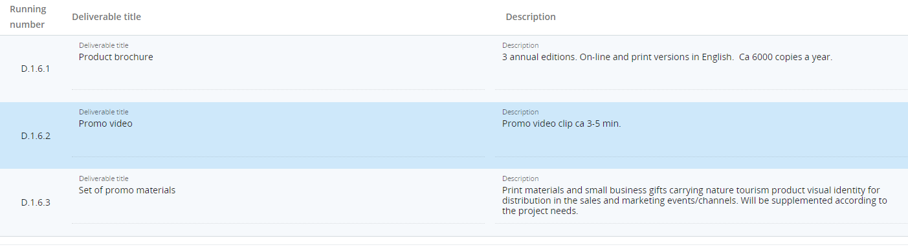
Activity 1.6
Estonian-Latvian nature tourism product promo materials
All the e-newsletters have been printed in 500 copies for marketing purposes to be distributed at events.
100 packets of Summer flower seeds were purchased and prepared as promotional materials. They were added to the summer newsletter and distributed in various marketing activities.
Together with the filming of the last short reel, work on the long promo video has also began. It is expected to be completed in end of autumn 2024.

Slide 8
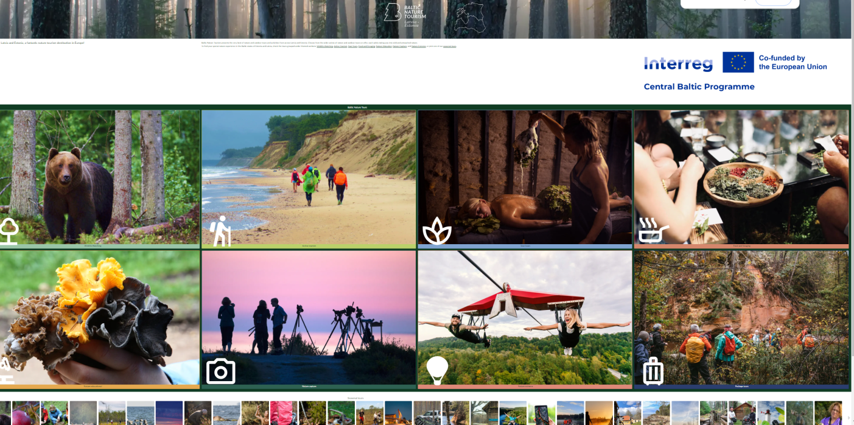
Activity 1.8
Nature tourism web platform https://balticnaturetourism.com
Package tours – requirements, data model hierarchy implementation Tour -> ToursProduct, TourPackage.
Major site visual design changes after partner discussions, audit and designer review.
Maps improvements and refactoring - search added to map page, activity icons for map view, track for package tours, embeddable map implementation to allow sharing in iframes.
OpenGraph sharing fixes, images for sub-activities, client request mail notification improvements, social links and video shorts in tour sections.
Sync logging and partner notification improvements.
Facebook feed API implementation, net cache for social feeds implementation, post synchronization, web display component (with single line and grid options).
New extended version of tourism service providers (guides, rentals, etc). Data models, airtable synchronization, web page for display as grid and individual provider.

Slide 9
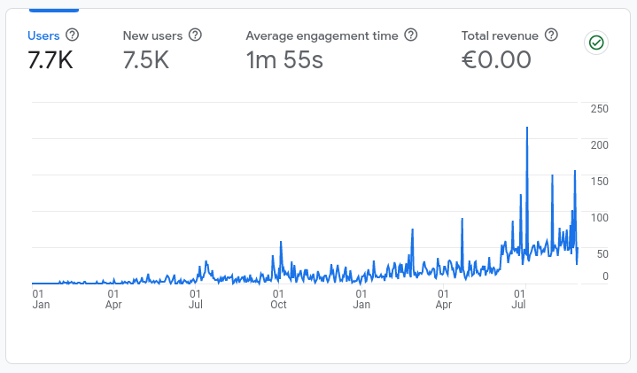
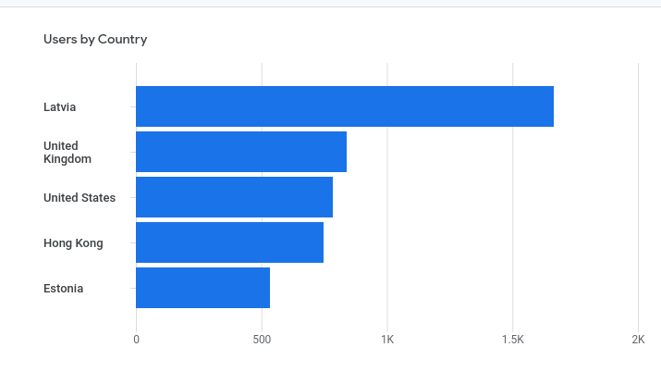
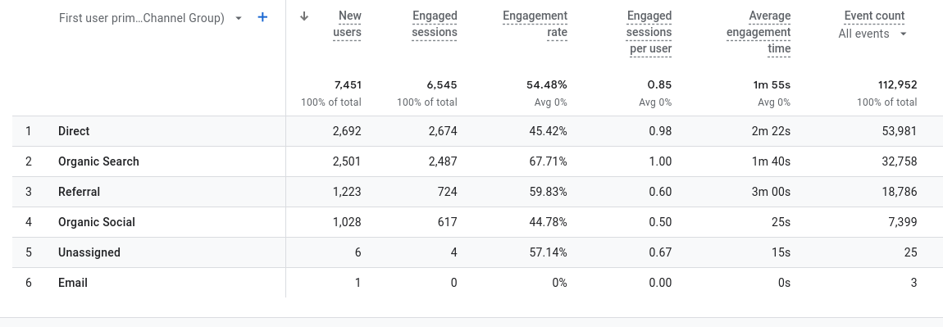
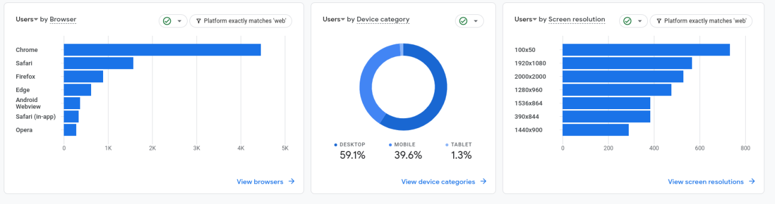
Nature tourism web platform
Statistics
2023.01.01. - 2024.08.28.
Total web page users
Users by country
How the web page was reached
Users by device and browser

Slide 10
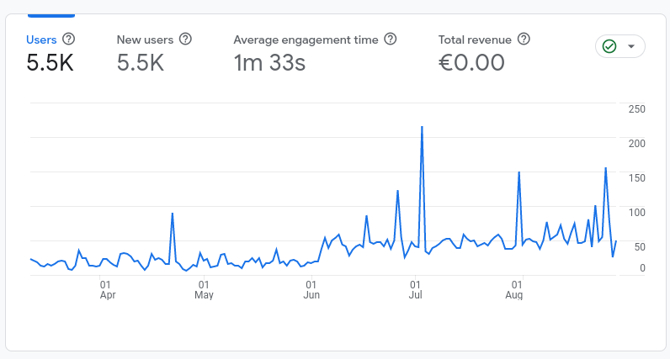
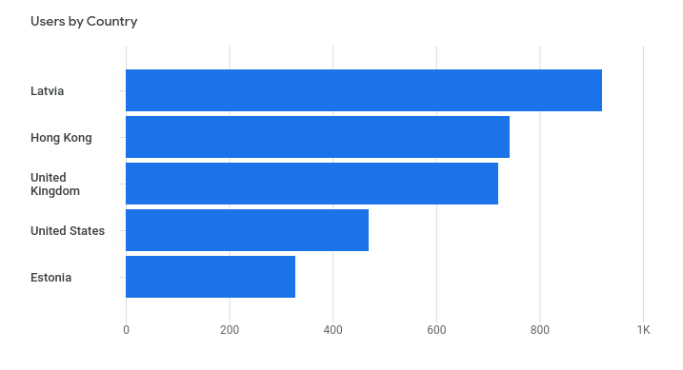
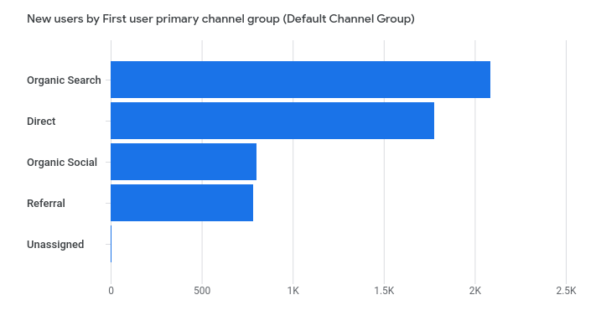
Nature tourism web platform
Statistics
12.03.2024. - 28.08.2024. (From last meeting, ~6 months)

Slide 11
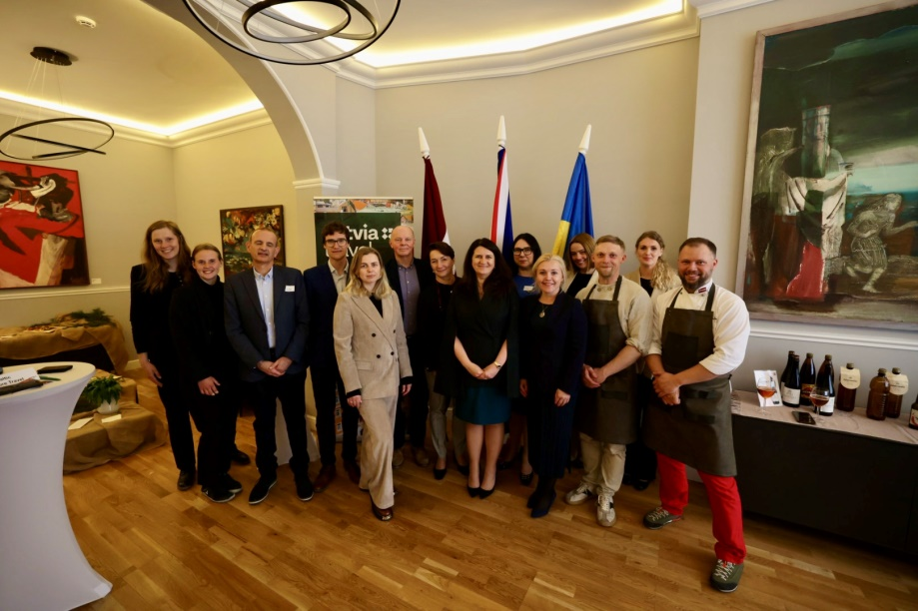
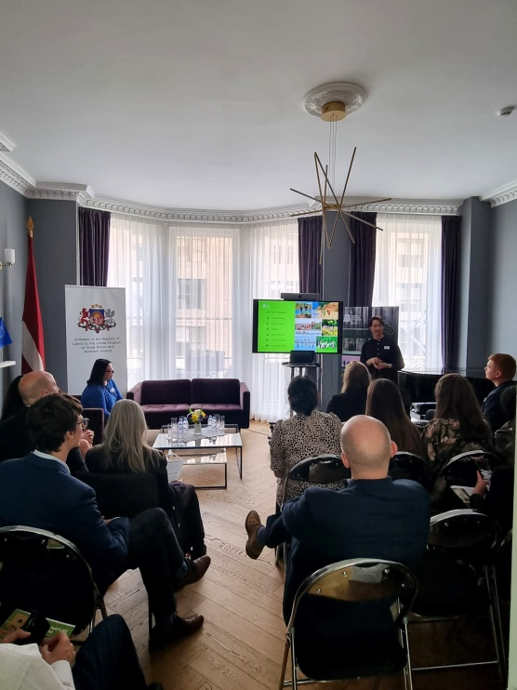
Activity 2.1
Estonian-Latvian nature tourism product presentation at specialised travel trade events
On April 18, in London - at the Embassy of Latvia in the United Kingdom, in cooperation with the LIAA Tourism Department, and AirBaltic - product presentation to introduce our nature tourism offer. The seminar was attended by more than 40 tour operators and media representatives specializing in nature tourism, with a special interest in the Baltic States.
Specific video was created for the event (later added to the web platform https://youtu.be/Wi2ktJ6SV44).
On the second part of the day, the 5 SMEs and project team had a B2B meeting with the present UK tour operators.
Before the seminar, in the morning of 18.04.2024. we met together with LIAA representative, Baltic Nature Travel and Nordic Travel Solution experts at the UK Media breakfast, which was attended by 4 journalists who had a genuine interest in nature tourism.

Slide 12
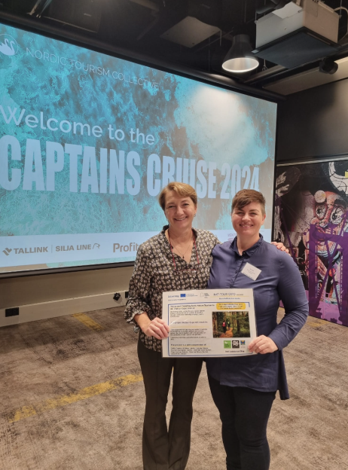
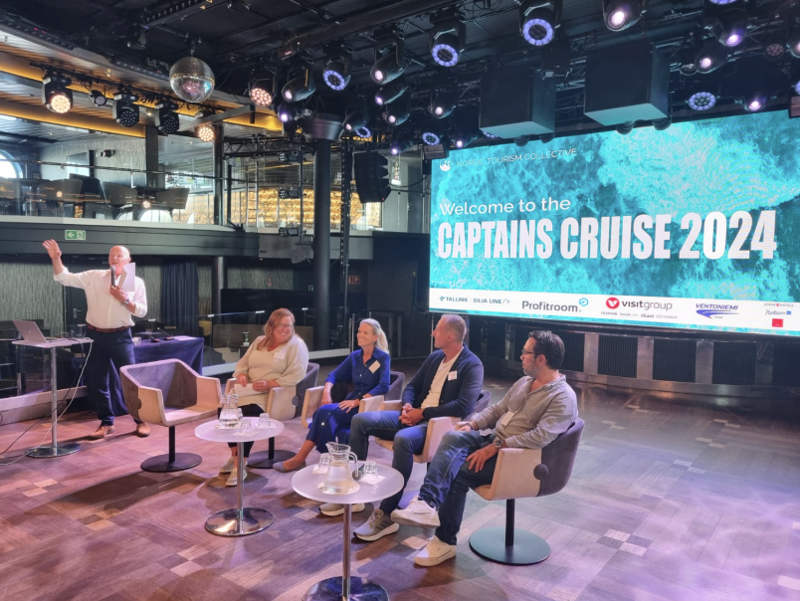
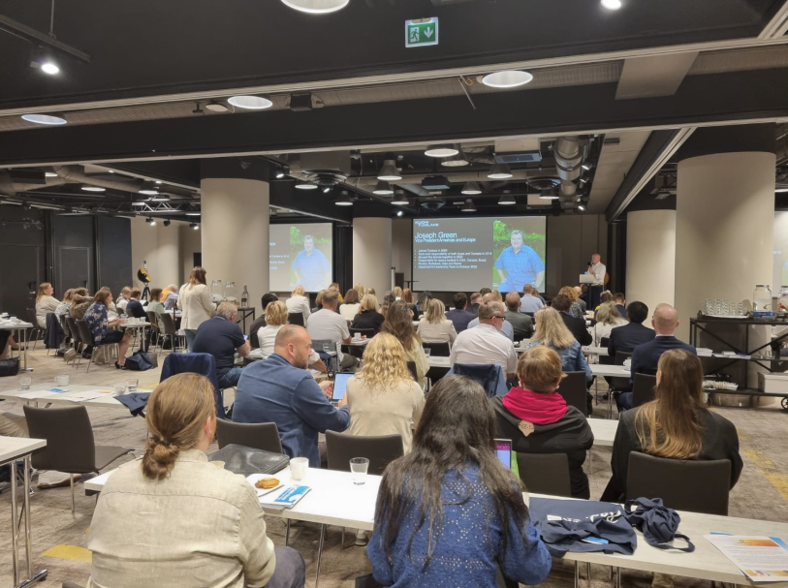
Activity 2.1
Estonian-Latvian nature tourism product presentation at specialised travel trade events
Participation in the 2024 Captains Cruise, on August 28th, 2024, organized by our cooperation partners, the Nordic Tourism Collective from the UK.
We showcased our Baltic nature tourism offerings at this event, which provided a prime opportunity to connect with industry leaders, share insights on the growing demand for nature-based travel, and discuss the future of tourism.

Slide 13
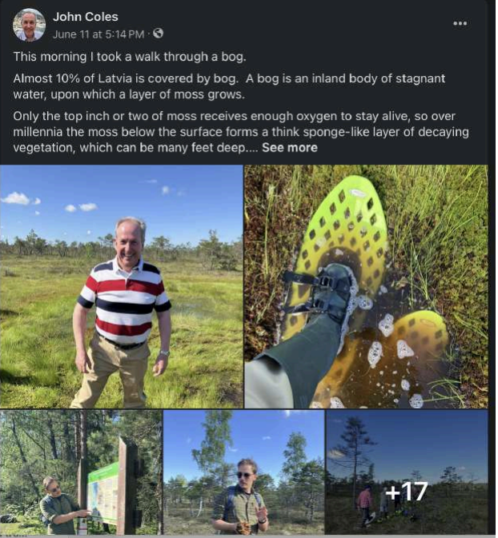
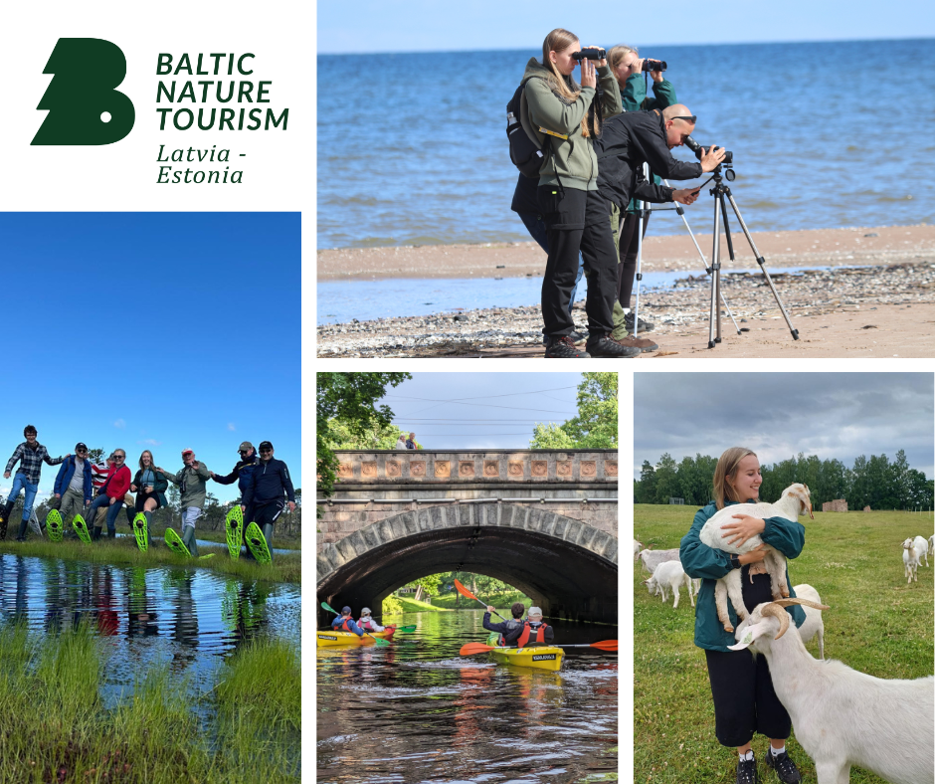
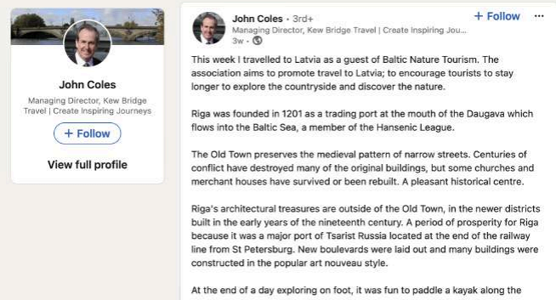
Activity 2.2
FAM trips for UK tour operators, travel companies and media
Since last meeting, 2 FAM trips were organised in cooperation with Latvian Tourism board (LIAA and airBaltic). The first one on May 30-31, 2024. 2 persons from UK travel trade participated.
The second one was held from June 10-13, 2024, where 7 UK tour operators and media representatives participated. Both FAM trips introduced the Estonian-Latvian nature tourism product. Feedback received was positive.

Slide 14

Activity 2.3
Estonian-Latvian nature tourism product presentation at travel markets
LC signed up for common Latvian stand for WTM in London together with the Latvian tourism board (NOV 2024, London). The contract is made and application form filled in.

Slide 15
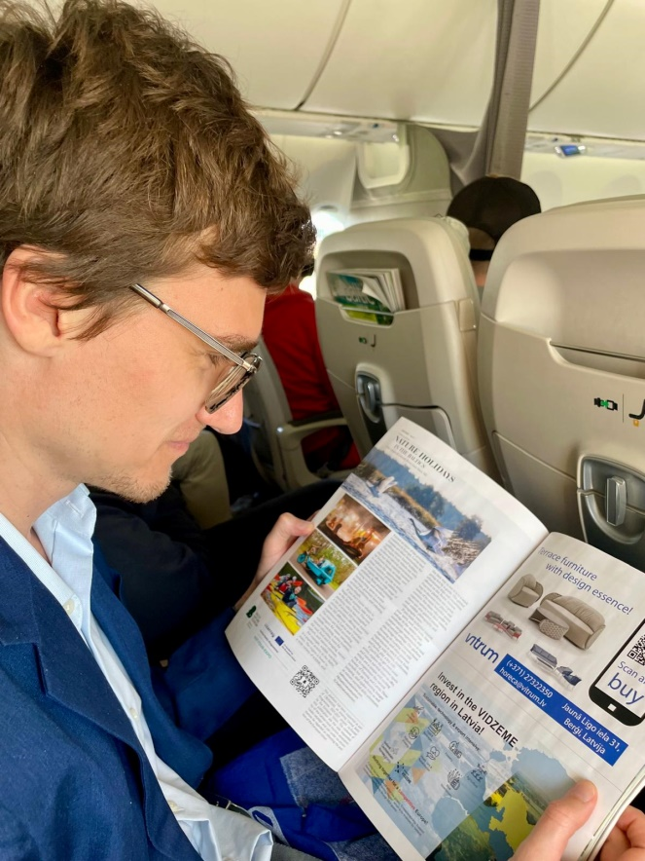
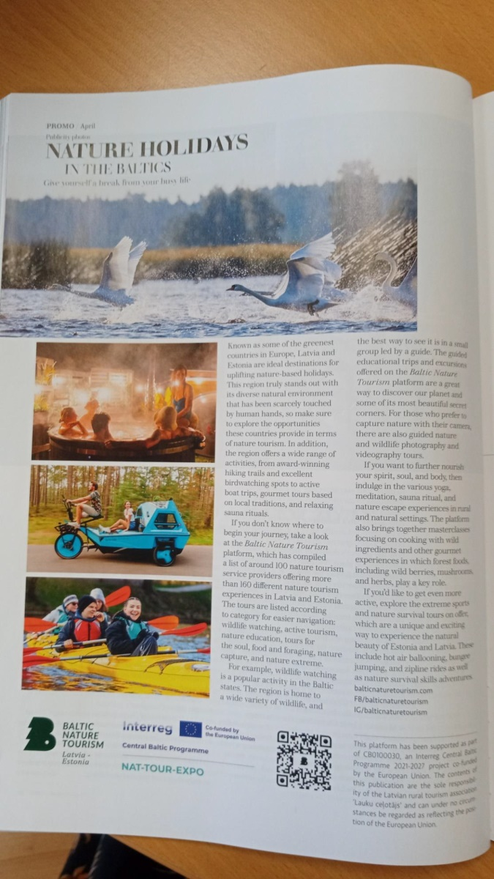
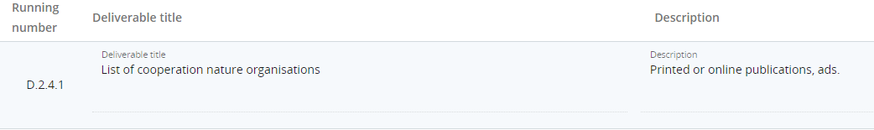
Activity 2.4
Estonian-Latvian nature tourism product presentation to nature organisations in the UK
During April, an advertisement was put in the Baltic Outlook (AirBaltic on-board magazine).

Slide 16
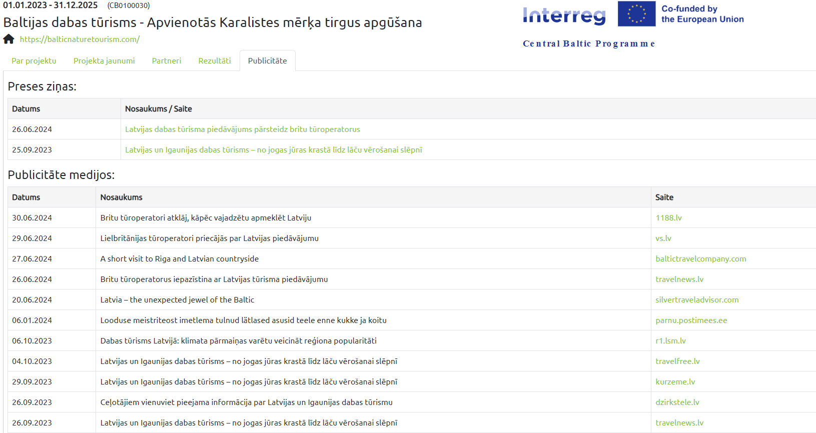
Activity 2.7
E-newsletters and press releases
On 26.06.2024, a press release about a feedback from BNT's FAM trip in Latvia was sent to 699 recipients - Latvian media and tourism information centers and Latvian tour operators and travel agents.
On 17.04.2024, a press release about the feedback on BNT's organized event in London for UK tour operators and media representatives - to 589 recipients, Latvian media and tourism information centers.
Both Summer e-newsletters (#5 & #6) to highlight seasonal nature tourism products, designed also as PDF file. Recipients - 200+ UK specialist operators and media, on Mailchimp e-mail marketing system 330+ for international travel agents and tour operators, 91 for Latvian and Estonian Nature tourism SMEs. 500 copies of Summer e-newsletter were printed for marketing purposes to be distributed at events.
2 MailChimp e-mails about different BNT activities were sent out to previously mentioned international travel agents and tour operators, Latvian and Estonian Nature tourism SMEs + 84 recipients of Latvian diaspora and embassies.

Slide 17
2.8. Review of other sales and marketing platforms
online marketing and sales platforms relevant for promotion and sales of the Estonian-Latvian nature tourism product.
will summarise the opportunities, conditions and costs to put the product on such platforms. Relevance criteria will include: affordability for SMEs, flexibility to update product information, flexibility of commercial contract conditions, etc. According to previous experience, commercial platforms are not an appropriate solution for newly developed products as they do not provide for flexibility in the first stage while the products need to undergo certain adaptation and fine-tuning before final commercialisation.
The SMEs will be able to approach relevant commercial platforms after they have experienced market reactions on the project platform.

Slide 18
UK activities
1) Generally suppliers are happy with the levels of business and enquiries they have received from the UK. BNT will share some information on bookings and enquiries from the UK market, to help our marketing strategies and operator engagement
2) The BNT will probably not participate in Nordic Marketplace 2025 -
3) Adventure Europe is an online event and BNT is considering whether to attend. In our view, his would be a good event in which to participate. Valdis registerred
4) Arival Activate Edinburgh . BNT definitely interested in attending. Registerred.
5) BNT now preparing the next Newsletter for September, we will also add that BNT will participate at WTM
6) We will separately inform all interested tour operators that the BNT will be on the Latvian stand at WTM and invite them to visit
7) Anna to create a BNT linkedin profile and social media assets for WTM. LC is created
8) Meeting Inese from LIAA tomorrow and Asnate will feedback any relevant developments or interest in UK activity . WS in March 2025 in Embassy.
9) We will join the BNT meeting on 4th Sept at 14.00 UK time with updates
10) Fam Trips - the autumn could be tricky but possible if we can promote a 'specific angle' also thinking about winter and the options there too. LIAA ready to cooperate, AirB too.
11) Sales calls to offices - we will give feedback from our meetings with tour operators on behalf of Visit Estonia. If there are specific operators from (1) above, we could increase our visibility with them.
12) We will check and present options for nature-based associations in the UK such as the National Trust, RSPB, Ramblers etc
14) Present options and costs for an Equator Learning BNT course. This would be targeted at operators and travel agents.
Started negotiations with LIAA.

Slide 19


