Slide 1
Pilot actions of the accesibility solutions in the improved sites VIDZEME
19.09.2023.

Slide 2
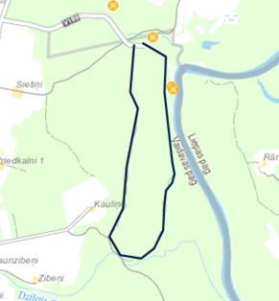
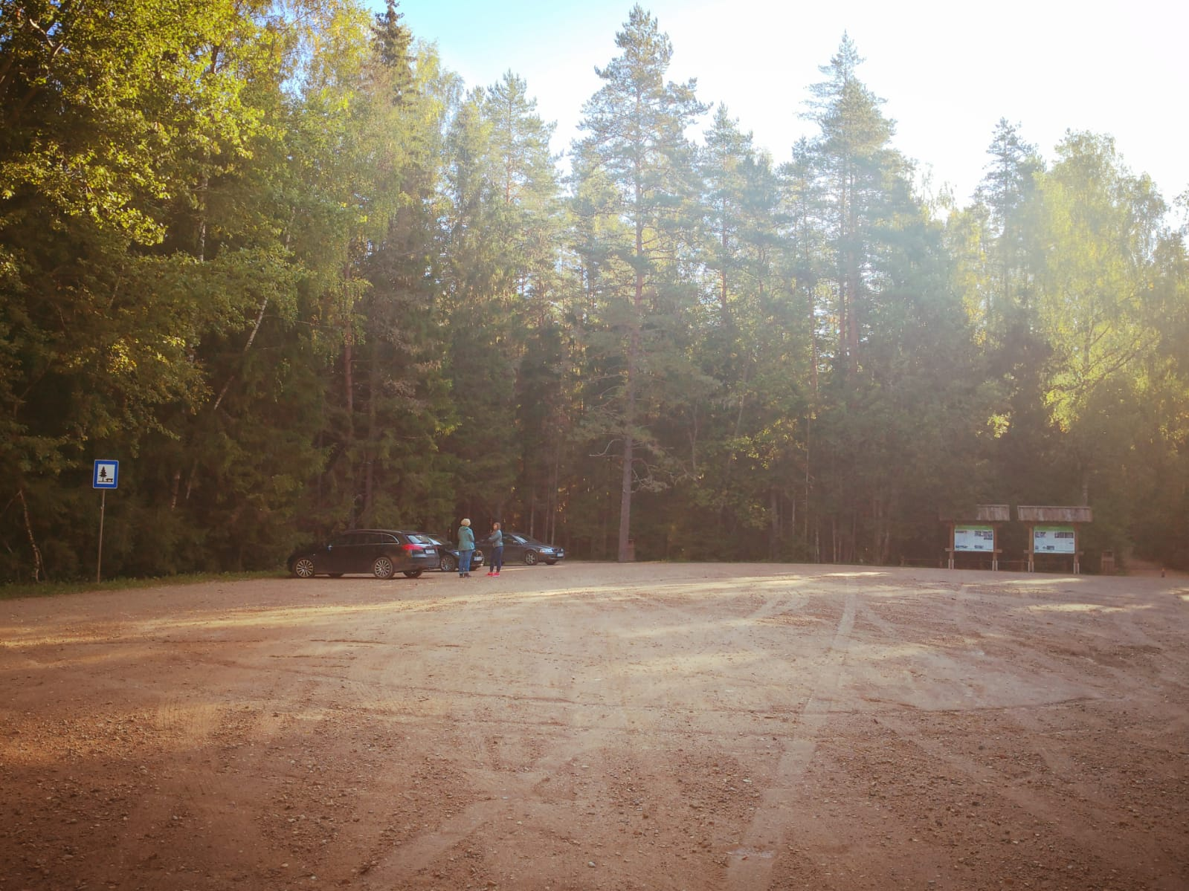
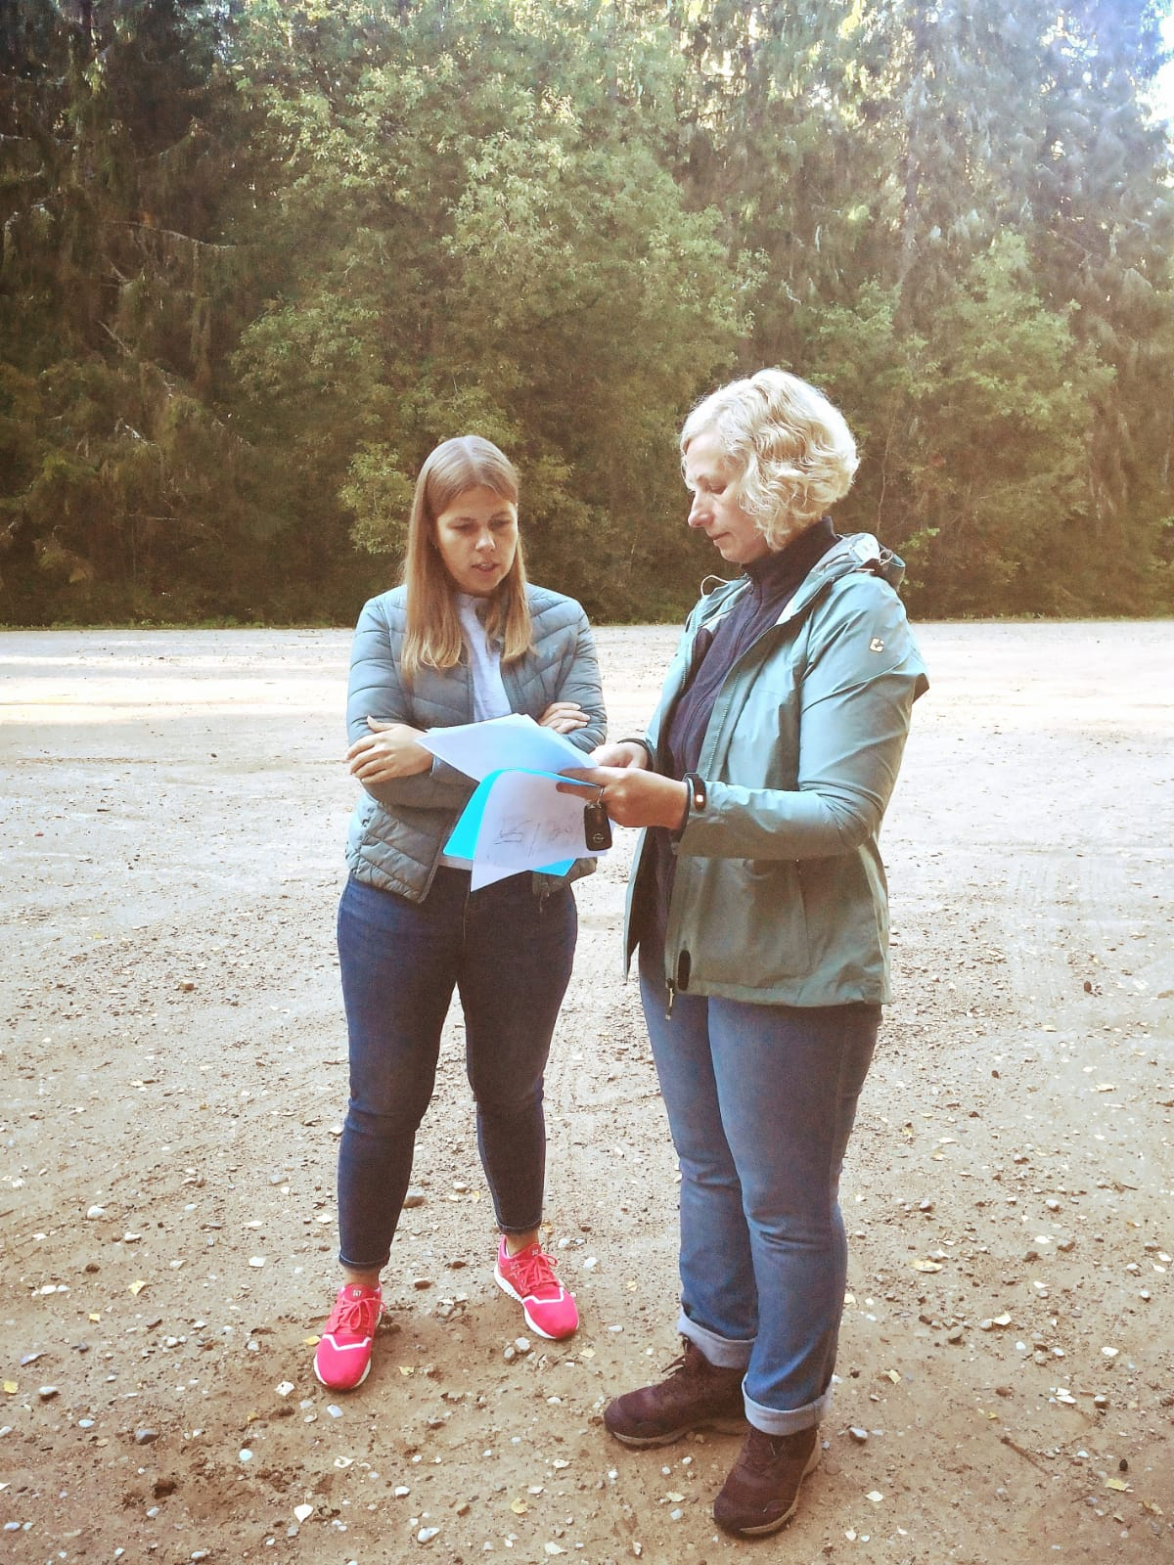
the Forest Trail section #8 Caunītes-Valmiera
3-4 km hiking loop
To make hiking more accessible for families with young children, seniors and other groups
A digital game will be developed and installed on the site using informative tablets with QR codes at the start/end points of loop

Slide 3
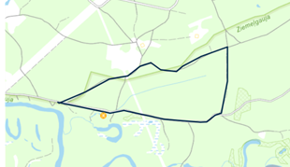
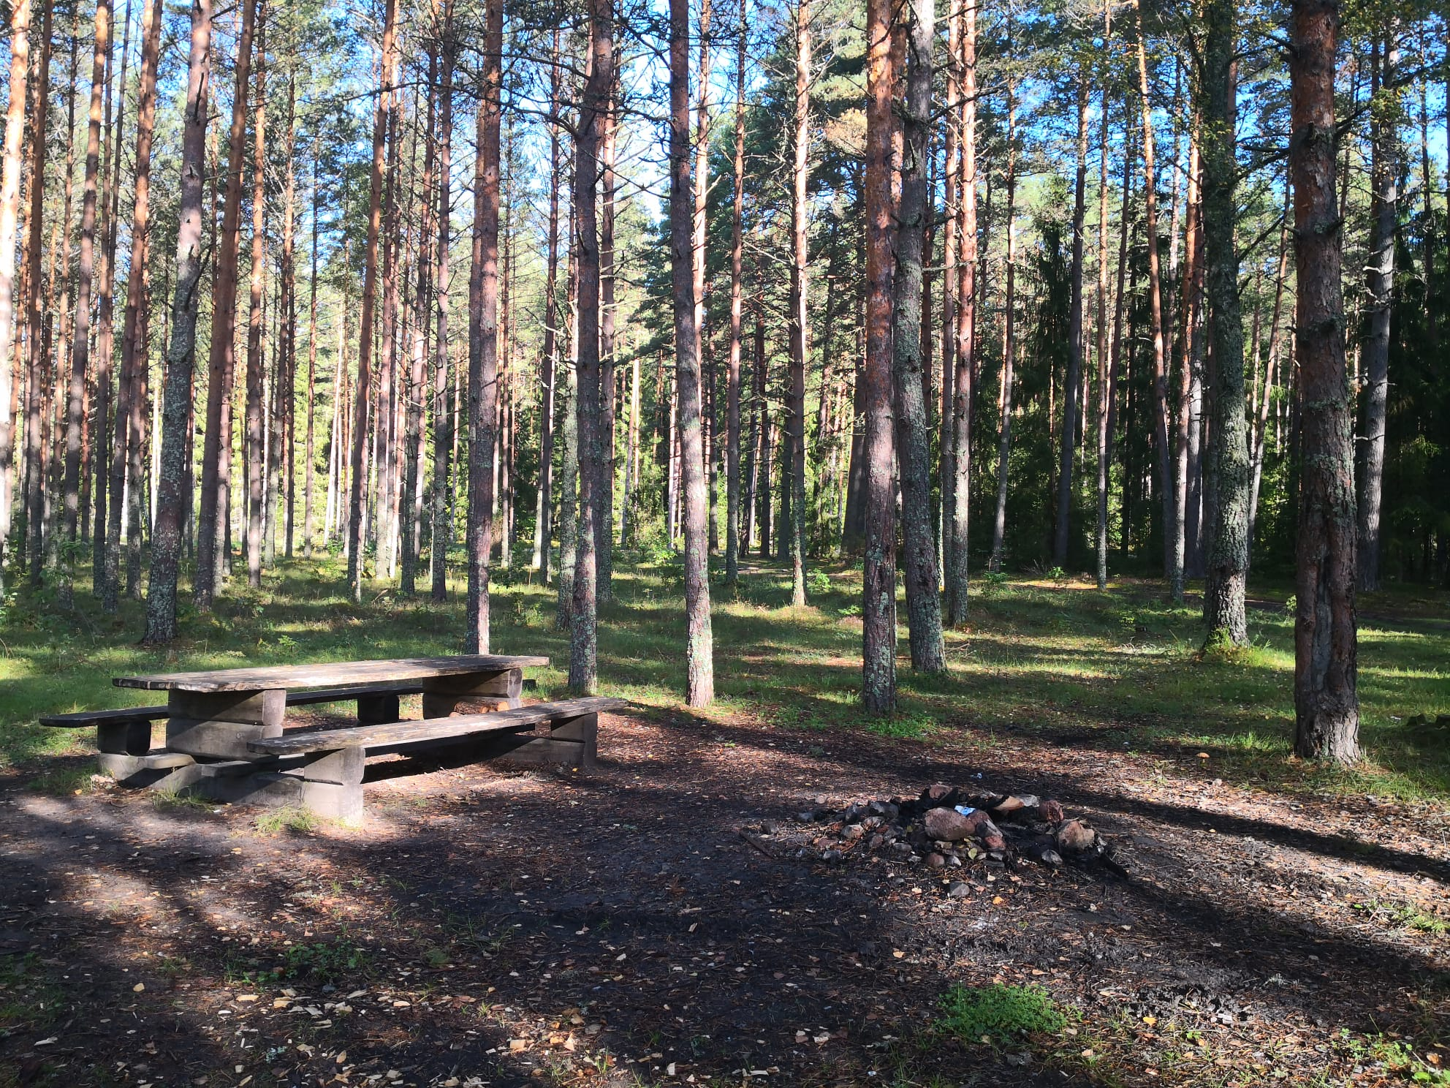
the Forest Trail section #10 Strenči-Spicu tilts
~ 2km hiking loop
To make hiking more accessible for families with young children, seniors and other groups
A digital game will be developed and installed on the site using informative tablet with QR codes at the start/end points of loop

Slide 4
Oliņas 15.09.2023.

