Slide 1

Accessible Hiking Trails
KICK-OFF MEETING
19.09.2023 | Riga
Iveta Šķiliņa
Riga Planning Region, Project coordinator
iveta.skilina@rpr.gov.lv

Slide 2
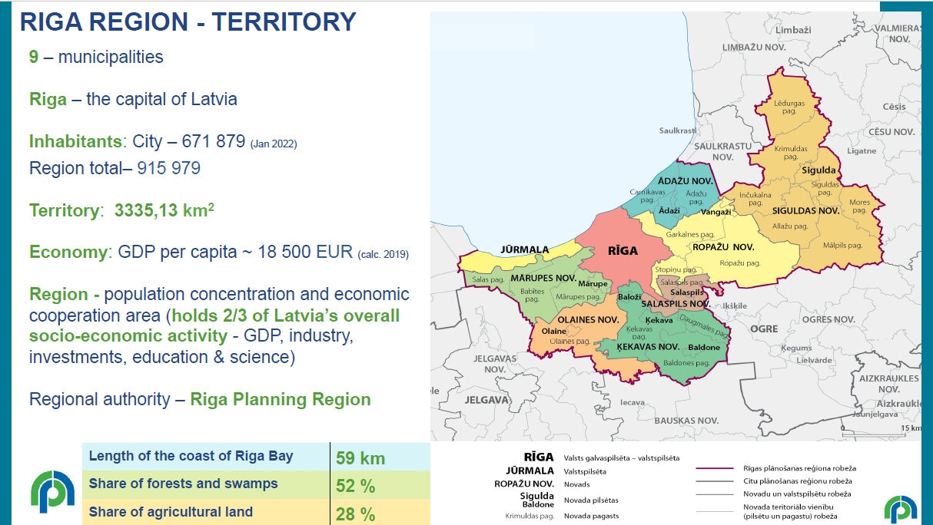

Slide 3
WP3 Pilot actions of the accessibility solutions in the improved sites
Activities and results

Slide 4
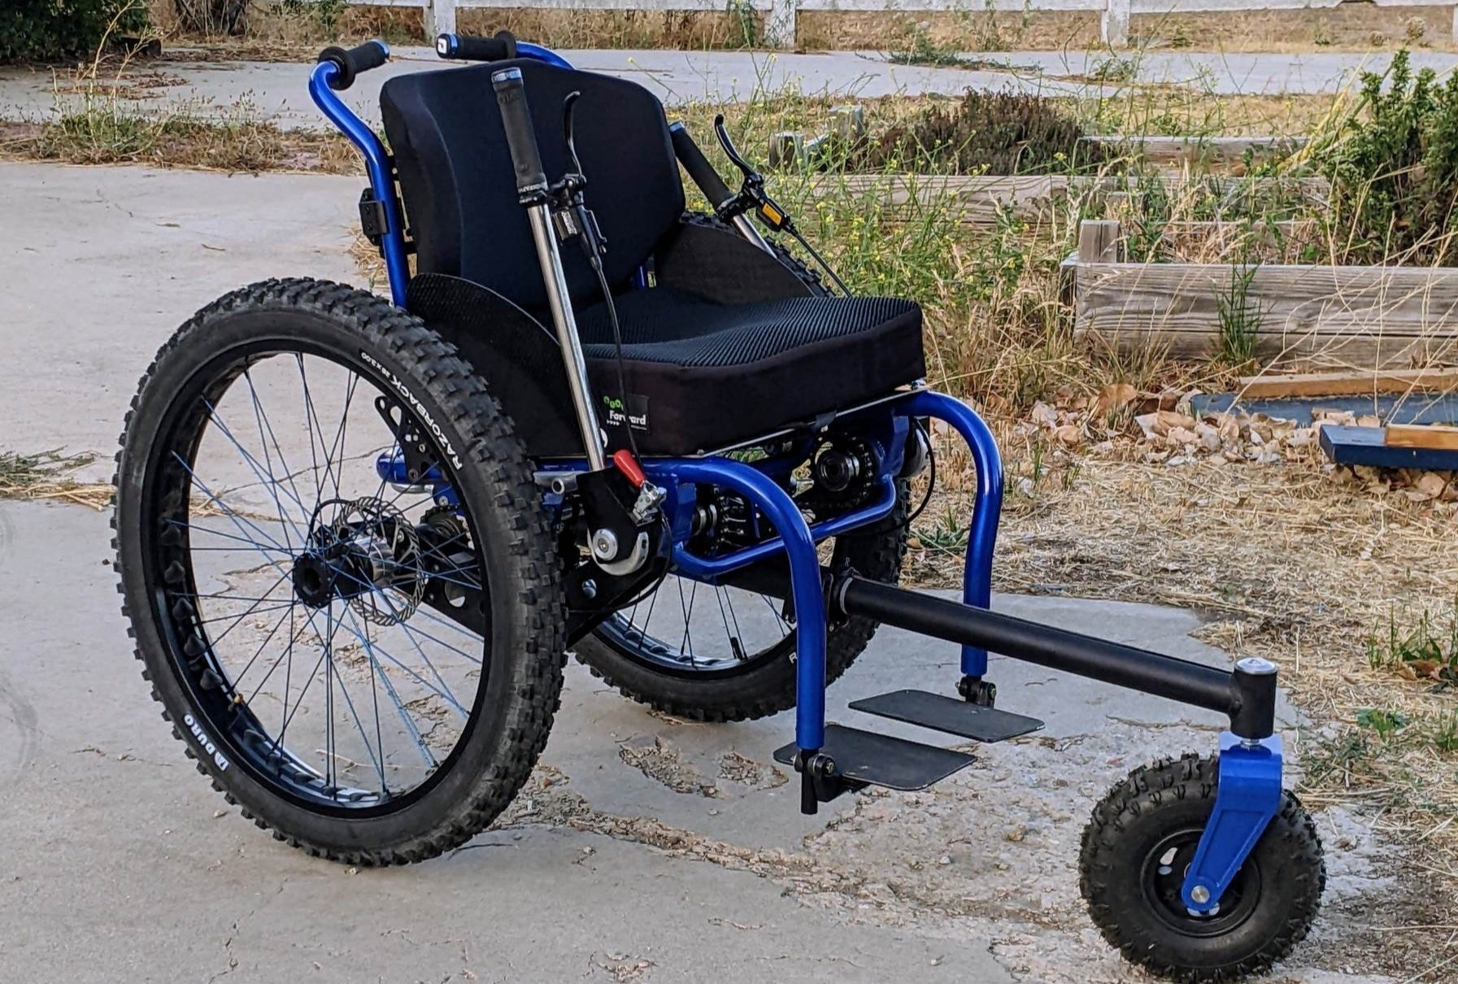
All surface wheelchair accessibility in Carnikava
Accessibility solution 1
Purchase of specially designed outdoor wheelchairs suitable for all trail surfaces and installation of universal design elements supporting accessibility (e.g., specific marking, info plates, digital route, beach access mats etc.)

Slide 5
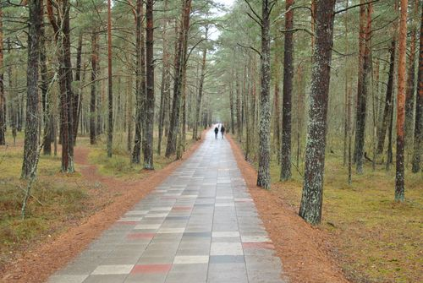
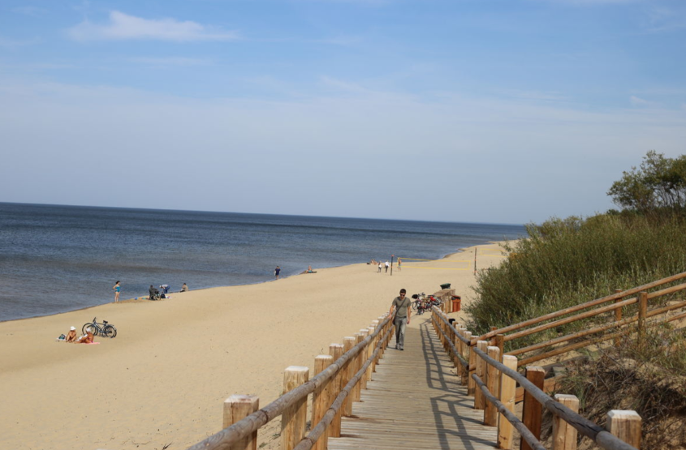
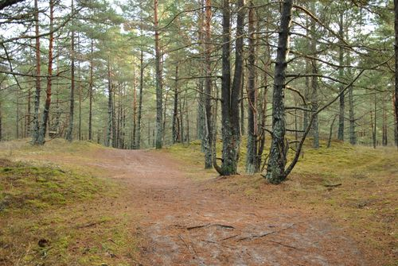
All surface wheelchair accessibility in Carnikava
Accessibility solution 1

Slide 6
All surface wheelchair accessibility in Carnikava
Accessibility solution 1
RESULTS:
hiking wheelchairs available individually at the Carnikava visitor’s centre;
developed wheelchair path;
online travel information, guidelines on using hiking wheelchair, safety information, etc.;
organized hiking events for people with disabilities.

Slide 7
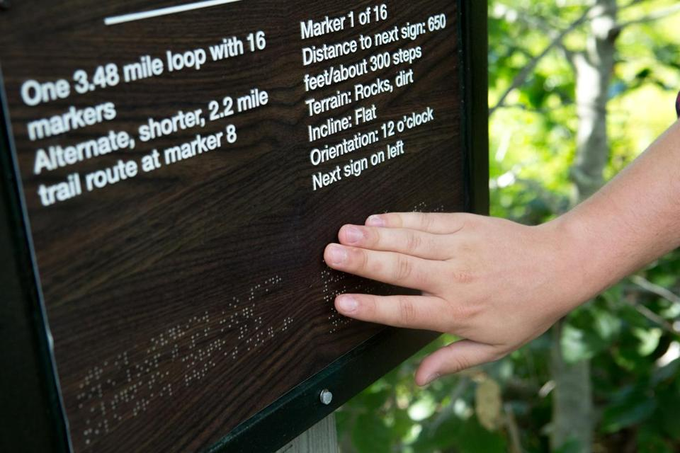
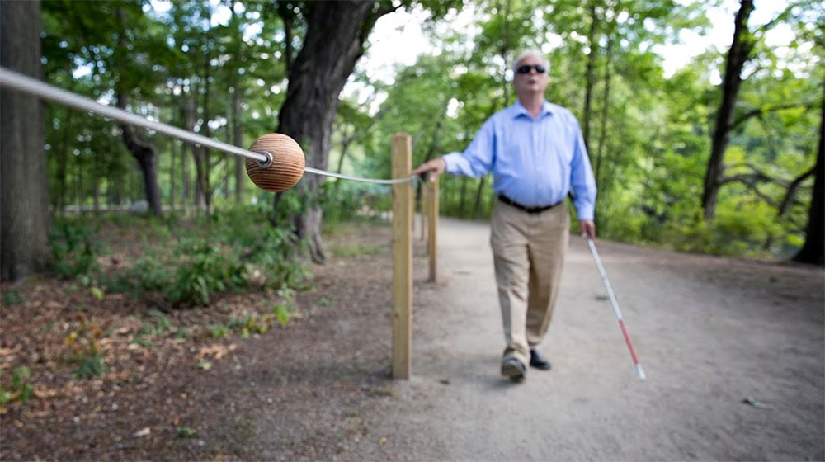
Impaired vision accessibility solutions in Jūrmala
Accessibility solution 2
2 km part of the Coastal Hiking trail with accessibility elements (e.g., info in braille, guided ropes, audio-guide with navigation instructions);
signs on the beach to the nearest WC with baby changing table accesible also for disabled persons.

Slide 8
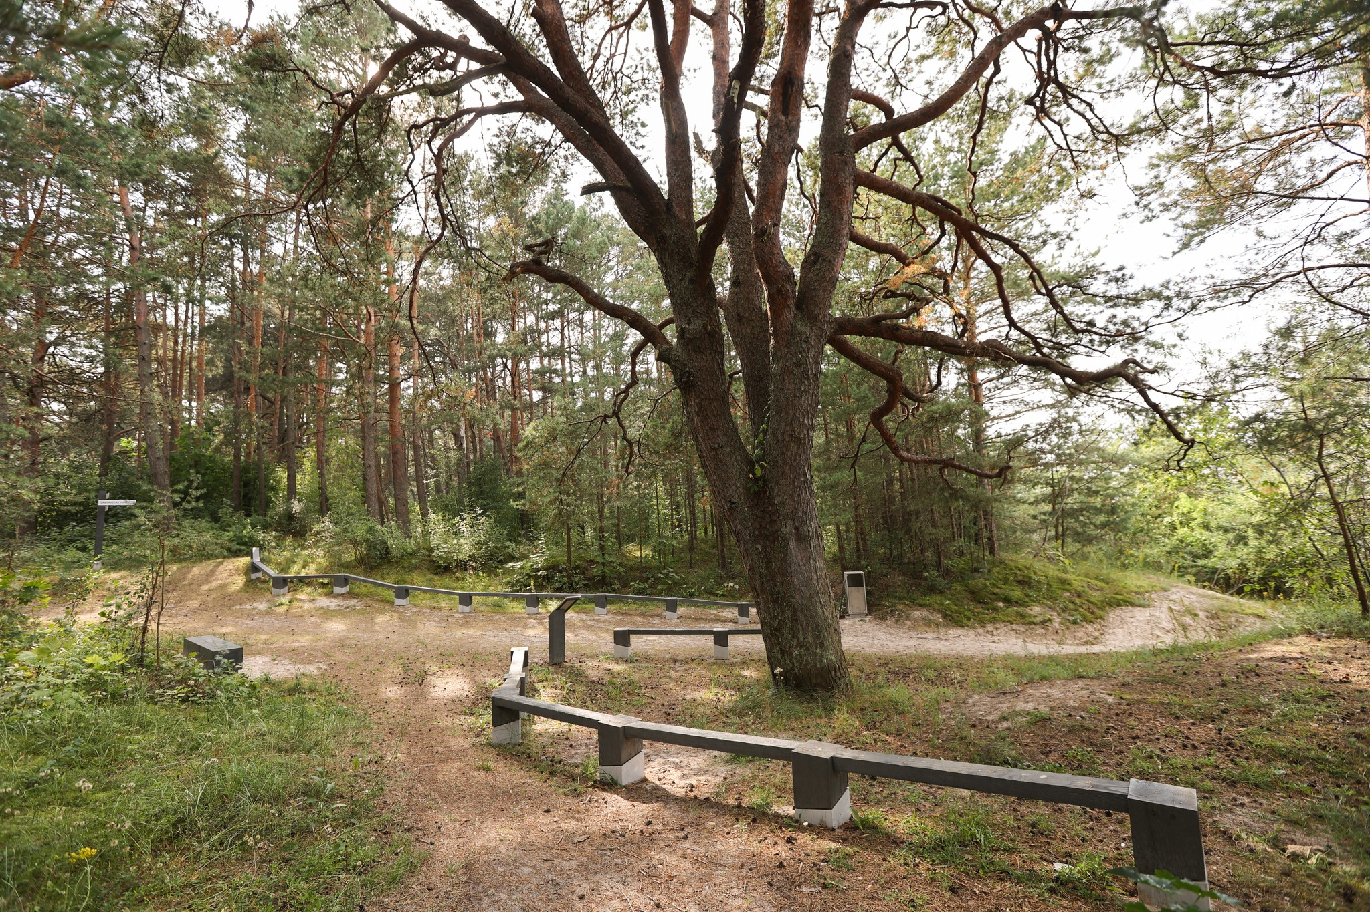
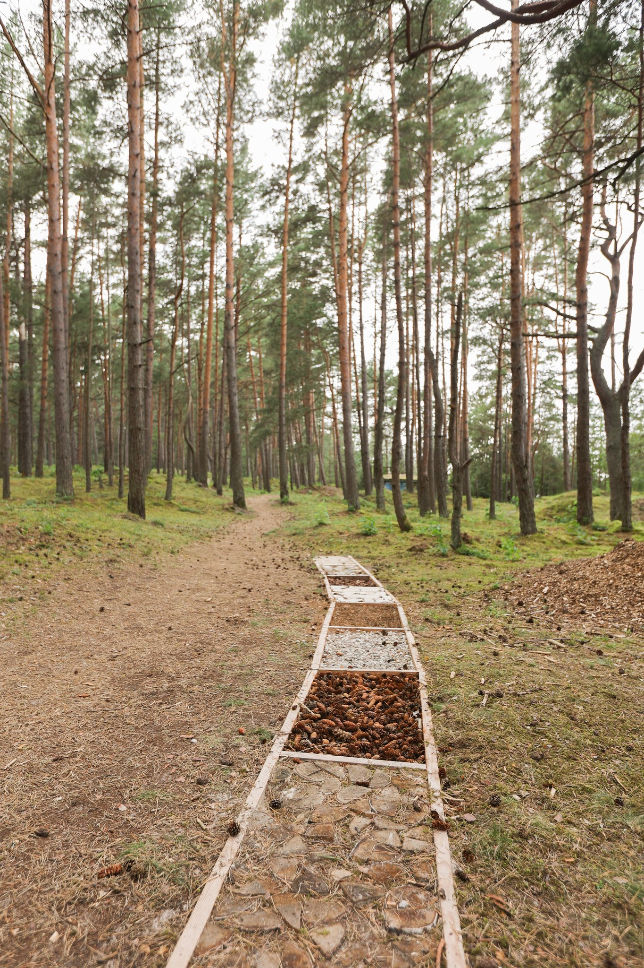
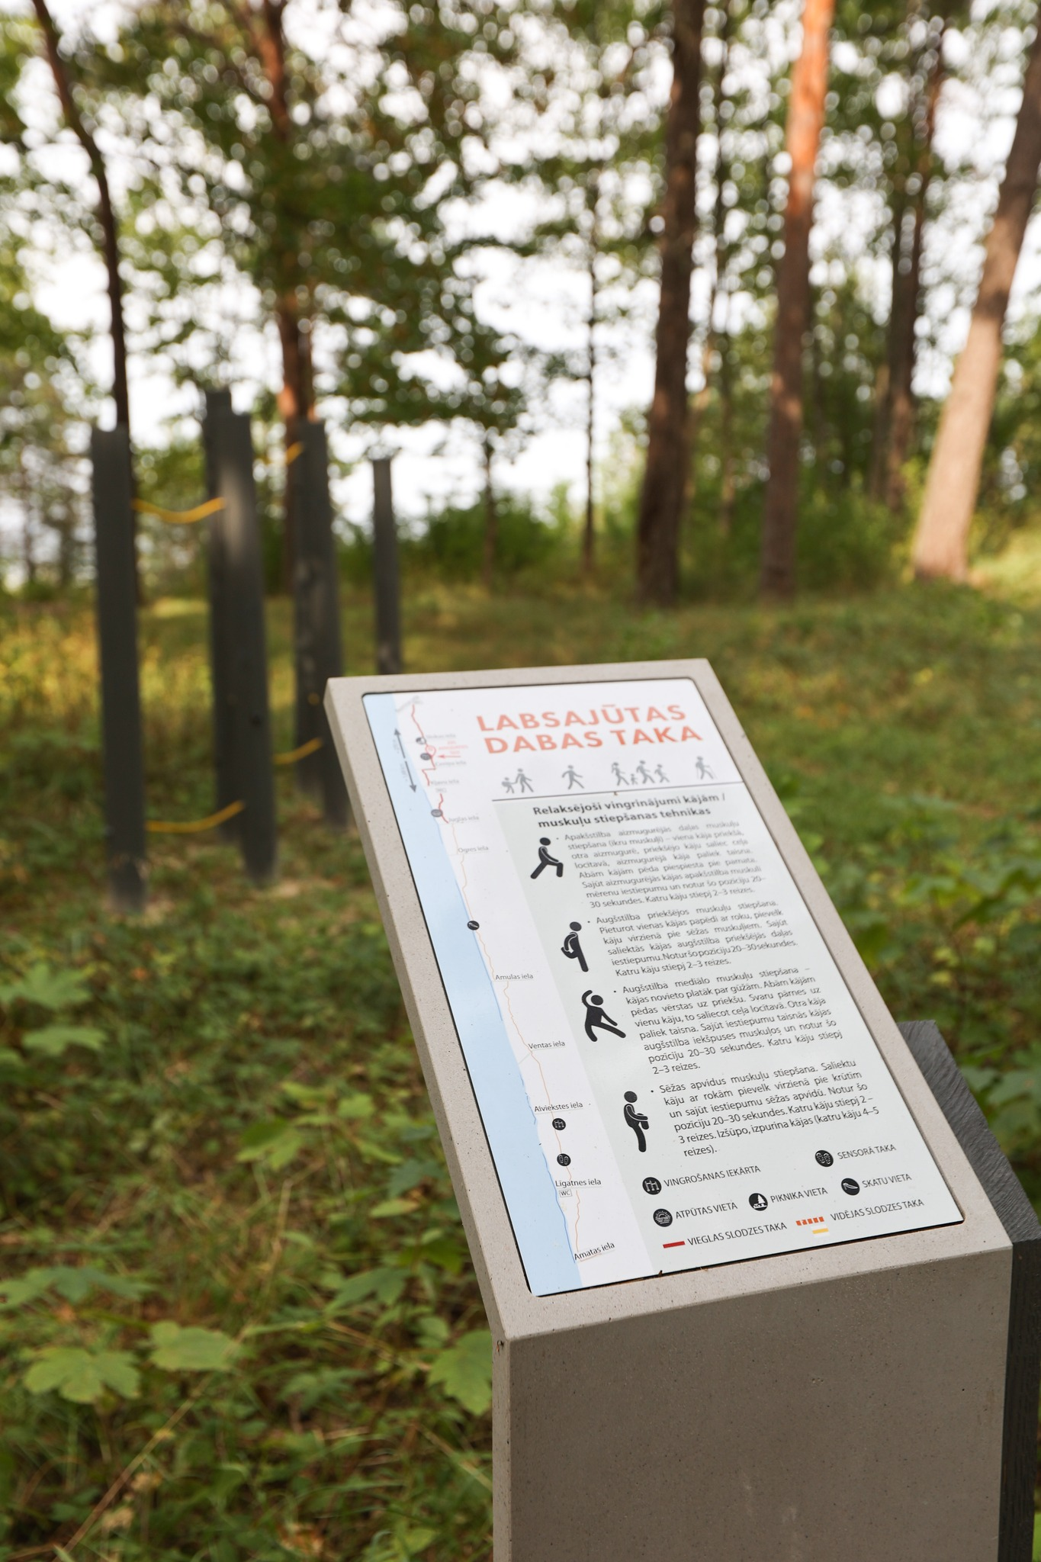
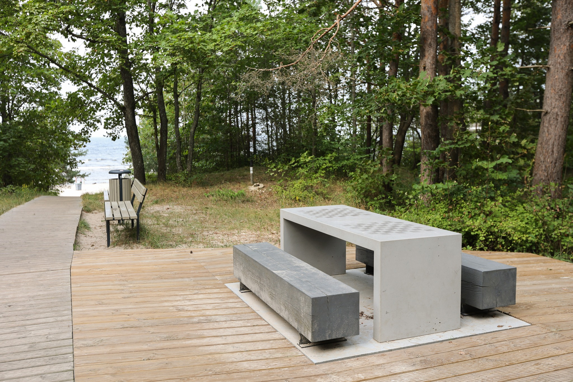
Impaired vision accessibility solutions in Jūrmala
Accessibility solution 2

Slide 9
Impaired vision accessibility solutions in Jūrmala
Accessibility solution 2
RESULTS:
access to the part of the Coastal Hiking Trail for people with visual impairments;
signs Accessible Toilet and Baby Changing on the beach area;
online travel information, guidelines on hiking, safety information, etc.;
organized hiking events for people with disabilities.

Slide 10
?
Questions

