Slide 1


Service design know-how for rural SMEs strengthening the link between adult learning and working life in rural SME local food sector
1st partner meeting, Parnu, EE, 21.10.2016.
Nordplus Adult 2016 (09/2016 - 08/2017) (NPAD-2016/10040)

Slide 2
Project partners
Lead partner:
Latvian Country Tourism Association
Project partners:
- EE-Olustvere Service and Rural Economy Vocational School (EE)
- Norwegian Rural tourism and local food "HANEN" (NO)

Slide 3
Key result of the project
„Service design know-how for rural food SMEs-
Opening your farm shop”:
Printable handbook
On-line training tool
LV, NO, EE languages
Project duration: 09/2016 - 08/2017

Slide 4
WP1. Specification of the On-line Training structure (09.-11.2016)
- define structure with chapters and sub-chapters = framework and specification for learning contents – done/proposed for partner meeting
- 1 partner meeting aligned with the 9th Baltic Sea Tourism Forum (BSTF) in Pärnu to discuss and finalise the On-line Training chapter titles and structure – ongoing
- evaluate the structure with the target audience – SMEs and training sector in LV, EE, NO. -
Deliverable: On-line Training structure in English – common for all partners / Baltic-Nordic country SMEs.

Slide 5
WP2. On-line Training learning contents (12. 2016. – 06.2017.)
1. Translate the On-line Training structure to partner languages.
2. Develop survey form and visit SMEs to collect best practice.
3. Olustvere school proposes instruction how the information content should be presented in the On-line Training tool.
4. Partners develop learning contents in their national languages.
5. Testing evaluation in partner countries with SMEs and training sector.
6. 2nd partner meeting in Norway.
Deliverable: On-line Training - full learning contents in LV, NO, EE languages.

Slide 6
WP3. Dissemination
(09.2016. – 08.2017.)
Dissemination Plan for project months 1-3:
- Project web page within www.celotajs.lv
- Partners produce e-flyer
- Dissemination and networking in the 9th Baltic Sea Tourism Forum (BSTF) in Pärnu

Slide 7
WP3. Dissemination (09.2016. – 08.2017.)
Dissemination plan for project months 4-11:
Dissemination focused on the On-line Training structure and testing evaluation.
all partners: roundmails, e-newsletter, social networks, project/partner web site info, board meetings, member assembly, meetings with networking partners, relevant international events;
Project 2nd meeting with public session and participation of Innovation Norway, regional representatives, members of Hanen and other interested stakeholders.

Slide 8
WP3. Dissemination (09.2016. – 08.2017.)
Dissemination plan for project month 12: Dissemination
focussed on promotion of the projuct result – the On-line training tool
with printable handbook version for reading and reference „Service
design know-how for rural food SMEs”.
All partners: roundmails, e-newsletter, social networks, project/partner web site, board meetings, member assembly, meetings with networking partners, relevant international events; training portal www.macies.celotajs.lv, links in web site www.gardsutvikleren.no ; links in web site www.olustvere.edu.ee
- Project final meeting in Latvia.

Slide 9
Dissemination WP deliverable:
Feedback summary from the target audience in all partner countries.
Target audiences – next slide:

Slide 10
Dissemination target audience - LV
ca 4000 rural tourism and rural food SMEs in LV;
ca 120 training establishments in LV, especially to vocational schools, competence centres and LLKC
Latvian Cooperation Council of Agricultural Organisations (~17 000 members)
the board and general assembly of the LCTA;
specialised media journalists

Slide 11
Dissemination target audience - EE
Eesti Maaturism and ca 100 rural tourism and rural food organizations;
ca 10 training establishments in Estonia offering adult training courses;
Estonian Cooperation Council of Agricultural Organisations

Slide 12
Dissemination target audience - NO
ca 460 rural tourism and local food SMEs in NO – members of the organization;
the board of Hanen;
12 regional offices of Hanen in Norway
ca 20 training establishments in NO;
organisations in NO: Statens Vegvesen, Innovation Norway, Farmers' market, Norwegian Farmers
Union (~60 000 members), Matmerk.
Social media, Facebook and Twitter
Nationen and Bondebladet – main papers for rural area
Rural development offices in 19 counties

Slide 13
Dissemination target audience - Baltic/Nordic:
Partner organisations in the project „Baltic Culinary Routes” (DE, DK, NO, EE, LT, LV, PL, NO, SE, FI, RU)
- Eldrimner www.eldrimner.com – Swedish organisation for local food
- Icelandic Farm Holidays (IFH)
- Savour South West Denmark
- Participants of the 9th Baltic Sea Tourism Forum (BSTF)

Slide 14
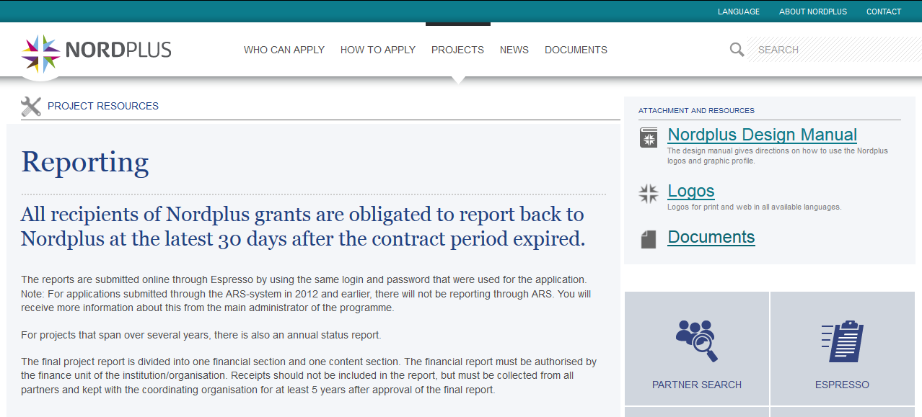
Visual identity rules and programme handbook
http://nordplusonline.org/Projects2/Project-resources

Slide 15
On-line training structure
(Handbook contents)
Introduction
General requirements
Design – store concept and merchandising
Store and warehouse
Safety
Hygiene conditions, taking visitors
Sales skills
Marketing and promotion
Useful IT solutions
Local cooperation

Slide 16
E-flyer contents - proposal
Title page: photo, title of the handbook (full title as in project application and brief title “Open your Farm Shop!”)
Brief annotation of the Handbook – for whom, why, where to get (links), how to use, languages
Handbook contents – headings of chapters listed
Illustrative and generic best pratice example – ideal farm shop (photos + brief description/comments in the context of Handbook)
Partner info
Project info
Nordplus visual identity and reference

Slide 17
Next tasks and deadlines to be agreed:
Task | Deadline
E-flyer | 30.11.16
Translate Handbook structure to EE, LV, NOR | 1.12.16
Evaluate the Handbook structure with the target audience SMEs | 15.12.16
Survey form for best practice visits | ???
Olustvere – content presentation instruction | 10.02.17
Learning contents in national languages | 1.04.17
Contents testing | 1.07.17
Putting contents online | 1.08.17
2nd partner meeting in NOR | 02.2017
3rd partners meeting in LV | 06.2017

Slide 18

Latvijas lauku tūrisma asociācija “Lauku ceļotājs”
Kalnciema iela 40, Rīga, LV-1046, +371 67617600
E-pasts: lauku@celotajs.lv Facebook: Lauku Celotajs twitter.com/Laukucelotajs

