Slide 1


Service design know-how for rural SMEs strengthening the link between adult learning and working life in rural SME local food sector
2nd partner meeting, Oslo, NOR, 09.-10.03.2017.
Nordplus Adult 2016 (09/2016 - 08/2017) (NPAD-2016/10040)

Slide 2
Project overview
WP title | WP duration | Deliverable
WP1. Specification of the On-line Training structure. | 09. - 11.2016 | On-line Training structure in English – common for all partners / Baltic-Nordic country SMEs.
WP2. On-line Training learning contents. | 12.2016. - 06.2017. | On-line Training - full learning contents in LV, NO, EE languages.
WP3. Dissemination | 09.2016. – 08.2017. | Feedback summary from the target audience in all partner countries.
https://drive.google.com/drive/folders/0B9FqfSUXLt1PYlg0SGVoZlZCeGc - project documents stored

Slide 3
WP1. Specification of the On-line Training structure (09.-11.2016)
- define structure with chapters and sub-chapters = framework and specification for learning contents – done
- 1 partner meeting aligned with the 9th Baltic Sea Tourism Forum (BSTF) in Pärnu to discuss and finalise the On-line Training chapter titles and structure – done
- evaluate the structure with the target audience – SMEs and training sector in LV, EE, NO. - ???
Deliverable: On-line Training structure in English – common for all partners / Baltic-Nordic country SMEs.

Slide 4
WP2. On-line Training learning contents (12. 2016. – 06.2017.)
1. Translate the On-line Training structure to partner languages - done
2. Partners develop survey form for visits to SMEs and collecting best practice – to do!
3. Partners select the best practice cases and visit them to source information for the On-line Training. Interviews with service providers to highlight the most important aspect, and document the best practices in photos. Visits in active season to get the best illustrative material – to do!

Slide 5
WP2 - continued
4. Olustvere school proposes instruction how the information content should be presented in the On-line Training tool – ongoing.
5. Partners develop learning contents in their national languages – ongoing.
6. Testing evaluation of on-line contents in partner countries with SMEs and training sector. The feedback will be incorporated in the final version (Ca 10 SMEs/organisations and at least 1 training establishment in each country – see also slide 10. Evaluation) – to do!
7. 2nd partner meeting in Norway - ongoing.
WP Deliverable: On-line Training - full learning contents in LV, NO, EE languages.

Slide 6
WP3. Dissemination
(09.2016. – 08.2017.)
Dissemination Plan for project months 1-3:
- Project web page within www.celotajs.lv – http://www.celotajs.lv/en/project/4 news to be added,
- Partners produce e-flyer - done
- Dissemination and networking in the 9th Baltic Sea Tourism Forum (BSTF) in Pärnu - done

Slide 7
WP3. Dissemination (09.2016. – 08.2017.)
Dissemination plan for project months 4-11:
Dissemination focused on the On-line Training structure and testing evaluation.
all partners: roundmails, e-newsletter, social networks, project/partner web site info, board meetings, member assembly, meetings with networking partners, relevant international events;
Project 2nd meeting with public session and participation of Innovation Norway, regional representatives, members of Hanen and other interested stakeholders.
! Partners please collect evidences of dissemination activities for reporting.

Slide 8
WP3. Dissemination (09.2016. – 08.2017.)
Dissemination plan for project month 12: Dissemination
focussed on promotion of the projuct result – the On-line training tool
with printable handbook version for reading and reference „Service
design know-how for rural food SMEs”.
All partners: roundmails, e-newsletter, social networks, project/partner web site, board meetings, member assembly, meetings with networking partners, relevant international events; training portal www.macies.celotajs.lv, links in web site www.gardsutvikleren.no ; links in web site www.olustvere.edu.ee
Project final meeting in Latvia – 26.06.2017

Slide 9
Dissemination target audience to reach:
LV | NOR | EE
- ca 4000 SMEs ca 120 training establishments Latvian Cooperation Council of Agricultural Organisations (~17 000 members) the board and general assembly of the LCTA; specialised media journalists. | - ca 460 members of Hanen the board of Hanen 12 regional offices of Hanen ca 20 training establishments - Organisations in NO: Statens Vegvesen, Innovation Norway, Farmers' market, Norwegian Farmers Union (~60 000 members), Matmerk - Social media, Facebook and Twitter - Nationen and Bondebladet – main papers for rural area - Rural development offices in 19 counties | - Eesti Maaturism and ca 100 rural tourism and rural food organizations; - ca 10 training establishments in Estonia; - offering adult training courses; - Estonian Cooperation Council of Agricultural Organisations
BALTIC/NORDIC - Partner organisations, project „Baltic Culinary Routes” (DE, DK, NO, EE, LT, LV, PL, NO, SE, FI, RU) - Eldrimner www.eldrimner.com – Swedish organisation for local food. - Icelandic Farm Holidays (IFH) - Savour South West Denmark - Participants of the 9th Baltic Sea Tourism Forum (BSTF)

Slide 10
Evaluation activities for reporting
evaluation of the project progress, budget and result achievement during the project meetings (each WP) – include in minutes;
evaluation of the On-line training structure with the target audience is done combining with dissemination events at the end of WP1 – partners to describe for reporting
evaluation of the On-line Training contents and functionality is done during WP2. Ca 10 SMEs/organisations and at least 1 training establishment in each country will do the testing evaluation:
  in LV with LLKS and Vallmiera Lifelong Learning centre,
  in EE with school students and in cooperation with Estonian Rural Tourism Organisation Eesti Maaturism,
  in NOR with farms school - Hvam vidaregående skole www.hvam.vgs.no and wth the 12 regional offices.
  To be discussed with WP2 tasks.

Slide 11
Handbook
“Service design know-how for rural SMEs” content and best example collection by each chapter

Slide 12
Handbook contents
Introduction
General requirements
Design – store concept and merchandising
Store and warehouse – sales room, arrangement of goods, logistics
Safety and food hygiene
Marketing and promotion
Sales skills
Useful IT solutions
Local cooperation

Slide 13
1. Introduction – possible forms of shops
(LV examples)
Seasonal or regular farmers’ markets www.straupestirdzins.lv.
Biological produce shop selling products from a number of farms: http://www.zalazeme.eu/lv/sakums
Home producers’ food shop: http://partikasamatnieki.lv/?page_id=762
Internet shop connecting producers with buyers
http://www.svaigi.lv/lv
Direct buying groups http://tiesapirksana.lv/
Shop on a farm: http://www.kurmisi.com/
Agricultural cooperative shop: http://www.kuldigaslabumi.lv/
All markets web site: www.gadatirgi.lv
Home producers in all regions: http://www.latvijasmajrazotaji.lv/

Slide 14
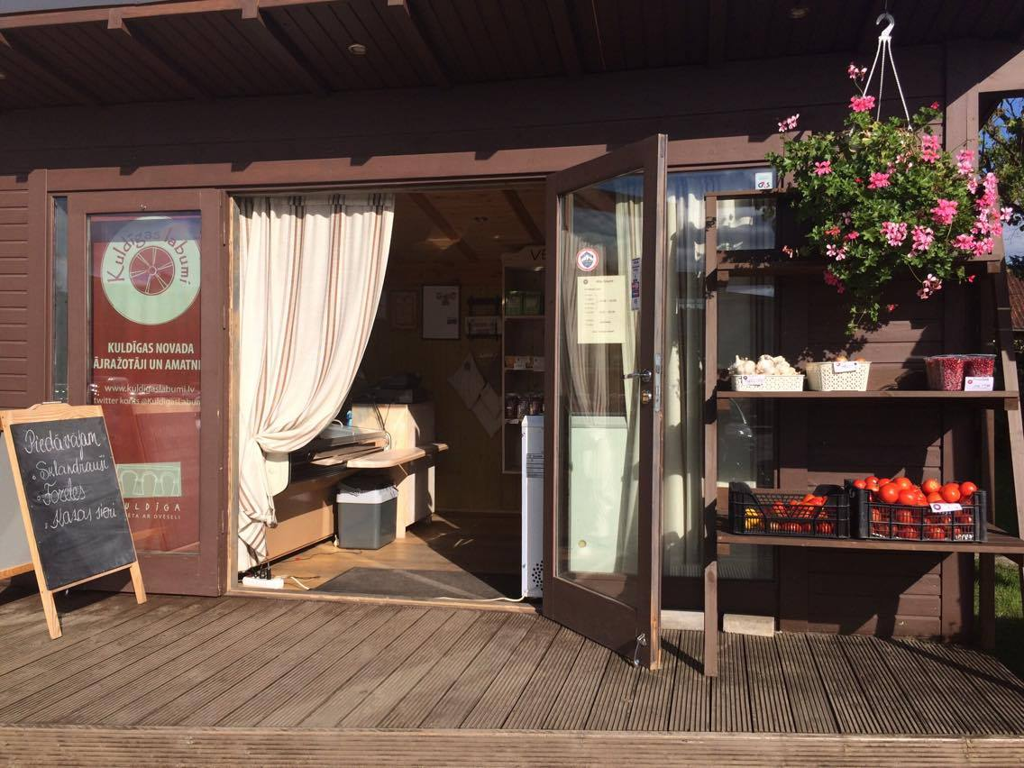
2. General requirements
Agricultural cooperative shop: http://www.kuldigaslabumi.lv/
own logo
legal form – cooperative allows to unite a variety of small producers in locality and gives them chances to survive
uses an accounting program
does not use bar codes, system too expensive
Photo stolen!

Slide 15
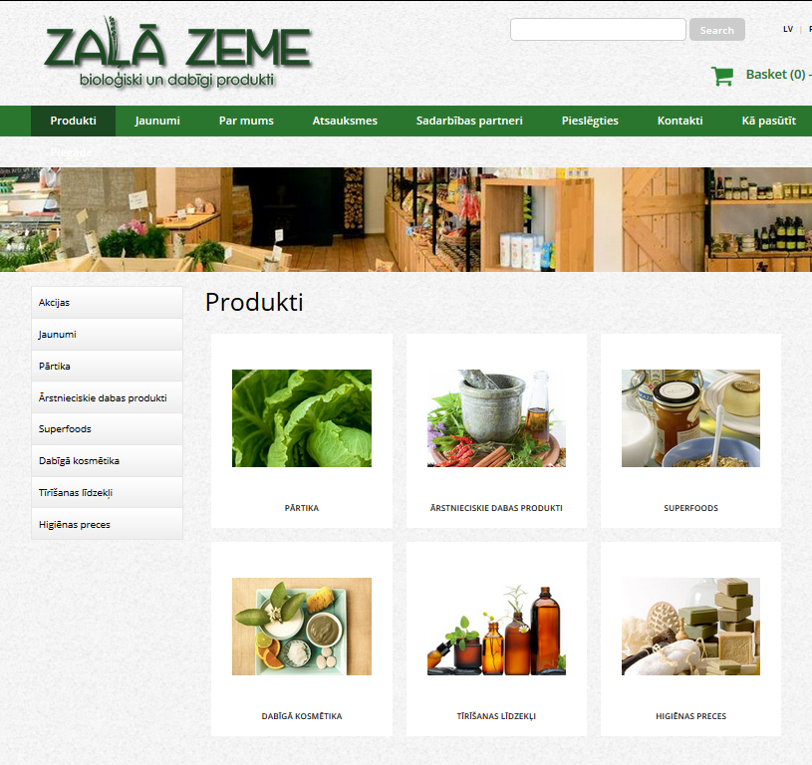
3. Design – store concept and merchandising
Biological produce shop http://www.zalazeme.eu
50 m² sales room and 30m² storage
recommends produce tasting as one of the best ways to introduce your product to the buyer
recommends to use services of a prefessional shop interior designer
focusses on young families with small children
Understand your target audience before you start to arrange the shop rooms!

Slide 16
4. Store and warehouse – sales room, arrangement of goods, logistics
Norway example?

Slide 17

5. Safety and food hygiene
Farm shop “Lauku Labumi”
http://www.latvijasmajrazotaji.lv/razotajs/lauku-labumi/
9 years experience
sells meet, milk and products from own farm and other farms
one person employed
food hygiene training done, but the most important experience and know-how is still gained at work
if a person has good hygiene habits, there are no problem to comply with official requirements
food and safety regulations do not present problems, while national tax policy does
Photo stolen!

Slide 18
6. Marketing and promotion
Example needed!

Slide 19
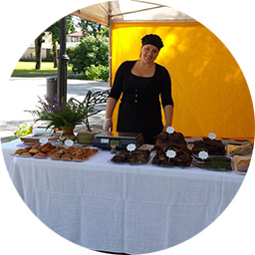
7. Sales skills
Home producer “Brešu virtuve” (Breši Kitchen) http://bresuvirtuve.lv/
home producer sells in markets own smoked meets, pastries, catering for events, parties, celebrations, etc.
the longer is your work experience, the better you understand your client or visitor
the most importan is to communicate actively with your customer talking and offering to taste your produce
shyness is a big problem of home producers – do not keep your mouth shut!
Photo stolen!

Slide 20
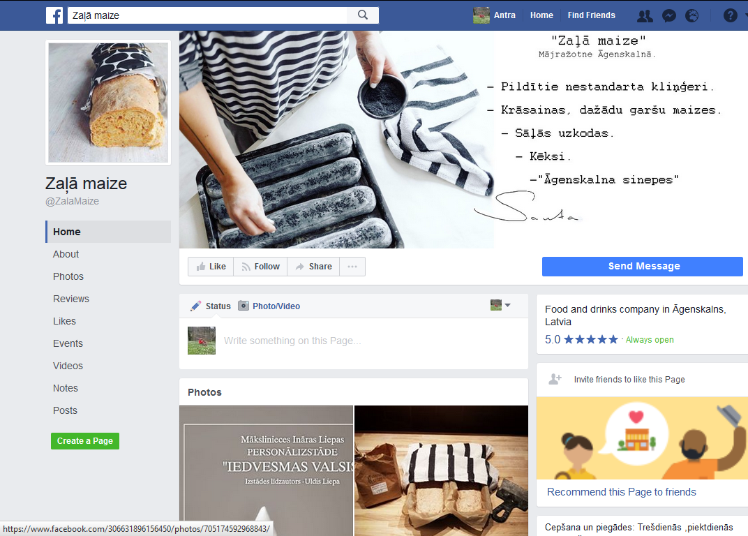
8. Useful IT solutions
Home producer “Zaļā maize” (The Green Bread) https://www.facebook.com/ZalaMaize/
home baked bread
business idea based on active presence in social networks - appearance in Fb brought immediate public attention
friendly communication, based on personal feelings about bread baking on that particular day

Slide 21
9. Local cooperation
Experience story needed!

Slide 22

Latvijas lauku tūrisma asociācija “Lauku ceļotājs”
Kalnciema iela 40, Rīga, LV-1046, +371 67617600
E-pasts: lauku@celotajs.lv Facebook: Lauku Celotajs twitter.com/Laukucelotajs

