Slide 1
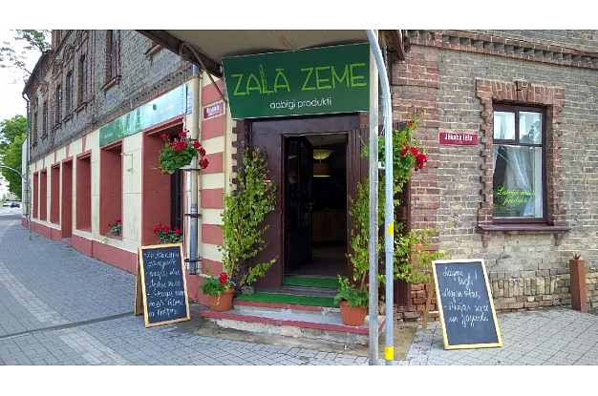

Handbook
Service design know-how for rural food SMEs
OPENING YOUR FARM SHOP
Content and general structure
Nordplus Adult 2016 (09/2016 - 08/2017) (NPAD-2016/10040) Project „Service design know-how for rural SMEs strengthening the link between adult learning and working life in rural SME local food sector”.

Slide 2

Contents!
Client base size?
Competition ?
Economically viable?

Slide 3

General requirements
Company registration
  Ltd, Society, Cooperative
Taxation;
Bureaucracy
  National
  Local!

Slide 4

Design – store concept and merchandising
Store location recommendations;
Facilities and equipment;
Running costs and cashflow expenditures;
Design fitout;
Merchandising – what is it, how to use it in small shops;
Environmentally friendly packaging – bags, coffee/ tea mugs, wrapping paper.
EXAMPLE – Where and how person gains knowledge about shop furnishing to attract customers.

Slide 5
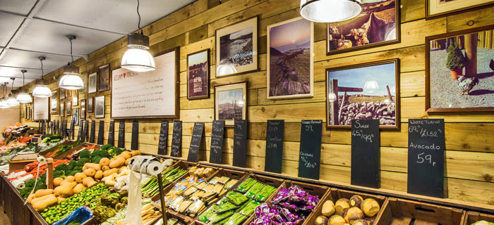
Store and warehouse
Finishing touches;
Appropriate lightning;
Presentation and arrangement; (what is marketable passage);
why define the target group of buyers;
Back office, prep and storage requirements;
Disability access; parents and toddlers.
EXAMPLE – Mareks Gūtmanis, “Zaļā zeme”.

Slide 6

Hygiene standards:
EU and MS hygiene regulations;
MS supervisory institutions and their role in food control;
Safety issues:
General requirements – fire safety, alcohol selling licence, copyright licence (for music), electricity, signage; insurance (property, also public liability insurance); safety at work; client safety – stairs, lightning, first aid requirements.
EXAMPLE– how sellers manage to comply with the requirements, whether it is easy or difficult
.

Slide 7
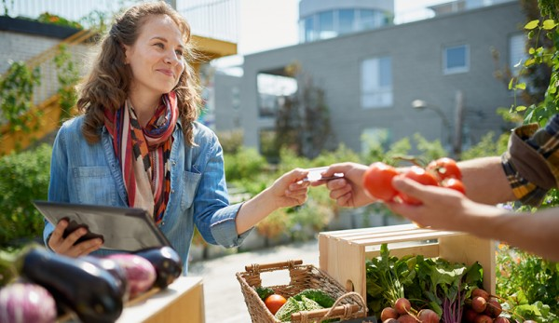
Sales skills
Customer behaviour – how do they choose the product (5 senses as the main instrument);
Advice, how to attract families with children;
Dress for success, attitude and knowledge;
EXAMPLE – observation practise of buyer behaviour.

Slide 8

Marketing and promotion
Tips, how and through which channels to advertise the store/ items/ farm;
Self promotion;
How to promote the product, attracting customer through their 5 senses;
EXAMPLE – particular shop/ landlord/ cooperative advertisement

Slide 9

Useful IT solutions
Advertising: internet (social network, websites, sales sites, how to get on search engines etc.);
Information about possibilities to improve knowledge in online marketing, safety issues, shop opening .
file:///C:/Users/Admin/Downloads/Rekomendacijas_Mazo_uznemejuregistracijai_un_integracijai_interneta_biznesa_registros.pdf
file:///C:/Users/Admin/Downloads/IT_ModuleEn.pdf
http://macies.celotajs.lv/course/view.php?id=4
EXAMPLE – what and how has changed in the business, starting to use opportunities offered by Internet.

Slide 10
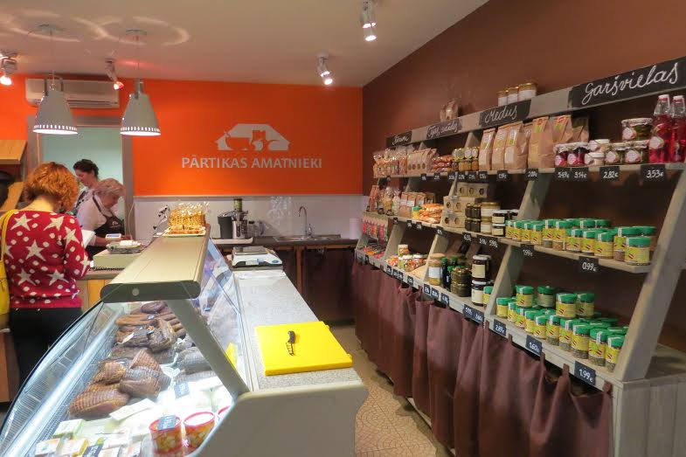
Local cooperation
Information about cooperation experience and benefits of it in other EU countries;
Cooperation with different partners – local associations, tourism information centre;
what is required to create co-operative (http://likumi.lv/doc.php?id=47009)
Cooperation in Latvia/ other partner countries.
EXAMPLE: „Food producers association” shop in Jelgava (on photo)

Slide 11
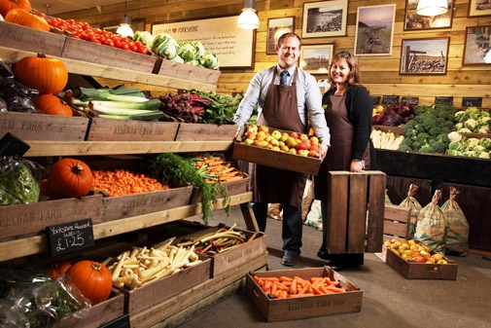
Thanks for your attention and good luck with your new farm shop!
Ilze Rūtenberga-Bērziņa

