Slide 1


Sustainability know-how for SMEs in rural tourism strengthening the link between adult learning and working life in rural SME sector
1st partner meeting, Riga, 16.11.2018.
Nordplus Adult 2018 (07/2018 - 06/2020) (NPAD-2018/10114)

Slide 2
Project duration: 07/2018 - 06/2020
Lead partner:
Latvian Country Tourism Association
Project partners:
- EE-Olustvere Service and Rural Economy Vocational School (EE)
- Norwegian Rural tourism and local food "HANEN" (NO)
Doc : https://drive.google.com/drive/folders/1ajpOY99ZWNofGb8n6OjOKZzS37EqXWFB

Slide 3
Key result of the project
To develop and disseminate On-line Training „Design of eco-friendly rural tourism services by SMEs”:
on-line training tool on Moodle platform;
on-line check-list;
printable handbook for reference
LV, NO, EE languages

Slide 4
WP1. Specification of the On-line Training structure (07.-12.2018)
- define structure with chapters and sub-chapters = framework and specification for learning contents
- 1st partner meeting aligned with the 11th Baltic Sea Tourism Forum (BSTF) in Riga to discuss and finalise the On-line Training chapter titles and structure
- evaluate the structure with the target audience – SMEs and training sector in LV, EE, NO.
Deliverable: On-line Training structure in English – common for all partners / Baltic-Nordic country SMEs.
Notes:
WP1. Specification of the On-line Training structure.
what is to be done. Partners agree upon the On-line Training structure. The concept is to develop a
detailed structure to cover the common challenges identified and to suit the national situations in all
partner countries. The structure shall be generic on one hand, to keep the international context, and
detailed on the other hand to the limit where national differences emerge. During this WP, partners will
define the structure of the On-line Training with chapters and sub-chapters to provide framework and
specification for learning contents. The final decision about the structure will be taken on the 1st partner
meeting in Latvia. The meeting program would include a visit to a best practice example – an ecofriendly
tourism business. The meeting will be aligned with the 11th Baltic Sea Tourism Forum (BSTF) in
Riga, Latvia for project dissemination and networking purposes.
The On-line Training chapter titles and structure will be proposed before the meting, discussed during it,
and finalized with active participation of all partners.
when it will be done
WP1 will take the first 6 months of the project duration.
who is responsible The lead partner is responsible for coordination of work and delivery of WP results,
with participation of all partners. The lead partner is responsible to organize the partner meeting.
what the outcomes will be Milestone deliverable outcome: On-line Training structure in English –
common for all partners / Baltic-Nordic country SMEs.

Slide 5
WP2. On-line Training learning contents
01.2019 – 03.2020
1. Translate the On-line Training structure to partner languages.
2. exchange the already existing relevant materials
3. agree what type of info to collect from best practice cases and how to structure it for learning contents.
4. select the best practice cases among their members and will make visits to source information for the On-line Training.
5. Olustvere proposes instruction how the information content should be presented in the On-line Training tool.
6. develop learning contents in their national languages.
7. Present content for SMEs and training sector.
8. 2nd (NOR) and 3rd (EE) partner meetings
Notes:
WP2. On-line Training learning contents.
what is to be done, In this WP the partners develop learning contents of the On-line Training within the
given structure, filling in the nationally specific information. For this, the following activities will take place:
1. The On-line Training structure will be translated to partner languages.
2. The partners will use and exchange the already existing relevant materials in their countries (partner
language skills allow to exchange, e.g., Latvian-Norwegian sources).
3. The partners will prepare for collection of information from best practice cases – agree what type of
information to collect and how to structure it for learning contents.
4. The 2nd partner meeting will take place in April 2019 in Norway. Lofoten is chosen as an
environmentally sensitive area with high tourist flows where lots of effort is put in sustainable and ecofriendly
management. The meeting program would include a visit to best practice tourism businesses
to observe sustainability aspects and source materials for learning contents. The partner meeting will
also discuss the necessary details for development of on-line training parts (contents, on-line check list,
printable reference handbook).
5. The partners will select the best practice cases among their members and will make visits to source
information for the On-line Training. The visit schedule will be made taking into account active season in
order to obtain the best illustrative material.
6. The training partner Olustvere school will propose instruction regarding how the information should be
presented in the On-line Training according to efficient adult learning practices.
7. Partners will develop the learning contents in their national languages by means of processing
the information collected in best practice cases and from previous sources of reference into learning
contents. Learning contents will be developed in partner languages to save costs of translation. Partner
language skills allow to exchange the working material and take over relevant parts.
8. The 3rd partner meeting will be organized during the stage of developing the contents and IT
solutions. It will take place in Estonia, end of August 2019. Hiiumaa or Saaremaa islands are considered
as possible meeting venues. The meeting could take place or visit a best practice example – an ecofriendly
tourism business.
9. The partners will present the On-line Training contents to the target audience for discussion and
evaluation. LC and HANEN – to board members or other interested rural tourism service providers.
Olustvere school – students and/or teaching staff. The feedback will be incorporated in the final version.
when it will be done
WP2 will take place in the project months 7-21 to get the project result ready for presentation at the final
seminar.
what the outcomes will be.Milestone deliverable: On-line Training - full learning contents in LV, NO, EE
languages.
who is responsible. The lead partner is responsible for coordination of work. Each partner is responsible
for organization of the On-line Training development process in home country. HANEN is responsible to
organize the 2nd partner meeting. Olustvere school is responsible to organize the 3rd partner meeting.

Slide 6
WP3. Dissemination
(7.2018 – 12.2018.)
- Project web page within the web site of the project lead partner www.celotajs.lv in EN and LV languages https://www.celotajs.lv/en/project/18 . It will introduce the partnership, the project goals and planned results. Along with the project progress, the web site will feature information from the project meetings (minutes, photos), project progress and availability of WP milestone results (they will be
available as downloads from the project web site).
Notes:
Project months 1-6:
- Project web page within the web site of the project lead partner www.celotajs.lv . The web page will be
set up with the start of the project in EN and LV languages. It will introduce the partnership, the project
goals and planned results. Along with the project progress, the web site will feature information from the
project meetings (minutes, photos), project progress and availability of WP milestone results (they will be
available as downloads from the project web site).

Slide 7
WP3. Dissemination (01.19. – 03.2020.)
Dissemination plan for project months 7-21:
Dissemination focused on the On-line Training structure and testing evaluation.
all partners: roundmails, e-newsletter, social networks, project/partner web site info, board meetings, member assembly, meetings with networking partners, relevant international events;
- HANEN: roundmails, e-newsletter, organisation web site, board meetings, member assembly, meetings
with networking partners, relevant national and international events to address the target audience. On
HANEN’s Annual Meeting 2019; Sustainable tourism will be one of the main topics
Notes:
Project months 7-21:
Dissemination activities will be focussed on networking, promotion of the 1st milestone result – the
On-line Training structure and testing evaluation of the On-line Training. The partners will use their
well established communication channels with the target audience – SMEs and adult training sector to
disseminate the project results:
- LCTA: roundmails, e-newsletter, social networks, project web site, board meetings, member assembly,
meetings with networking partners, relevant national and international events to address the target
audience;
- HANEN: roundmails, e-newsletter, organisation web site, board meetings, member assembly, meetings
with networking partners, relevant national and international events to address the target audience. On
HANEN’s Annual Meeting 2019; Sustainable tourism will be one of the main topics
- Olustvere: roundmails, organisation web site, board meetings, meetings with networking partners,
relevant national and international events to address the target audience.

Slide 8
WP3. Dissemination (04. – 06.2020.)
Dissemination plan for project month 22-24: on the On-line training tool with on-line check list and printable handbook version for reading and reference ”Design of eco-friendly rural
tourism services by SMEs”.
- all: roundmails, e-newsletter, social networks, project web site, board meetings, member assembly, meetings with networking partners, relevant international events; training portal
LC - www.macies.celotajs.lv
- HANEN: http://www.kurs.hanen.no
- Olustvere: www.olustvere.edu.ee .
- Project final meeting in Latvia.
Notes:
Project month 22-24:
Dissemination activities will be focussed on promotion of the project result – the On-line training tool with
on-line check list and printable handbook version for reading and reference ”Design of eco-friendly rural
tourism services by SMEs”.
- LCTA: roundmails, e-newsletter, social networks, project web site, board meetings, member assembly,
meetings with networking partners, relevant international events; training portal www.macies.celotajs.lv
- HANEN: roundmails, e-newsletter, organisation web site, board meetings, member assembly, meetings
with networking partners, relevant international events; web site http://www.kurs.hanen.no
- Olustvere: roundmails, organisation web site, board meetings, member assembly, meetings with
networking partners, relevant international events, web site www.olustvere.edu.ee .
- Project final seminar in Riga. Partners will present their experience. Participants: SMEs, training sector,
environmental and rural sustainability stakeholders.
Dissemination material: PP presentations, press releases, promotional texts (for roundmailing, social
networks, etc.).

Slide 9
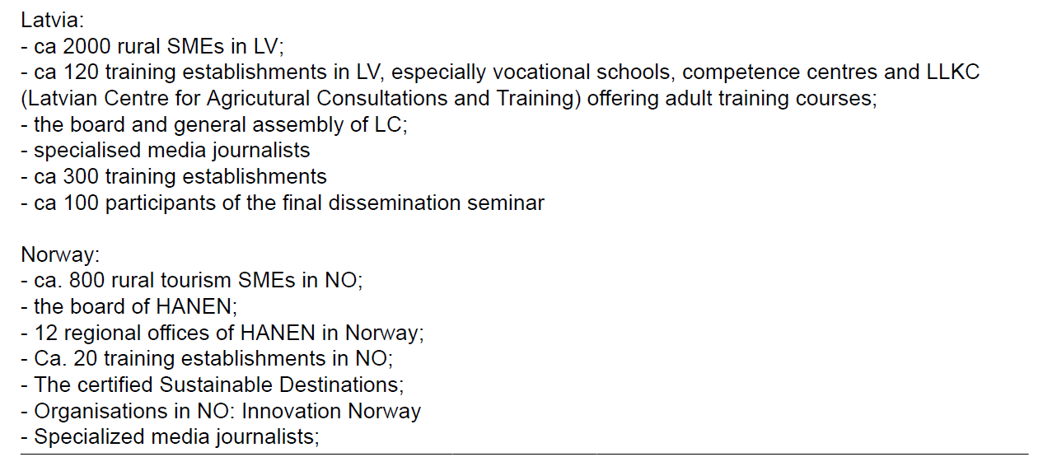
Dissemination target audience LV / NOR

Slide 10
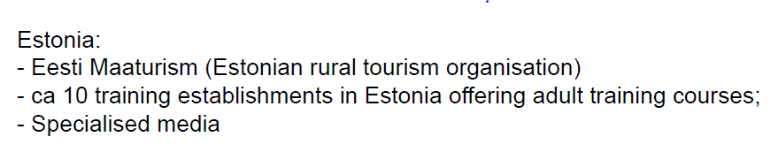
Dissemination target audience - EE

Slide 11
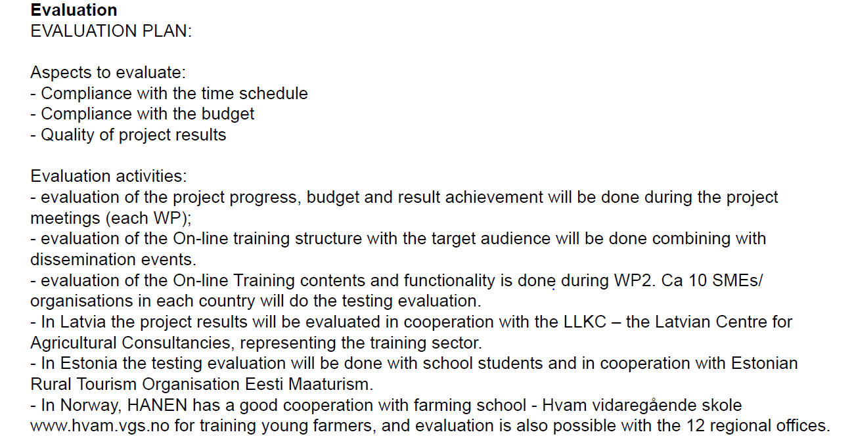
Evaluation plan

Slide 12
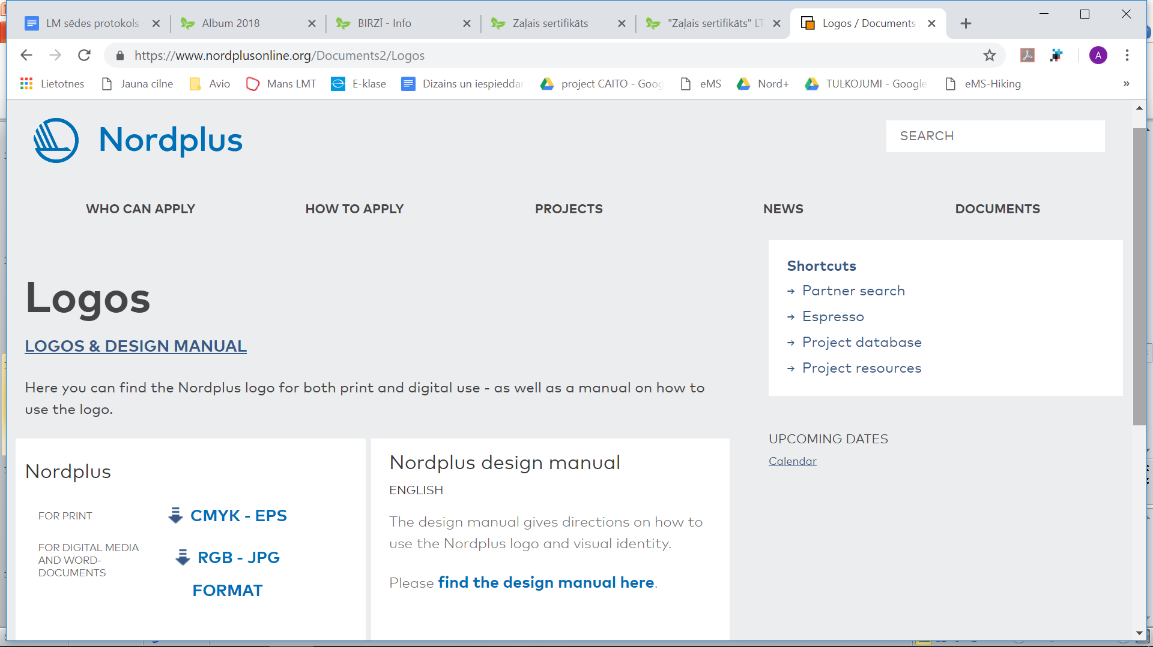
Visual identity, logos https://www.nordplusonline.org/Documents2/Logos
https://www.nordplusonline.org/Documents2/Logos

Slide 13
On-line training structure
(Handbook contents)
1. Introduction – sustainable development and eco-friendly rural tourism.
2. What does it mean – to be a sustainable rural tourism business.
3. Sustainable rural tourism business types: (accommodation, food and catering (local food, biological food) active tourism, open farms)
4. Sustainable use of resources
5. Use of environment friendly materials in building, interior, etc.
6. How to build local knowledge and cooperation (accommodation+local food producers+activity providers+guides, etc.....)
7. Communication and marketing – how to communicate that you are responsible and eco friendly business.
8. Useful tools and assistance for sustainable development – eco labels, etc.
https://docs.google.com/document/d/1Ur_Jr_wR4ALoyUHjszTt-kx-cL1E_ljSfdwpMxjuFAM/edit

Slide 14
2nd partner meeting will take place in April 2019 in Norway, Lofoten
Lofoten is chosen as an environmentally sensitive area with high tourist flows where lots of effort is put in sustainable and ecofriendly management. The meeting program would include a visit to best practice tourism businesses
to observe sustainability aspects and source materials for learning contents. The partner meeting will also discuss the necessary details for development of on-line training parts (contents, on-line check list, printable reference handbook).
12.-15.05.2019 p.12.10 no Rigas vi un 10.40 no Eve

Slide 15
Next tasks and deadlines to be agreed:
Task | Deadline
Translate Handbook structure to EE, LV, NOR | 31.12.2018
Evaluate the Handbook structure with the target audience SMEs | 22.11.18 LV/ 19-20.11.18 / EE autumn2018
Finding best practices | 05.2019
Olustvere – content presentation instruction | 01.2020
Learning contents in national languages | 9.2019
Contents testing | Autumn 2019
Putting contents online | 03.2020
On –line checklist (decide on May2019 – solutions EE/NIR) | 05.2020
2nd partner meeting in NOR, Lofoten | 12-15.05.19
3rd partners meeting in EE, Hiumaa? | 09.2019
4rd in NOR, Vestfal (Sandefjord) | 03.2020
5th meeting + event, LV | 06.2020

Slide 16

Latvijas lauku tūrisma asociācija “Lauku ceļotājs”
Kalnciema iela 40, Rīga, LV-1046, +371 67617600
E-pasts: lauku@celotajs.lv Facebook: Lauku Celotajs twitter.com/Laukucelotajs

